Slide 1
Preparation process for
WRC-19
Xingguo Zhou
Radiocommunication Bureau, ITU
ICAO Frequency Spectrum Management Panel WRC-19 Regional Preparatory Group, 27 – 28 March 2017, Bangkok, Thailand

Slide 2
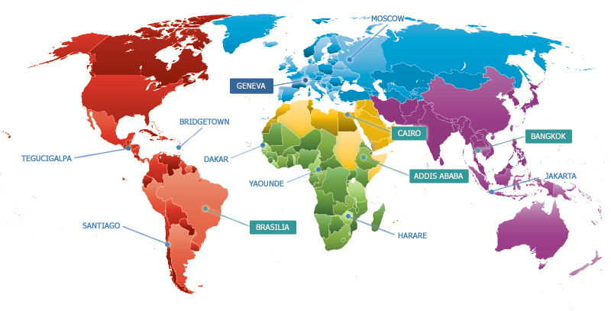
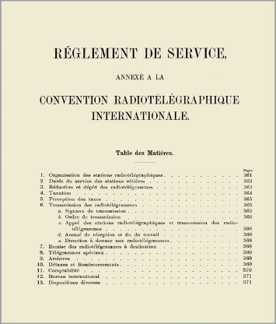
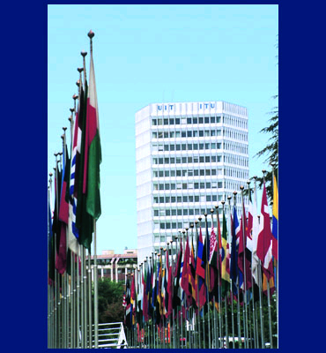
ITU
Founded on 17 May 1865
193 Member States, >700 Sector Members , Associates & Academia
4 regional offices, 8 area offices, HQ in Geneva, Switzerland

Slide 3
Structure of ITU-R
The Radiocommunication Sector of ITU (ITU-R)
World Radiocommunication Conferences (WRC): establish and amend the Radio Regulations (RR) - an important international treaty governing the use of radiocommunications;
Radio Regulation Board (RRB): clarifies ambiguous and difficult provisions of the RR through adoption of Rules of Procedures;
Radiocommunication Assemblies (RA): approve the ITU-R recommendations supporting the development and compatibility of radio system;
Study Groups (SG): develop the technical bases for World Radiocommunication Conferences and develop global standards in the form of Recommendations;
Radiocommunication Bureau(BR): is ITU-R secretariat responsible for daily work, e.g. registration of frequencies, resolving interference, etc.

Slide 4
Main WRC objectives
Allocate spectrum/orbit resource for emerging radio technologies and applications, while protecting the existing usage
Maintain the right balance between the spectrum requirements of all radiocommunication services, including aeronautical services
Achieve global spectrum harmonization for economies of scale and interoperability of the equipment
Create regulatory certainty for users, regulators and multi-trillion dollars telecommunication industry in utilizing spectrum

Slide 5
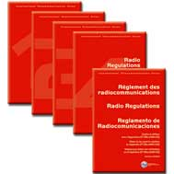
Main WRC purposes
WRC normally takes place every 3 – 4 years for a 4 week duration and gathers more than 3000 delegates
To revise the Radio Regulations, an international treaty which is ratified by the ITU Member States and is mandatory for applications
  Spectrum allocation
  Frequency assignment and allotment Plans
  Procedures of Coordination and Notification
  Resolutions
  Administrative and operational procedures
To address any radiocommunication matter with worldwide nature, e.g. major cases of interference
To determine questions for future study under the future WRCs’ Agenda Items, e.g. studies on sub-orbital flights decided at WRC-15

Slide 6
WRC cycle
Develops agenda for the next WRC and preliminary agenda for subsequent WRC
3-4 years
WRC-n
1st Conference Preparatory Meeting (CPM)
organizes ITU-R preparatory studies to WRC
CPM-1
ITU-R studies
Develop technical, operational and procedural solutions for WRC
Consolidates results of studies and tries to reconcile regulatory solutions
CPM-2
Allocation/identification of bands, regulations
WRC-n+1

Slide 7
Main Steps towards WRC-19
ITU WRC-15:WRC-19 Agenda > Resolution 809 (WRC-15)
4 years
1
1st Session Conference Preparatory Meeting (CPM19-1)
held on 30 Nov. – 01 Dec. 2015
2
ITU Council-16: approved WRC-19 Agenda in Resolution 1380 with date & venue Approved/Confirmed in Geneva after ITU Member States consultation (CVs 42 and 118)
3
2nd Session Conference Preparatory Meeting (CPM19-2)
Planned in Geneva, 18-28 Feb. 2019
4
Final meetings of regional groups and preparation of Member State’s proposals and common proposals to WRC-19
5
RA-19: 21-25 Oct. 2019, in Geneva
WRC-19: 28 Oct. to 22 Nov. 2019, in Geneva

Slide 8
Structure of the draft CPM Report to WRC-19
Chapters of the draft CPM Report to WRC-19
1 | Chapter 1 - Land mobile and fixed services
2 | Chapter 2 - Broadband applications in mobile service
3 | Chapter 3 - Satellite services
4 | Chapter 4 - Science services
5 | Chapter 5 - Maritime, aeronautical and amateur services
6 | Chapter 6 - General issues

Slide 9
Final CPM Report to WRC-19
  the draft CPM Report developed by the responsible groups
  Contributions from ITU-R membership
  ICAO position is submitted as an informational document, but it has a great impact on the discussions of aeronautical AIs.
  *Up-to-date information online at: http://www.itu.int/en/ITU-R/study-groups/rcpm/Pages/wrc-19-studies.aspx
  **the aeronautical AIs 1.10 and 9.1.4 of ICAO primary interest as well as AIs 1.7, 1.8, 1.9, 1.11, 1.12, 1.13, 1.14, 1.16, 4, 8, 9.1 (issue 9.1.3) and 9.1 (issue 9.1.6) potentially having impact on aviation

Slide 10
Proposals to WRC-19
Discussions and decisions of WRC are based on the following documents:
contributions from the ITU Member States
Regional Common proposals of Regional Groups and groups of countries
The following documents are taken into account into WRC discussions:
CPM Report - a reference document with technical basis for WRC-19 (3 years of studies);
positions of the main UN partners, i.e. ICAO, IMO, WMO – informational but extremely important documents.

Slide 11
ITU Inter-regional Workshop on WRC-19 Preparation
1st Workshop [Nov.2017], To be scheduled halfway through the preparatory cycle
-Presentation and review of the on-going preparatory studies of the ITU-R responsible groups for CPM-19
-Presentation of the organization, preliminary views, draft priorities and positions of the regional groups & the preliminary positions from international organizations like ICAO, IMO, WMO
2nd Work shop [Q4 2018], To be scheduled few months prior to CPM19-2
-Presentation of the Draft CPM Report to WRC-19 (explanation of the draft Methods to satisfy the WRC-19 agenda items)
-Presentation and review of the regional groups’ draft views, positions and common proposals & the draft positions from international organizations like ICAO, IMO, WMO
3rd Workshop [Q3 2019], To be scheduled few months prior to WRC-19
-Presentation of the CPM & Dir. Reports to WRC-19
-Presentation and review of the regional groups’ draft views, positions and common proposals & the draft positions from international organizations like ICAO, IMO, WMO

Slide 12






WRC Regional Preparation
2nd APG-19: 17-21 July 2017, Bali, Indonesia
1st APT Conference Preparatory Group for WRC-19 (APG-19): 26-28 July 2016, Chengdu, People's Republic of China
Asia Pacific Telecommunity
2nd ASMG: [2017]
1st Arab Spectrum Management Group (ASMG): 17-20 July 2016, Sharm el-Sheikh, Egypt
Arab Spectrum Management Group
2nd APM-19: 7-11 August 2017, Dakar, Senegal
1st African Group Preparatory Meeting for WRC-19(APM-19):19-22 September 2016, Nairobi, Kenya
African Telecommunications Union
4th CPG-19: 4-7 July 2017, Brussels, Belgium
3rd CPG-19: 14-17 March 2017, Vienna, Austria
2nd CPG-19: 6-9 December 2016, Feusisberg, Switzerland
1st ECC Conference Preparatory Group for WRC-19 (CPG-19) :16-18 April 2016, Bonn, Germany
European Conference of Postal and Telecommunications Administrations
XXIX PCC.II: 27 - 30 June 2017, Orlando, USA
XXVIII PCC.II: 29 Nov. - 2 Dec. 2016, Punta Cana, Dominican Republic
XXVII Permanent Consultative Committee II (PCC.II): 28 June - 1 July 2016, Bogota, Colombia
Inter-American Telecommunication Commission
3rd RCC WG WRC-19/RA-19: 10-13 April 2017, Bishkek, Kyrgyz Republic
2nd RCC WG WRC-19/RA-19: 12-15 September 2016, Minsk, Belarus (Republic of)
1st RCC WG WRC-19/RA-19:25 February 2016, Astana, Kazakhstan (Republic of)
Regional Commonwealth in the field of Communications
See details at www.itu.int/go/wrc-19-regional

Slide 13
BR Director's Report to WRC-19
  BR Director’s Report
  the activities of ITU-R since previous WRC
  Activities of the Radio Regulations Board
  the difficulties or inconsistencies encountered in the application of the RR, e.g. difficulties in recording aeronautical frequencies in the ITU database presented at WRC-12
  Etc.

Slide 14
Timetable towards WRC-19
30 Nov. – 01 Dec. 2015: CPM19-1
31.8. 2018: Submission of material from SGs to CPM19 Chapter Rapporteurs
[Q4. 2018]: 2nd Inter-regional Workshop
2016-2018: ITU-R Study Groups studies
[Nov. 2017]: 1st Inter-regional Workshop
18-28 Feb. 2019: CPM19-2 [Q3. 2019]: 3rd Inter-regional Workshop
21-25 Oct. 2019: RA-19 28 Oct. to 22 Nov. 2019: WRC-19
Up-to-date information online at: www.itu.int/en/events/Pages/Calendar-Events.aspx?sector=ITU-R

Slide 15
Guidelines for the preparation of the Draft CPM text for WRC-19
Executive summary for each WRC‑19 Agenda item
Mandatory use of the 2016 Edition of the Radio Regulations
References to ITU-R texts (Recommendations, Reports, …)
Quoting existing texts should be avoided, use of specific references;
Definitive references to draft texts will be reviewed at CPM19-2
Minimum number of Methods to satisfy the Agenda items
- the description should be as concise as possible;
- limit number of advantages and disadvantages for each Method to a maximum of 3 each;
- a “No-change” Method could be included, provided it is proposed by an administration together with advantage(s) and disadvantage(s).
Average page limit of 10 pages per WRC-19 Agenda Item in a given Chapter of the draft CPM Report to WRC-19

Slide 16
Summary
WRC-19 preparations are made at 3 levels
National: the starting point in WRCs process of the country
Regional: the position is further developed taking into account of
interest of other countries
International: ITU and stakeholders

Slide 17
Thank you
for your attention!
Q&A

