Slide 1
2019 World Radiocommunication Conference Agenda Item 9.1.4
Stations on-Board Sub-Orbital Vehicles
(Spaceplanes)
ICAO Regional Preparatory Group meeting
Johannesburg, South Africa 4-5 September 2018
John Mettrop
UK CAA

Slide 2
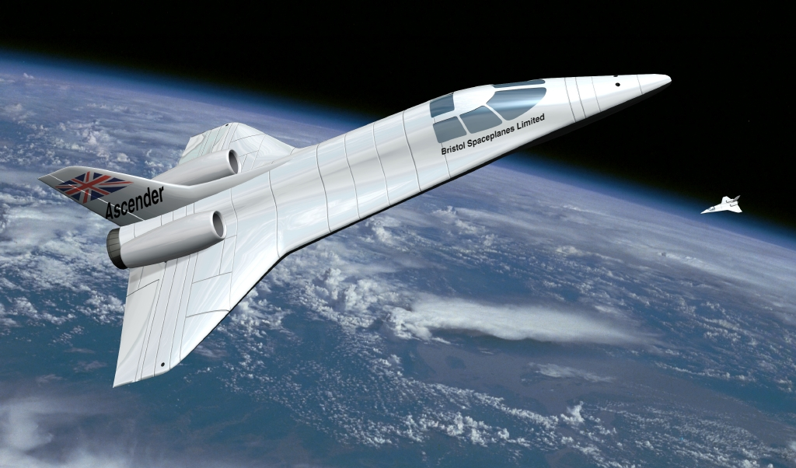
Agenda Item 9.1.4 – Resolution 763
resolves to invite the ITU Radiocommunication Sector
  to conduct studies to identify any required technical and operational measures, in relation to stations on board sub-orbital vehicles, that could assist in avoiding harmful interference between radiocommunication services;
    to conduct studies to determine spectrum requirements and, based on the outcome of those studies, to consider a possible future agenda item for WRC‑23;

Slide 3
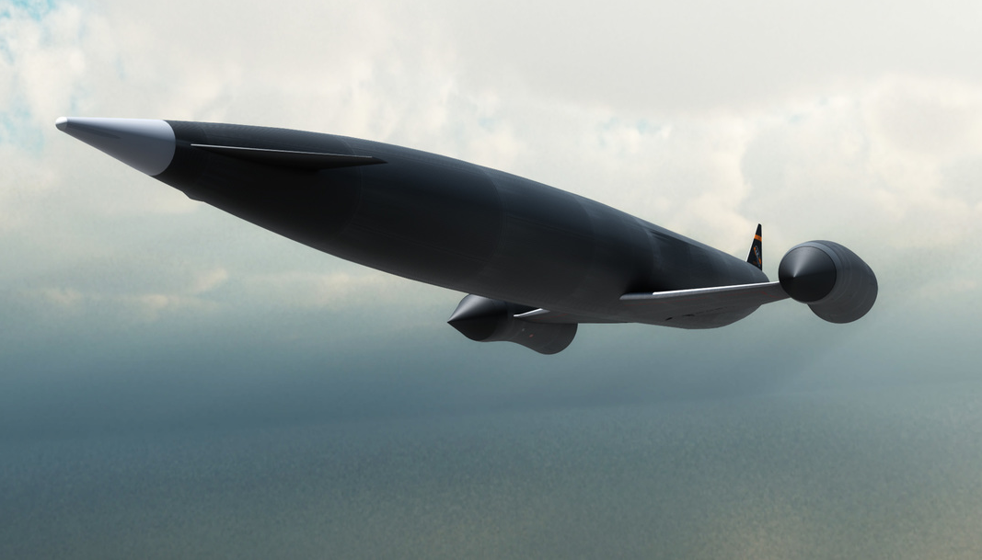
ITU-R Question 259/5
decides that the following Questions should be studied
  How will planes be operated including a description of the various phases of flight?
  During which phases of flight described in decides 1, will, if at all, need to be supported by air traffic control systems and what sort of systems are expected?
  What radio links will be required to support planes operations and under what radiocommunication service definition will they fall?

Slide 4
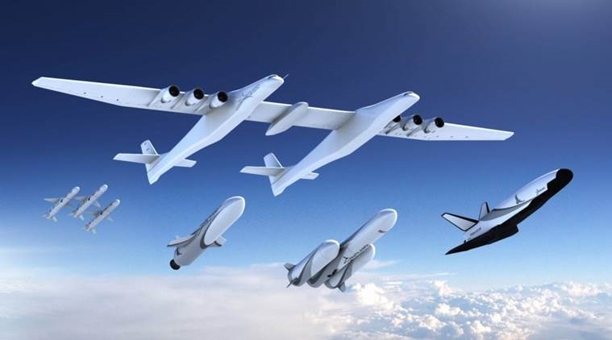
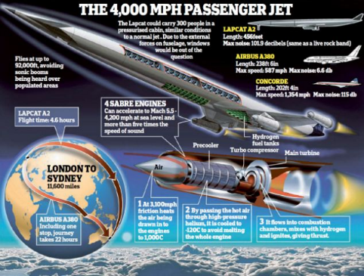
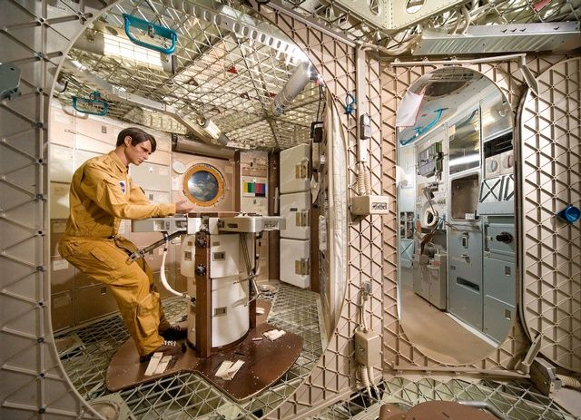
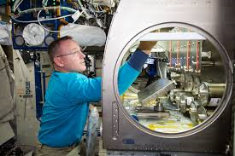
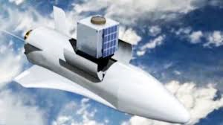
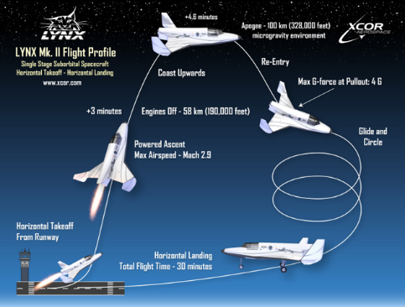
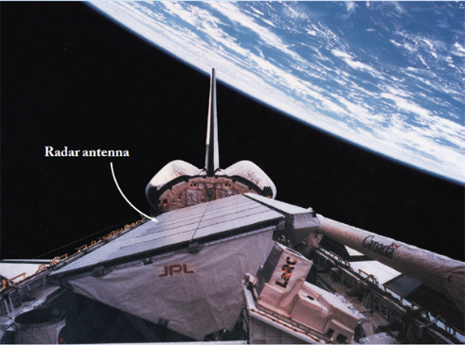
Space Plane Applications
Technology testing
Hypersonic travel
Scientific research
Satellite launch
Space tourism
Remote sensing

Slide 5
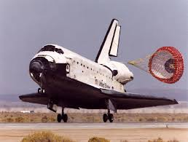
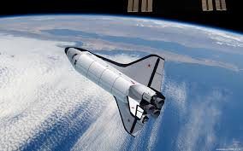
Aircraft or Spacecraft?
Aircraft: Any machine that can derive support in the atmosphere from the reactions of the air other that the reactions of the air against the Earth’s surface (ICAO)
spacecraft: A man-made vehicle which is intended to go beyond the major portion of the Earth's atmosphere. (ITU)

Slide 6



Issues with Respect to Aeronautical Spectrum
Height
Radio Horizon
6,500 km/hr
  Link Budget
  Time in Sector
Speed
120 km
  Doppler Shift
Incompatible with current planning rules
1,000 km/hr
45,000 ft
Aeronautical system Capabilities e.g. ADS-B max
522 NM
  Velocity 4096 knots
  Height 131,072 ft
1,544 NM

Slide 7
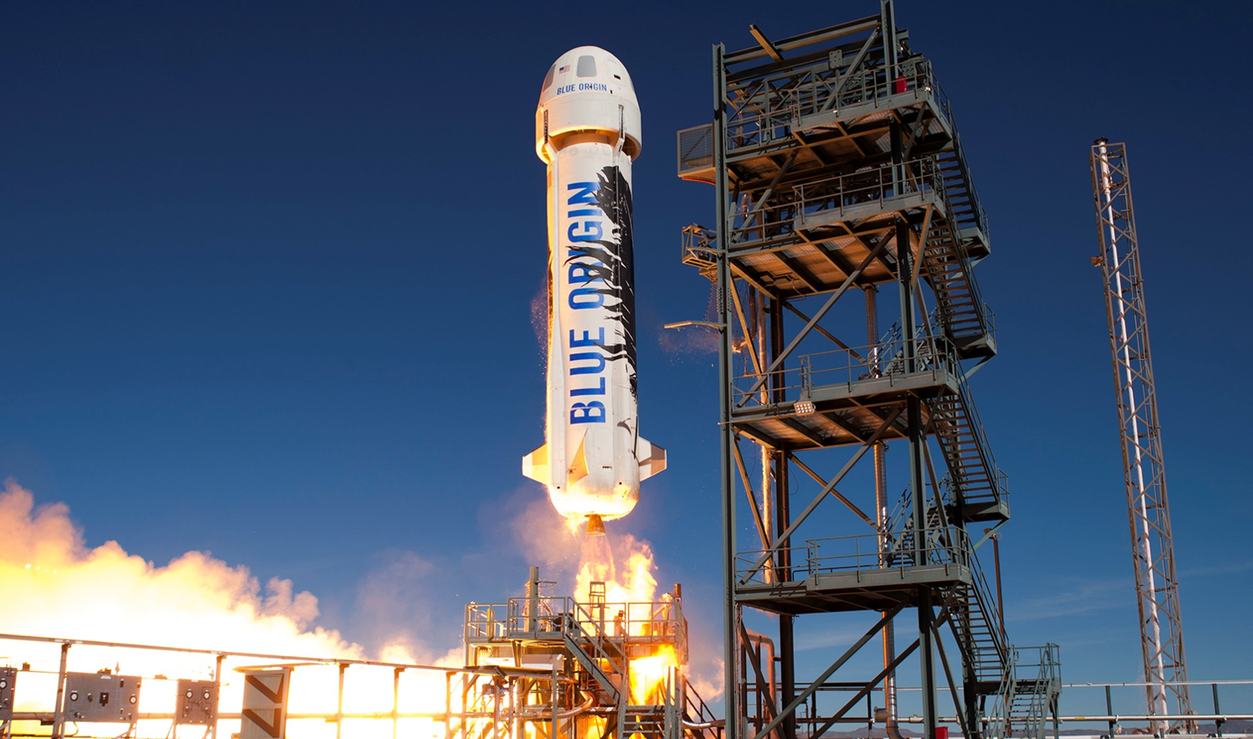
Which Radio Service?
Amateur
Aeronautical mobile (R)
Broadcasting
Aeronautical mobile (R)
Radiocommunication
Aeronautical mobile
Aeronautical mobile
Aeronautical mobile (OR)
Fixed
Aeronautical mobile (OR)
Meteorological aids
Land mobile
Port operations
Mobile Service
Mobile Service
Maritime mobile
Ship movement
Aeronautical radionavigation
Radiodetermination
Aeronautical radionavigation
Radiodetermination
Radiolocation
Radionavigation
Standard frequency & time signal
Radionavigation
Maritime radionavigation
Radio astronomy
Safety
Safety
Safety
Special
Special
Space research
Space operation
Space operation
Amateur
Broadcasting-Satellite
Aeronautical mobile-satellite (R)
Earth exploration-satellite
Meteorological-satellite
Aeronautical mobile-satellite (R)
Aeronautical mobile-satellite
Aeronautical mobile-satellite
Aeronautical mobile-satellite (OR)
Fixed-Satellite
Aeronautical mobile-satellite (OR)
Inter-satellite
Land mobile-satellite
Mobile-satellite
Mobile-satellite
Mobile-satellite
Maritime mobile-satellite
Aeronautical radionavigation-satellite
Radiodetermination-satellite
Radiolocation-satellite
Aeronautical radionavigation-satellite
Radiodetermination-satellite
Radionavigation-satellite
Standard frequency & time signal-satellite
Radionavigation-satellite
Maritime radionavigation-satellite

Slide 8
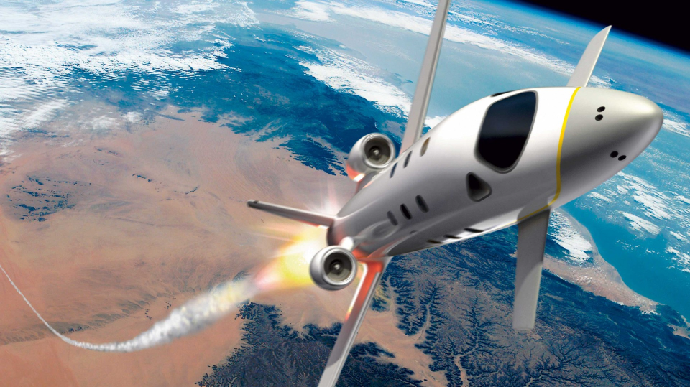
Current Proposals within the ITU
WDPDN Report
ITU-R M.[Suborbital Vehicles]
(https://www.itu.int/dms_ties/itu-r/md/15/wp5b/c/R15-WP5B-C-0538!N24!MSW-E.docx)
  Identifies the phases of flight for single & multistage suborbital vehicles
  Types of applications
  Spectrum requirement
    Communication
    Navigation
    Surveillance
    Telemetry
    Telecommand
  Identifies radio spectrum issues
Draft CPM text on
WRC-19 AI 9.1, issue 4
(https://www.itu.int/dms_ties/itu-r/md/15/wp5b/c/R15-WP5B-C-0538!N08!MSW-E.docx)
  No Change to the Radio Regulations is proposed for WRC-19. Further operational, technical and regulatory issues may need to be addressed, which require continuing studies, in particular of the status of the station aboard suborbital vehicles and type of applications, through the appropriate mechanism. No action has been taken with respect to retention, revision or suppression of Resolution 763 (WRC-15).

Slide 9
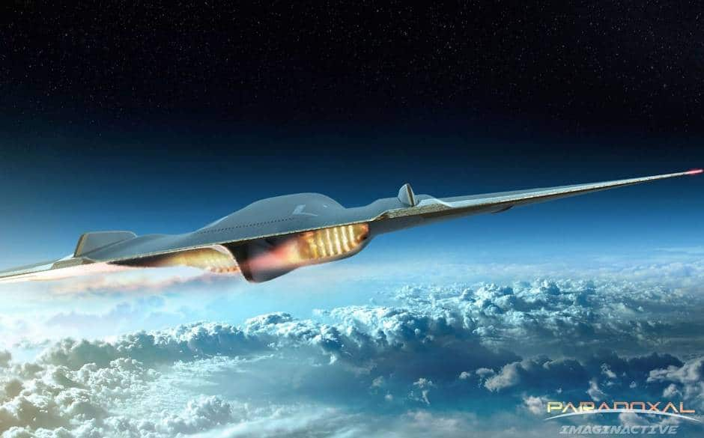
ICAO Position
To support the studies called for by Resolution 763 (WRC-15) noting that those studies need to be completed during this study cycle.
If the results of studies indicate that additional spectrum and/or other regulatory measures are required, seek an agenda item for WRC-23.

Slide 10
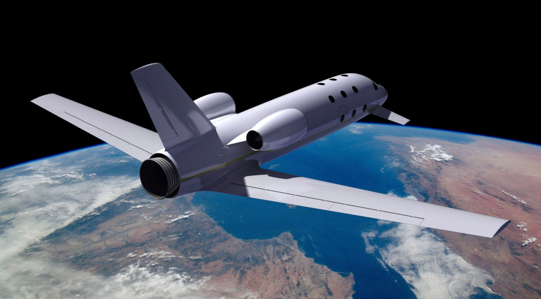
Summary
How Much Spectrum is Required?
Which Service?
Sufficient Spectrum Available?
Impact on Existing Aeronautical Services
  Standards
  Planning rules
  Sector Size
Support the need for a WRC-23 Agenda Item
Support ICAO/ITU Studies

Slide 11

Questions

