Slide 1
FSMP/ 1 Report
Presentation to the ANC
Michael Biggs
FSMP Chair
28 August, 2015

Slide 2
Content
General overview of meeting
Development of job cards
Work Programme
  Development of Job Cards
  Upcoming Deliverables / Priorities
Structure of the panel

Slide 3
General Overview
1st Frequency Spectrum Management Panel Meeting: 24 to 25 August 2015
  Attendance
    17 Contracting States
    7 International Organizations
    ~60 participants
Chairman – Mr Michael Biggs (United States)
  Vice-Chairman – Mr Andrew Roy (ASRI)
  Secretary – Loftur Jonasson (ICAO Secretariat)

Slide 4
Development of job cards
5 job cards, amended / finalized
  Previously developed by ACP WG-F/31 (6 – 10 Oct 2014)
    Maintenance and update of the ICAO frequency spectrum strategy and policy;
    ITU Radio Regulations (RR) and ITU World Radiocommunication Conferences (WRC) (frequency spectrum access for aeronautical systems);
    Maintenance of the ITU Radioregulatory framework relevant to aviation and keeping ICAO provisions and the ITU Radioregulatory framework in sync (ITU-R Recommendations and Reports affecting the implementation of aeronautical systems);
    Radio frequency interference issues for aviation and the need for action by States, ICAO and international organizations; and
    Development and maintenance of SARPs and guidance material to facilitate frequency management of C, N and S systems.

Slide 5
Upcoming Deliverables / Priorities
Agenda for WRC-19 will be decided by WRC-15 in Nov 2015
  First Priority: Develop Position for WRC-19
    Deliver draft Pos to ANC by 4Q 2016. If agreeable, then State review process, WG/FSMP, ANC, Council approval and SL by 3Q 2017
  Second Priority: Update Spectrum Strategy and Spectrum Policy statements
    First cut of Spectrum Strategy, as approved by Council is in Doc 9718 Vol I, Chapter 8. Consider update for potential approval by Council.
    Spectrum Policy, as approved by Council is in Doc 9718 Vol I, Chapter 7. Develop updates reflecting outcome of WRC-15, for potential approval by Council.
  Other specific tasks to be progressed as detailed in Job Cards

Slide 6
Structure of the panel
Panel will work in a single stream to progress work in the most efficient manner possible
  Chairman of FSMP will act as Rapporteur of WG-FMSP
  Two to three mtgs of FSMP to be held each quadrennial WRC cycle
  Held in conjunction with less formal mtgs of a WG/FSMP to progress work not resulting in formal deliverables
  Other mtgs to be held in a less formal mode of a WG/FSMP, some in ICAO Regions, supporting regional WRC preparatory Workshops.

Slide 7
Structure of the panel
Tentative workplan:
2016 |  | 2017 |  | 2018 |  | 2019
Q1 | Q3 | Q1 | Q3 | Q1 | Q3 | Q1 | Q3
WG/FSMP | FSMP | WG/FSMP | WG/FSMP | WG/FSMP | WG/FSMP | FSMP | WG/FSMP
ICAO HQ | ICAO HQ | APAC | SAM/CAR-NAM | AFI | MID | ICAO HQ | ICAO HQ

Slide 8
Coordination with other panels
Spectrum is an enabler for all Communication, Navigation and Surveillance systems.
  Hence, the Panel will need to coordinate closely with the various groups of experts responsible for other Annexes and disciplines, in particular with CP, NSP, ASP and RPASP
  In addition, the Panel will assist Secretariat with development of input documentation and views to support work of Study Groups and Working Parties of the ITU Radiocommunication Sector

Slide 9
Meeting of WG-FSMP/1
(a.k.a. the 33rd meeting of Working Group F)
Main thrust of meeting was to finalize preparations for WRC-15
  ICAO Position agreed by Council in June, no new output/changes from this meeting
  Informal discussion of the various strategies by administrations and regional preparatory groups
    On some issues (1.17, 1.18, etc) have common views
    On others (1.5, GFT, GADSS) opinions differ
Also progressed items such as spectrum strategy and studies on 5 GHz band planning

Slide 11
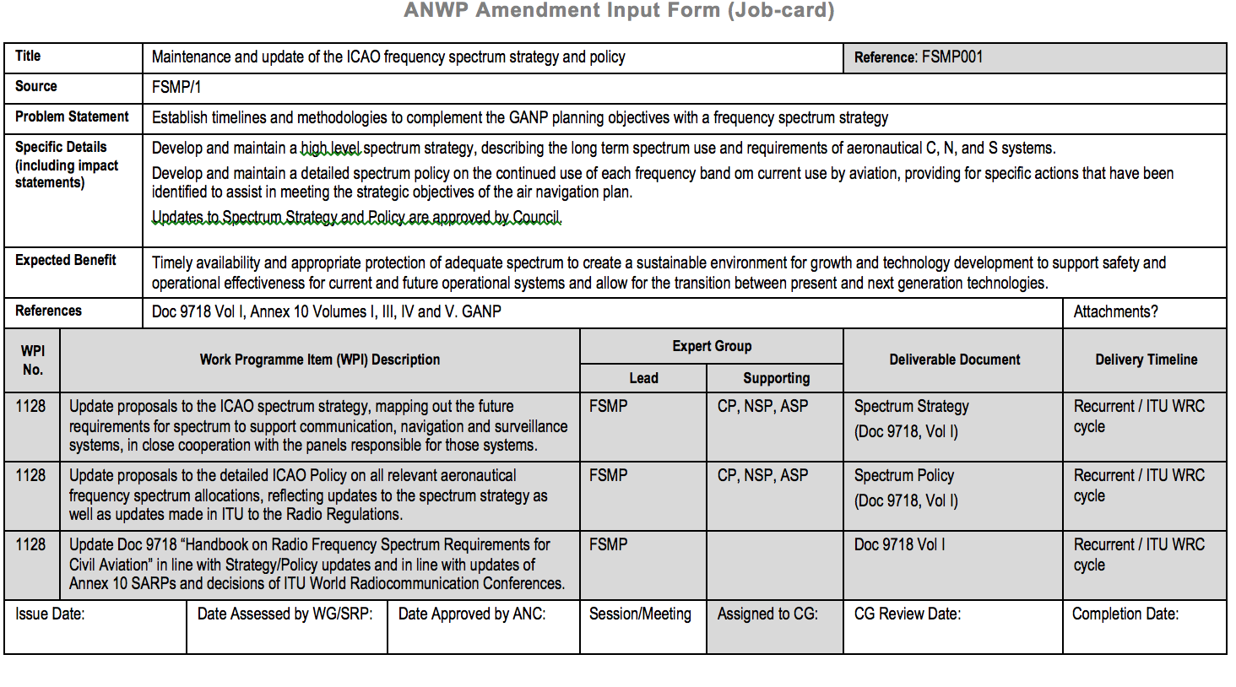
Development of job cards

Slide 12
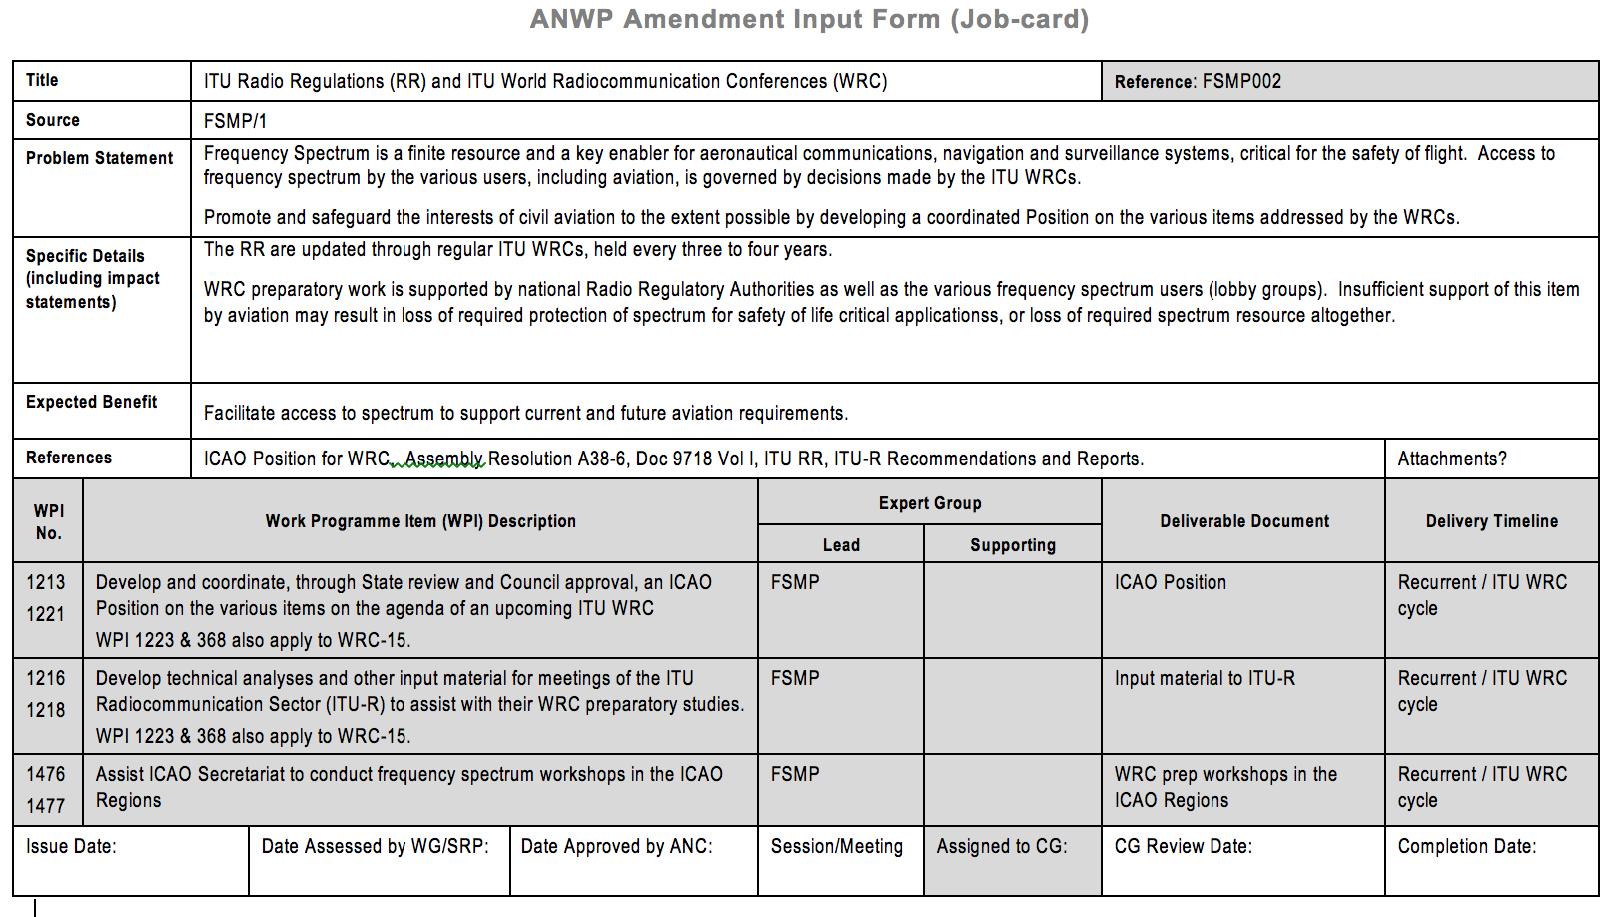
Development of job cards

Slide 13
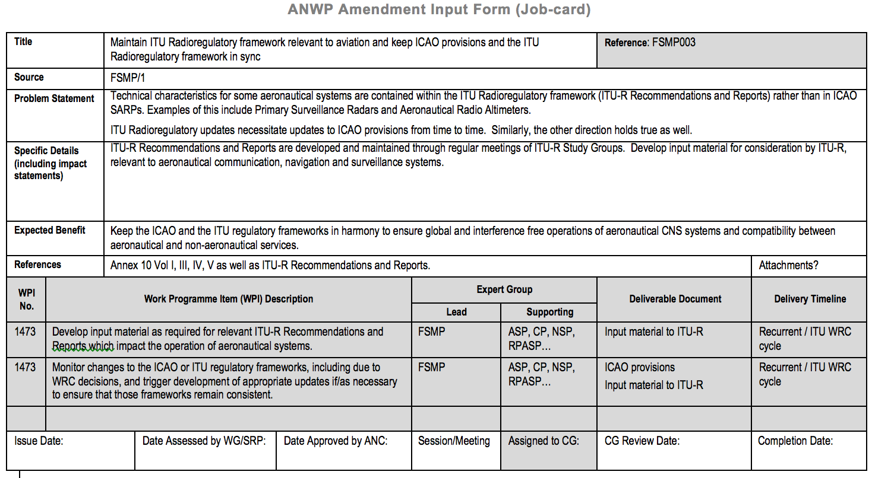
Development of job cards

Slide 14
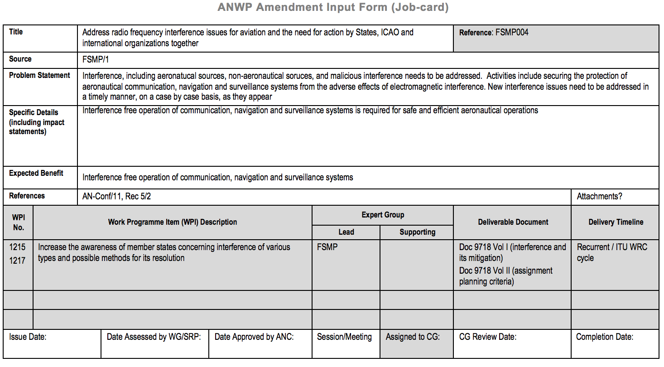
Development of job cards

Slide 15
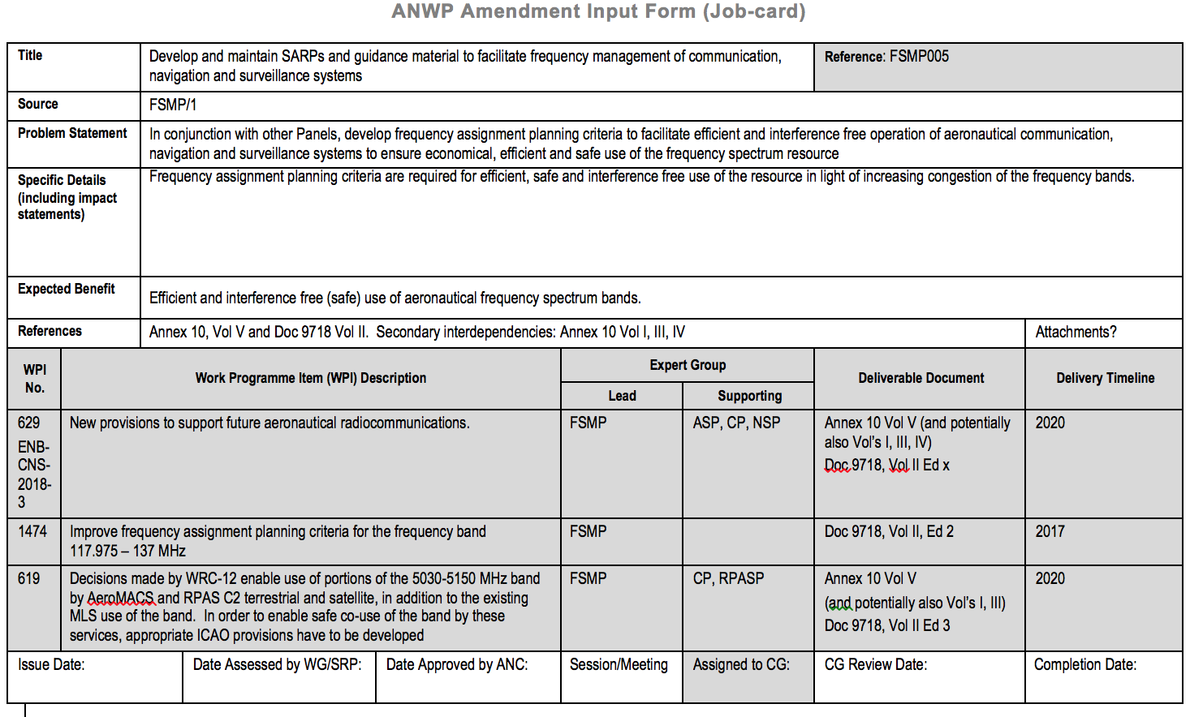
Development of job cards

