Slide 1
Key Potential Operational Effects from 5G on Radio Altimeter
Regional preparations for WRC-23 – ATU
Claude Pichavant, Executive Expert Com, Nav, Surv
22 April 2022

Slide 2
Agenda & Acknowledgements
The Problem & Impacts
5G and Radio Altimeter Band
Context & Technical concern
AMOC process V1, V2 & V3
Conclusion & Way Forward
Acknowledgements to Airbus teams from Engineering, Flight Ops, Certification, Support & Programs, in particular, Capucine Amielh, Patrick Heins, Laurent Azoulai & Jean-Luc Robin who have contributed to this presentation

Slide 3


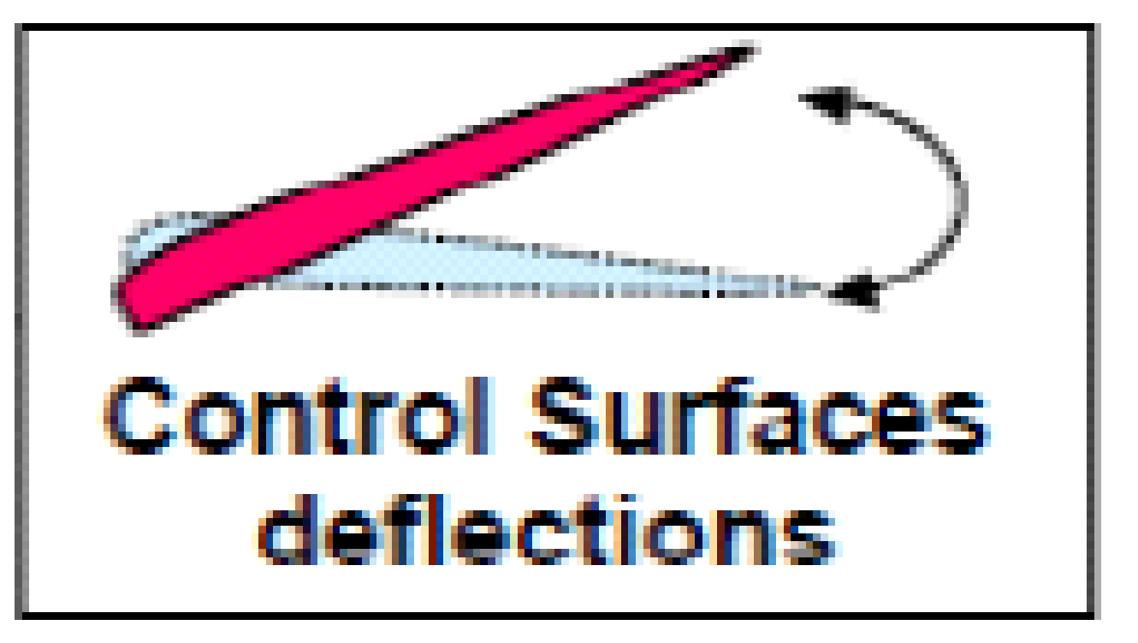
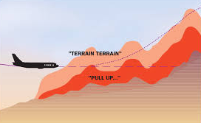
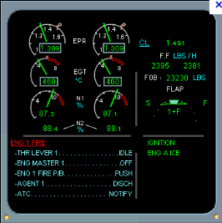

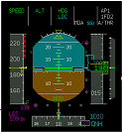
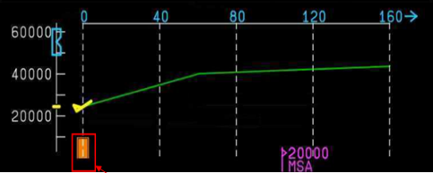
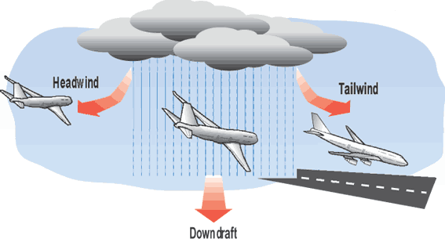

The Problem and Impacts
Governments all over the world are considering (or have considered) allowing 5G cellular systems to operate in parts of the frequency ranges 3.4 - 4.2 GHz and 4.4 - 4.9 GHz (adjacent to the band used by radio altimeters from 4.2 - 4.4 GHz.)
Based on the Radio Technical Commission for Aeronautics (RTCA) Paper No. 274-20/PMC-2073, the 5G mid-band emissions may interfere with the Radio Altimeters.
Impacted aircraft potentially include commercial aircraft, military aircraft, helicopters and larger GA & UAS aircraft with radio altimeters
RA Antennas
Some altimeters appear to be vulnerable to high power cellular systems.
New Radio Altimeter standards are being developed to sustain planned 5G environment.
The level of the problem can be different depending on the platform and integration /architectures.
FLIGHT CONTROL and AUTOPILOT
Terrain Awareness and Warning System (TAWS)
COCKPIT ALERT and WARNING
COCKPIT DISPLAY (PFD, HUD)
Radio Altimeter sensors
WIND SHEAR SURVEILLANCE
Traffic Collision Avoidance System (TCAS)

Slide 4
5G and Radio Altimeter band
Snapshot of 5G roll-out in mid-band spectrum (C Band)
Some countries (France, USA, Czech Republic, Canada,…) have put in place precautionary measures
around airports
UK
3.4 – 3.8
3.805 – 4.195
RA Band
Low power
Europe
3.4 – 3.8
China
3.4 – 3.7
4.8 – 4.99
Japan
3.4 – 4.1
4.5 – 4.8
South Korea
3.4 – 4.0
Australia
3.4 – 3.7
Canada
3.47 – 3.65
USA
3.1 – 3.55
3.7 – 3.98
Allocation with current
data available
India
3.3 – 3.6
Saudi Arabia
3.4 – 3.8
GHz
...
3.0
3.2
3.4
3.6
3.8
4.0
4.2
4.4
4.6
4.8
5.0

Slide 5
Future 5G roll-out in study
UK
3.4 – 3.8
3.805 – 4.195
RA Band
Fix Service
Europe
3.4 – 3.8
3,8 – 4.2
China
3.4 – 3.7
4.4 – 4.5
4.8 – 4.99
Japan
3.4 – 4.1
4.5 – 4.8
South Korea
3.4 – 4.0
Australia
3.4 – 3.7
3.7 – 4.0
Canada
3.47 – 3.65
3.7 – 3.9
USA
3.1 – 3.55
3.7 – 3.98
New Allocation in study
India
3.3 – 3.6
Saudi Arabia
3.4 – 3.8
3.8 – 4.0
4.0 – 4.2
GHz
...
3.0
3.2
3.4
3.6
3.8
4.0
4.2
4.4
4.6
4.8
5.0

Slide 6
Context and Technical concern
Power
Radar Altimeter
Typical RA filters tolerance Mask*
Fundamental Satellite signals are filtered by RA
Fixed Satellite emission
MHz
3700
4200
4400
*To ease understanding:
Not to scale and not representative to current filters
Power
5G Terrestrial emission
Fundamental Terrestrial 5G energy not filtered by all RA models
Radar Altimeter
Typical RA filters tolerance Mask*
MHz
3700
3980
4200
4400
Air Transport RA receivers have not been designed to support such level of terrestrial interferences in its adjacent band (previously allocated to Fixed Satellites Services) even though they are fully compliant with applicable regulations

Slide 7
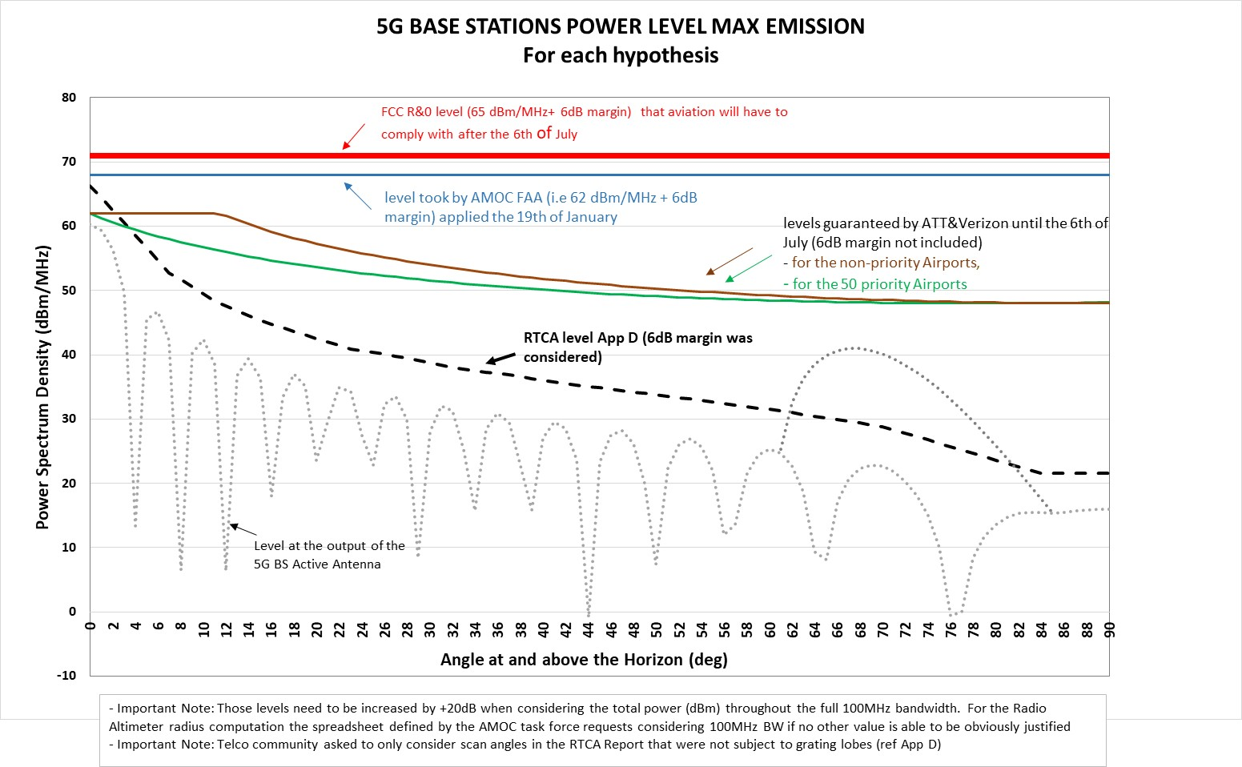
Context and Technical concern in US

Slide 8
AMOC ( Alternative Means Of Compliance) Process raised by FAA
AD 2021-23-12 Issued December 7, 2021 with an effective date January 4, 2022, prohibits certain types of approaches in areas of 5G C-band interference as identified by NOTAMs
AMOC process refers to Radio Altimeter performance metrics based on standardized test parameters to define a protection radius per RA model without interferences
Aircraft Manufacturers have submitted AMOCs based on:
  Level taken by FAA (62 dBm/MHz + 6 dB margin)
  Each RA suppliers technical parameters defined to compute the minimum radius
  FAA tool (including all 5G NOTAMs) evaluate Airplanes/RA combination eligible for an AMOC approval per runway based on radius and base station locations
Airports/Runways clearance is then provided by the FAA
An AMOC Approval per Airport/Runways is composed of :
  An introduction Letter stating the RA Supplier/associated Part Number(s) combined with associated aircraft types, for which the AMOC is applicable. This Letter mentions an expiry Date.
  An appendix providing a 5G Cleared Airport/Runways List for given RA Part Number(s) and Aircraft type(s)

Slide 9
AMOC Process in force in the United States
AMOC Task Force is composed of FAA, Airframers, RA Suppliers, Telecom operators
New 5G C-band service turned-on
New 5G C-band service max power turned-on in line with telecom licenses
First AMOC
approved
FAA AD
Continuous
AMOC process update
12 JAN
16 JAN
19 JAN
28 FEB
7 DEC 2021
5 JULY 2022
New cycle of AMOC approval (monthly basis)
End 2021, belated awareness in US, huge activity linked to the AD 2021-23-12
87 main airports/runways clearance
Additional airports/runways clearance according to ongoing 5G base stations deployment
Unknown situation
1
AMOC: Alternative Means Of Compliance
Notes:
Claude (Mardi) / Laurent (jeudi)

Slide 10
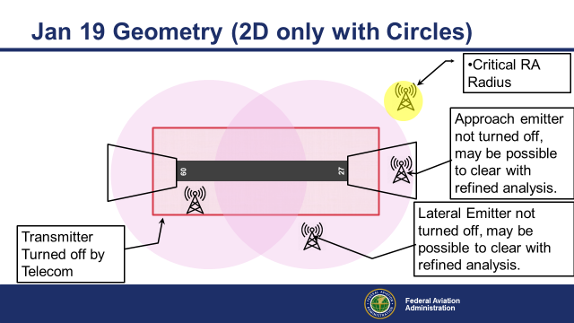
FAA protection surfaces as per January 19th 2022 (AMOC V1)

Slide 11


FAA protection surfaces as per February 2022 (with AMOC V2)
Fixed Radius Method AMOC V2
AMOC FAA: 62 dBm/MHz + 6dB margin
Performance Buffer
5G base station in this zone and radiating in the exclusion zone shall be turned off
Runway Safety Zone
No 5G base station allowed in this area
X
FAA value
2 NM or 3.7 km
Runway
0.625 NM or 1.1575 km
BS radiation coverage at full power
Derived from FAR Part 77 Surfaces
Half Runway

Slide 12
FAA protection surfaces as per end March 2022 (with AMOC V3)
Variable Radius Method AMOC V3
AMOC FAA: 62 dBm/MHz + 6dB margin
Realistic parametric model
RA sensitivity characteristics
RA antenna pattern
Terrain elevation
Base station altitude
Performance Buffer
5G base station in this zone and radiating in the exclusion zone shall be turned off
Runway Safety Zone
No 5G base station allowed in this area
X
FAA value
2 NM or 3.7 km
Runway
0.625 NM or 1.1575 km
BS radiation coverage at full power
Derived from FAR Part 77 Surfaces
Half Runway
AMOC V3 “Variable Radius Method” will :
- clear more runways whatever Aircraft/RA couple
- allow more 5G base stations deployment

Slide 13



FAA Variable Radius Method or AMOC V3
Above Ground Level height [0….1000ft], independent from the operation and from the vertical trajectory
Horizontal Distance D between the Base Station and the aircraft [0…max]
>>> MaxRadius = maximum D amongst all AGL heights with worse Altitude BS
Altitude Base Station [0..500ft]
Realistic parametric model
RA sensitivity characteristics
RA antenna pattern
Terrain elevation
Base station altitude and exact location
Slant range
ϕ
AGL_height
θ1
This approach will allow more 5G base stations deployment and clearance of runways whatever aircraft/RA couple
Altitude BS
BS height
A
Terrain
Terrain Profil height
θ2
Horizontal Distance D -> MaxRadius

Slide 14
RTCA/EUROCAE status about RA MOPS
Currently published standards:
RTCA DO-155, “Minimum Performance Standards Airborne Low-Range Radar Altimeters”, published November 1, 1974
EUROCAE ED-30, “Minimum Performance Specification for Airborne Low Range Radio (Radar) Altimeter Equipment”, published March 1980
Existing Radio Altimeter Standards
Do not address 5G/C-Band RF Interference

Slide 15
RTCA/EUROCAE status about RA MOPS
Radio Altimeter RTCA Special Committee SC-239 and EUROCAE Working Group WG-119 are working jointly to address minimum performance requirements for radio altimeters when subjected to RF interferences.
  Original work plan was to completely re-write the MOPS document (including the addition of new RF interference requirements and test procedures) and to release the entire DO-155A/ED-30A MOPS update by Dec. 2022.
  Since the immediate need by industry and regulators are the RF interference requirements & associated tests, the work plan has been revised to first release a new DO-XXX/ED-XXX document “Technical Standard on RF Interference Environment for Radar Altimeters” in Dec. 2022, followed by the DO-155A/ED-30A MOPS revision in Dec. 2023.

Slide 16

RTCA/EUROCAE SC-239/WG-119 Committee
DO-XXX/ED-XXX Plan and Schedule for Long Term ( RA)
7th April 2022
Beg July 2022
Beg August 2022
End Sept 2022
Mid-Nov 2022
15th Dec 2022
Maximum Tolerable Power Flux Density defined by RA manufacturers
(Frequency Range [3…5GHz])
3rd Party
(FAA, FCC, NTIA, EASA TBC)
Aggregate, Anonymized
Discussion on the performance and document Writing/Editing
PERIOD
Final Review And Comment
Open Consulation
PERIOD
RTCA PMC/ EUROCAE TAC
Official Publication of the document « DO/ED Technical Standard on RF Interference Environment for Radar Altimeters”
PMC: Program Management Committee
TAC: Technical Advisory Committee

Slide 17
RTCA/EUROCAE Spectrum Guidance Committee
New joint RTCA Special Committee SC-242 and EUROCAE Working Group WG-124 has been initiated
  The WG is intended to provide guidance to ensure that the radio frequency characteristics of aeronautical Communications, Navigation and Surveillance systems use the spectrum efficiently while respecting the necessary safety margins.
  The guidance is intended to facilitate any future evaluation of compatibility with other systems and ensure that the usage of the allocated spectrum is as efficient as possible, fully taking into account the specificities of aeronautical CNS systems. The deliverables are envisaged to be referenced by EASA, FAA, other CAAs, ICAO, and national/international spectrum regulators, as appropriate, in guidance material for aviation systems.

Slide 18
ICAO letters
ICAO Letter 25 March 2021, “Potential Safety Concerns Regarding Interference to Radio Altimeters”
  Requested ICAO member States to “Consider as a priority, public and aviation safety when deciding how to enable cellular broadband/5G services in radio frequency bands near the bands used by radio altimeters”
ICAO NAM/CAR/SAM Letter 25 January 2022 “Potential Safety Concerns Regarding Interference to Radio Altimeters
  States were “urged to carry out evaluations of their operations, especially at international airports, to assess the impact that the implementation of 5G technology may have on operational safety”

Slide 19
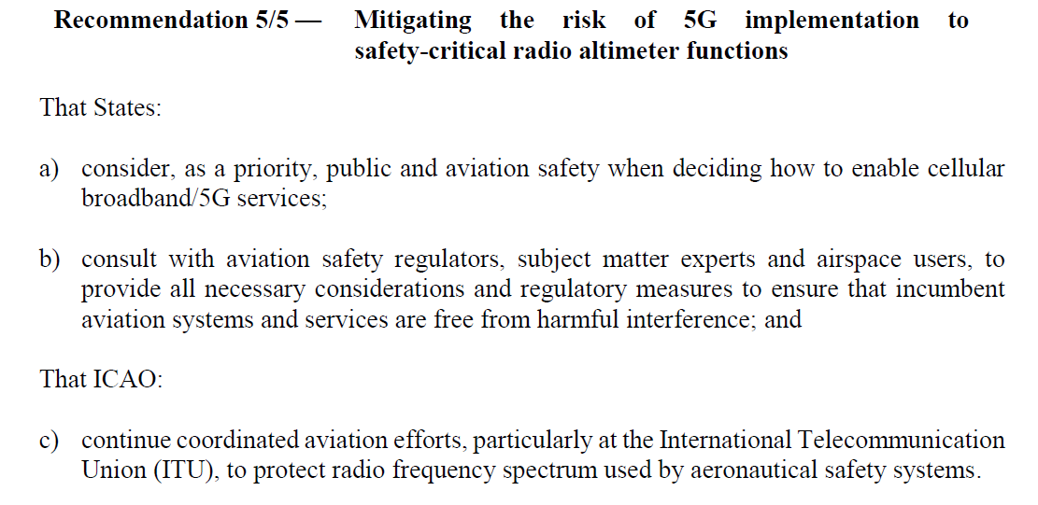
ICAO HLCC outcome
Recommendation 5/5 from ICAO HLCC 2021
Take all practicable and necessary measures to ensure that mid-band 5G unwanted emissions
will not cause harmful interference to Radio Altimeters and improve transparent data sharing between Telecom Operators & Manufacturers and Aviation Industry to safely co-exist in the future

Slide 20
Way forward
The introduction of 5G telecommunications networks across the world may introduce new threats towards the aviation sector and flight safety, nevertheless Airframe OEM’s support 5G and its deployment.
Common objective is to ensure the continuous safe operations of airplanes in assessing & addressing potential interference between the 5G networks and aircraft systems, while allowing future 5G deployment including supporting aviation industry, once potential risks are mitigated.
Continuing activity with all stakeholders to address worldwide 5G levels threat.
Airbus continue to support airworthiness authorities and provide updates to airlines/ customers.

Slide 21
Conclusion
Fortunately, as of today, no misbehavior on RA due to 5G interference has been reported on the Airbus fleet worldwide.
Long Term:
In addition to RTCA/EUROCAE committee activity to develop new Radar Altimeter Minimum Operational Performance Standards (MOPS) to cope with worldwide future Radio Frequency environment, it is also necessary to identify robustness need increase for radio receivers (Satcom, GNSS, DME, ILS…)
RF environment becomes more and more constraining for Aviation CNS systems, Spectrum is a scarce resource, various actions are launched in different worldwide forums to prepare the future of aviation and anticipate design changes.

Slide 22
Thank you
This document and all information contained herein is the sole property of Airbus. No intellectual property rights are granted by the delivery of this document or the disclosure of its content. This document shall not be reproduced or disclosed to a third party without the expressed written consent of Airbus. This document and its content shall not be used for any purpose other than that for which it is supplied.
Airbus, it’s logo and product names are registered trademarks.

