Slide 1

Interference Susceptibility Evaluations of Pulsed Radio Altimeters Due to 5G Mobile Base Station Signal
National Institute of Maritime, Port and Aviation Technology
Electronic Navigation Research Institute
ICAO Frequency Spectrum Management Panel (FSMP) 12th Working Group Meeting, Virtual Meeting, October 2021 – IP/07
S. Futatsumori
Electronic Navigation Research Institute

Slide 2
Contents
Summary
Interference test results of two pulsed radio altimeters due to 5G mobile base station signal
Interference test parameters
Interference signal frequency conditions
Overview of the test set-up
Example of recorded data
Interference test results
In-band interference
Out-band interference

Slide 3
Interference susceptibility test
Summary
  The interference susceptibility of two pulsed radio altimeters with the same product number (PN) is investigated using DO-155 test protocols.
  The in-band and out-band interference signal are additive white Gaussian noise (AWGN) and 5G base station test signals, respectively.
Objectives
  The repeatability of the Japanese MIC test results is assessed. Furthermore, the interference susceptibility fluctuation of the identical PN radio altimeters is measured.
Radio altimeters for the test
  A pulsed radio altimeter identical to the one stated in the Japanese MIC test report (same serial number).
  For a pulsed radio altimeter, use the same PN as above.

Slide 4
Test parameters
 | Parameters
Pulse radio altimeter for test | RT-300 (7001840-913, SN98056822, No. 1) RT-300 (7001840-913, SN90013302, No. 2)
Altitude (ft) | 50, 100, 500, 1000, 1500 (MIC test results: 50, 100, 500)
Interference signal | AWGN (In-band) 5GNR signal NR-FR1-TM1.1 (Out-band)
Interference signal bandwidth (MHz) | 200 (In-band) 100 x 2 (Out-band, both side) 100 (Out-band, single side)
Interference signal power | −130 dBm/MHz− −45 dBm/MHz (In-band) −80 dBm − −10 dBm (Out-band)
Interference signal power sweep step (dB) | 10 for the initial sweep, 1 for the detailed sweep
Interference signal configurations | 4.2 GHz−4.4 GHz (In-band) 4.0 GHz−4.1 GHz and 4.5 GHz−4.6 GHz (Out-band, guard band 100 MHz, both side) 4.0 GHz−4.1 GHz (Out-band, guard band 100 MHz, lower side band) 4.5 GHz−4.6 GHz (Out-band, guard band 100 MHz, upper side band) 3.9 GHz−4.0 GHz and 4.6 GHz−4.7 GHz (Out-band, guard band 200 MHz, both side) 3.8 GHz−3.9 GHz and 4.7 GHz−4.8 GHz (Out-band, guard band 300 MHz, both side)
Interference signal injection time | 10 s on, 10 s off
Band stop filter for RA band | ×(In-band) ○(Out-band)
Interference criteria | Altitude error exceed 0.5 % (cross-check for RTCA report) Altitude error exceed 2 % (cross-check for MIC report)

Slide 5
Interference signal frequency configurations
RA band
Inband
(AWGN Bandwidth 200 MHz)
AWGN
4.2
4.4
BW100 MHz on both side
BW100 MHz on LSB
BW100 MHz on USB
Guardband: 100MHz
Guardband: 100MHz
Guardband: 100MHz
Outband
(5GNR Bandwidth 100 MHz)
(Guardband 100 MHz)
RA band
RA band
RA band
5GNR
5GNR
5GNR
5GNR
4.05
4.2
4.4
4.55
4.05
4.2
4.4
4.05
4.2
4.4
4.55
BW100 MHz on both side
Guardband: 200MHz
Outband
(5GNR Bandwidth 100 MHz)
(Guardband 200 MHz)
RA band
5GNR
5GNR
3.95
4.2
4.4
4.65
BW100 MHz on both side
Guardband: 300MHz
Outband
(5GNR Bandwidth 100 MHz)
(Guardband 300 MHz)
RA band
5GNR
5GNR
3.85
4.2
4.4
4.75

Slide 6
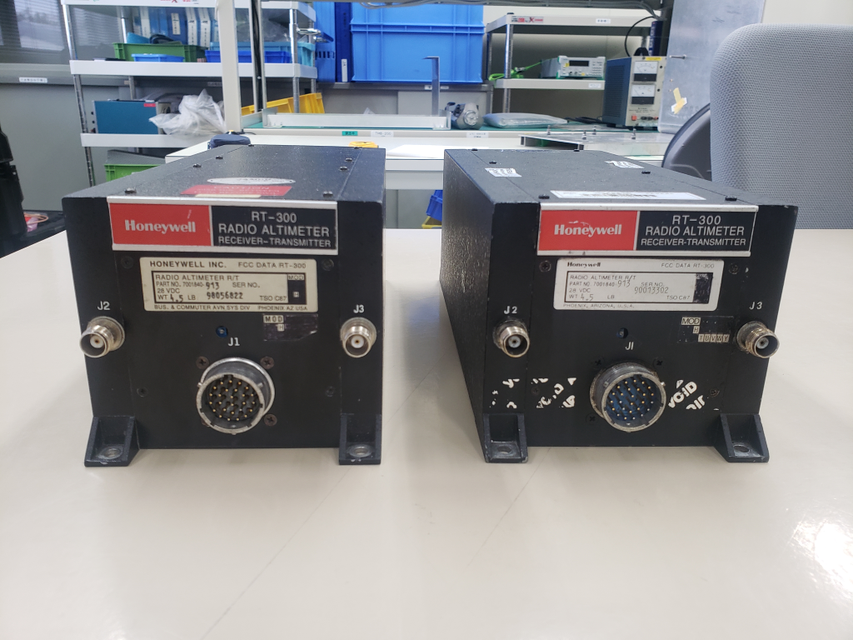
Pulsed radio altimeter
RT-300(Model: 7001840-913)
RT-300 No.1
(SN: 98056822)
RT-300 No.2
(SN: 90013302)

Slide 7
Block diagram
Experimental set-up based on DO-155 test procedures
TX port
Fixed Attenuator
Step Attenuator
Delay line
Radio
altimeter
RX port
20 dB
0 – 110 dB
50, 100, 500, 1000, 1500 ft
Precision out
3 dB hybrid
Spectrum analyzer
Band stop filter
Keysight Technologies N9918B
In-band test
Interference signal path
Digitizer
Isolator
NI USB-6212
Signal generator
3 dB hybrid
Isolator
Isolator
Anritsu MG3710E
Computer
Dual channel signal output
(Maximum bandwidth: 120 MHz for each channel)

Slide 8
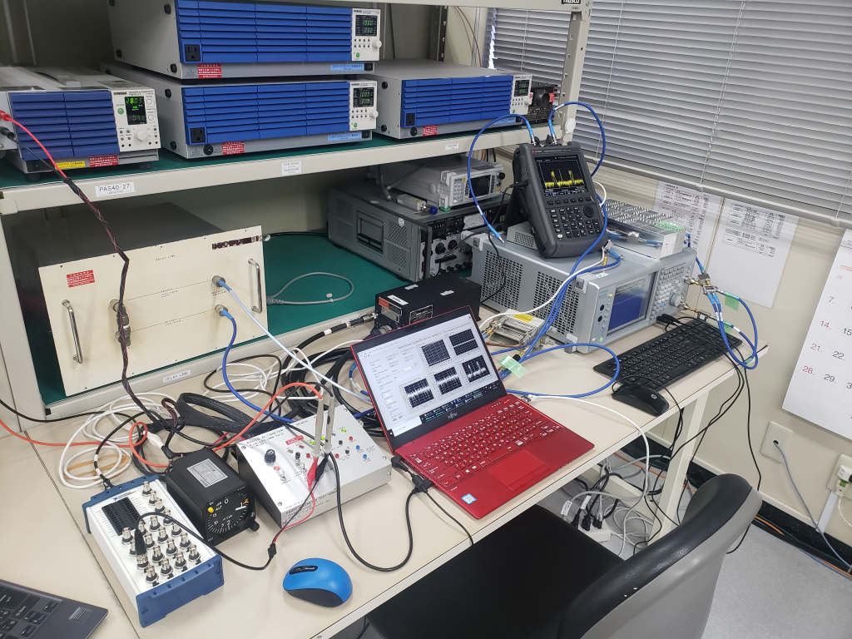
Overview of the set-up
Spectrum analyzer
(Recorded)
Band stop filter for inband test
Delay line
Radio altimeter
Dual channel Signal generator
Data recorder

Slide 9
Example of the recorded data
Inband, AWGN 200 MHz bandwidth (4.2 GHz-4.4 GHz)
Each data points stands for an average of 1000 pts of 10 kS/s
The altitude output voltage is measured and recorded using the digitizer.

Slide 10
In-band interference: Results
AWGN 200 MHz bandwidth (4.2 GHz-4.4 GHz)
Interference power exceed 0.5 % error (dBm/MHz)
Criteria/Altitude | 50 ft | 100 ft | 500 ft | 1000 ft | 1500 ft
RT-300 No. 1 (7001840-913 SN98056822) | −77.8 | −80.8 | −82.8 | −85.8 | −86.8
RT-300 No. 2 (7001840-913 SN90013302) | −79.8 | −83.8 | −83.8 | −92.8 | −86.8
Interference power exceed 2 % error (dBm/MHz)
Criteria/Altitude | 50 ft | 100 ft | 500 ft | 1000 ft | 1500 ft
RT-300 No. 1 (7001840-913 SN98056822) | −72.8 | −73.8 | −78.8 | −84.8 | −86.8
RT-300 No. 2 (7001840-913 SN90013302) | −72.8 | −77.8 | −78.8 | −86.8 | −85.8
RT-300 No. 1 (7001840-913 SN98056822) (MIC report) | −70 | −70 | −76 | - | -
RA band
AWGN
4.2
4.4
The maximum variation of interference threshold power is less than 7 dB.
The maximum difference between MIC report is 4 dB for RT-300 No. 1.

Slide 11
Out-band interference: Results 1
5GNR 100 MHz+100 MHz bandwidth (Guardband 100 MHz)
Interference power exceed 0.5 % error (dBm/MHz)
Criteria/Altitude | 50 ft | 100 ft | 500 ft | 1000 ft | 1500 ft
RT-300 No. 1 (7001840-913 SN98056822) | −45.0 | −50.0 | −51.0 | −59.0 | −55.0
RT-300 No. 2 (7001840-913 SN90013302) | −35.0 | −39.0 | −42.0 | −47.0 | −46.0
Interference power exceed 2 % error (dBm/MHz)
Criteria/Altitude | 50 ft | 100 ft | 500 ft | 1000 ft | 1500 ft
RT-300 No. 1 (7001840-913 SN98056822) | −41.0 | −46.0 | −49.0 | −53.0 | −54.0
RT-300 No. 2 (7001840-913 SN90013302) | −31.0 | −36.0 | −39.0 | −45.0 | −45.0
RT-300 No. 1 (7001840-913 SN98056822) (MIC report) | −32 | −34 | −45 | - | -
Guardband: 100MHz
RA band
5GNR
5GNR
4.05
4.2
4.4
4.55
The maximum variation of interference threshold power is more than 10 dB. The maximum difference between MIC report is 12 dB for RT-300 No. 1.

Slide 12
Out-band interference: Results 2
5GNR 100 MHz bandwidth LSB (Guardband 100 MHz)
Interference power exceed 0.5 % error (dBm/MHz)
Criteria/Altitude | 50 ft | 100 ft | 500 ft | 1000 ft | 1500 ft
RT-300 No. 1 (7001840-913 SN98056822) | −47.7 | −52.7 | −53.7 | −57.7 | −57.7
RT-300 No. 2 (7001840-913 SN90013302) | −38.7 | −41.7 | −44.7 | −49.7 | −50.7
Interference power exceed 2 % error (dBm/MHz)
Criteria/Altitude | 50 ft | 100 ft | 500 ft | 1000 ft | 1500 ft
RT-300 No. 1 (7001840-913 SN98056822) | −43.7 | −48.7 | −50.7 | −55.7 | −57.7
RT-300 No. 2 (7001840-913 SN90013302) | −34.7 | −38.7 | −41.7 | −47.7 | −49.7
RT-300 No. 1 (7001840-913 SN98056822) (MIC report) | - | - | - | - | -
Guardband: 100MHz
RA band
5GNR
4.05
4.2
4.4
The maximum variation of interference threshold values is more than 10 dB. The −57.7 dBm threshold is observed at 1500 ft due to the signal on LSB.

Slide 13
Out-band interference: Results 3
5GNR 100 MHz bandwidth USB (Guardband 100 MHz)
Interference power exceed 0.5 % error (dBm/MHz)
Criteria/Altitude | 50 ft | 100 ft | 500 ft | 1000 ft | 1500 ft
RT-300 No. 1 (7001840-913 SN98056822) | −28.4 | −31.4 | −30.4 | −32.4 | −32.4
RT-300 No. 2 (7001840-913 SN90013302) | −24.4 | −26.4 | −27.4 | −31.4 | −31.4
Interference power exceed 2 % error (dBm/MHz)
Criteria/Altitude | 50 ft | 100 ft | 500 ft | 1000 ft | 1500 ft
RT-300 No. 1 (7001840-913 SN98056822) | −23.4 | −27.4 | −27.4 | −29.4 | −30.4
RT-300 No. 2 (7001840-913 SN90013302) | −20.4 | −23.4 | −24.4 | −29.4 | −31.4
RT-300 No. 1 (7001840-913 SN98056822) (MIC report) | - | - | - | - | -
Guardband: 100MHz
RA band
5GNR
4.05
4.2
4.4
4.55
The USB interference threshold values are almost 20 dB higher than those of LSB interference values. The variations are small values compared with LSB.

Slide 14
Out-band interference: Results 4
5GNR 100 MHz+100 MHz bandwidth (Guardband 200 MHz)
Interference power exceed 0.5 % error (dBm/MHz)
Criteria/Altitude | 50 ft | 100 ft | 500 ft | 1000 ft | 1500 ft
RT-300 No. 1 (7001840-913 SN98056822) | −36.0 | −41.0 | −40.0 | −45.0 | −42.0
RT-300 No. 2 (7001840-913 SN90013302) | −23.0 | −25.0 | −26.0 | −29.0 | −28.0
Interference power exceed 2 % error (dBm/MHz)
Criteria/Altitude | 50 ft | 100 ft | 500 ft | 1000 ft | 1500 ft
RT-300 No. 1 (7001840-913 SN98056822) | −32.0 | −37.0 | −37.0 | −40.0 | −41.0
RT-300 No. 2 (7001840-913 SN90013302) | −19.0 | −22.0 | −23.0 | −27.0 | −28.0
RT-300 No. 1 (7001840-913 SN98056822) (MIC report) | −24 | −27 | −34 | - | -
Guardband: 200MHz
RA band
5GNR
5GNR
3.95
4.2
4.4
4.65
The maximum variation of interference threshold values is more than 10 dB. The maximum difference between MIC report is 10 dB for RT-300 No. 1.

Slide 15
Out-band interference: Results 5
5GNR 100 MHz+100 MHz bandwidth (Guardband 300 MHz)
Interference power exceed 0.5 % error (dBm/MHz)
Criteria/Altitude | 50 ft | 100 ft | 500 ft | 1000 ft | 1500 ft
RT-300 No. 1 (7001840-913 SN98056822) | −29.0 | −31.0 | −30.0 | −32.0 | −34.0
RT-300 No. 2 (7001840-913 SN90013302) | N/A | N/A | -16.0 | −20.0 | −20.0
Interference power exceed 2 % error (dBm/MHz)
Criteria/Altitude | 50 ft | 100 ft | 500 ft | 1000 ft | 1500 ft
RT-300 No. 1 (7001840-913 SN98056822) | N/A | −21.0 | −29.0 | −31.0 | −32.0
RT-300 No. 2 (7001840-913 SN90013302) | N/A | N/A | -14.0 | −18.0 | −20.0
RT-300 No. 1 (7001840-913 SN98056822) (MIC report) | N/A | N/A | -27 | - | -
Guardband: 300MHz
RA band
5GNR
5GNR
3.85
4.2
4.4
4.75
The maximum variation of interference threshold values is more than 10 dB. The difference between MIC report is observed for RT-300 No. 1.

Slide 16
Conclusions
Conclusions
The interference threshold due to the 5G mobile base station is evaluated for two pulsed altimeters.
The repeatability of the MIC report is evaluated by using the same radio altimeter. The threshold power is almost within 4 dB difference.
The interference threshold power is reduced as the altitude is getting higher. The maximum measurement altitude is 1500 ft.
The variations of the interference threshold power is more than 10 dB at the same test conditions for the same PN radio altimeter.
The minimum interference threshold values for the in-band and the out-band interference test are −57.7 dBm and −86.8 dBm/MHz, respectively
Future works
We will take more measurements with the various PN pulsed radio altimeters as well as several FMCW radio altimeters.

