Slide 1
French ongoing Works on the
31,8-33,4 GHz Frequency band
Presented by
Christian Fleury
DGAC - DSNA

Slide 2
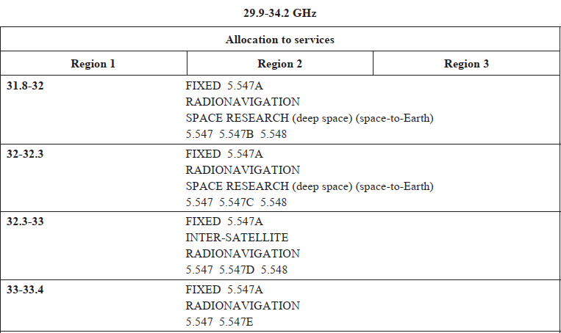
Current
Situation
5.547 A Administrations should take practical measures to minimize the potential
interference between stations in the fixed service and airborne stations in the
radionavigation service in the 31.8-33.4 GHz band, taking into account the operational
needs of the airborne radar systems. (WRC-2000)
5.547 B-C-D-E Alternative allocation: in the United States, the band 31.8-33.4 GHz is
allocated to the radionavigation and xxxxxxx services on a primary basis.

Slide 3
Historical
Sept 2016 :During FSMP WG03, FRANCE proposed to upgrade the PRELIMINARY DRAFT REVISION OF RECOMMENDATION ITU-R M.1466-0 to a DRAFT REVISION OF RECOMMENDATION ITU-R M.1466-0 (FSMP-WG03-WP07_1466 Agenda item 6)
January 2017: Recommendation ITU-R M.1466-1 Characteristics of and protection criteria for radars operating in the radionavigation service in the frequency band 31.8-33.4 GHz recognizes the radar characteristics developed by Dassault Aviation for Enhanced Flight Vision System (EFVS).
July 2018 : The ECC approved the new ECC Decision (18)06 “Harmonised technical conditions for Mobile/Fixed Communications Networks (MFCN) in the band 24.25-27.5 GHz”, before WRC19

Slide 4
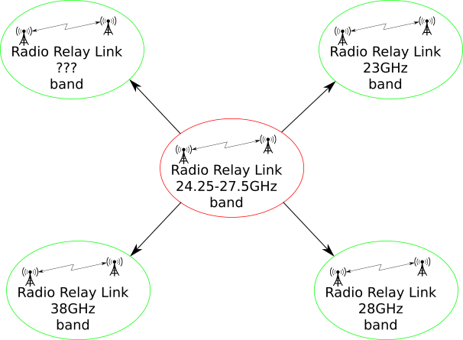
Due to IMT allocation in the band 24,25-27,5 GHz (the 26 GHz band), radio relay link (Fixed Service) has to move to an other frequency band.

Slide 5
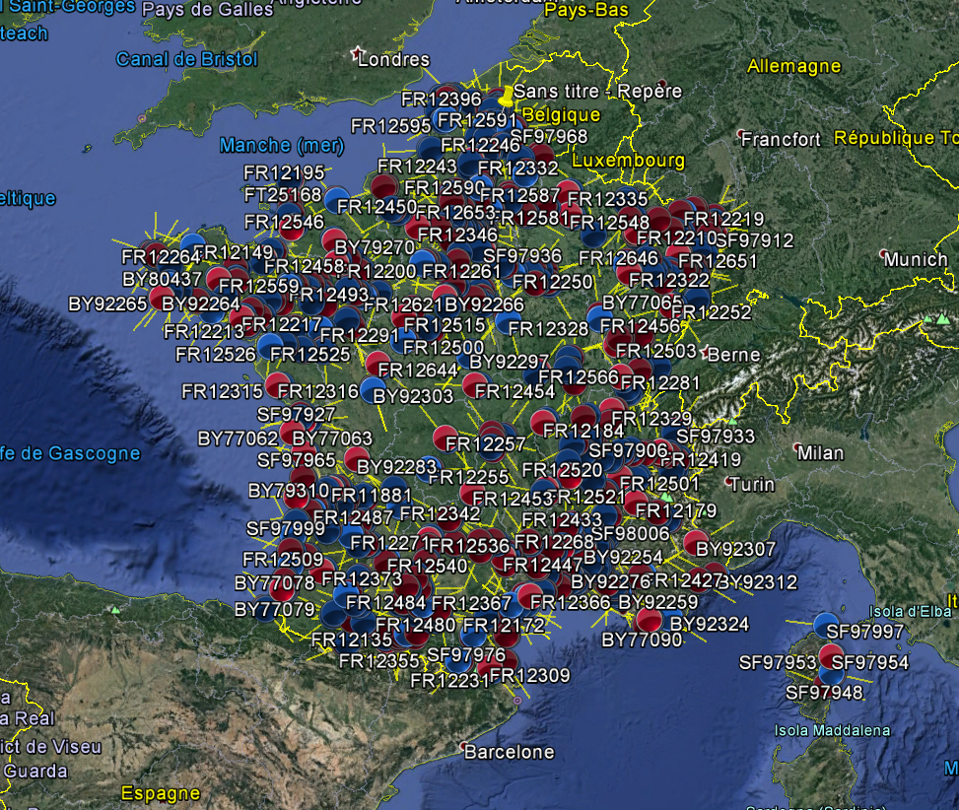
Without any consultation with other co-primary users in the 31.8-33.4 GHz band, ARCEP (the French communication networks regulator) decided to move all Fix service from the 26 GHz band into the 32 GHz band.
This could be considered as a preemption of the band!
July 2018 : ARCEP started the process to register 880 Relay fix link in the 32GHz Band.
October 2018 : DGAC, as a co primary user, opposed the registration of 60 of those in order to protect 41 identified airports.
December 2018 : negotiations between ARCEP and DGAC started. Failure!

Slide 6
January 2019:
the Commission d’Attribution des bandes de Fréquences (Frequency band allocation Commission) agreed with DGAC.
To be continued

Slide 7
Intercalaire

Slide 8
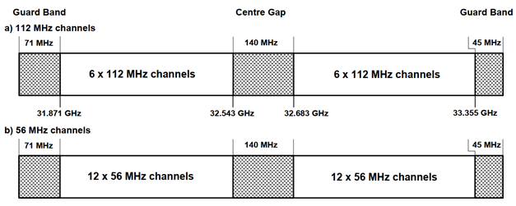
How is the band in Europe (at CEPT Level) shared with the fixed service?
ERC RECOMMENDATION (01)02
Preferred channel arrangements for fixed service systems operating I, the frequency band 31.8 – 33.4 GHz

Slide 9
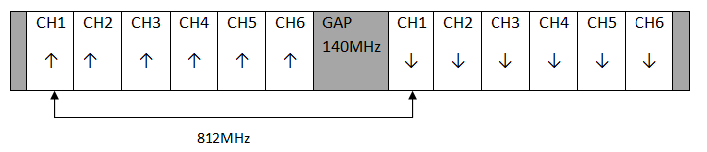
How is the band in Europe (at CEPT Level) shared with the fixed service?

Slide 10
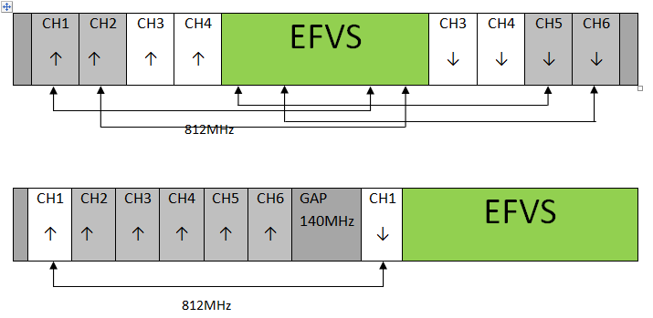
How is the band in Europe (at CEPT Level) shared with the fixed service?
Following Recommendation ITU-R M.1466-1, EFVS would need 500 MHz band to operate.
To be efficient, we have to use the center Gap.
OR
Not Spectrum efficient

Slide 11
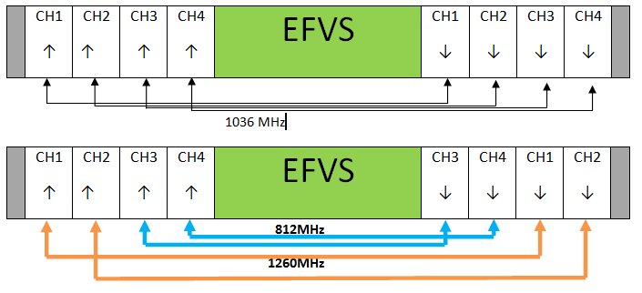
How is the band in Europe (at CEPT Level) shared with the fixed service?
We submitted some thought/solution.
OR

Slide 12
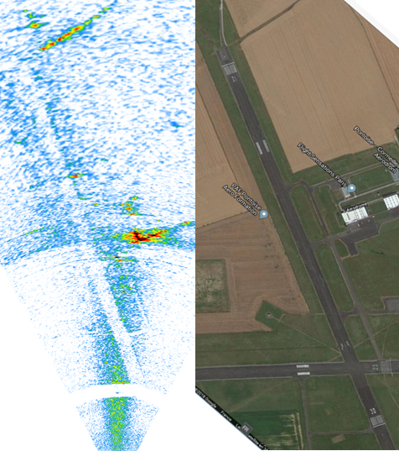
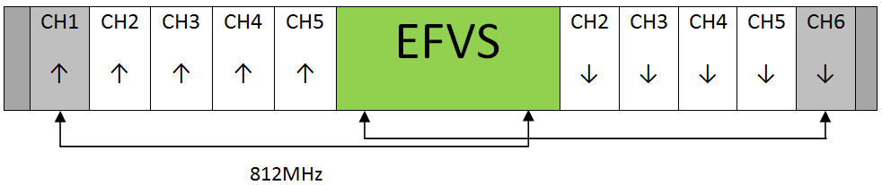
Experimentations and conclusions
In 2018, Dassault Aviation carried out experimentations on the sensor in the 32GHz frequency band.
The result showed that a bandwidth of 350Mhz give an acceptable/suitable resolution for civil application.
140+112*2=364
In this configuration, the impact on Fixed service is 50% less. And a channel Uplink CH1/Downlink CH6 is still possible.

Slide 13
Questions?

