Slide 1
HF Next Technical Overview
Modernization of HF Communications
January 2019

Slide 2
Agenda
Current HF Communications Issues
Proposed “HF Next” System Improvements
  Waveform/Protocol
  Airborne Radio
Long Range Communications Link Diversity
HF Next Notional Roadmap

Slide 3

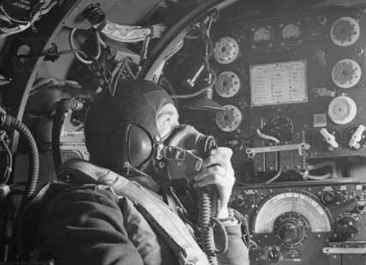
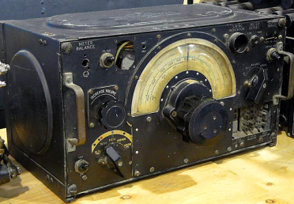
Legacy HF Communications
Say again, over!
HF communications has not improved significantly in many decades

Slide 4
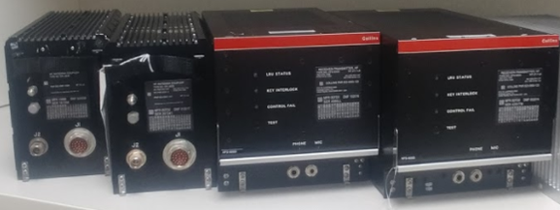
Current HF Communications Issues
Voice quality:
  Noisy, hard to understand
Datalink performance:
  Data rate too slow
  Inadequate availability, frequent disconnects
  Insufficient to support RCP 240
Flight crew workload:
  Cumbersome to choose channel with good propagation characteristics
Avionics size, weight, and power (SWaP):
  Bulky, numerous LRUs
  Heavy
  Excessive cabling
  3-phase 115 VAC power complicates installation

Slide 5
Proposed HF Next System Improvements
A modernized “HF Next” system is proposed to address afore-mentioned HF communications issues
  More spectrally efficient waveform based on proven MIL-STD-188-110D
    Standard is publicly available, not export controlled
    Digital voice for significantly reduced noise/improved clarity
    100+ kbps data rates (vs. 1.8 kbps maximum for legacy HFDL)
      3 to 48 kHz “wide-band” channels
      Advanced modulation (up to 256QAM), dynamically adaptable based on signal quality
    Protocol enhancements to improve link availability
      Continuous background signal propagation soundings with proactive channel hand-over when signal degrades
      Separate uplink and downlink channels (close in frequency to ensure similar propagation characteristics)
      RCP 240 compliant
    Utilize existing 2.8 to 24 MHz HF aeronautical frequency spectrum
    Interoperable with legacy HF (analog voice and HFDL)
      Existing ground stations will continue to support legacy HF functionality as needed
      Separate frequencies for new HF Next ground stations
Changing channel bandwidth and modulation within existing HF aeronautical frequency spectrum

Slide 6
Proposed HF Next System Improvements
Application of state-of-the-art Software-Defined Radio (SDR) technology to improve airborne HF system
  Allows combination of HF Transceiver and Coupler into single remote-mounted LRU
    Sufficient size, weight, and power reductions to justify customer business cases
  Multi-channel receive capability allows single airborne LRU to provide simultaneous voice and data link functionality
    Analog or digital voice communication
    Legacy HFDL or HF Next wide-band data link
    Retains transmit “ruthless preemption” of current HF system (single airborne antenna limitation)
HF Next modernizes HF communications to support future airspace needs

Slide 7
HF Next Achievable Data Rates vs. Signal-to-Noise Ratio
Notes:
(1) Most 2PSK modulations use "repetition" (sending payload bits more than once) and have different coding rates.
(2) First 4PSK waveform listed above has more robust coding than second.
(3) First 64QAM waveform listed above has more robust coding than second.
(4) 256QAM modulation originally designed for surface wave HF (sea and ground), but does work over skywave with strong SNR.
(5) Last column Signal-to-Noise Ratio (SNR) values come from actual over-the-air testing of mid-latitude links, corresponding to the observed low-end threshold with acceptable bit error rate.

Slide 8
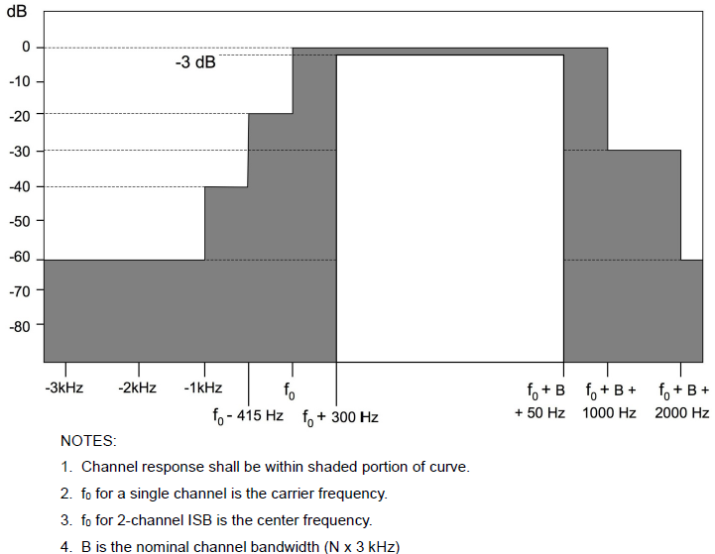
HF Next Spectral Mask/Emissions
MIL-STD-188-141D provides corresponding HF Next spectral mask/emissions specifications (excerpt shown below)
  Ensures non-interference with adjacent legacy HF or HF Next channels

Slide 9
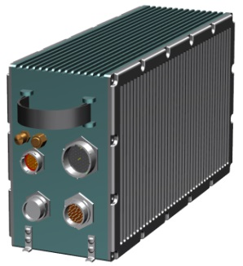
Airborne HF Next Radio (HFN) Concept
Combines HF Transceiver and Coupler into one LRU
Remote mounted near antenna (no long RF coax cable run)
No cooling air required
Significant size, weight, and power reductions
SDR design allows HF multi-channel capability with single LRU
Modernized features:
  Digital voice
  Wide-band data (100+ kbps)
  Improved availability
Provides interoperability/ backward compatibility with legacy HF (analog voice and HFDL)
HF Antenna
Remote Equipment
HF Feeder
HF Next Remote Radio
Concentrated High Speed Digital Link
AFDX/Ethernet Switch, Data Concentrator, or IMA Resource
Electronics Bay Equipment
…
Other Avionics Equipment

Slide 10

HF Analog vs. Digital Voice Comparative Recordings
Recording of legacy ANALOG SSB HF voice in poor channel conditions:
HF Next will implement digital voice using an industry standard vocoder
  For example, Mixed Excitation Linear Predictive - Enhanced (MELPe) using 2400 bps on a standard 3 kHz channel, based on MIL-STD-3005
Recording of MELPe DIGITAL HF voice in the same poor channel conditions:

Slide 11
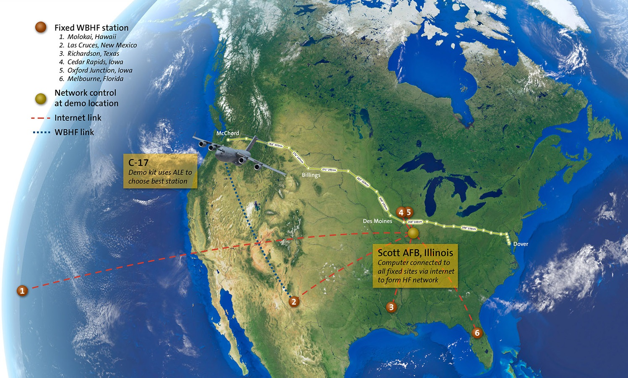
HF Next Prototype C-17 Flight Testing
WBHF C-17 Flight Testing

Slide 12
HF Next Prototype C-17 Flight Testing Results
Establish an HF link to “best” station using 4G ALE
Establish an HF link to specific ground stations using 4G ALE
Conduct real-time chat between aircraft and ground
Conduct full-motion streaming video from aircraft to ground
  Believed to be first transmission of live video from aircraft to ground using HF radio
Conduct large file transfer (> 1 MB) from ground to aircraft
Conduct half-duplex, digital voice audio communication between aircraft and ground using Mixed Excitation Linear Prediction – Enhanced (MELPe) standard
Conduct 4G ALE soundings from both aircraft and ground stations to collect Link Quality Assessment (LQA) information
Transmit/receive test data streams between aircraft and ground stations to collect signal strength, signal-to-noise ratio, and bandwidth availability information under various flight conditions
  Ground-to-air: average data rate of 38.32 kbps, maximum data rate of 96 kbps
  Air-to-ground: average data rate of 19.2 kbps, maximum data rate of 48 kbps
WBHF C-17 Flight Testing

Slide 13
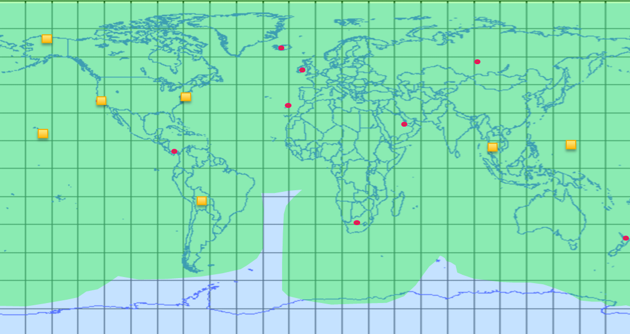
HF Next Ground Station Infrastructure Plans
HF Ground Stations
Alaska
Bahrain
Bolivia
California
Canary Islands
Guam
Hawaii
Iceland
Ireland
New York
New Zealand
Panama
Russia (non-operational)
South Africa
South Korea
Thailand
Worldwide coverage with up to 16 ground stations
  Transmitters and receivers
  TX and RX antennas
  Shelters
  Ground station computers and routers
  Support for legacy and HF Next operations
Modernize software protocol
  Integrated voice/data
  Enables worldwide voice
  Supports FANS and future airspace RCP requirements
Legend
HFDL station
Voice/HFDL station
Areas of
primary coverage
Areas of
secondary coverage

Slide 14
Long Range Communications Link Diversity
Aircraft installation of both HF and SATCOM maximizes availability/reliability of long range communications
  Ensures global (ETOPS & polar) coverage at all times
    Supports continuous FANS communication
    HF allows ATC to broadcast to multiple aircraft simultaneously
  Eliminates celestial vs. terrestrial network single point of failure concerns
    Media diversity for protection from acts of nature, war, or terrorism
    HF network has multiple points of redundancy to ensure robustness
    Susceptibilities differ for SATCOM vs. HF (solar events, rain fade, jamming, satellite failures, ground station failures, etc.)
  HF and SATCOM can operate simultaneously, increasing total aircraft communications capacity
    Dual L-Band SATCOM systems interfere with each other (allows only “hot spare”)
  Some regional ATC ground infrastructures do not support SATCOM

Slide 15
HF Next Notional Roadmap
2019
2020
2021
2022
2023
2024
2025
2026
Avionics
Avionics HFN Development
Basic HFN
(legacy HF functionality, SWaP reduction)
HF Next functionality (digital voice, high speed data)
Ground
Ground Infrastructure Development
Initial HF Next operations supported in a single oceanic region
Global HF Next coverage
Channel Authorization
External Dependency
Initiate authorization process
Test frequencies
authorized
Full frequencies
authorized

Slide 16
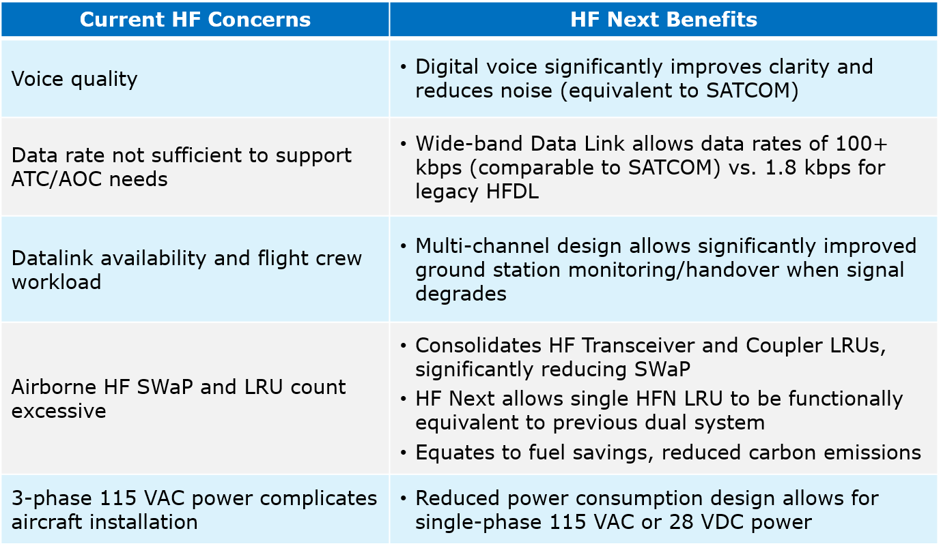
Summary of HF Next Benefits
HF Next modernizes HF communications to support future airspace needs.
Complementary with SATCOM to provide link-diverse long range communications solution.

