Slide 1

Aerospace Vehicle Systems Institute
Update on AVSI WAIC-Radio Altimeter Coexistence Testing
Texas A&M Engineering
Experiment Station
Dr. David Redman, AVSI
FOURTH WORKING GROUP MEETING OF THE FREQUENCY SPECTRUM MANAGEMENT PANEL (FSMP – WG/4)
29 March – 7 April 2017 ICAO APAC, Bangkok, Thailand

Slide 2
Purpose
The AVSI WAIC Team asks the Meeting to consider preliminary testing of radio altimeter susceptibility to WAIC signal interference for the purpose of
Providing an update on the current status of the work supporting the Radar Altimeter and WAIC job cards submitted in February 2016, and
Providing an opportunity for the Meeting to comment on the suitability of the proposed method.

Slide 3
Outline
A brief history of WAIC at AVSI that leads us to here…
Description of tests investigating WAIC interference on radio altimeters
Future plans for additional testing
This work represents the collective
efforts of the entire AVSI WAIC Team.

Slide 4
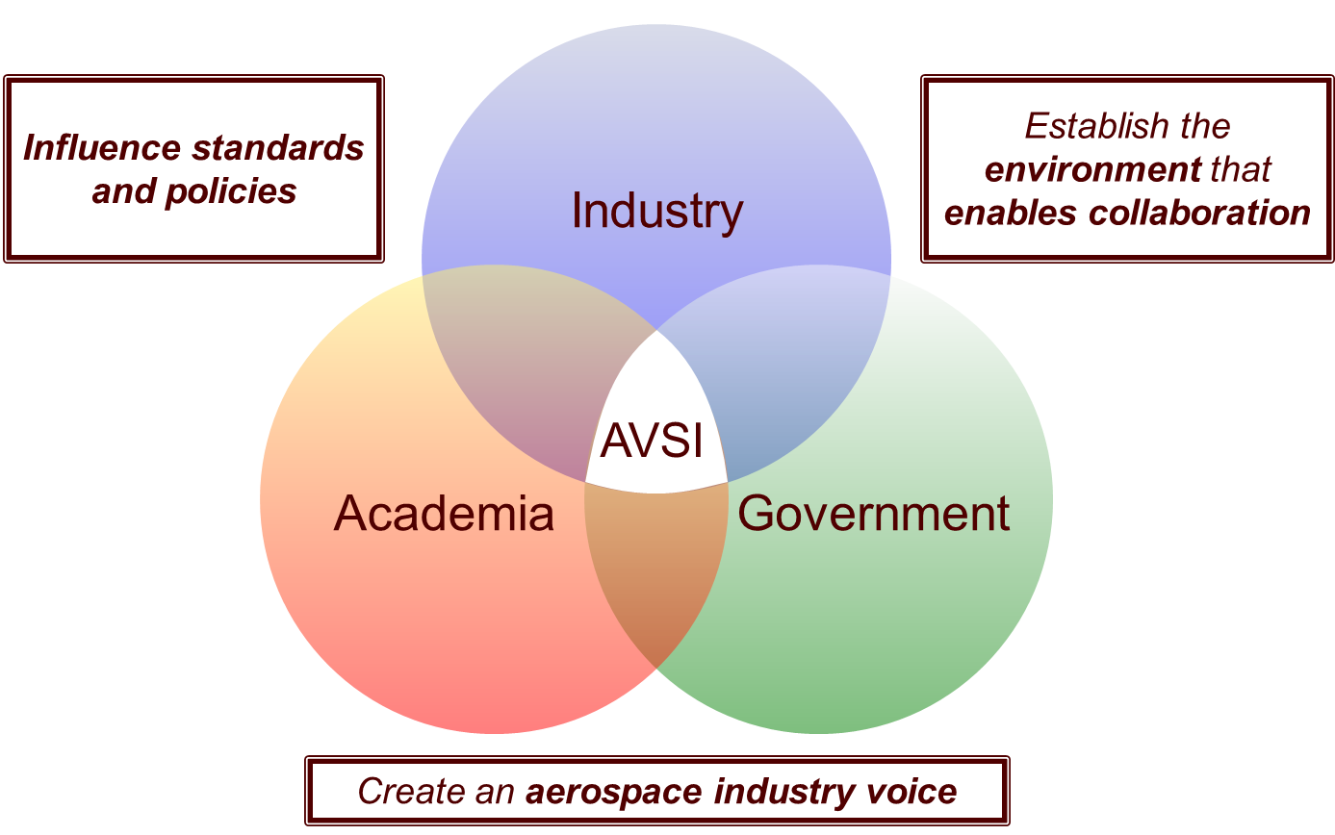

The Aerospace Vehicle Systems Institute
AVSI is an industry-centric applied research cooperative founded in 1998 at Texas A&M University that facilitates pre-competitive collaborative research projects (“AFE’s”).

Slide 5















AVSI Membership Represents the Industry
Full Members
Airbus
Boeing
DoD
Embraer
GE Aviation
Honeywell
Rockwell Collins
Rolls Royce
Saab
Thales
United Technologies
Liaison Members
FAA
NASA
Aerospace Valley
SEI
Associate Members
ATI Wah-Chang
HarcoSemco
Rafael D. S.
SAES-Getters
Lufhansa Technik
Zodiac
Current membership includes a cross-section of aerospace industry stakeholders, including aircraft producers, system suppliers, regulatory bodies, government and trade organizations, and academia.
Past and present WAIC participants in bold

Slide 6
WAIC Journey
First “dedicated” spectrum workshop
First document submission to ITU
First ITU Report on WAIC
Final ITU Report on WAIC
RTCA-EUROCAE MOPS Process Initiated
MOPS Process Completed
AFE 56
AFE 73 (through s3)
AFE 76
AFE 76s1
2006
2007
2008
2009
2010
2011
2012
2013
2014
2015
2016
2017
2018
2019
AFE 14 (2001)
AFE 23 (2003)
ICAO SARP Process
Agenda Item
on WAIC
Protected Spectrum
Approved at WRC-15
Notes:
Pre-History
AFE 14 – completed 2001
Wireless Communication for Aircraft Systems
Focus on:
Generic characterization of future on-board wireless systems: throughput, latency, data losses, etc
Prospective suitability of COTS components
Conclusion: “Wireless communication in one form or another may be suitable at least for some aircraft applications”
AFE 23 – completed 2003
Certification Guideline for Wireless Communication in Aircraft
Focus on:
Installed systems communicating with PEDs but also with other installed wireless
Non-essential applications, but not excluding higher criticality
Overview of certification processes and issues to be addressed
These two foundational studies prepared the ground for WAIC

Slide 7
AVSI Testing
New project members in January 2016 expressed strong interest in supporting testing and provided additional resources
Introduction of WAIC-related ICAO FSMP-WG/4 job cards specifically called for analyses proving safe coexistence of WAIC systems and radio altimeters (RA’s) installed on different aircraft and this accelerated the need for supporting experimental date
Initiation of MOPS development activity under the joint RTCA SC-236 / EUROCASE WG-96 committee also added to the urgency to obtain test data to support analysis of single aircraft coexistence

Slide 8
Coexistence Scenarios with RA’s
Interference between WAIC and RA’s onboard aircraft equipped with WAIC.
Interference between WAIC and RA’s onboard other aircraft within interference range
The latter is expected to arise during flight phases “Standing”, “Pushback/Towing”, “Taxi-Out”, “Take Off”, “Landing” and “Taxi-in”.

Slide 9
WAIC Roadmap

Slide 10
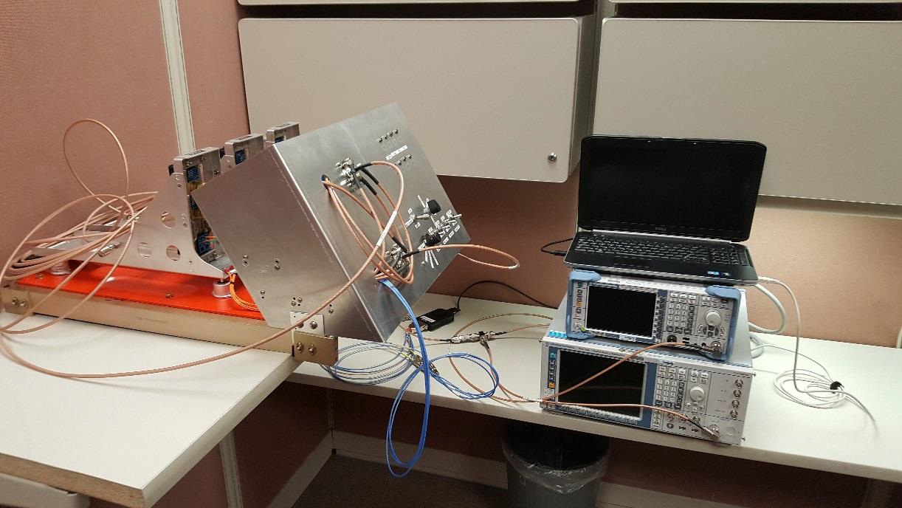
WAIC Electronics Test Rack (WETR)

Slide 11

Laboratory Testing
RA #1
Flight
Test
Rack
Fiber Optic Delay Line
Tx
Rx
ARINC
429
16 dB Directional Couple
Tx
RA #2
Rx
Vector Signal Generator
Tx
RA #3
Spectrum Analyzer
Rx
GPIB

Slide 12
Radio Altimeters Used for Testing
Rockwell Collins LRA-2100
Dimensions | L = 15.6”, W = 3.64”, H = 7.7”
Weight | 8.47 lb nominal (8.8 lb max.)
Input Power | 115 V AC ±10%, 360 to 800 Hz
Mounting | ARINC 600
Software | DO-178A
Rockwell Collins LRA-900
Dimensions | L = 15.6”, W = 3.64”, H = 7.7”
Weight | 9.6 lbs
Input Power | 115 V AC ±10%, 380 to 420 Hz
Mounting | ARINC 600
Software | DO-178A
(1)
(2)
Thales ERT-530
Dimensions | L = 15.6”, W = 3.64”, H = 7.7”
Weight | 8.47 lb nominal (8.8 lb max.)
Input Power | 115 V AC ±10%, 360 to 800 Hz
Accuracy | 1 ft over runway surface
Thales ERT-530
Dimensions | L = 15.6”, W = 3.64”, H = 7.7”
Weight | 9.6 lbs
Input Power | 115 V AC ±10%, 380 to 420 Hz
Mounting | ARINC 600
(3)
(4)
Honeywell ALA-52B
Dimensions | L = 15.6”, W = 3.64”, H = 7.7”
Weight | 8.6 lb
Input Power | +28 VDC
Mounting | ARINC 600
Software | DO-178B, LA
(5)

Slide 13
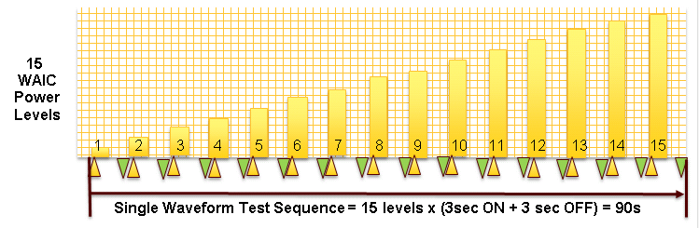
Radio Altimeter Test Scenarios
For constant AGL: Record the effect of WAIC interference on each of 5 RadAlts at 5 altitudes.
  4 waveform types will be evaluated:
    2 Constant Envelope Signals (MSK)
    2 Orthogonal Frequency Division Multiplexing Signals (OFDM)
  Waveform transmit power will be increased in 15 (1dB) steps with signal power ON and OFF (to measure true altitude) for each step.
  Specific events to be noted:
    First instance of radio altimeter output to differ between the ON and OFF state.
    Altimeter accuracy just meets DO-155 specification for that altitude.
    Altimeter loses lock (Null Acquisition Mode)

Slide 14
Testing Scenarios
Per RA Model
Height |  | WAIC Waveforms
 |  | Single Carrier |  |  | Dual Carrier MSK |  |  | Single Channel OFDM |  |  | Dual Channel OFDM
 |  | 4.3 GHz | 4.24 GHz | 4.36 GHz | 4.3 GHz | 4.24 GHz | 4.36 GHz | 4.3 GHz | 4.24 GHz | 4.36 GHz | 4.3 GHz | 4.24 GHz | 4.36 GHz
500 ft. | Threshold
 | Out of Spec
 | Loss of Lock
1500 ft. | Threshold
 | Out of Spec
 | Loss of Lock
3000 ft. | Threshold
 | Out of Spec
 | Loss of Lock
5000 ft. | Threshold
 | Out of Spec
 | Loss of Lock
8000 ft. | Threshold
 | Out of Spec
 | Loss of Lock

Slide 15
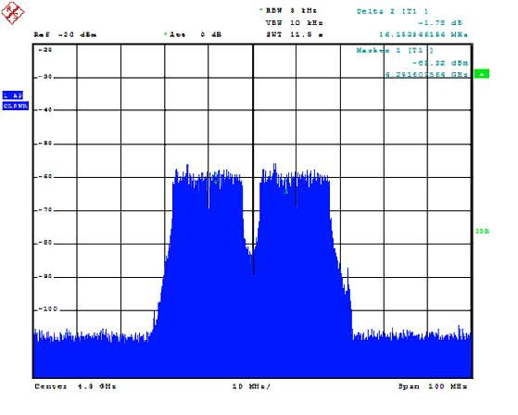
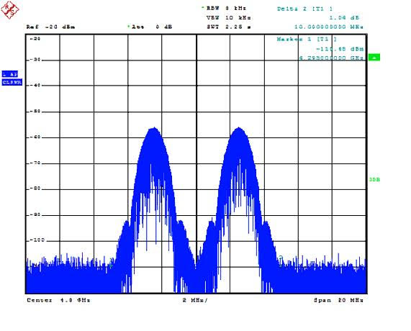
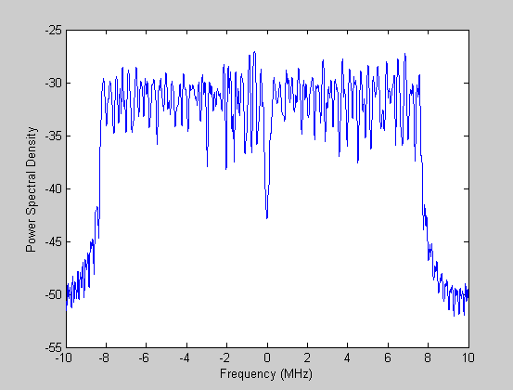
Signal Generation for Injection
MATLAB OFDM and MSK simulated baseband signals loaded into vector signal generator.
OFDM based on the IEEE 802.11 parameters; 52 subcarriers, 312.5 kHz carrier separation, 20 MHz bandwidth and 16 MHz occupied bandwidth, 20 Msps (3.2 µs data symbol duration with a 0.4 µs guard length).
Center frequencies – Center of band, 4.3 GHz, +/- 60 MHz
OFDM
Dual Channel OFDM
Dual MSK
Notes:
Two MSK signals at 5 MHz apart (+/- 2.5 MHz offsets from center), each with 2 Msymbol/s. MSK, continuous phase frequency shift keying
OFDM signals (exact same signal) 20 MHz apart (+/-10 MHz offsets). Each signal should have about 16-17 MHz bandwidth. The VSG power setting is -30 dBm. The peak SA’s readings are much lower as shown due to the low resolution bandwidth setting. I think the total integrated power should be -30 dBm. Also, if there is only signal, the peaks are higher than with two signals.

Slide 16
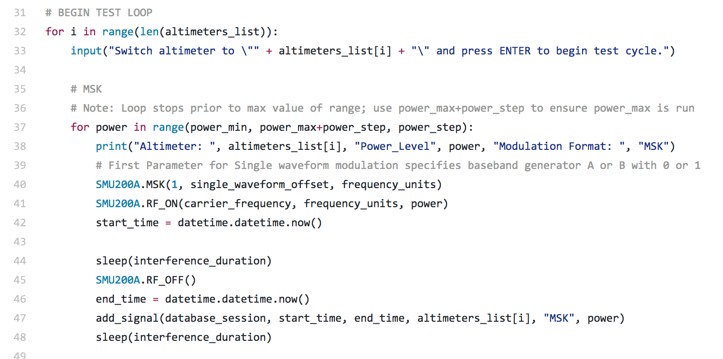
Data Collection Automation
The same control and data acquisition software will be used in both the laboratory and in planned flight testing to step through a full set of measurements with minimal operator interaction
For each 1 of 5 altitudes
  For each 1 of 5 test altimeters
      Manually select RA under test
      For each 1 of 4 waveforms
        Load/Select VSG Waveform
        For each 1 of 15 power levels
          Read & record altitude without interference power for 10 seconds
          Turn on interference signal
          Read and record altitude with selected int. power for 10 seconds
          Turn off interference signal

Slide 17
Flight Testing Overview
Flight Test Objectives
  Validate the laboratory test apparatus and method.
  Analyze the the effects of terrain on WAIC/RA interference characteristics
  Provide real-world data supporting development of standards under ICAO and RTCA.
  Provide real-world data supporting development of WAIC technical characteristics, including waveform modulations, protocols and con-ops, being developed under an AVSI project.
Two Flight Test Campaigns
  Phase 1: Direct injection of representative WAIC signals into RadAlt receive antenna. (WAIC on RA)
  Phase 2: Distributive representative WAIC transmitters about the aircraft. (RA on WAIC / WAIC on WAIC)
Note: Additional RadAlt ground scattering tests are also in preparation

Slide 18
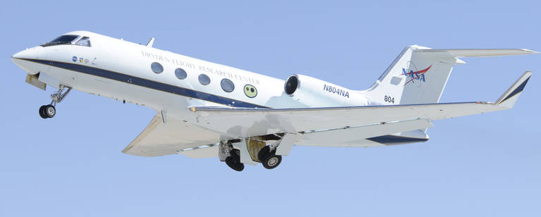
Flight Test Aircraft: Gulfstream G3
Business jet developed by Gulfstream Aerospace.
Equipped with 2 Radio Altimeters.
  Primary → Thales ERT-530A
  Secondary → Thales ERT-530A
https://www.nasa.gov/centers/armstrong/multimedia/imagegallery/G-III_Aerodynamics/index.html
Notes:
Antenna 9.5 dBi gain

Slide 19
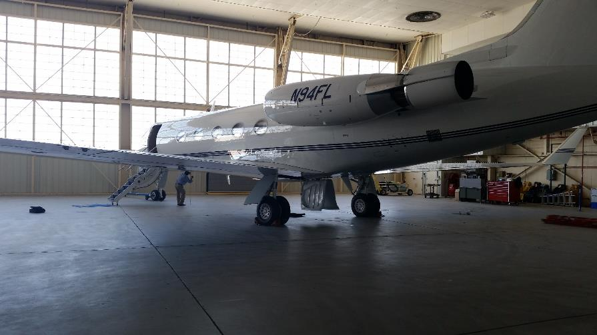

Gulfstream 3 – Tail #808 Floor Plan
Gulfstream 3 Floor Plan with WAIC Test Rack.
WAIC Test Rack replaces aircraft seat on the starboard side.
RadAlt #2 disconnected, antennas used with WAIC test rack.
15” 37” 26”
78”

Slide 20
Flight Test Profile
Start
Fly to start point: Set altimeter 1, waveform 1 ~15 minutes
Each Altitude:
  Altimeter 1
    For 4 Waveforms: (1.5 minutes*4) + (10 sec. waveform switch*3) = 6.5 Min.
    Turn, switch to waveform 1, switch to altimeter 2 = 3 Min.
  Altimeter 2
    For 4 Waveforms: (1.5 minutes*4) + (10 sec. waveform switch*3) = 6.5 Min.
    Turn, switch to waveform 1, switch to altimeter 2 = 3 Min.
  Altimeter 3
    For 4 Waveforms: (1.5 minutes*4) + (10 sec. waveform switch*3) = 6.5 Min.
    Turn + Descend, switch to waveform 1, switch to altimeter 2 = 3 Min.
  Total Time Per Altitude: 28.5 Min.
3 Altimeters over 5 Altitudes: 28.5 Min. x 5 altitudes = 142.5 Min.
Fly and settle to approach #1 position: ~10 Min.
Touch and go's (500 ft AGL): 10 minutes each x 3 = 30 Min.
Total time, 3 altimeters: 142.5 + 10 + 30 = 182.5 Min.
End

Slide 21
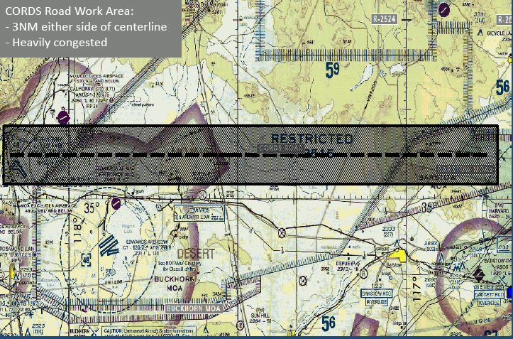
Flight Test Area
R-2515, CORDS Road, north of Edwards Air Force Base.
40 NM legs, 3 NM either side of the center line.
  13.33 minute legs at 180 knots, 16.55 minute legs at 145 knots.
  3 minute turns for “dog-bone” flight path.
15 minutes flight to start point.

Slide 22
Flight Test Profile

Slide 23
Conclusions
Preliminary laboratory testing has begun at AVSI to characterize the interference of candidate WAIC signals on commercial radio altimeters.
This data, validated by planned flight testing, is critical to the development of the WAIC SARP
The AVSI WAIC team invites the ICAO FSMP – WG/4 to consider the suitability of the experimental method to develop an acceptable SARP.

Slide 24

Comments?
Questions?
Dave Redman
  dredman@avsi.aero
  979-218-2272

