Slide 1



Aviation Frequency Spectrum
and the
ITU World Radiocommunication Conferences (WRC)
WRC-19
28 Oct – 22 Nov 2019
ICAO Regional Preparatory Group meeting
Bangkok, Thailand, 27 – 28 March 2017
Loftur Jónasson
ICAO

Slide 2
Aeronautical Frequency Spectrum Management
Accurate navigation, landing guidance, situational awareness (airborne collision avoidance system, radar, radio altimeters) weather radar and reliable communications with air traffic control are prerequisites for a safe flight

Slide 3
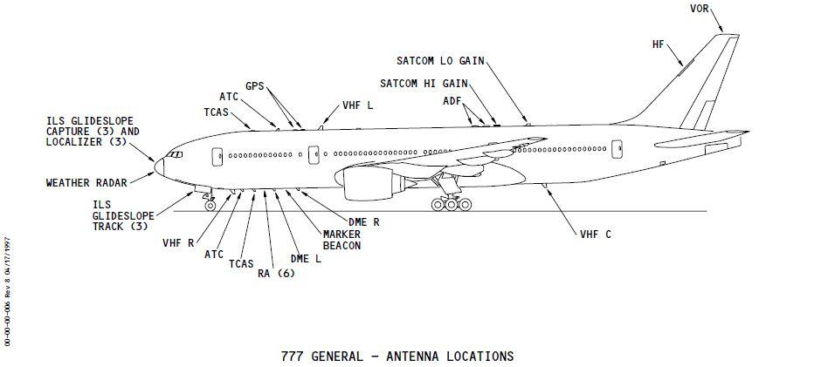
Aeronautical Frequency Spectrum Management
Accurate navigation, landing guidance, situational awareness (airborne collision avoidance system, radar, radio altimeters) weather radar and reliable communications with air traffic control are prerequisites for a safe flight

Slide 4
Aeronautical Frequency Spectrum Management
Aeronautical Frequency Spectrum Management

Slide 5






Aeronautical Frequency Spectrum Management
Scarce natural resource with finite capacity limits and constantly increasing demands
Congestion imposes the need for efficient frequency spectrum management
Spectrum management:
  combination of administrative and technical procedures
  necessary to ensure interference free and efficient operation of radio services (e.g. Air/Ground Communications and Radionavigation)

Slide 6

Aeronautical Frequency Spectrum Management
Air Transport is a rapidly growing industry:
World wide consistent growth 1970 – 2017
  >4.5% per year, on average.
  Doubles every 15 years
If aviation were a country, it would rank 21st in the world in terms of gross domestic product (GDP)
Source for statistics: Air Transport Action Group (ATAG)

Slide 7
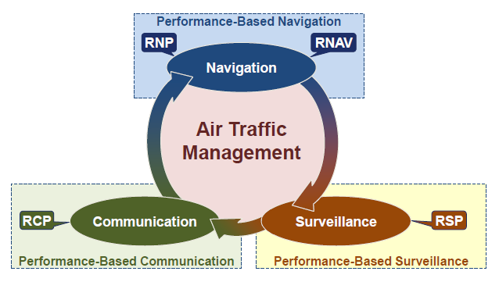
Performance of Air Traffic Management
ICAO Doc 9869 “Performance based Communication and Surveillance Manual”, Fig 1.1
is directly related to the performance of the Communication, Navigation and Surveillance systems;
which are completely dependent upon availability and access to frequency spectrum

Slide 8
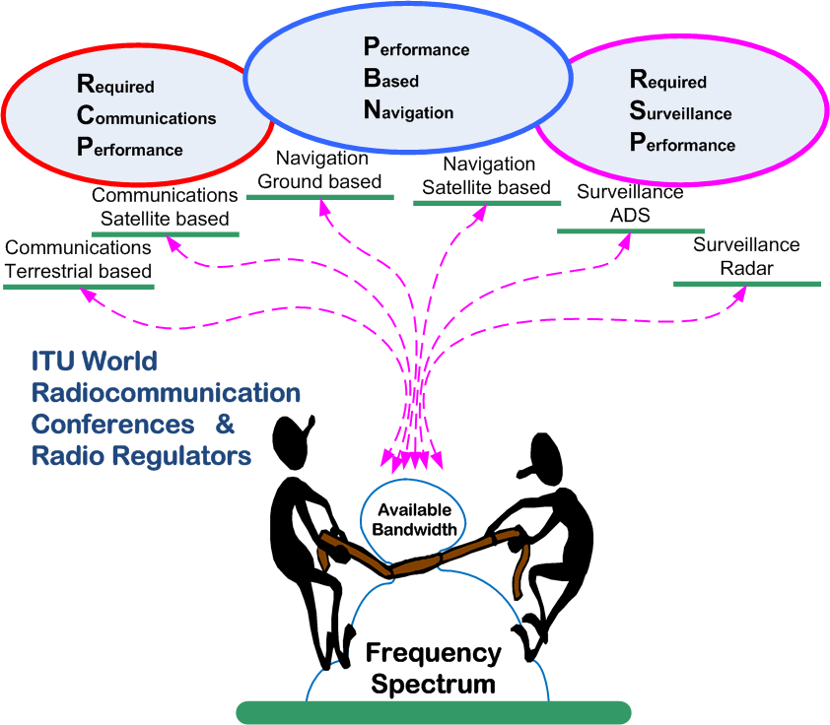
Performance of Air Traffic Management
is therefore also directly dependent on an outside programme:
  the ITU World Radiocommunication Conferences and the WRC preparatory process in the ITU and the Regional Telecommunication Organizations

Slide 9
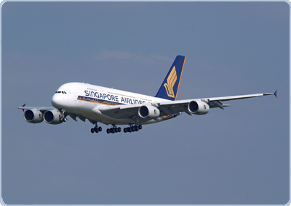

Aeronautical Frequency Spectrum Management
The highest level of Spectrum Management takes place at the ITU World Radiocommunication Conferences (WRC), held every four years:
Maintenance of the International provisions for Spectrum Management, contained in the ITU Radio Regulations (RR)
This includes maintenance of the Table of Frequency Allocations
A consequence of this is that aviation frequency managers need to develop, and lobby for an aviation position on frequency spectrum use

Slide 10






Aeronautical Frequency Spectrum Management
Co-ordination of aviation position for ITU World Radiocommunication conferences
  At the national level:
    National position is developed and co-ordinated by the National Frequency Spectrum authority. Aviation is but one of many users that lobby for attention
  At the regional level:
    National telecommunications authorities co-ordinate their position through regional organizations. Aviation representatives may not be allowed to speak up as the National Frequency Spectrum Authority has only “one official position”. ICAO is allowed to participate
  At the international level:
    National telecommunications authorities (and Regional) co-ordinate their position through the ITU-R Study Groups. Although aviation may be represented in the national delegations, they may not be allowed to speak up, as the national delegation has only “one official position”. States look to ICAO for guidance on aviation matters

Slide 11
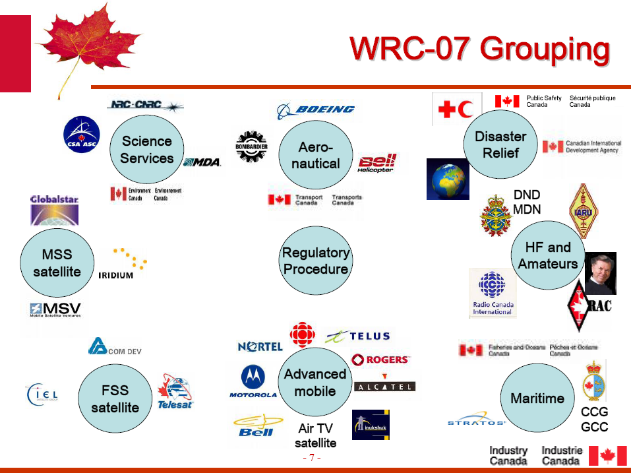
Aeronautical Frequency Spectrum Management
An old slide borrowed from the Canadian Frequency Regulator shows a good example of the many “special interest” groups represented in any national position.

Slide 12
Aeronautical Frequency Spectrum Management
    The ITU Radio Regulations update cycle
  A very competitive environment
  Aviation or any other user cannot expect preferential treatment
  Those that do their homework and participate succeed, others lose.
Definition of Radio Frequency Management:
“Radio frequency management is done by experts who meld years of experience with a curious blend of regulation, electronics, politics and not a little bit of larceny. They justify requirements, horsetrade, coerce, bluff and gamble with an intuition that cannot be taught other than by long experience.”
Vice Admiral Jon L. Boyes
U.S. Navy

Slide 13
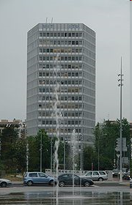
ITU in brief
UN Specialized agency, established to standardize and regulate international radio and telecommunications.
  Based in Geneva, Switzerland
  Founded on 17 May 1865
  193 Member States, 800 Sector members and associates
  >700 staff, ~90 nationalities

Slide 14

ITU in brief
Radio Regulations
International treaty:
  Facilitate equitable access to and rational use of the radio frequency spectrum and the geostationary orbit
  Ensure availability and protection from harmful interference of frequencies for distress and safety purposes
  Assist in prevention and resolution of cases of harmful interference
  Facilitate efficient and effective operation of radiocommunications services
  Provide for, and regulate new applications of telecommunications technology

Slide 15
ITU in brief
Radio Regulations
Contents of the Radio Regulations:
  A set of regulatory provisions addressing the major topics of:
  Definitions for services and technical features related to spectrum and frequency planning
  Frequency Allocations to services
  Procedures for coordination and registration of frequencies
  Provisions for distress and safety communications
  Provisions for individual radio services (including Aeronautical Services)
  Interference – reporting and clearance
  Administrative provisions, including licensing
  Together with:
  Appendices (30) addressing planning, technical parameters and operational procedures
  Resolutions and Recommendations

Slide 16


ITU WRCs
General Overview
WRCs update the International Radio Regulations
Held every 4 years
  Last was in Nov 2015
  Next in Oct-Nov 2019
Main purposes:
  To revise the Radio Regulations (RR); and
  To address Radiocommunication issues of a worldwide character.
Radio Regulations: International treaty governing the use of the Radio Frequency Spectrum
Why participate at World Radiocommunication Conferences:
  To protect existing services
  To obtain access to spectrum for new services and enhance spectrum access for existing services
  To facilitate market access for radio equipment manufacturers; and
  To provide regulatory certainty to operators.

Slide 17
ITU WRCs
WRC-15 in numbers
Participation: 3300 delegates
Budget of ~$7 million US Dollars
4 weeks (5 ½ weeks counting RA-15 and CPM19-1)
  162 Administrations
  5 regional telecommunication organizations
  6 intergovernmental organizations
  3 UN specialized agencies (ICAO, IMO, WMO)
  >115 other international/regional, scientific and industrial agencies or organizations.
  Over 50 meetings/day, including weekends.
  6AM – Latest finish to a Plenary session
  9AM - …start time the next (same) morning.
No definition on RA-07 and CPM

Slide 18
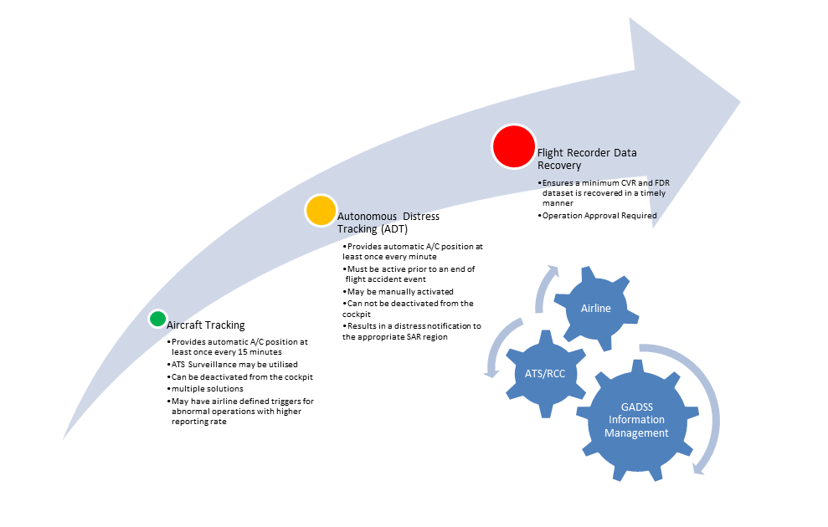
WRC-15
Main Results for Civil Aviation (1)
Global Flight Tracking and GADSS:
  A new allocation for space based reception of ADS-B, enabling tracking of aircraft globally, including remote and polar regions
  An agenda item for WRC-19, to consider spectrum needs and regulatory provisions for the introduction and use of the Global Aeronautical Distress and Safety System (GADSS)

Slide 19

WRC-15
Main Results for Civil Aviation (2)
Better regulatory protection of Fixed Satellite Service (FSS) VSAT links used in Africa and Indian Ocean to provide terrestrial aeronautical and meteorological communications networks
                VSAT networks for aeronautical ground-ground telecommunications are in wide use in both Africa and Central/South America
Tamba
Bamako
NMY
Kano
NDJ
Abidjan
Accra
Cotonou
Lagos
Bangui
Malabo
Douala
Libreville
Brazzaville
Station B (11 M)
Mahga
Antsirana
Station F2 (7m30)
Station F1 (3m60)
Tana
Toamasina
Toliara

Slide 20
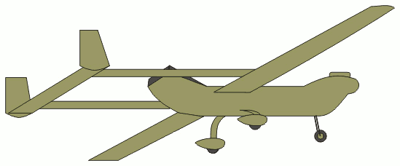
WRC-15
Main Results for Civil Aviation (3)
New regulatory provisions related to earth stations on-board unmanned aircraft which operate with geostationary satellite networks in the fixed satellite service (FSS)
              A delicate compromise achieved by the conference. It provides the ICAO Remotely Piloted Aircraft Systems Panel (RPASP) with a set of conditions to develop SARPs against – or to identify showstoppers, if any. It is expected that WRC-23 will revisit the issue, based on the outcome of the ICAO studies

Slide 21
WRC-15
Main Results for Civil Aviation (4)
Other positive outcomes achieved:
  Full protection of primary surveillance radar spectrum and the frequency band used by aeronautical radio altimetes
  Increased regulatory protection for the COSPAS/SARSAT
  A new allocation for Wireless Avionics intra-communications, a potential enabler for safer and more fuel efficient aircraft.

Slide 22
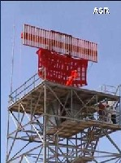
WRC-15
Main Results for Civil Aviation (5)
In general, conference results conformed to the ICAO Position. Major factors contributing to this include:
Early development and dissemination of the draft ICAO Position
Active participation by national aviation experts and ICAO in the preparatory work of the ITU, including the relevant meetings of the ITU-R
ICAO participation (from HQ and regional offices) in meetings of the regional telecommunication organizations
Increased awareness in the Regions through FSMP meetings and ICAO Radio Frequency Workshops in the Regions
Active Participation of the ICAO Delegation at WRC-15 allowed ICAO to counter and refute proposals which would have adversely impacted aeronautical spectrum

Slide 23
Management and Defense of Aviation Frequency Spectrum
ICAO Frequency Spectrum Strategy:
  High level vision on existing and future spectrum requirements in support of the evolving CNS systems and infrastructure requirements
ICAO Frequency Policy Statements:
  Statements of official policy on each and every frequency band used by aeronautical systems for the provision of CNS
ICAO Position for WRC:
  ICAO Position on the specific agenda items of the upcoming ITU WRC to ensure that aeronautical requirements and safety concerns are met
Strategy for establishing and promoting the ICAO WRC Position (including Assembly Resolution A38-6)

Slide 24
ICAO Spectrum Strategy
(as per AN-Conf/12 Recommendation 1/12)
e) develop and implement a comprehensive aviation frequency spectrum strategy to be referenced to the GANP, which includes the following objectives:
  timely availability and appropriate protection of adequate spectrum to create a sustainable environment for growth and technology development to support safety and operational effectiveness for current and future operational systems and allow for the transition between present and next generation technologies
  demonstrate efficient use of the spectrum allocated through efficient frequency management and use of best practices; and
  clearly state in the strategy the need for aeronautical systems to operate in spectrum allocated to an appropriate aeronautical safety service;
Now contained in ICAO Doc 9718, Vol I (First Edition, 2014), chapter 8.

Slide 25
ICAO Spectrum Policy Statements
A WRC is limited to certain issues and certain frequency bands. The ICAO position only addresses spectrum usage in context with issues identified in the pre-set WRC agenda.
The ICAO Policy Statements however, indicate overall ICAO policy for each and every frequency band used by aviation safety services
The Policy Statements are “Official ICAO Policy”, approved by Council. Latest revision of the policy statements was done together with the development of the ICAO Position.
Included in Doc 9718, Vol I, the “Handbook on Radio Frequency Spectrum Requirements for Civil Aviation”

Slide 26
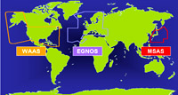
ICAO Position and WRC preparations (1)
Strategy for establishing and promoting the ICAO Position for future ITU WRCs - ICAO Doc 9718, Vol I, Attachment E
ICAO Position is established as early as possible after the agenda for that WRC is established
The Position presents ICAO views on all agenda items of interest to international civil aviation on the agenda of the WRC, with particular regard to the impact on safety, regularity and efficiency of flight
Focal point on all aspects related to the development of the ICAO Position is the Frequency Spectrum Management Panel.
Proper co-ordination with ICAO Regional Offices
  (Bangkok, Cairo, Dakar, Lima, Mexico, Nairobi, Paris)

Slide 27
ICAO Position and WRC preparations (2)
Draft Position is reviewed by the ICAO Air Navigation Commission (ANC), sent to States and relevant International Organizations for comments, and a consolidated ICAO Position is submitted to ANC and Council for approval
Approved Position is sent to States for use in the States’ own internal coordination process, when developing national positions
Following development of the Position, consequential amendments to Spectrum Strategy and Policy Statements are developed for approval by the Council
Subsequent developments arising from ICAO and ITU activities in preparation for the WRC are considered by the Council with a view to update the Position as necessary

Slide 28
ICAO Position and WRC preparations (3)
Guidance for the promotion of the ICAO position
Assembly Resolution A38-6 shall be fully implemented so as to secure support from States to the ICAO Position and ensure that the resources necessary to support increased participation by ICAO to international and regional spectrum management activities are made available.
ICAO contributes to the WRC preparatory activities conducted by ITU and Regional Telecommunications Organizations, by submitting additional technical papers supporting the ICAO Position
ICAO maintains close co-ordination and co-operation with other aviation organizations participating in the Conference, such as IATA
Regional ICAO co-ordination meetings to present and discuss the ICAO Position should be organized as required. These meetings to be held in conjunction with meetings of FSMP

Slide 29
ICAO Position and WRC preparations (4)
Assembly Resolution A38-6 (part 1)
  Urges Member States, international organizations and other civil aviation stakeholders to support firmly the ICAO frequency spectrum strategy and the ICAO position at WRCs and in regional and other international activities conducted in preparation for WRCs, including by the following means:
    working together to deliver efficient aeronautical frequency management and “best practices” to demonstrate the effectiveness and relevance of the aviation industry in spectrum management;
    supporting ICAO activities relating to the aviation frequency spectrum strategy and policy through relevant expert group meetings and regional planning groups;
    undertaking to provide for aviation interests to be fully integrated in the development of their positions presented to regional telecommunications fora involved in the preparation of joint proposals to the WRC;
    including in their proposals to the WRC, to the extent possible, material consistent with the ICAO Position;

Slide 30
ICAO Position and WRC preparations (5)
Assembly Resolution A38-6 (part 2)
    supporting the ICAO position and the ICAO policy statements at ITU WRCs as approved by Council and incorporated in the Handbook on Radio Frequency Spectrum Requirements for Civil Aviation (Doc 9718);
    undertaking to provide civil aviation experts to fully participate in the development of States’ and regional positions and development of aviation interests at the ITU; and
    ensuring, to the maximum extent possible, that their delegations to regional conferences, ITU study groups and WRCs include experts from their civil aviation authorities and other civil aviation stakeholders who are fully prepared to represent aviation interests;
  Requests the Secretary General to bring to the attention of ITU the importance of adequate radio frequency spectrum allocation and protection for the safety of aviation; and
  Instructs the Council and the Secretary General, as a matter of high priority within the budget adopted by the Assembly, to ensure that the resources necessary to support the development and implementation of a comprehensive aviation frequency spectrum strategy as well as increased participation by ICAO in international and regional spectrum management activities are made available.

Slide 31
Current Status of Work
ICAO Position was developed by FSMP in 2016, reviewed by the Air Navigation Commission and sent to States for comments (1 Dec 2016)
Position to be finalized by FSMP WG/4 in March-April 2017, based on feedback from States – for subsequent final review by the Air Navigation Commission in May 2017.
Position then to be approved by ICAO Council and disseminated to States and International Organizations

Slide 32
Thank You!

