Slide 1

Aerospace Vehicle Systems Institute
WAIC Radio Altimeter Interference Susceptibility Testing
Texas A&M Engineering
Experiment Station
Michael Franceschini
ICAO FSMP WG 4, ICAO APAC
March 29 - April 7 2017

Slide 2
Overview of Radio Altimeter Interference Susceptibility Testing
Purpose: Derive meaningful SARP guidelines
  Determine incident interference power limits to fielded RadAlts that ensure their continued safe operation
    The 5 RA models identified cover the installed ATR base
    Identifying a single worst case limit yields a unified RA SARP, simplifies any WAIC coexistence analyses & constraints
  Understand the behavior of unique RA algorithms in the presence of various forms of interference signal types
    Provides guidance for preferred WAIC signal designs
    Will help understand aggregation, multi-channel impacts
Initial assessment: RAs seem robust against anticipated WAIC interference levels
  Should yield reasonable WAIC installation criteria

Slide 3
Laboratory & Flight Tests Status
Test Rack (for flight test) is Complete & Calibrated
Uses DO-155 External Loop Loss, 45 deg BW (G=20) to set desired return signal levels
Tests will span RA operational altitude limits
  500, 1500, 3000, 5000, 8000 feet (ARINC 429 max)
  Practical operation limits around 5000 feet
  Tested 3 RA types at 508 feet to date
Carrier frequencies of 4240, 4300, 4360 MHz.
Four waveform types planned (Rec m.2067)
  Single Channel types: 802.15.4 MSK, 802.11a/g OFDM
  Multichannel effects: Dual MSK, Dual OFDM
    Rationale: assess band occupancy scalability (duty cycle effect)

Slide 5
Tabular Summary of Test Cases
Radio Altimeter Model
Height | WAIC Waveforms
 | Single Carrier |  |  | Dual Carrier MSK |  |  | Single Channel OFDM |  |  | Dual Channel OFDM
 | 4.3 GHz | 4.24 GHz | 4.36 GHz | 4.3 GHz | 4.24 GHz | 4.36 GHz | 4.3 GHz | 4.24 GHz | 4.36 GHz | 4.3 GHz | 4.24 GHz | 4.36 GHz
500 ft.
1500 ft.
3000 ft.
5000 ft.
8000 ft.
Cells entries can be filled with: level of first perturbation, accuracy spec exceeded, NCD limit

Slide 6
Initial Lab Test Results
All RAs seem to perform well in the presence of single constant envelope interference signals
  Operate at 508 feet with higher than practical WAIC signal levels (good for landing scenarios)
    consider 45 dB LOS path loss at 1m & 17 dBm P_{TX} max
  Tests span full interference level ranges of concern
    well above M.2059 specified receiver compression point
Must consider transient interference responses as well as steady state (WAIC burst effects)
  algorithmic differences, overload recovery times…
Each RA model has unique degradation modes

Slide 7
ALA 52B Single Carrier MSK Test
VSG | Ratio | WAIC Waveform |  |  |  |  |  | Interference
Output | VSG Signal | Single MSK - 2 Mcps (802.15.4) Low Rate: 5 MHz bandwidth |  |  |  |  | Standard | at RadAlt Rcvr | I/S
Signal | to | 4.3 GHz |  |  |  |  | Deviation
Strength | RA Signal | ARINC 429 (Feet)
dBm |  | Min | Max | Mean | Variance | Max % Err
-8 |  |  |  |  |  |  |  | dBm | dB
-6
-4
-2
0
2
4
6
8
10
508 Ft Altitude; xx dB VSG-to-RadAlt

Slide 8
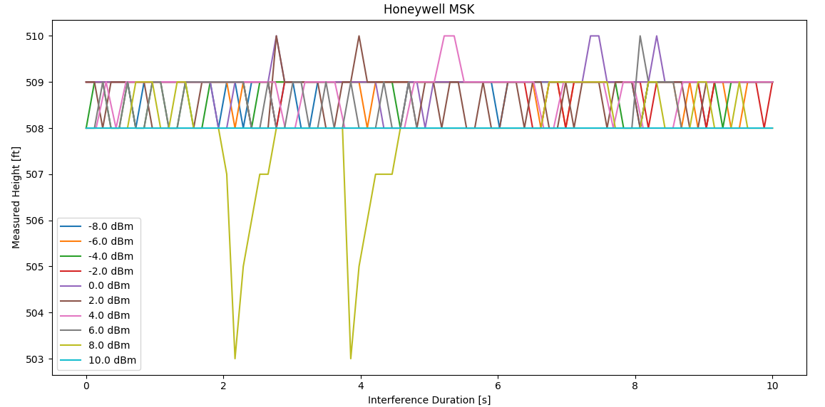
ALA 52B Single Carrier MSK Test
Note: Accuracy Spec is +/- 10 ft
+10 dBm is NCD
508 Ft Altitude; 25 dB VSG-to-RadAlt

Slide 9
LRA 900 Single Carrier MSK Test
-8 dBm VSG
Note: Accuracy Spec is +/- 10 ft
508 Ft Altitude; xx dB VSG-to-RadAlt

Slide 10
Accuracy Spec is +/- 10 ft

Slide 15
Initial Multi-Carrier Test Issues
All 3 cases revealed unexpected RA behaviors
  Performance did not scale linearly with I bandwidth
Warrants further investigation, focused tests

Slide 16
Next Step Test Plans
Performance at higher Altitudes
  RA return signal strength decreases, I/S increases
  Accuracy limits increase (+/- 2% of altitude)
  Should also be lower interference levels experienced
Repeat all tests at lower and upper band edges
  4240 MHz, 4360 MHz are near FMCW sweep limits
  Some variations across band have been witnessed
Might assess expanded multi-channel cases
  For higher duty-cycle occupancy impacts, if not deemed to be linearly scalable with # of channels
  Variations in relative amplitudes on each channel

Slide 17
Potential Expanded Tests
Out-of-band interference susceptibility
  Rec M.2059 only estimated bandpass filter rolloffs
  Meaningful frequencies need to be determined
  Standalone, multichannel out-of-band…
  Simultaneous with in-band interference from WAIC
Identify other critical altitude breakpoints in algorithms (unique to each RA model)
Pulsed altimeter susceptibility (bizjet, GA)
Effects of combined WAIC & multiple RA sources
Additional waveform types; mixed modes
Other suggestions ?

Slide 18
Summary Comments on RA Interference Susceptibility
Lab test is ongoing and initial results are promising for WAIC compatibility
  Highly tolerant to constant envelope signals
  Need to proceed to higher altitude performance
Must further evaluate multi-channel cases
Many more cases may need to be addressed
SARPs may only need single NTE constraint
  Interference incident <“x”dBm, RA must tolerate “x”dB
  May still need to spec aggregation limits (TBD)
    For example, # of signals at “x”, or sum total of all to ”y”…..

