Slide 1
Regional Preparations for WRC-19
Asia-Pacific Telecommunity
(ITU Geographic Region – Region 3)
APAC Regional Preparatory Group (RPG) Meeting for WRC-19
Bangkok, 27-28 March 2017

Slide 2

Presented by
Eddy D’Amico
developed based on the report of the 1st meeting of the
APT Preparatory Group for WRC-19
(APG19)

Slide 3
Contents
APT Preparatory Group for WRC-19 (APG19)
Process of developing APT Common Proposals
WRC-19 Agenda items of interest to aviation
APT developments on WRC-19 Agenda items of interest to aviation
Preparations for next meeting of the APG19

Slide 4
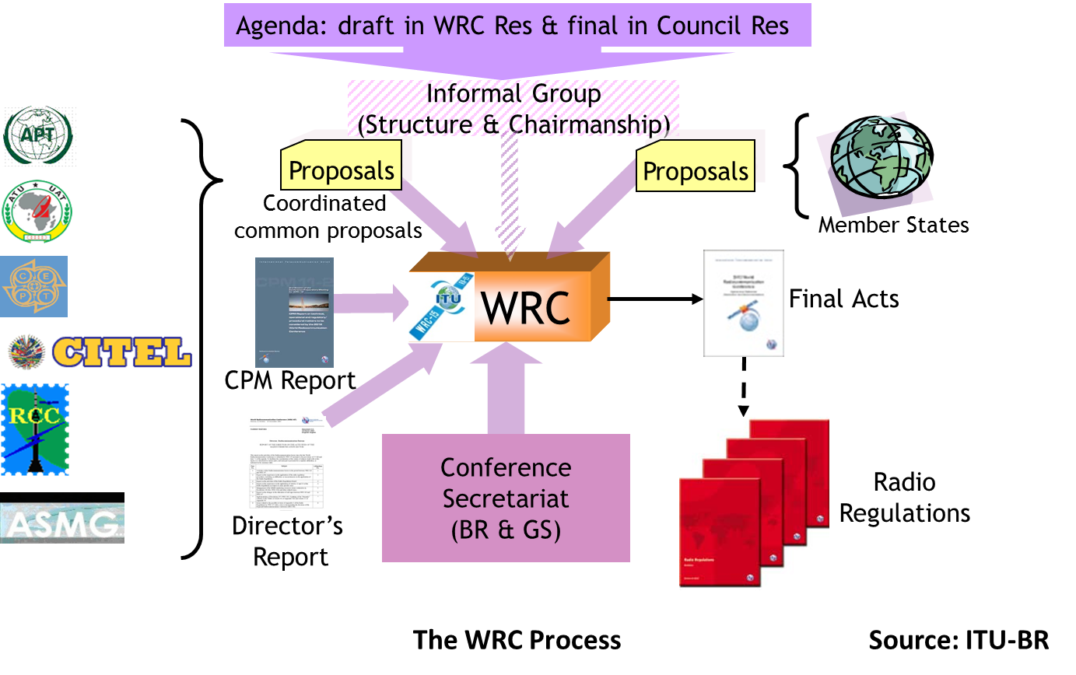
APT Preparatory Group for WRC-19

Slide 5
APT Preparatory Group for WRC-19
Preparatory activities for WRC-19 were started in 2016
  1st meeting was held 26-28 July 2016 in Chengdu, People's Republic of China
  2nd meeting is to be held 17-21 July 2017 in Bali, Indonesia
  Three further meetings scheduled before the conference in 2019
Chairman:
  Dr. Kyu-Jin Wee (Republic of Korea)
Vice Chairs:
  Mr. Neil Meaney (Australia)
  Mr. Xiaoyang Gao (People's Republic of China)
Editorial Chair:
  Dr. Tommy Chee (New Zealand)
Special Senior Adviser to the APG:
  Mr. Kavouss Arasteh (Islamic Republic of Iran)

Slide 6
APG19-1 Meeting Outcomes
The following were achieved:
  Key outcomes RA-15, WRC-15 and CPM19-1 reviewed
  Chairman and Vice-Chairmen of APG elected
  APG19 structure established and Working Party Chairmen appointed
  APG working methods reviewed
  An initial review of issues associated
  with each WRC-19 AI undertaken
  APG work plan including tentative
  schedule of meetings developed
Composition of meeting:
  273 delegates from 24 of 38 APT Member countries
  45 delegates from Affiliate/Associate Members, Regional Organisations and APT staff

Slide 7
APG19-1 Meeting Outcomes
Election of Chairman
  The main focus of the meeting was to find a way forward in appointing a Chairman of APG19
  2 competent individuals nominated: KJ Wee (Korea) and Kavouss Arasteh (Iran)
  Consensus at the meeting was that important for APG to retain the services of both candidates
  Finally agreed that role as ‘Special Senior Advisor to the APG’ to be conferred on Mr Arasteh with Dr Wee being appointed APG19 Chairman
Election of Vice-Chairmen
  2 nominations for the 2 positions of Vice-Chairmen agreed:
    Mr Neil Meaney (Australia)
    Mr Gao Xiaoyang (People’s Republic of China)

Slide 8
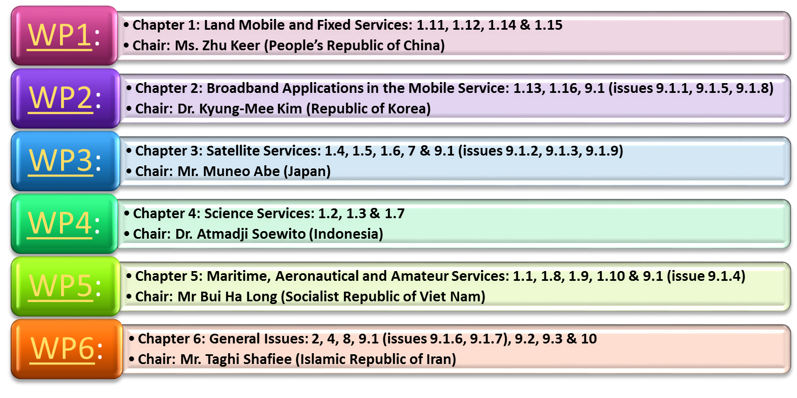
APG19-1 Meeting Outcomes
APG Structure is same as CPM Chapter Structure

Slide 9
Process of Developing ACPs
In general, the APT organises five APG meetings in each WRC preparatory cycle (currently 2016 – 2019)
The APG meetings develop and update APT Preliminary Views (APVs) on WRC agenda items based on:
  ITU-R studies that are available
  Input contributions from Members
A two stage procedure is followed for preparing and approving APT Common Proposals (ACPs) for submission to the WRC

Slide 10
Process of Developing ACPs
Stage 1:
  Based on the APT Preliminary Views (APVs) on Agenda Items
  → WPs at the 5th and final APG meeting develop proposals
  For each proposal, if consensus is reached at Plenary by APT Members attending the meeting, the proposal becomes a Preliminary APT Common Proposal (PACP)
Stage 2:
  All APT Member administrations (38) are then requested to indicate if their country name is to be included as a signatory for each PACP
  A PACP becomes APT Common Proposal (ACP) if it is
    Supported by at least 25% of the APT Members (Administrations)
    And not opposed by 50% of the number of Members who support it

Slide 11
Process of Developing ACPs
Active support from APAC aeronautical spectrum experts is vital to ensure ACPs reflect civil aviation’s continued need for spectrum:
  Assembly Resolution A38-6 (Support of the ICAO Policy on radio frequency spectrum matters)
  12th Air Navigation Conference Recommendation 1/12 (Development of the aeronautical frequency spectrum resource)
  APANPIRG Conclusion 27/45 (Preparations for WRC-19)
Need to actively participate in domestic process in developing State positions
Attend APG meetings supporting aviation views

Slide 12
Work on APVs
The APVs on WRC-19 agenda items will commence development at the next meeting of the APG19
  APG19-2 from 17-21 July 2017 in Bali, Indonesia
Need your help to develop APVs on WRC-19 Agenda items of most interest to aviation
  Agenda Items of particular importance: AIs 1.10 and 9.1
  (issue 9.1.4)
  Agenda Items of concern: AIs 1.7, 1.8, 1.9 (issues 1.9.1 & 1.9.2), 1.11, 1.12, 1.13, 1.14, 1.16, 4, 8, 9.1 (issues 9.1.3 & 9.1.6)
  and 10

Slide 13
WRC-19 AIs related to aviation
Agenda items related to specific aviation issues
  AI 1.10 - Spectrum & regulatory provisions for GADSS
  AI 9.1 (issue 9.1.4) - Stations on board sub-orbital vehicles
Agenda items in which aviation is a concerned party
  Land Mobile and Fixed Services: AIs 1.11, 1.12 & 1.14
  Broadband Applications in the Mobile Service: AIs 1.13 & 1.16
  Science Services: AI 1.7
  Maritime Services: AIs 1.8 & 1.9 (issues 1.9.1 & 1.9.2)
  Satellite Services: AI 9.1 (issue 9.1.3)
  General: AIs 4, 8, 9.1 (issue 9.1.6) and 10

Slide 14
AIs of Particular Importance
Agenda Items of particular importance to aviation
  AI 1.10 - Spectrum & regulatory provisions for GADSS
  AI 9.1 (issue 9.1.4) - Stations on board sub-orbital vehicles

Slide 15
Agenda Item 1.10 (GADSS)
“to consider spectrum needs and regulatory provisions for the introduction and use of the Global Aeronautical Distress and Safety System (GADSS), in accordance with Resolution 426 (WRC‑15)”
  Aviation lead
  Aviation view: Support regulatory changes that enhance the GADSS concept, while ensuring protection of aviation systems
APT Preliminary Views:
  TBD
  Candidates for DG Chairmen (DG 5-5)
  co-chaired by
    [Mr Sungchul Chae – Korea]
    [Dr Suryanegara Muhammad – Indonesia]

Slide 16
Agenda Item 9.1 (Issue 9.1.4)
(Space Planes)
“to consider and approve the Report of the Director of the Radiocommunication Bureau, in accordance with Article 7 of the Convention: on the activities of the Radiocommunication Sector since WRC‑15
Issue 9.1.4 - Resolution 763 (WRC‑15) - Stations on board sub-orbital vehicles”
  Study technical and operational measures that could assist in avoiding harmful interference between radiocommunication services
  Determine spectrum requirements and, based on the outcome of those studies, to consider a possible future agenda item for WRC-23
  Aviation view: Ensure protection of aviation systems
APT Preliminary Views:
  TBD
  Candidates for DG Chairmen (DG 5-6)
  TBD

Slide 17
Agenda Items of Concern
Agenda items in which aviation has concerns of spectrum access by other services, compatibility with other services or protection from interference
  1.7, 1.8, 1.9 (issues 1.9.1 & 1.9.2), 1.11, 1.12, 1.13, 1.14, 1.16 and 9.1 (issue 9.1.3)
Agenda items where the future interests of aviation need to be promoted and taken into account
  4, 8, 9.1 (issue 9.1.6) and 10

Slide 18
Agenda Item 1.7 (TT&C for short duration NGSO)
“to study the spectrum needs for telemetry, tracking and command in the space operation service for non-GSO satellites with short duration missions, to assess the suitability of existing allocations to the space operation service and, if necessary, to consider new allocations, in accordance with Resolution 659 (WRC-15)”
  Aviation view: Protect aviation use of 150.05-174 MHz and 400.15-420 MHz (e.g. 406 MHz)
APT Preliminary Views:
  TBD
Candidates for DG Chairmen (DG 4-3)
  Mr Nguyen Huy Cuong – Vietnam

Slide 19
Agenda Item 1.8 (GMDSS)
“to consider possible regulatory actions to support Global Maritime Distress Safety Systems (GMDSS) modernization and to support the introduction of additional satellite systems into the GMDSS, in accordance with
Resolution 359 (WRC-15)”
  Aviation view: Support GMDSS improvements, but monitor to ensure no impact to aviation systems – if GMDSS targets AMS(R)S bands then ensure AMS(R)S maintains priority
APT Preliminary Views:
  TBD
Candidates for DG Chairmen (DG 5-2)
  co-chaired by
    [Mr Byungok Kim – Korea]
    [Mr Zhao Xiao Dong – China]

Slide 20
Agenda Item 1.9 (Issue 1.9.1) (Autonomous maritime radio devices in 156-162.05 MHz)
“to consider, based on the results of ITU‑R studies:
Issue 1.9.1 - regulatory actions within the frequency band
156-162.05 MHz for autonomous maritime radio devices to
protect the GMDSS and automatic identifications system
(AIS), in accordance with Resolution 362 (WRC-15)”
  Aviation view: Support GMDSS improvements, but monitor to ensure no impact to aviation systems
APT Preliminary Views:
  TBD
Candidates for DG Chairmen (DG 5-3)
  [Mr Hu Bo – China]

Slide 21
Agenda Item 1.9 (Issue 1.9.2)
(VDES satellite component)
“to consider, based on the results of ITU‑R studies:
Issue 1.9.2 - modifications of the Radio Regulations, including new
spectrum allocations to the maritime mobile-satellite service
(Earth‑to‑space and space-to-Earth), preferably within the frequency
bands 156.0125-157.4375 MHz and 160.6125-162.0375 MHz of
Appendix 18, to enable a new VHF data exchange system (VDES)
satellite component, while ensuring that this component will not
degrade the current terrestrial VDES components, applications
specific messages (ASM) and AIS operations and not impose any
additional constraints on existing services in these and adjacent
frequency bands as stated in recognizing d) and e) of Resolution 360
(WRC-15)”
  Aviation view: Support enhanced maritime communications, but monitor to ensure no impact to aviation systems
APT Preliminary Views:
  TBD
Candidates for DG Chairmen (DG 5-4)
  [Mr Yoshio Miyadera – Japan]

Slide 22
Agenda Item 1.11 (Railway)
“to take necessary actions, as appropriate, to facilitate global or regional harmonized frequency bands to support railway radiocommunication systems between train and trackside within existing mobile service allocations, in accordance with Resolution 236 (WRC-15)”
  Aviation view: Ensure protection of aviation systems
APT Preliminary Views:
  TBD
Candidates for DG Chairmen (DG 1-1)
  [Mr Liu Bin – China]
  [Dr Andrei Qiantori – Indonesia]
  [Mr Nguyen Anh Tuan – Vietnam]

Slide 23
Agenda Item 1.12 (ITS)
“to consider possible global or regional harmonized frequency bands, to the maximum extent possible, for the implementation of evolving Intelligent Transport Systems (ITS) under existing mobile-service allocations, in accordance with Resolution 237 (WRC-15)”
  Aviation view: Ensure protection of aviation systems
APT Preliminary Views:
  TBD
  Candidates for DG Chairmen (DG 1-2)
  [Mr Satoshi Oyama – Japan]
  [Mr Suppapol Jaroonvanichkul – Thailand]

Slide 24
Agenda Item 1.13 (IMT-2020)
“to consider identification of frequency bands for the future development of International Mobile Telecommunications (IMT), including possible additional allocations to the mobile service on a primary basis, in accordance with Resolution 238 (WRC-15)”
  Studies on frequency-related matters for IMT identification including possible additional allocations to the mobile services on a primary basis in portion(s) of the frequency range
  24.25 - 86 GHz
  Aviation view: Monitor to make sure no impact on commercial systems used by civil aviation
APT Preliminary Views:
  TBD
Candidates for DG Chairmen (DG 2-1)
  Dr Hiroyuki Atarashi – Japan

Slide 25
Agenda Item 1.14 (HAPS)
“to consider, on the basis of ITU‑R studies in accordance with Resolution 160 (WRC-15), appropriate regulatory actions for high-altitude platform stations (HAPS), within existing fixed-service allocations”
  Aviation view: If studies show no impact on aviation systems, support concept of using UAS/RPAS for HAPS platform, provided no constraint on future use of HAPS fixed links for aeronautical communications
APT Preliminary Views:
  TBD
Candidates for DG Chairmen (DG 1-3)
  [Dr Andri Qiantori – Indonesia]
  [Mr Nguyen Anh Tuan – Vietnam]
  [Mr Mahdi Abyaneh Nazari – Iran]

Slide 26
Agenda Item 1.16 (RLAN)
“to consider issues related to wireless access systems, including radio local area networks (WAS/RLAN), in the frequency bands between 5 150 MHz and 5 925 MHz, and take the appropriate regulatory actions, including additional spectrum allocations to the mobile service, in accordance with Resolution 239 (WRC-15)”
  Aviation view: Ensure any changes near 5 150 MHz do not impact AeroMACS below that frequency and protect ARNS in 5 350-5 470 MHz
APT Preliminary Views:
  TBD
Candidates for DG Chairmen (DG 2-2)
  [Dr Fang Jicheng – China]

Slide 27
Agenda Item 4
(Review WRC Res. and WRC Rec.)
“in accordance with Resolution 95 (Rev.WRC‑07), to review the resolutions and recommendations of previous conferences with a view to their possible revision, replacement or abrogation”
  Review of WRC Resolutions and WRC Recommendations
APT Preliminary Views:
  TBD
Candidates for DG Chairmen (DG 6-1)
  Dr Akira Hashimoto – Japan

Slide 28
Agenda Item 8 (Country footnotes)
“to consider and take appropriate action on requests from administrations to delete their country footnotes or to have their country name deleted from footnotes, if no longer required, taking into account Resolution 26 (Rev.WRC-07)”
  Review of Country footnotes
APT Preliminary Views:
  TBD
Candidates for DG Chairmen (DG 6-2)
  Dr Arifin Nugroho – Indonesia

Slide 29
Agenda Item 9.1 (Issue 9.1.3)
(C-Band NGSO-FSS Operations)
“to consider and approve the Report of the Director of the Radiocommunication Bureau, in accordance with Article 7 of the Convention: on the activities of the Radiocommunication Sector since WRC‑15
Issue 9.1.3 - Resolution 157 (WRC-15) - Study of technical and
operational issues and regulatory provisions for new non-
geostationary-satellite orbit systems in the 3 700-4 200 MHz, 4 500-
4 800 MHz, 5 925-6 425 MHz and 6 725-7025 MHz frequency
bands allocated to the fixed-satellite service”
  Aviation view: Ensure no impact on aviation use in those bands and protection of aviation systems in 4 200-4 400 MHz
APT Preliminary Views:
  TBD
Candidates for DG Chairmen (DG 3-6)
  Mrs Cheng Fenhong – China

Slide 30
Agenda Item 9.1 (Issue 9.1.6)
(Wireless Power Transmissions)
“to consider and approve the Report of the Director of the Radiocommunication Bureau, in accordance with Article 7 of the Convention: on the activities of the Radiocommunication Sector since WRC‑15
Urgent studies required in preparation for the 2019 World
Radiocommunication Conference
Issue 9.1.6 - Issue 1) in the Annex to Resolution 958 (WRC-15)”
  Studies concerning Wireless Power Transmissions (WPT) for electric vehicles
  Aviation view: Ensure aviation systems considered in studies
APT Preliminary Views:
  TBD
Candidates for DG Chairmen (DG 6-3)
  Mr Satoshi Kobayashi – Japan

Slide 31
Agenda Item 10 (Future WRC AIs)
“to recommend to the Council items for inclusion in the agenda for the next WRC, and to give its views on the preliminary agenda for the subsequent conference and on possible agenda items for future conferences, in accordance with Article 7 of the Convention”
  Development of APT proposal to WRC-19 on future WRC AIs
  Resolution 810 (WRC-15) details preliminary agenda for WRC-23
APT Preliminary Views:
  TBD
Candidates for DG Chairmen (DG 6-5)
  TBD

Slide 32
Schedule of APG19 Meetings
The 2nd meeting of the APG (APG19-2) will be held for 5 days from 17-21 July 2017 in Bali, Indonesia
The 3rd meeting of the APG (APG19-3) will be held in [Q2/Q3] of 2018 [TBC]
The 4th meeting of the APG (APG19-4) will likely be held in [Q1] of 2019 [TBC]
The 5th meeting of the APG (APG19-5) will likely be held in [Q3] of 2019 [TBC]
Notes:
This slide provides the schedule for the remaining 4 meetings of the APG19
The next meeting will take place in Bali, Indonesia from 17-21 July 2017

Slide 33
Work Plan for APG19-2
Finalise APG coordinators for WRC-19 Agenda Items
Review the progress of studies in ITU-R Study Groups on WRC-19 Agenda items
Develop APT’s Preliminary Views on WRC-19 Agenda Items based on result of Member’s contribution and study results available at ITU-R Study Groups
Develop APT’s views on RA-19 related issues
[Meeting Invitation: www.aptsec.org/2017-APG19-2]

Slide 34

APG Documents are available at:
www.aptsec.org/APTAPG
Thank you!

