Slide 1
GNSS RFI Source Localization using Flight Track Data
Gerhard BERZ
Focal Point Navigation Infrastructure
ATM Directorate, Research & SESAR Division, NAV & CNS Unit
gerhard.berz@eurocontrol.int
ICAO EUR FMG / WRC-19 Workshop
Paris, 12 September 2017

Slide 2
Overview
ICAO GNSS RFI Mitigation Plan (Doc 9849)
  Published April 2017
Detecting GNSS Outages
  From passive threat monitoring to active intervention in case of relevant events
Determination of Probable Cause
  Elimination of Non-RFI Causes
Localization and Elimination of RFI Source
  Supporting the chain of detection (Operator / ANSP) to confirmation, characterization and localization (radio regulator) to elimination (law enforcement)

Slide 3
Moving from Vulnerability to Mitigation
Objective of RFI Mitigation Plan
  Define set of activities for States to ensure that risks to aviation from GNSS RFI are sufficiently mitigated
  Checklists of set of activities to be considered
  Much is already in place, State to decide depending on local environment
  Not intended to impose a significant workload or investment
  To enable reliance on GNSS and associated aviation benefits
Focused on States
  Spectrum a sovereign responsibility
  Regulation and enforcement part of national oversight
  Framework to encourage coordination and exchange of best practices
  Supported by regional and global mechanisms due to system nature

Slide 4
Mitigation Plan Framework
Assess Risks
Scenario Variation & Escalation
Impact Assessment
Identify Existing Barriers
2
Monitor Threats
Proactive & Reactive Monitoring
Environment Evolution
1
Deploy Mitigation Measures
Reduce Risks to Acceptable Levels
Integrate in SMS
3

Slide 5
Risk Trade Space
Feasability
??? Probability ???
Normal Events, Limited Severity
Unpredictable Catastrophic Event
If probability difficult to quantify, only approach is to limit impact
Severity

Slide 6
Implementing Mitigation Barriers
Prevent GNSS Service Outage
GNSS Resilience
On-board Integration
Prevent Transmission of RFI
Regulatory Control and Enforcement
Outreach
Limit Severity of Impact
CNS/ATM Integration
A-PNT
Detection & Resolution
GNSS RFI Vulnerability
Note: Limiting “success probability” of intentional RFI limits likelihood of events (exposure to detection)
Supported by Threat Monitoring Networks (Preventive & Reactive Role)

Slide 7
Meeting “Stated ATCO Requirement”
Budapest GPS Outage Simulations:
  “Tell me when event starts, when it ends, and how many sectors are affected”
  No simple technical solutions exist today
  Allows contingency planning through planner ATCO
  Best to monitor at the impact source: aircraft receiver
  Currently, only pilot can observe receiver outage
  Subsequent reporting requires support at regional and global level to determine probable cause (only RFI is local problem)
  Provides essential risk assessment link on operational impact
  Try to get as much information from the air as possible before starting search on ground: cooperative approach for efficiency
ATCO = Air Traffic Control Officer

Slide 8

GPS OUT Reporting Streams Today
GNSS Multi-Modal
Aviation one User among many
Aviation Specific
GNSS Out One Issue among many
GPS NAVCEN
IATA
AO
Airline OPS Center
FOQA Monitoring?
PIREP: Local AIS
Eurocontrol Network Manager
ESSP
Local ANSP ?
AIS to Technical Services
Technical Services activate subsequent process?
No aggregate vision of events ➔ Incomplete threat picture
Resolution depends on awareness of many individuals

Slide 9
Implemented: GNSS in EVAIR
EVAIR = Eurocontrol Voluntary ATM Incident Reporting
  Established Safety Process (Confidentiality, Anonymity)
  250 Participating Aircraft Operators
  Coverage: Europe, Middle East, Northern Africa
  Close cooperation with IATA
  Part of Network Manager Functions
Info Bulletin sent beginning 2015 and mid-2016
  Initial wave of reports received covering 2013/2014
  Additional reports coming in every few weeks
  GNSS Outage one issue among many
  Simple to set up because it is an existing process / framework
  Sending further awareness materials to aircraft operators

Slide 10
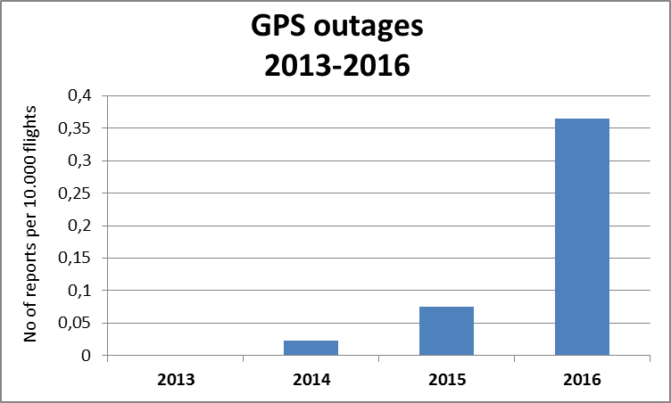
Notes:
In total for the period Nov 2013 Feb 2016 EVAIR received 104 GPS outages reports. For the same period for other type of the ATM issues EVAIR received about 14000 reports from AOs.

Slide 11
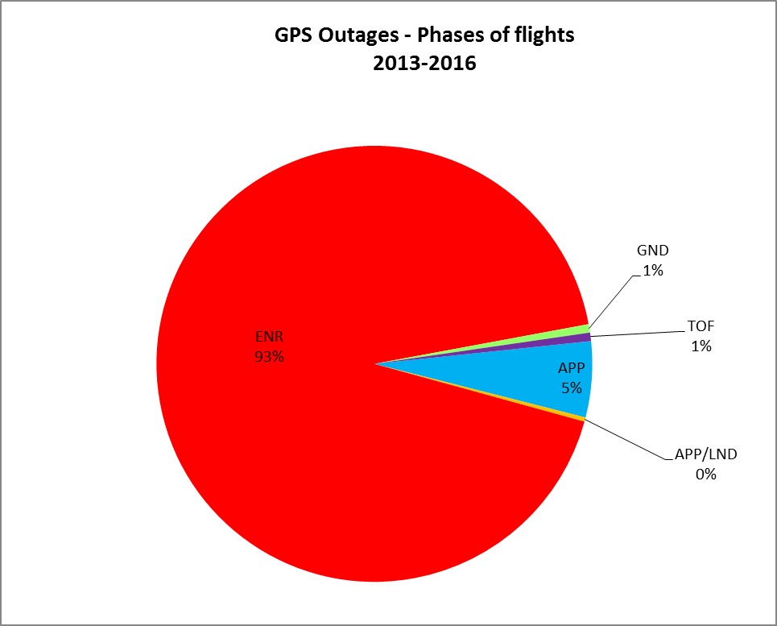

Slide 12
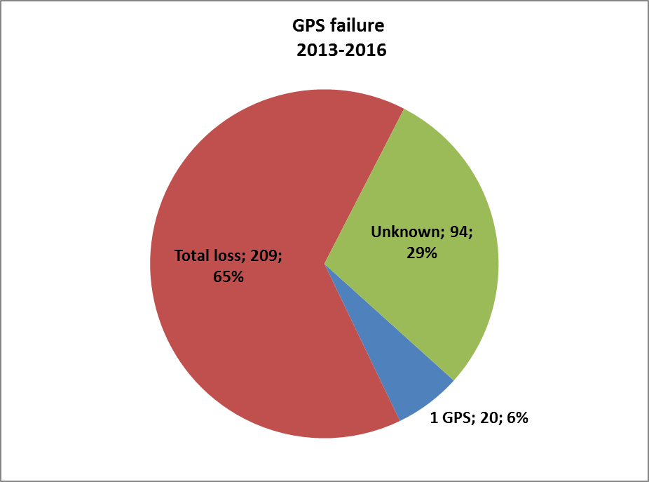
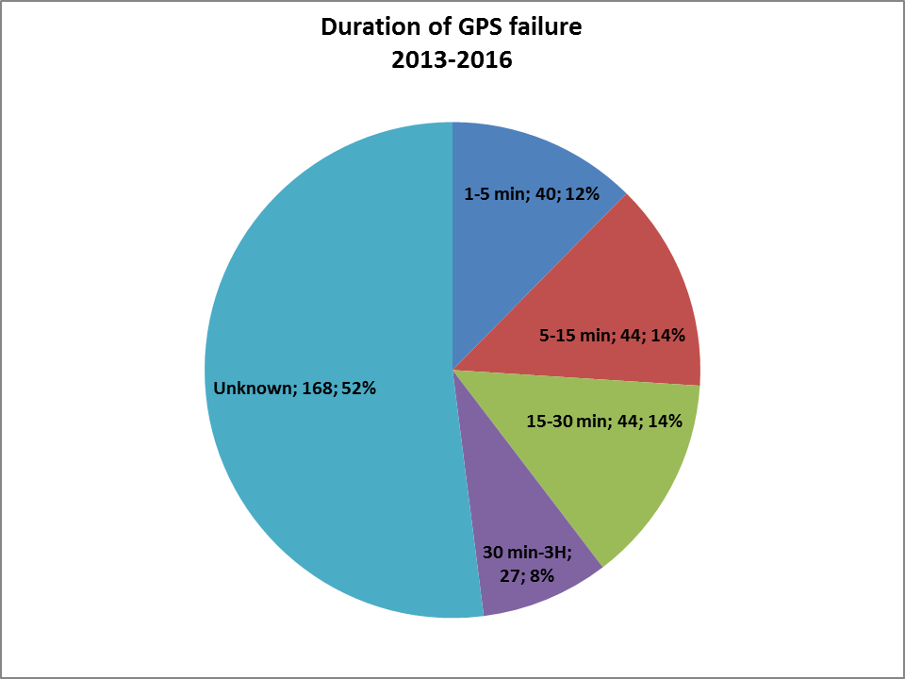

Slide 13
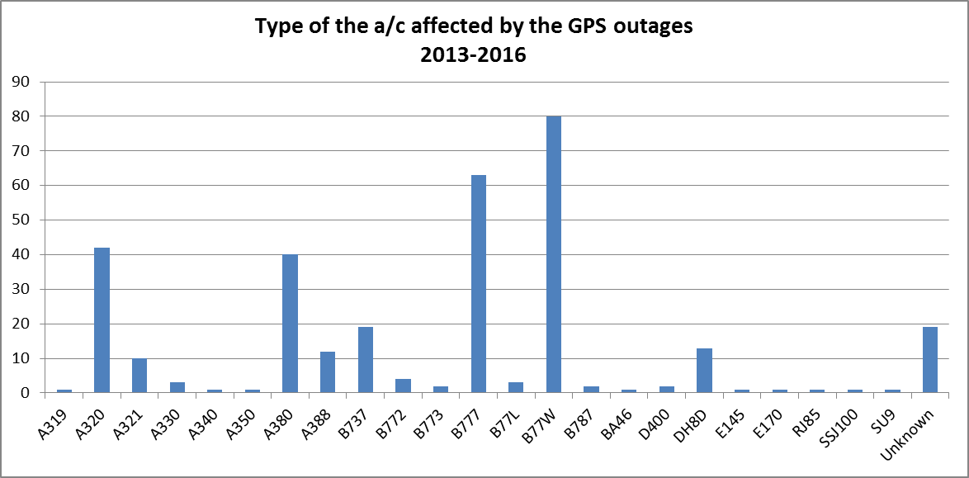
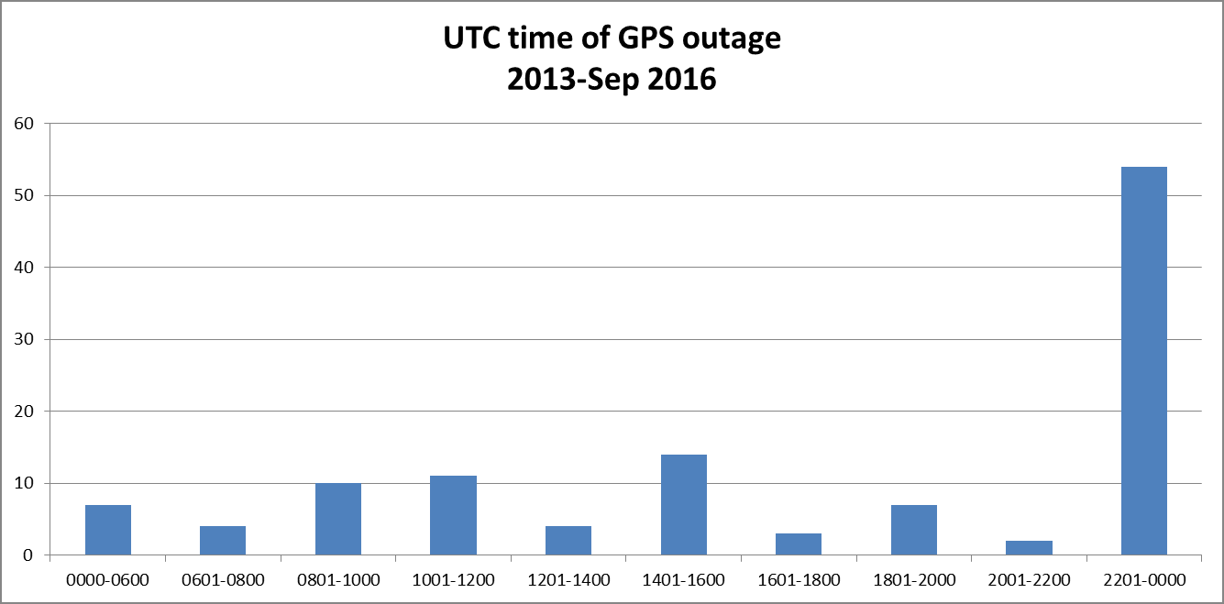
B777 is most flown type in areas most affected
Most Events Occur at Night!

Slide 14
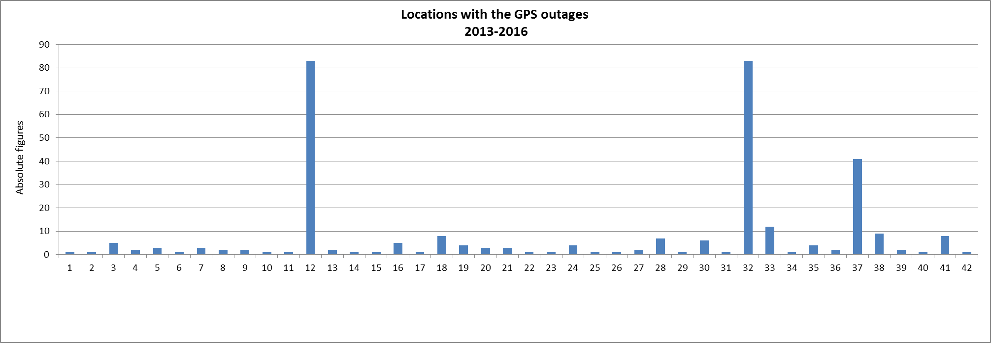
Specific Actions already facilitated by EVAIR:
Information Bulletin sent to Airspace Operators in Black Sea / Caspian Sea Region
NOTAM Issued by Turkey’s DHMI (Ankara Region)

Slide 15
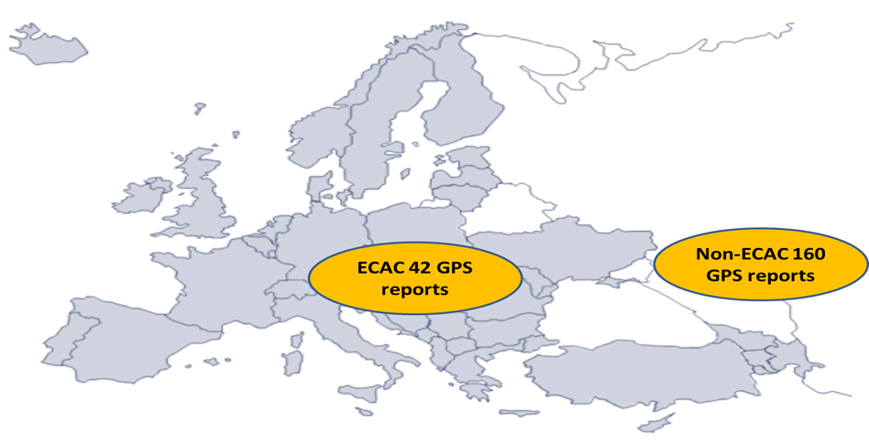
Geographic Distribution of Events
(as of SEP 2016)
ECAC = European Civil Aviation Conference

Slide 16
Identification of Probable Cause Through Elimination
Due to Space Weather ?
Space Wx Agencies (NOAA, etc.)
Iono Monitoring Networks
Due to Constellation / Satellite ?
Due to Receiver Problem ?
CSP Centers (GPS NAVCEN, etc.)
Augmentation User Support (ESSP, etc.)
Reported GNSS Outage Event
Receiver Manufacturers
Avionics Integrators
GLOBAL
REGIONAL
LOCAL
If all else can be excluded, must be RFI !
Due to Military Testing ?
Civil-Military Coordination, NATO
National Defense
Local Verification & Resolution

Slide 17
Moving Towards RFI Localization Support
Primary current method to detect potential RFI is pilot reporting
  Pilot reporting by nature not precise about location of event
  Developing process of what to do with reports
  Evaluating if meaningful localization can be made possible if flight track data is made available
Prerequisite is that relatively precise lat/lon/ht of GNSS Outage event start and end is available
  Either through ADS-B or other airline data reporting system
  Possible for single, omnidirectional and static RFI source only
    If search inconclusive using this method, could also be a valuable data point to suspect more sophisticated threat
  Objective is to reduce RFI source search area for State and reduce associated intervention time

Slide 18
Flight Track Data Possibilities?
If precise report of start and stop coordinate of outage event are known, bisector line of potential RFI source location can be derived
  Assumes omnidirectional RFI source and constant aircraft altitude
  Assumes that loss of tracking and reacquisition thresholds are similar
  Multiple aircraft reports could lead to localization
Within limits, a minimum power level can also be hypothesized
Aircraft Flight Paths
RFI Impact Area

Slide 19
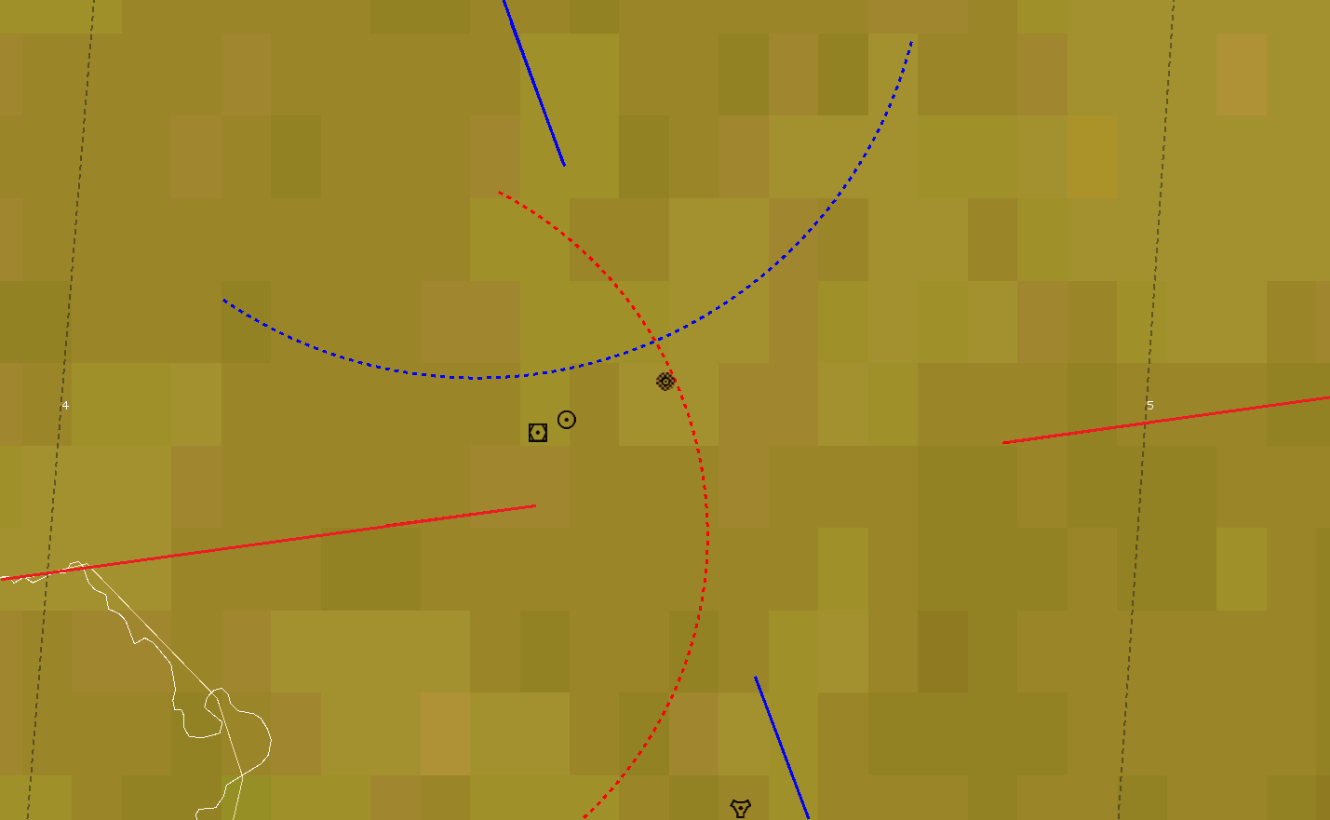
Modelling and Visualisation in DEMETER
GPS track 1 (eastbound)
Possible RFI position
GPS track 2 (southbound)
Possible RFI position

Slide 20
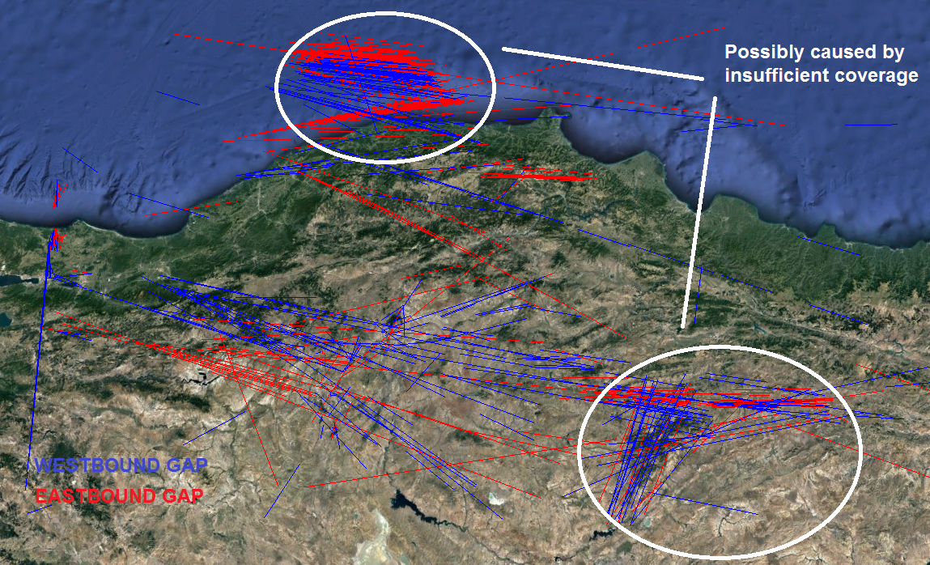
Data Analysis Challenges

Slide 21
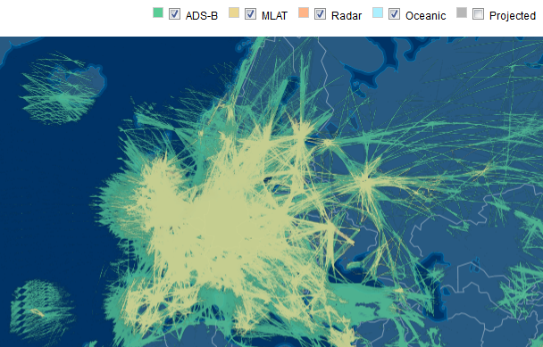
FlightAware Coverage

Slide 22
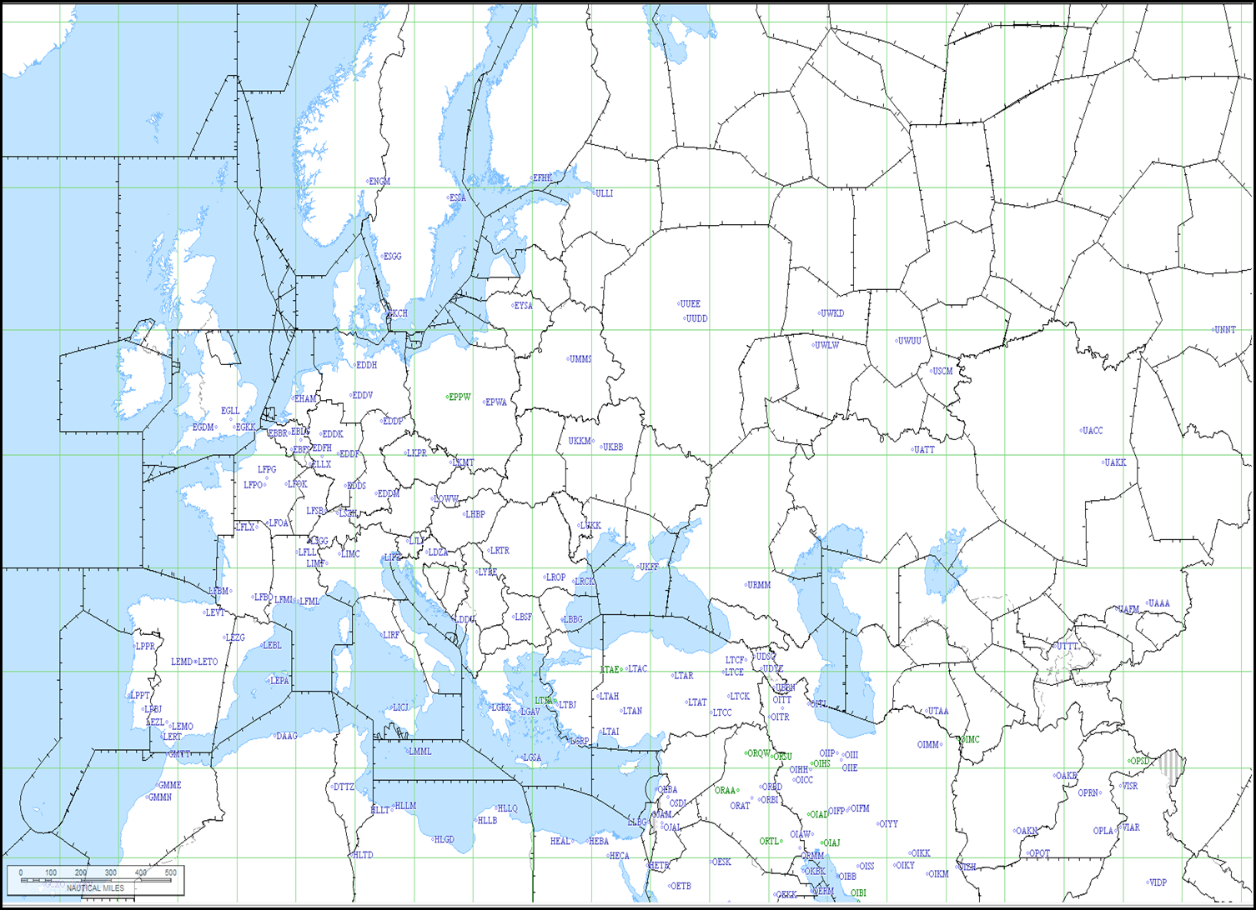

Slide 23
RFI Localization Process
EVAIR Reports serve as a trigger for further investigation
  First check to eliminate non-RFI causes as much as possible
Then need to rely on public domain ADS-B sources
  Manage coverage and data quality issues
  Limitations on data history
  Limitations on track distribution (due to route network)
  Recall earlier findings (CNS Team, Avionics White List)
Options to be investigated:
  Framework agreement with ADS-B data providers?
  Publication on Network Manager Operations Portal Nconnect
  Further investigation of aircraft installed GNSS Rx tracking and acquisition thresholds as a function of ground based RFI type and main airframe type?
  Future Alternatives: GNSS RX Data, Global Flight Tracking?

Slide 24
Summary
GNSS RFI Mitigation continues to be an exercise in setting up interfaces
  Current effort on ADS-B track data providers
  Other venues to be developed: GNSS providers, multi-modal projects (EC), Aircraft OEM’s, Airline FOQA Systems, NATO?
  Developing “GNSS Information Concept” to know what to make available to aircrews and how (NOTAM or alternate channels)
  Happy to consider any data source incl. ground monitors!
Focus on short-term implementable options that approach stated ATCO requirement (“tell me which sectors are affected”)
AOB: Related IFIS and ION Paper: RFI Localization using CRPA
  Published in GPS World Magazine
http://gpsworld.com/tracking-rfi-interference-localization-using-a-crpa/

Slide 25
Requests to ICAO FMG / WRC19 Workshop
Support further development of GNSS RFI Detection and Localization Methods
  Through ADS-B or other Sources, Air & Ground
  Provide data on actual cases to relevant groups (ARIA) and Eurocontrol (Network Manager Project)
Next Steps: Improve ICAO guidance on RFI Measurement
  Database of RFI Device Signatures (STRIKE3 Project?)
  Methodologies: Generic RF Test Equipment or GNSS Receivers
  To be included in Testing Manual (Doc 8071 Vol 2)
Provide Feedback on Implementation of GNSS RFI Mitigation Plan

