Slide 1
SARPs on C2 Links for RPAS
- Status Update -
– RPAS Panel WG2 –
FSMP WG/14-IP/02 – Agenda 5c
25-29 April, 2022

Slide 2

ICAO Responsibilities regarding AI 1.8, WRC-23
ITU-R is looking to ICAO to provide SARPs that complement the Radio Regualtions and, in particular for the FSS, provide for the equivalent safe operation in the absence of an AMS(R)S allocation
The ICAO SARPs, covering FSS and other C2 Link technologies, are being developed within the RPAS Panel
  Part I (Procedures) adopted in February 2021 and are now effective
  Part II (Systems) are underdevelopment and are anticipated to be completing State Letter review during WRC-2023

Slide 3
C2 Link SARPs - Background
    Because the C2 Link is, for several reasons, very different to other aeronautical communication systems the C2 Link SARPs are contained in their own volume (Volume VI) of Annex 10
    Part I of Annex 10, Volume VI, contains the already adopted and effective Procedures associated with C2 Links
      Many additions also to Annex 6 “Operation of Aircraft” in support of the C2 Link Procedures
    RPASP WG2 is now developing the Systems SARPs for, Volume VI, Part II and the accompanying Manual on C2 Links for RPAS
      Planning that the SARPs will be ready for a Preliminary Review by the ANC in Q4 2022
      Anticipate completion of State review by Q4 2023
      Anticipate adoption of second package of SARPs in Q1 2025

Slide 4
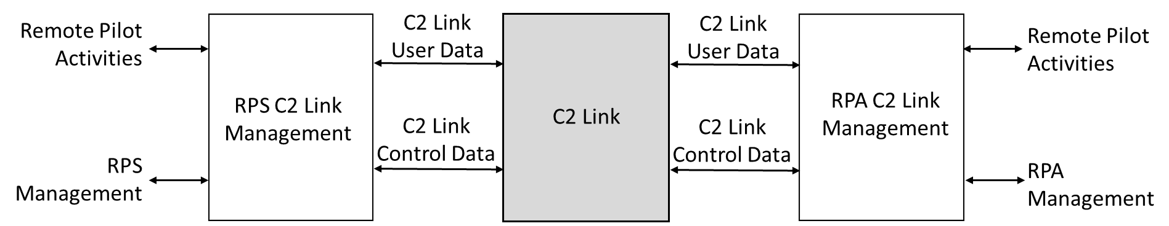
C2 Link SARPs - Background
Graphic from the SARPs
    The C2 Link is a “black box” connecting the RPS and the RPA
      Supports all remote pilot activities required to safely manage the RPA
      Supports external management of its operation by the Remote Pilot /RPS and RPA
    Neither “end“ of the C2 Link needs to be standardized in SARPs
      The C2 Link is entirely inside the RPAS and does not need to directly connect with other standardized aeronautical systems
    Many technical solutions are possible some already know, some to be discovered
      Currently RPASP WG2 is considering several terrestrial and satellite solutions, including the FSS
      No interoperability between solutions is required
      Compatibility between solutions sharing the same frequency band is required

Slide 5
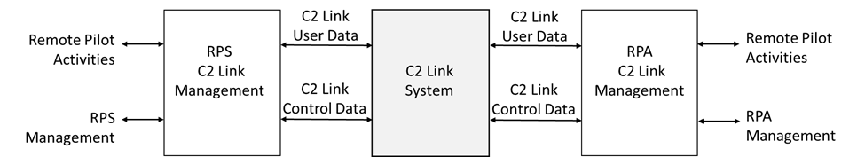
C2 Link SARPs - Background
Graphic from the SARPs
    RPASP WG2 and RTCA have developed the Required Link Performance (RLP) concept for the C2 Link User Data
      Same RLP for all RPAS/C2 Links operating in the same airspace/phase of flight
      All RPAS are equally “safe” irrespective of their design or their C2 Link design
    The C2 Link is Managed by the Remote Pilot/RPS and RPA
      Currently only how and how well the C2 Link responds to C2 Link Control Data is part of the proposed SARPs and Manual on C2 Links for RPAS
      How the C2 Link itself is managed by the Remote Pilot/RPS and RPA is outside the scope of the RPASP WG2
        Will be part of the Type Certification of the RPAS

Slide 6
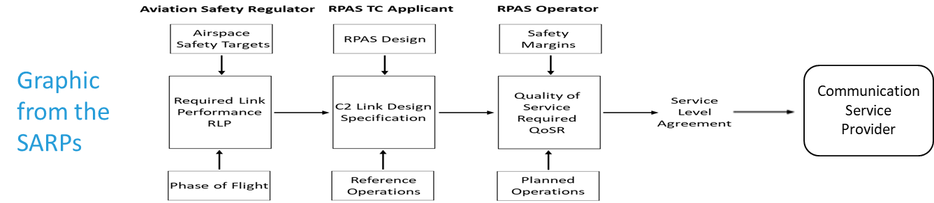
C2 Link SARPs – RLP Context
    The required performance of a C2 Link is highly dependent on
      The Target Level of Safety in the airspace = RLP
      The phase of flight = RLP
      The pilot activity it is supporting = RLP
      The level of automatic capability in the RPA and RPS = C2 Link Specification
        Too many different levels of RPAS automatic capability to cover in the RLP/SARPs
    The RLP is developed by Aviation Safety Regulators
      The RPAS Designer then specifies the, RPAS design dependent, C2 Link Specification
      The RPAS Operator then contracts, through a Service Level Agreement with the C2CSP, for a QoSR for their planned operation

Slide 7
C2 Link SARPs – Strategy
    The Annex 10, Volume VI, Part II Systems SARPs
      Contain high level technical requirements that can be applied to any current or future C2 Link technology
        SARPs will not need to change every time the technical solution changes or a new technology is introduced
        SARPs provide a framework for any new technology concept
      SARPs standardize any C2 Link’s
        Performance
          Performance based RLP, high level concept and process, actual values in Manual
        Management
          Performance based, response to commands to Establish/Terminate, Switchover, Handover and Report Status, actual values in Manual
        Compatibility
          Performance based, management of interference and protection of systems, actual values in Manual
        Security
          Performance based security controls, actual values in Manual

Slide 8
SARPs on C2 Links for RPAS
Foreword
Part I – C2 Link Procedures
  Chapter 1. Definitions
  Chapter 2. Specifications
  Chapter 3. Procedures
Part I I – C2 Link Systems
  Chapter 1 Definitions
  Chapter 2 Systems
  2.1 System description
  2.2 Interfaces
    2.3 Frequency Spectrum
    2.4 System Characteristics
    2.5 User Data Transmission Characteristics
    2.6 C2 Link User Data Performance Requirements
    2.7 C2 Link Control Data Response Characteristics and Performance Requirements
    2.8 Security
    2.9 Records
    2.10 C2 Link Communications Service Providers
Part I SARPs already adopted/effective

Slide 9
Informal Coordination – Comments
    Comments received from AVSECP, AIRP, ATMOPSP ,CP, FLIRECSWG, FLTOPS, FSMP, NSP, OPDLWG, SASP, SMP, SP, TFSG
      Received 165 comments from 13 Panels and Task Groups
    During RPASP 19, in March WG2, adjudicated all comments and incorporated any necessary changes into updated SARPs that will be circulated for Formal Coordination in the next few weeks
    Clarification of terms
      E.g., C2 Link, C2 Link Connection and C2 Link System
        The C2 Link is the logical connection, however physically realized, used for the exchange of information between the remote pilot station (RPS) and the remotely piloted aircraft (RPA) (already effective from Part I).
        C2 Link Connection. The logical addressed means to support secure exchange of C2 Link User Data between the RPS C2 Link Management and the RPA C2 Link Management
        C2 Link System. The physical system that supports the C2 Link and C2 Link Connection.
  E.g., Notes added to already effective SARPs from Part I
    2.2.1 The C2 Link shall only support the remote pilot tasks required for the safe and efficient operation of the RPAS.
    Note 1.— Because the C2 Link is a logical link, the physical link that supports the C2 Link may also support any data that is not C2 Link data.

Slide 10
Informal Coordination – Comments
    Clarification of terms
  Required Link Performance (RLP). The, technology neutral, performance that any C2 Link must achieve to comply with the Acceptable Level of Safety Performance and efficiency of the airspace in the phase of flight and airspace in which it is operating.
      Required Link Performance (RLP). The performance that any C2 Link must achieve to enable any RPAS to comply with the acceptable level of safety risk for the phase of flight and airspace in which it is operating.
    Standard replaced with Recommendation
      The C2 Link system, shall be designed using state of the art techniques to enable efficient and equitable spectrum usage while enabling the QoSR to be met.
      Comment e.g. The phrase “state of the art techniques” is too subjective. Recommended means of compliance can be provided in the guidance material.
      Comment Response = As experience in ICAO confirms not keeping technical solutions up to date can lead to inefficient use of spectrum and safety related interference issues, make Recommendation not SARP,
      Recommendation.— C2 Link Systems should be designed using state of the art techniques in order to provide efficient and equitable spectrum usage so maximizing the number of RPAS operations that can be supported.

Slide 11
Informal Coordination – Comments
    Improvement in precision of text
      E.g., removed words like “avoid”
    During the establishment, and reestablishment, of the C2 Link Connection the C2 Link shall avoid connecting the RPS to the wrong RPA .
        The probability of a C2 Link System connecting the RPS to the wrong RPA during the establishment and reestablishment of the C2 Link Connection shall be consistent with the acceptable level of safety risk in the airspace and phase of flight in which the RPA is operating.
      E.g., added qualifier
        Note. — Compatibility between aeronautical systems operating in frequency bands allocated to the aeronautical mobile service or the aeronautical mobile satellites service is managed by ICAO in accordance with ITU-R Radio Regulations.
        Note. — Compatibility between aeronautical systems standardized or to be standardized by ICAO, operated in frequency bands allocated to the aeronautical mobile service or the aeronautical mobile satellites service is managed by ICAO in accordance with the ITU Radio Regulations.

Slide 12
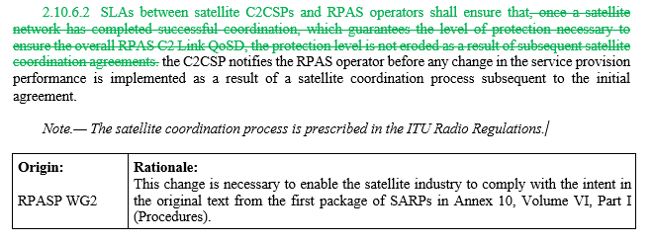
Informal Coordination – Comments
    Changes of particular relevance to FSMP/ITU-R

Slide 13
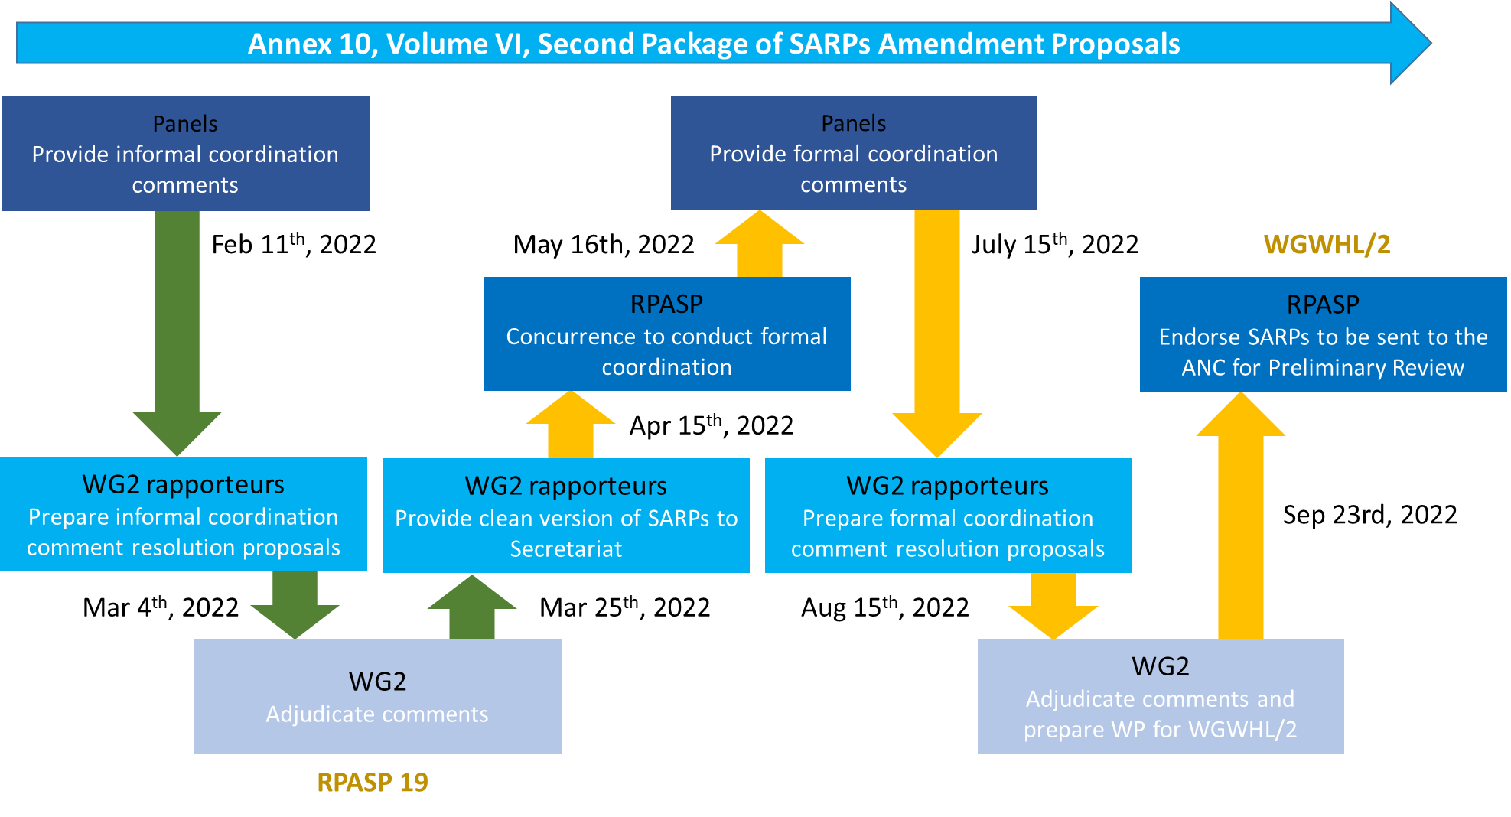
C2 Link SARPs – Next Steps outside the RPASP
Formal Coordination comments from Panels May-July 2022

