Slide 1
AERONAUTICAL FREQUENCY SPECTRUM MANAGEMENT
IN THE AFRICA AND INDIAN OCEAN (AFI) REGION
Presented by: Harvey Gabriel LEKAMISY
Regional Officer Communications, Navigation and Surveillance
ICAO REGIONAL OFFICE NAIROBI, KENYA
ICAO AFI REGIONAL PREPARATORY GROUP (RPG) WORKSHOP FOR WRC-2019
Johannesburg, South Africa, 4-5 September 2018

Slide 2
PLAN OF PRESENTATION
Introduction
Aeronautical Frequency Spectrum
AFI Aeronautical Frequency Spectrum Management
Summary and key Messages

Slide 3
INTRODUCTION

Slide 4
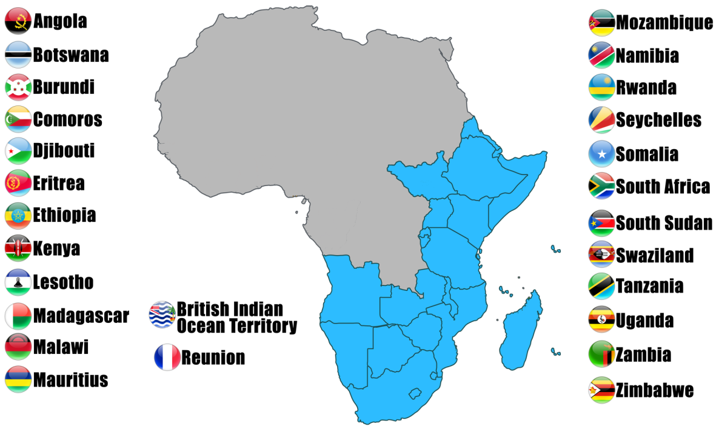
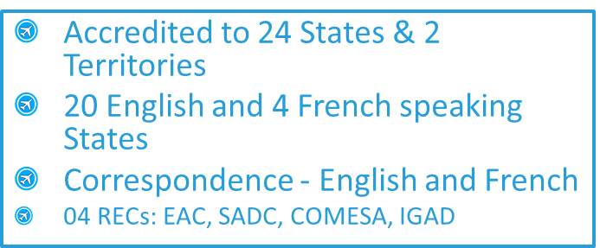
INTRODUCTION (1)
ESAF Areas of Accreditation

Slide 5
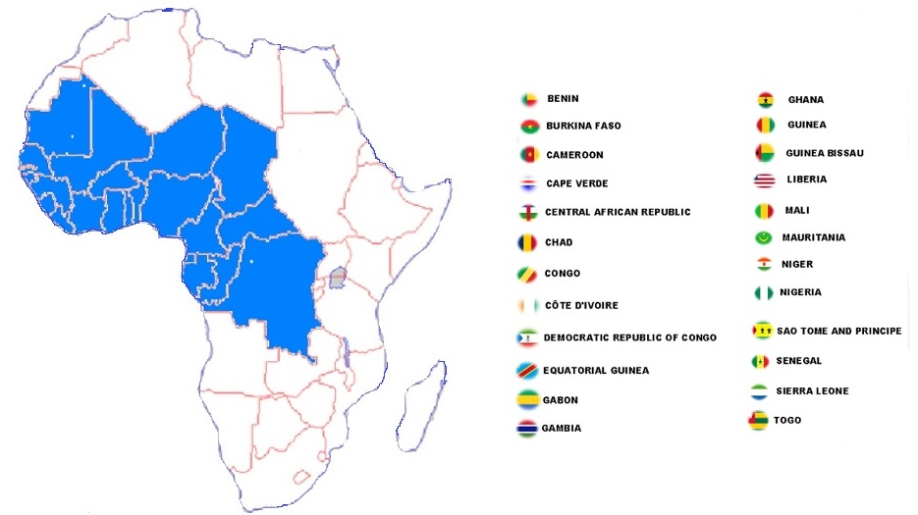

INTRODUCTION (2)
WACAF Areas of Accreditation
Accredited to 24 States
  French, English, Portuguese and Spanish are official languages in 15, 5, 3 and 1 States respectively

Slide 6
AERONAUTICAL FREQUENCY SPECTRUM

Slide 7
AERONAUTICAL FREQUENCY SPECTRUM (1)
Accurate navigation, landing guidance, situational awareness (airborne collision avoidance system, radar, radio altimeters) weather radar and reliable communications with air traffic control are prerequisites for a safe flight

Slide 8
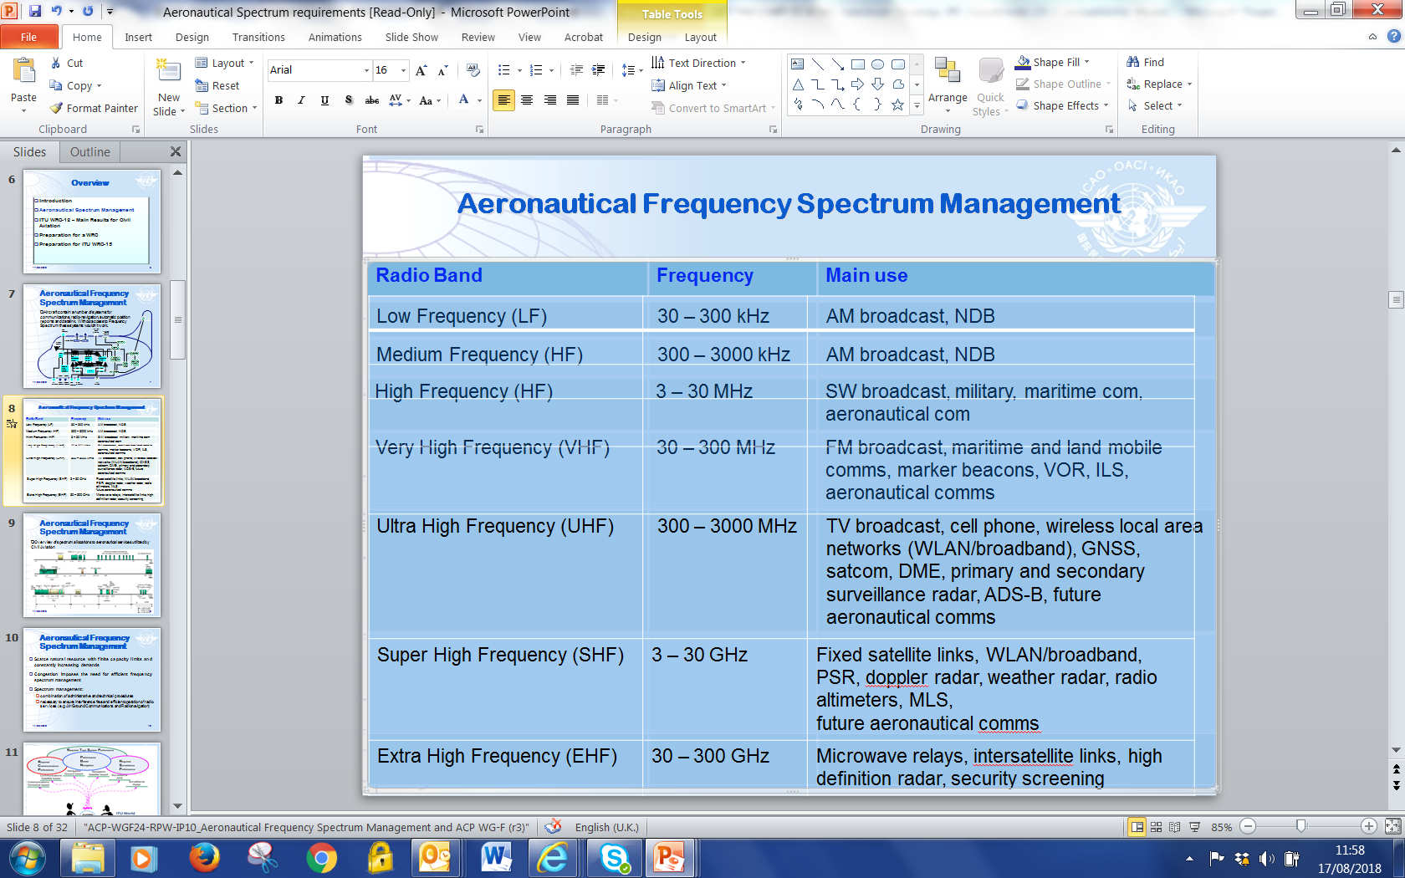
AERONAUTICAL FREQUENCY SPECTRUM (2)

Slide 9
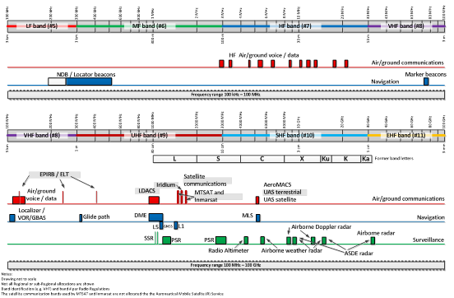
AERONAUTICAL FREQUENCY SPECTRUM (3)

Slide 10
ICAO AFRICA AND INDIAN OCEAN REGION
AERONAUTICAL FREQUENCY SPECTRUM MANAGEMENT

Slide 11
ISSUES AND CHALLENGES
Scarce natural resource with finite capacity limits and constantly increasing demands
Congestion imposes the need for efficient frequency spectrum management
Spectrum management:
  combination of administrative and technical procedures
  necessary to ensure interference free and efficient operation of radio services (e.g. Air/Ground Communications and Radionavigation)

Slide 12
REFERENCE DOCUMENTS AND TOOL
AFI AERONAUTICAL FREQUENCY SPECTRUM MANAGEMENT (2)
ICAO Doc 9718, Volumes I and II: The Handbook on Radio Frequency Spectrum Requirements for Civil Aviation
ICAO Policies and practices related to radio frequency spectrum matters (Assembly Resolution A38-6)
Annex 10, Volume V: Aeronautical radio Frequency Spectrum Utilization
Frequency Finder Tool/Software
ITU Radio Regulation, etc…(extra-Documents)

Slide 13
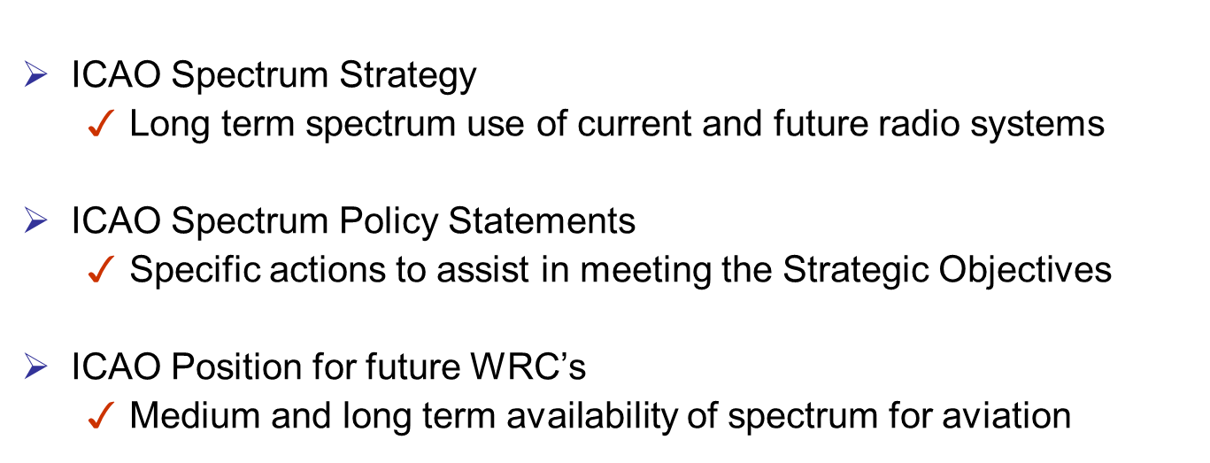
AFI AERONAUTICAL FREQUENCY SPECTRUM MANAGEMENT (3)
The Handbook on Radio Frequency Spectrum Requirements for Civil Aviation

Slide 14
AFI AERONAUTICAL FREQUENCY SPECTRUM MANAGEMENT (4)
The Handbook on Radio Frequency Spectrum Requirements for Civil Aviation Handbook (Doc 9718), Volume II- Frequency assignment planning
Provide globally harmonized frequency assignment planning criteria and guidance material to support the application of SARPs in Annex 10, Vol. V
Developed in conjunction with the revisions to Annex 10, Vol. V
Developed by ACP Working Group F
Implementation through Regional Air Navigation Agreement by PIRG
To support the development of the Global Air Navigation Plan (GANP).

Slide 15
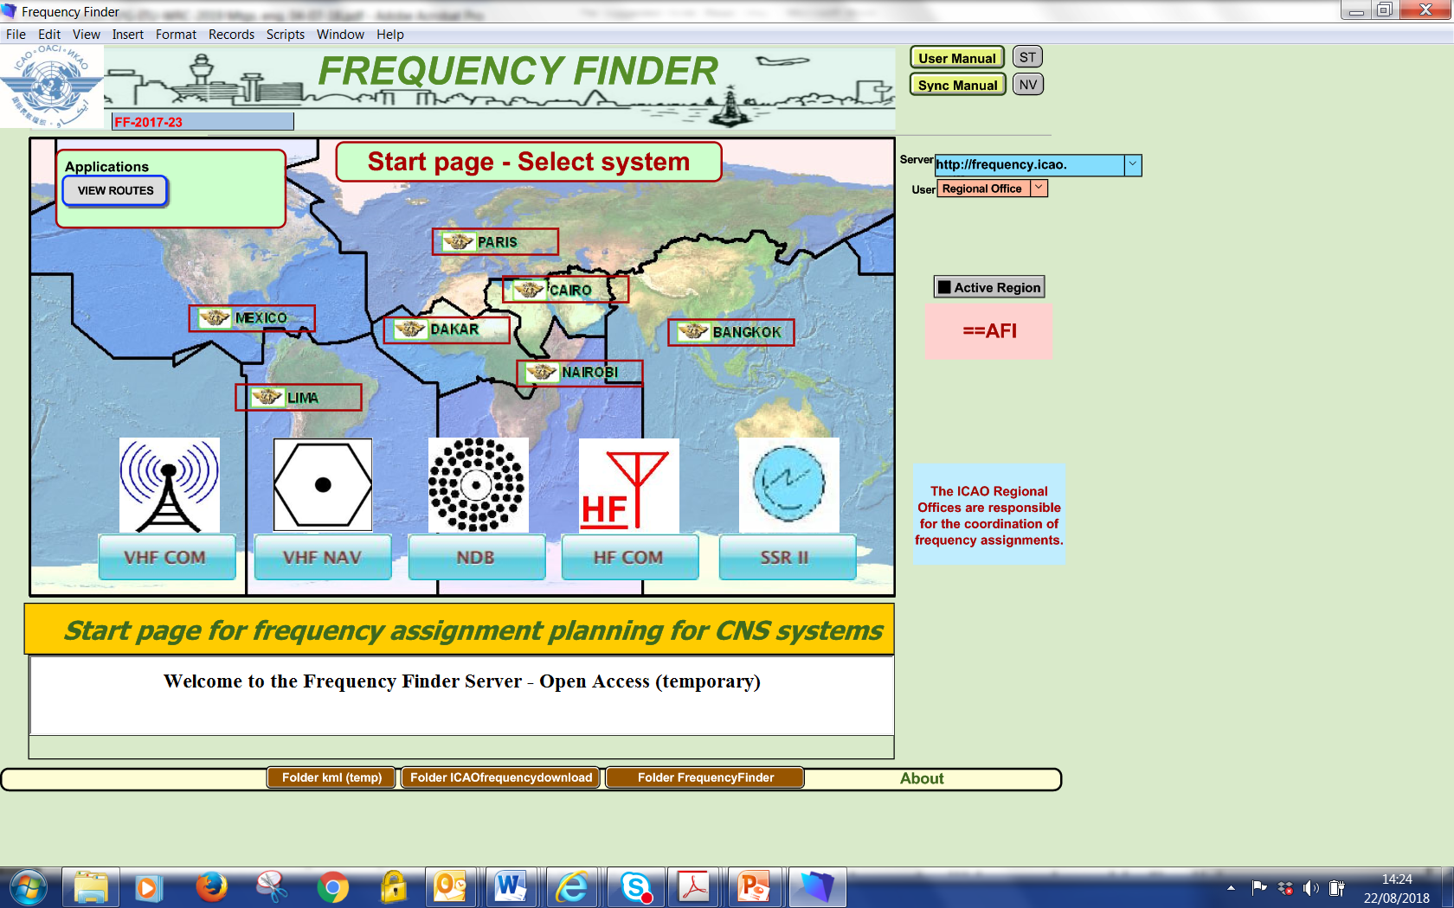
AFI AERONAUTICAL FREQUENCY SPECTRUM MANAGEMENT (5)
Frequency Finder Tool

Slide 16
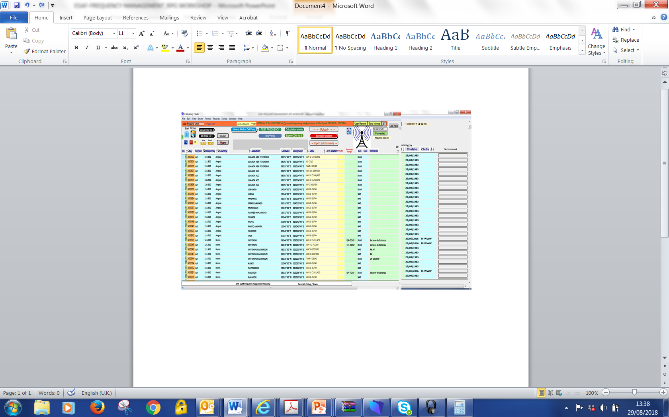
AFI AERONAUTICAL FREQUENCY SPECTRUM MANAGEMENT (6)
VHF COM Home Page

Slide 17
AFI AERONAUTICAL FREQUENCY SPECTRUM MANAGEMENT (7)
WRC-15 Main Result for Civil Aviation: RESOLUTION 154 (Rev. WRC-15)
Consideration of technical and regulatory action in order to support existing and future operation of fixed-satellite service earth station within the frequency band 3 400-4 200 MHz, as an aid to the safe operation of aircraft and reliable distribution of meteorological information in some countries in Region 1.
Better regulatory protection of Fixed Satellite Services (FSS) VSAT link used in Africa and Indian Ocean to provide terrestrial aeronautical and meteorological communication networks.
VSAT networks for aeronautical ground-ground telecommunications are in wide use in both Africa and Central/South America.
APIRG CONCLUSION
CONCLUSION 20/30: Protection of C band spectrum
That, in accordance with Resolution 154 (Rev. 154 WRC-12), States/Organizations take the appropriate measures in order to ensure the protection of the satellite C-band operated by the AFI VSAT networks:
Registration of the aeronautical VSAT frequencies in the States register held by the national authorities of regulation of telecommunication; and
Follow-up with the concerned authorities in the States to further register the frequencies in the ITU master International Frequency Register (MIFR).

Slide 18
AFI AERONAUTICAL FREQUENCY SPECTRUM MANAGEMENT (8)
APIRG CONCLUSIONS
CNCLUSION 21/14 : Aeronautical Spectrum Issues
That, in order to protect and maintain continuous vigilance on ongoing threats to the aeronautical frequency spectrum:
ANSPs and airlines should regularly report cases of harmful radio interference within the aeronautical frequency spectrum to the national Telecommunication authorities through the civil aviation authorities, ICAO and IATA;
The IIM/SG with the support of ICAO, should accordingly develop and maintain a regional database on reported cases of such harmful interference.

Slide 19
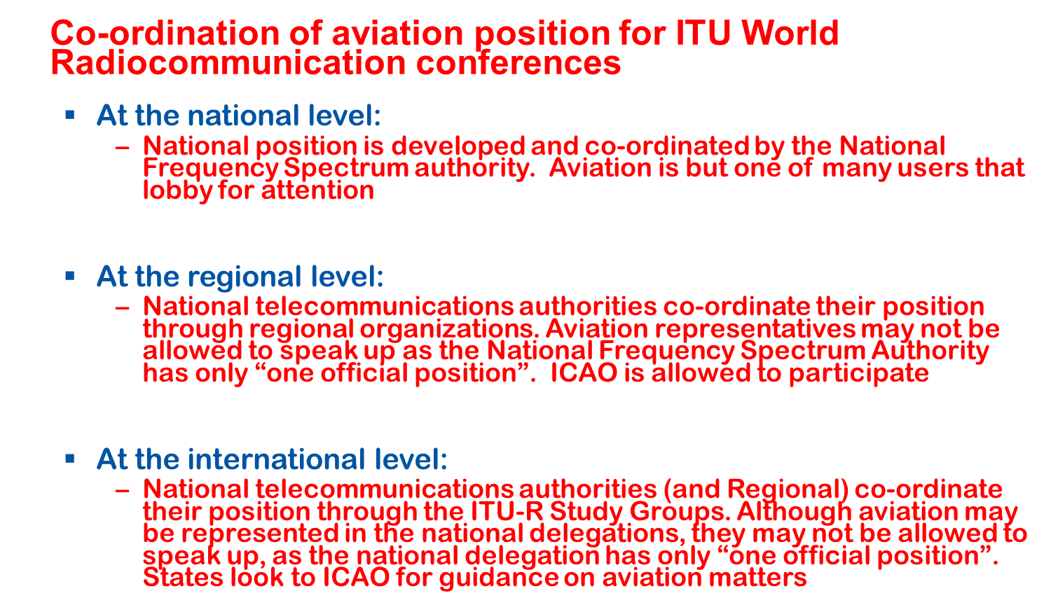
AFI AERONAUTICAL FREQUENCY SPECTRUM MANAGEMENT (9)

Slide 20
AFI AERONAUTICAL FREQUENCY SPECTRUM MANAGEMENT (10)
APIRG CONCLUSION
CONCLUSION 20/29: Continued support to ICAO Position
That, in accordance with ICAO spectrum strategy, policy and related information as contained in Handbook on Radio Frequency Spectrum Requirements for Civil Aviation (Doc 9718):
States/Organizations continue to support ICAO position from WRC in particular on agenda item of high importance to the safe operation of aircraft by participation in the national and regional/sub regional preparatory Meeting for ITU WRC Meeting; and
The Secretariat reinforce the coordination of the initiatives that will ensure the alignment of heir national position with ICAO position for WRC.

Slide 21
SUMMARY AND KEY MESSAGES
  Spectrum Management is a combination of administrative and technical procedures,
Clean spectrum means keeping the used aeronautical frequencies free from licensed, unlicensed and illegal transmissions that interfere with CNS equipment reception,
ICAO Member States Good will, cooperation and exchange of information among parties is essential (ICAO Regional Office -CAAs and CAAs – National telecommunication regulators)
Continuous support of CAAs to ICAO Position for the WRCs
APIRG/20 Meeting adopted a project ‘’ Protection of aeronautical spectrum’’, under IIM SG to develop policies and systems to provide and protect aeronautical spectrum.
Only continuous synergetic collaboration and action by the CAA and National telecommunication regulators can guarantee a minimum level of interference is kept.

