Slide 1
LDACS Update
Current Status of LDACS Development and Standardization
Prepared by Project Team Terrestrial Data Link (PT-T)
of the ICAO Communications Panel
Presented to FSMP
October 2021

Slide 2
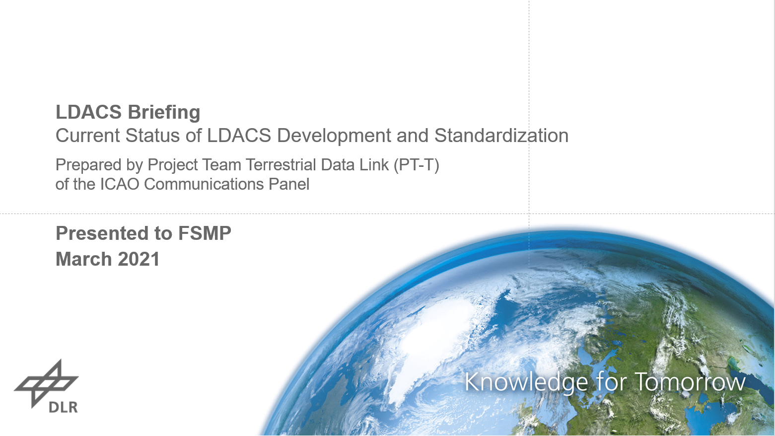
LDACS Briefing and Overview
LDACS =
L-band Digital Aeronautical Communications System
LDACS briefing presented to
FSMP WG-11 in March 2021 (IP04)
LDACS Update to FSMP WG-12

Slide 3
LDACS Briefing and Overview
Some important LDACS characteristics
Well positioned in SESAR’s ATM Master Plan and essential part of the Future Commun. Infrastructure (FCI)
Well reflected in ICAO’s Global Air Navigation Plan (GANP)
Under ICAO standardization within CP/DCIWG PT-T
LDACS is the first integrated CNS solution
  Providing high-throughput secure communications
    Data rates from 550 kbps – 2.6 Mbps (55 – 260 times VDL2)
    Date link and digital voice communications with cyber-security included
    Low-latency transmission through coordinated channel access
    ATN/B1, ATS/B2, emerging ATS/B3 and additional future services are covered by LDACS
    Service priorities allow parallel transmission of high-volume AOC data while ensuring immediate access for safety-critical services
  Supporting navigation through an APNT service

Slide 4
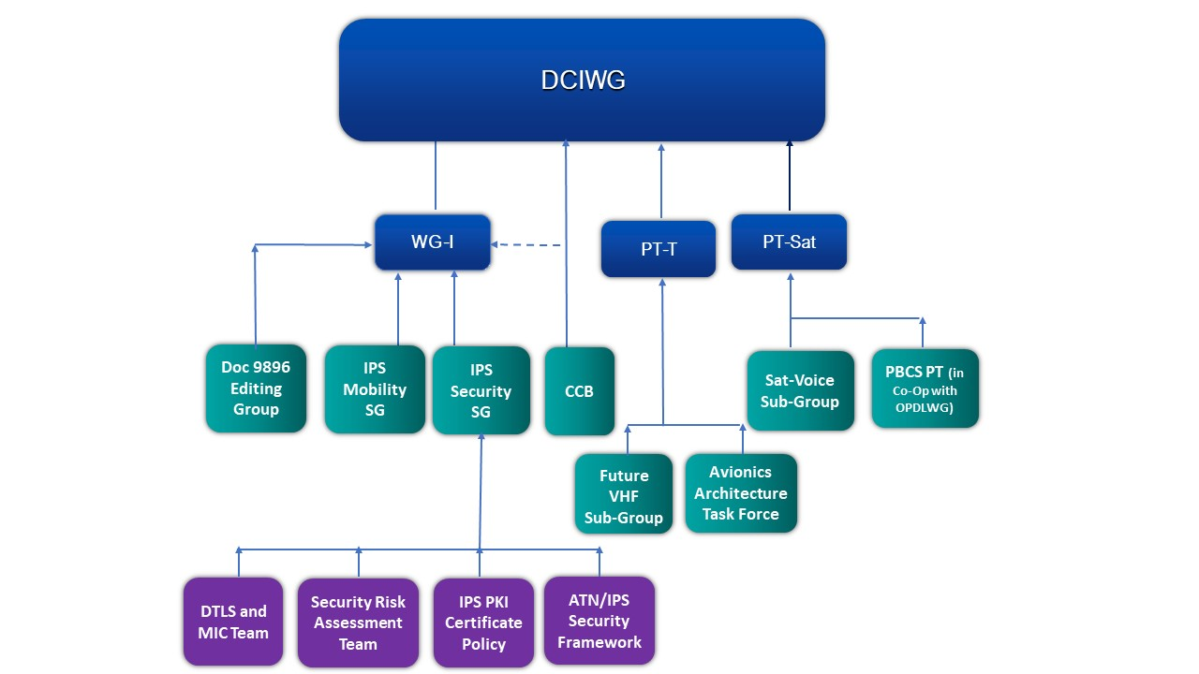

LDACS Standardization Within ICAO CP DCIWG
CP = Communications Panel
CP = DCIWG + OPDLWG
DCIWG = Data Communication
Infrastructure Working Group
OPDLWG = Operational Data Link
Working Group

Slide 5
Current Status of LDACS Standardization
Development of standardization documents
Amendment of Annex 10 – Vol III (LDACS SARPs)
  Draft SARPs have been endorsed by CP/DCIWG in October 2018
  Final SARPs in preparation
LDACS Manual (new ICAO Doc 10114)
  Based on SESAR LDACS specification
  Work in progress
LDACS Validation Report
  Validation Document set-up
  Work in Progress: Collection and filling-in of validation results
Amendment of Annex 10 –Vol V
  Coordination process on L-band compatibility with ICAO Panels (NSP and SP) ongoing
  Delayed

Slide 6
Current Status of LDACS Standardization
Timeline for LDACS Standardization
Amendment of Annex 10 – Vol III and guidance material (Perf. Requirements and Tech. Specification)
  Delivery to CP/DCIWG for approval Q2/2022
  Effective date July 2024
  Applicability date November 2024
Amendment of Annex 10 –Vol V (Spectrum)
  Delivery to CP/DCIWG for approval Q4/2023
  Effective date July 2026
  Applicability date November 2026
Timelines for amendments no longer aligned
  Long and intense coordination and harmonization process among ICAO Panels on L-band compatibility
  This highlights the need for a consistent framework for new aviation system sharing spectrum with existing aviation systems
2022
2023
2024
2025
2026
2022
2023
2024
2025
2026

Slide 7
Thank you for your attendance!
Contact details:
Michael.Schnell@dlr.de
For more information, see:
www.ldacs.com

