Slide 1
Compatibility between Terrestrial & Satcom C2 Link Services Operating in the 5030-5091 MHz Band
A. Malaga
Presented @ ICAO FSMP
August 2022

Slide 2
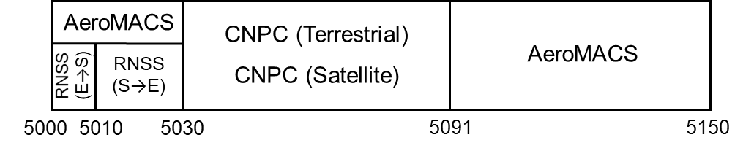
C2 Link Spectrum Allocation
ITU WRC-15 allocated the 5030-5091 MHz to Aeronautical Mobile Service (R) and Aeronautical Mobile-Satellite Service (R); see ITU Radio Regulations (RR) footnotes 5.443C and 5443D
  Both AMS (R) and AMSS (R) must comply with International Standards
  Unwanted emissions from AMS (R) service must protect Radio Navigation Satellite Service in 5010-530 MHz band
  Unwanted emissions from AMS (R) services must protect AeroMACS AMS (R) services in the 5000-5030 and 5091-5150 MHz band when both types of services are supported out of the same airport
MLS Radio Navigation Service (RNS) has priority use of the 5030-5091 MHz spectrum over AMS (R) and AMSS (R) – see ITU RR footnote 5.444
The AMS (R) services approved for use of the 5030-5091 MHz allocation are UAS Command and Control (C2) Links using terrestrial-based Non-Network Access (NNA) service (i.e. direct point-to-point C2 Links) and Network Supported Services (NSS), and High-Altitude Relay platform-based NSS
The AMSS (R) services approved for use of the 5030-5091 MHz allocation are UAS Command and Control (C2) Links using Geo Stationary Satellite-based NSS that provide regional or global coverage
The 5030-5091 MHz Band must be shared by terrestrial and satellite based C2 Link services
Ideally UAS equipped with Terrestrial C2 Link Systems and UAS equipped with Satcom C2 Link Systems should be capable to operate in the same airspace with no coordination between them

Slide 3
5030-5091 MHz Band Sharing Options
Background: Feasibility of sharing the band between RPAS equipped with RTCA DO-362A MOPS compliant Terrestrial C2 Link Systems & EUROCAE ED-265 MOPS compliant Satcom C2 Link Systems investigated in 2021
  2 MHz minimum frequency separation between channels assigned to Terrestrial & Satcom C2 Links
  -56 dBm/kHz spurious emissions noise floor – flat beyond 2 MHz frequency separation
  3000 feet (900m) minimum vertical separation between Terrestrial and Satcom equipped RPA
  2000 feet (600m) minimum horizontal separation
What can be done to reduce or eliminate the need to maintain minimum separation?
Option 1: Split the 5030-5091 MHz band into separate sub-bands for Terrestrial and Satellite based C2 Link Services
Option 2: Terrestrial and Satellite based C2 Link Systems employ Compatible Transmit/Receive Time Division Duplex (TDD) operation
Both Option 1 and Option 2 would require updates to the Terrestrial RTCA DO-362A MOPS

Slide 4
Split 5030-5091 MHz Band (Option 1)
Separate sub-bands with less than 30 MHz of spectrum each for Terrestrial and Satellite based C2 Link Services
Terrestrial and Satcom C2 Link Systems would be able to use their own non-compatible Transmit/Receive TDD Operation
  Optimum TDD Frame Duration for Terrestrial services is 50ms Frame with 4 ms guard time and 23ms available for forward and reverse link TX bursts each (DO-362A)
  Optimum TDD Frame Duration for geostationary Satellite-based services with ±70⁰ latitude & ±63⁰ longitude coverage is 260ms with 21.4ms guard time and 119.3ms for forward and reverse link TX bursts each (EUROCAE White paper)
Each system would employ an RF bandpass filter with less than 25 MHz bandwidth to reduce unwanted emissions into the other system’s band by at least 20 dB
  Reduces minimum vertical and horizontal separation by a factor of 10
  Size and weight of RF filter may preclude use of C2 Link System on smaller RPA
  How much spectrum to assign to Terrestrial and Satellite services must decided before any system is fielded – hard to recall fielded equipment via airworthiness directive if spectrum assignment is changed later
  Frequency guard band needed between Terrestrial & Satcom sub-bands – reduced usable spectrum
  Terrestrial spectrum may need to be split between spectrum for Non Network Supported (NNS) C2 Link Systems and spectrum for terrestrial Network Supported Services (NSS)
    Must decide if NNS and NSS should use the same TDD Frame structure or if it is desirable to allow NSS to use non RTCA standard by using frequency guard bands between NNS and NSS – further reduction in usable spectrum

Slide 5
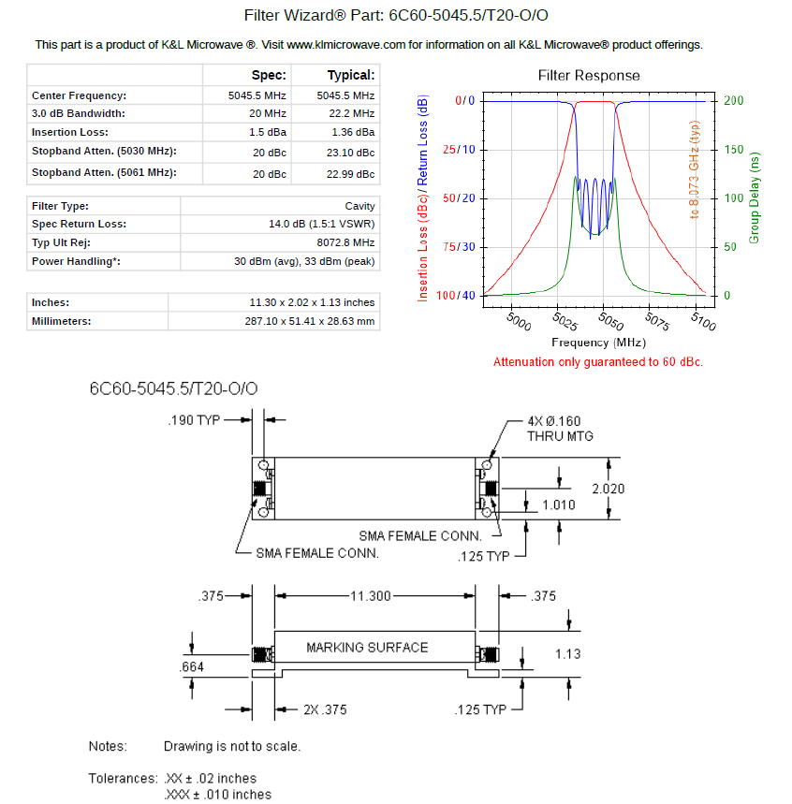
C-Band RF Bandpass Filter Specs
Note maximum RF power handling capability
Weight depends on operating temperature range
Weight increases by factor of 3 when temperature range is outside 15⁰C-35⁰C
Note that Qualification Testing and TSO must include the RF Filter

Slide 6
Compatible Transmit/Receive TDD (Option2)
Terrestrial and Satcom C2 Link Systems would use the same TDD Frame Structure i.e., same frame duration, forward link and reverse link data TX burst duration and same time guards between forward and reverse link TX bursts)
  Time would need to allow up to 21.4ms of delay spread to support satellite C2 Link systems with ±70⁰ latitude & longitude coverage
  TDD Frame duration would need to allow support of ATC VHF Voice relay by Terrestrial C2 Link Systems – the maximum one-way latency of terrestrial C2 Links must be less than 87ms
TDD Frame Durations of 130, 86.67, 65, and 52 ms with guard times of approximately 20 ms are possible
  A TDD Frame Duration of 130 ms is the best compromise – greater Channel Utilization
  The forward and reverse link TX burst duration must be divided into 10 TX Slots to ensure the maximum latency of a terrestrial C2 Link is less than 87ms
Compatible TDD structure benefits
  No minimum separation between RPA
    Installation and simultaneous operation of Terrestrial and Satcom C2 Link Systems on same RPA is possible
  Spectrum assignment flexibility
    No guard bands between different types of services
    All RPA classes would be able to employ the 5030-5091 MHz band
  Spectrum sharing
Option 2 is more desirable
  But which option makes more efficient use of spectrum?

Slide 7
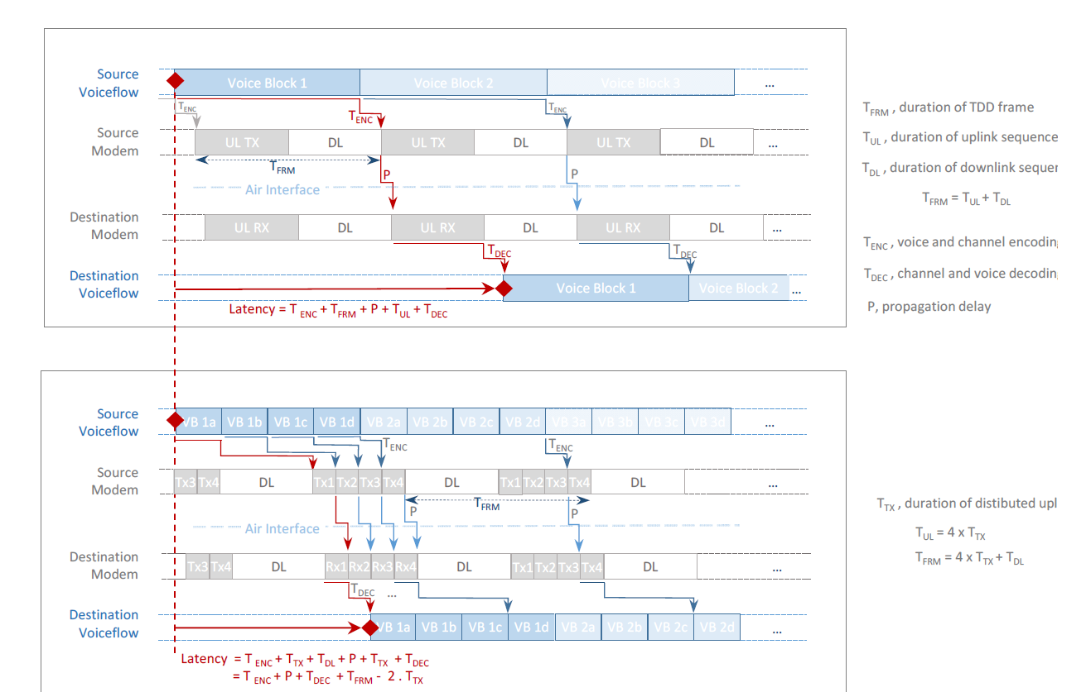
TDD Frame with One & Four Slots for Forward & Reverse Links
One Slot for Forward Link & One Slot for Reverse Link
Four Slots for Forward Link & Four Slots for Reverse Link

Slide 8
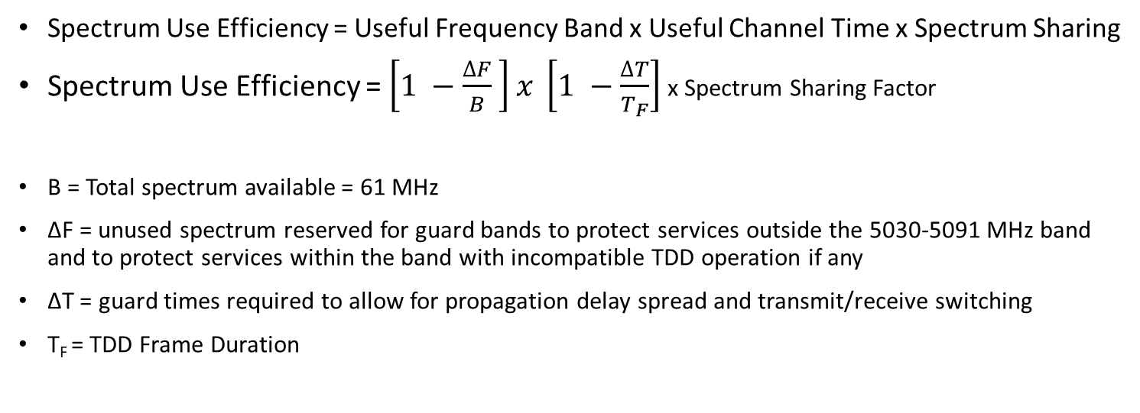
Spectrum Use Efficiency Considerations
Spectrum Use Efficiency = Useful Frequency Band x Useful Channel Time x Spectrum Sharing
Spectrum Use Efficiency = $\left[1 −\frac{∆F}{B} \right]x \left[1 −\frac{∆T}{T_{F}}\right]$ x Spectrum Sharing Factor
B = Total spectrum available = 61 MHz
∆F = unused spectrum reserved for guard bands to protect services outside the 5030-5091 MHz band and to protect services within the band with incompatible TDD operation if any
∆T = guard times required to allow for propagation delay spread and transmit/receive switching
T_{F} = TDD Frame Duration
Eff ≈ 67.5%
Eff ≈ 83%
Eff ≈ 145% to 166%
22 MHz
22 MHz
30 MHz
30 MHz
4 x 15 MHz
Terrestrial
Satcom
Terrestrial
Satcom
¾ Terrestrial Sectors +
¼ Satellite Spot Beam
5030.5
5090.5
5030.5
5090.5
5030.5
5090.5
Split Band with Dissimilar TDD
Split Band with Compatible 130ms TDD
Shared Band with Compatible 130ms TDD

Slide 9
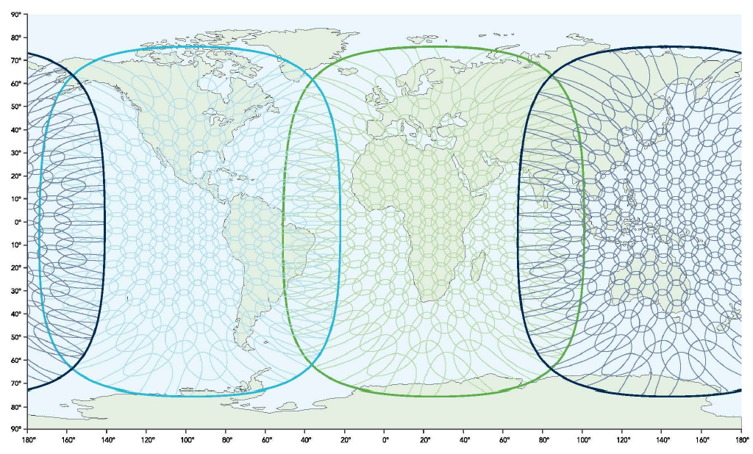
Satellite Service Spectrum Needs for Global Coverage
Global coverage is provided with 3 Geo Stationary satellites with spot beam antennas
Spectrum assigned to the satellite service is shared by the beams using a cellular pattern with frequency reuse factor of 4

Slide 10
Terrestrial/Satcom Frequency Re-Use/Sharing Concept
5030-5091 MHz band is divided into 4 four 15 MHz segments
  Terrestrial and Satcom services share use of the 15 MHz segments as follows
Satcom NSS Service employs spot beams to provide intended coverage
  Spot beams are assigned one of the 15 MHz segments using 4-frequency re-use pattern illustrated in previous slide
  Satcom equipped RPA operating in a given spot beam area are dynamically assigned channels by Satcom NSS provider from the 15 MHz segment
Terrestrial Systems providing services within the area of a Satcom spot beam share the three 15 MHz segments not in use by the Satcom Service
  The 45 MHz must be divided into spectrum available for Terrestrial Non Network Service (NNS) C2 Links and spectrum assigned to “Regional” Network Supported Services (NSS) operating within the area of the spot beam
  Channel assignments for the NNS C2 Links set up in the area of the spot beam are managed by a frequency manager authority – channel assigned for the duration of mission/flight only
  The “Regional” NSS provider dynamically manages the assignment of individual channels to RPA C2 Links that subscribe to the NSS services as the RPA transits through the coverage area
Spectrum sharing efficiency
  Satcom service capacity doubles over the capacity that could be achieved by assigning 30 MHz of spectrum to Satcom services & 30 MHz to Terrestrial services
    Satcom services in oceanic and remote areas can make use of spectrum which otherwise would be unused because it is reserved for terrestrial services.
  Terrestrial services capacity increases by 50% by making use of spectrum which otherwise would be reserved for Satcom
  Terrestrial services capacity doubles in non-oceanic areas where satellite services are not available/approved

Slide 11
Back-Up

Slide 12
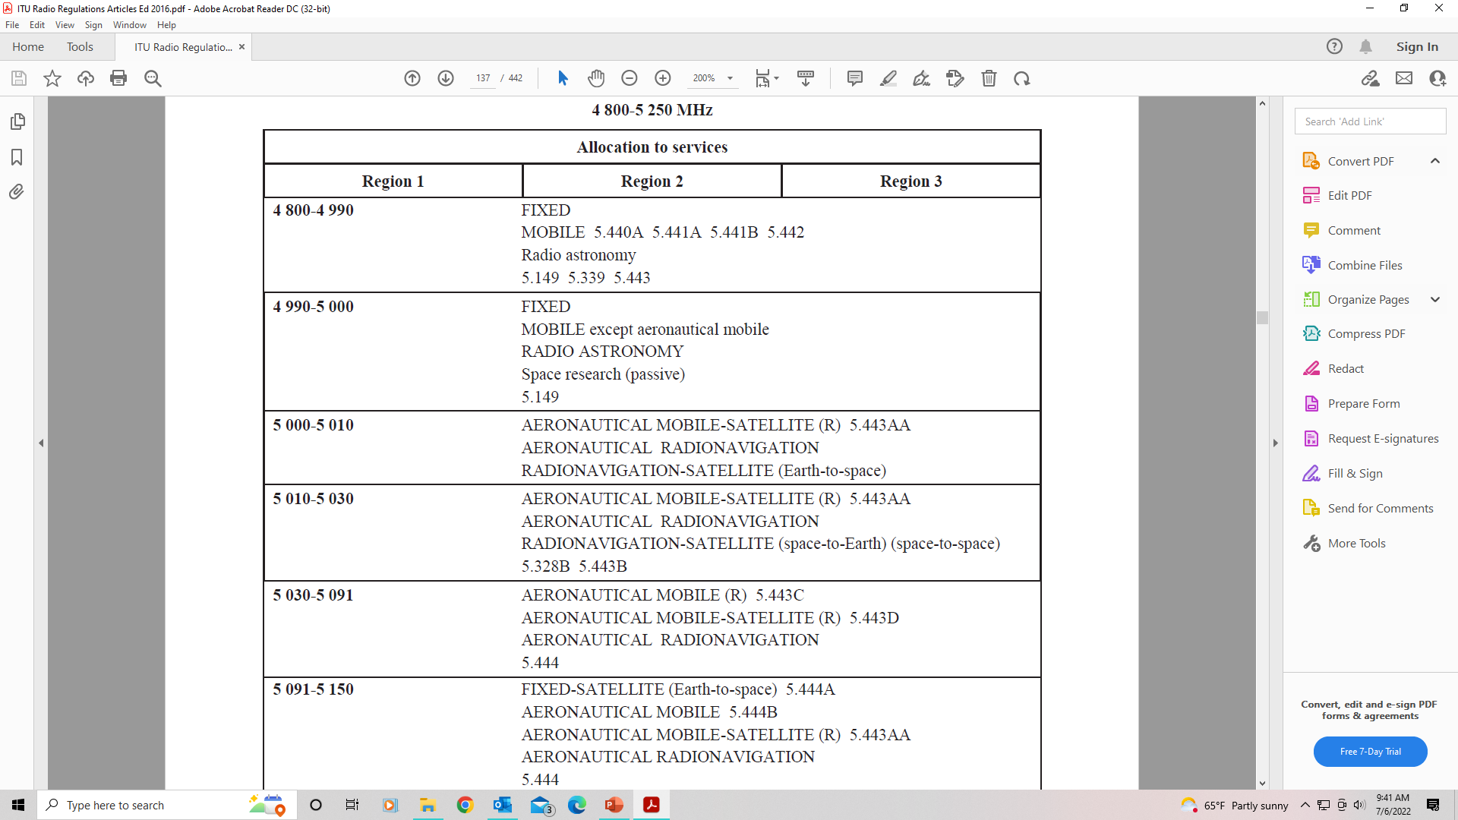
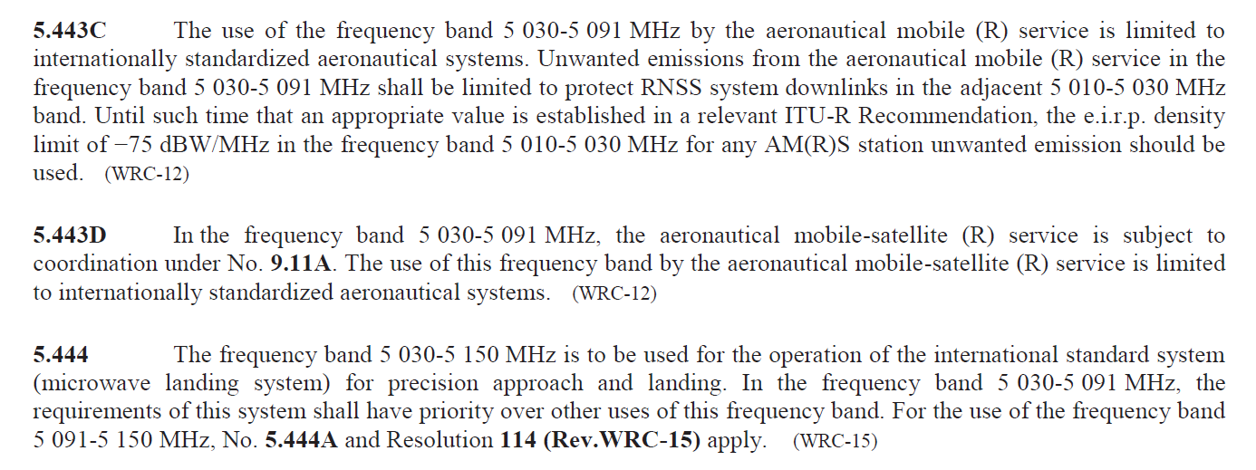
ITU Radio Regulations (5030-5091 MHz)

Slide 13
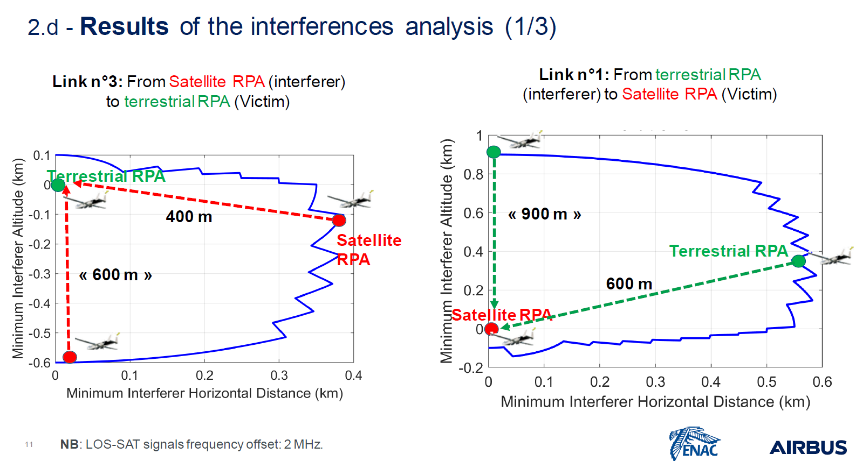
Terrestrial/Satcom Mutual Interference Analysis

Slide 14
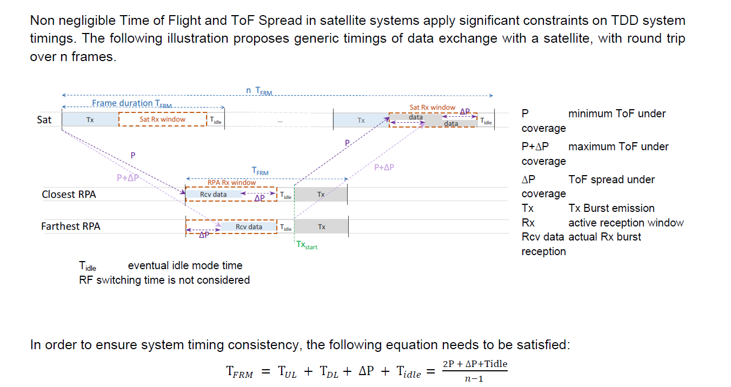
TDD Frame Timing Constraints for Geostationary Satellites

Slide 15
TDD Frame Time Guard Requirements for Compatible C-band Systems
 | Terrestrial Fwd & Reverse Links¹ | High-Altitude Relay Fwd & Rev User Links^{1,2} | Regional Satellite Fwd & Rev User Links^{3,4} | Global Satellite Fwd & Reverse User Links^{3,5}
Minimum propagation distance | 100 m | 1.5 km | 36,510 km | 35,786 km
Maximum propagation distance | 462 km | 502 km | 38,790 km | 41,679 km
Minimum propagation delay | 333 ns | 5 μs | 121.7 ms | 119.3 ms
Maximum propagation delay | 1.5 ms | 1.7 ms | 129.3 ms | 138.9 ms
Propagation delay spread | 1.5 ms | 1.7 ms | 7.6 ms | 19.6 ms
Tx-Rx +Rx-Tx switching guard times | 2.5 ms | 2.3 ms | 2.4 ms | 1.8 ms
Minimum Propagation Delay Spread + T/R Switching guard times | 4.0 ms | 4.0 ms | 10.0 ms | 21.4 ms
Note 1: Assumes maximum altitude of UA is 55,000 feet
Note 2: Assumes altitude of High-Altitude Relay platform is 60,000 to 65,000 feet
Note 3: Assumes altitude of Geostationary Satellite altitude is 35,785 km, Earth Radius is 6,378 km
Note 4: Assumes N25⁰ to N50⁰ latitude coverage and ±25⁰ longitude coverage over continental US only
Note 5: Assumes ±70⁰ latitude coverage and ±64⁰ longitude global beam coverage at 0⁰ elevation limit

Slide 16
TDD C-band System Spectrum Usage Efficiency vs TDD Frame Duration
n | TDD Frame Duration (ms) | Time Guard Duration (ms) | Fwd Link Tx + Rev Link Tx Bursts Duration (ms) | Channel Utilization Efficiency | Number of Tx Slots N per Fwd/Rev | Tx Slot Duration² (ms) | TDD Frame Delay¹ (ms)
2 | 260 | 21.4 | 2 x 119.3 = 238.6 | 91.8% | 32 | 3.73 | 148.1
3 | 130 | 21.4 | 2 x 54.3 = 108.6 | 83.5% | 10 | 5.43 | 86.6
4 | 86.67 | 21.4 | 2 x 32.635 = 65.27 | 75.3% | 4 | 8.16 | 70.4
5 | 65 | 21.4 | 2 x 21.8 = 43.6 | 67.0% | 2 | 10.9 | 65.0
6 | 52 | 21.4 | 2 x 15.3 = 30.6 | 58.8% | 1 | 15.3 | 67.3
DO-362A Terrestrial | 50 | 4.0 | 2 x 23 = 46.0 | 92% | 1 | 23.0 | 73
Note 1: Equal to 1 TDD Frame minus (N-1) Tx Slot durations transmitter latency plus 1 Rx burst slot duration receiver latency. Propagation path delay is not included.
Note 2: Tx Slot duration = Burst duration/Number Tx Slots N

