Slide 1
Use of the Fixed Satellite Service for RPAS/UAS C2 Links -
ITU-R Status Update
FSMP WG/05
Regional Spectrum Seminar
11-12 September 2017, M Neale

Slide 2
ITU-R Status Update
At WRC 2015 Resolution 155 was adopted
This presentation considers all of the resolves in the Resolution and discuss ITU-R’s status
  General Considerations
  Coordination Considerations
  Harmful Interference Considerations
  Non-RPAS/UAS System Protection Considerations
  RPAS/UAS System Considerations
  ICAO Considerations

Slide 3
At WRC 2015 Resolution 155 was adopted
General Considerations
  resolves
  1 that assignments to stations of geostationary FSS satellite networks operating in the
  frequency bands 10.95-11.2 GHz (space-to-Earth), 11.45-11.7 GHz (space-to-Earth), 11.7-12.2 GHz
  (space-to-Earth) in Region 2, 12.2-12.5 GHz (space-to-Earth) in Region 3, 12.5-12.75 GHz (space to-
  Earth) in Regions 1 and 3 and 19.7-20.2 GHz (space-to-Earth), and in the frequency bands
  14-14.47 GHz (Earth-to-space) and 29.5-30.0 GHz (Earth-to-space), may be used for UAS CNPC
  links in non-segregated airspace*, provided that the conditions specified in resolves below are met;
  2 that earth stations in motion on board UA may communicate with the space station of a
  geostationary FSS satellite network operating in the frequency bands listed in resolves 1 above,
  provided that the class of the earth station in motion on board UA is matched with the class of the
  space station and that other conditions of this Resolution are met (see also instructs the Director of
  the Radiocommunication Bureau 3 below);
  3 that the frequency bands specified in resolves 1 shall not be used for the UAS CNPC links
  before the adoption of the relevant international aeronautical standards and recommended practices
  (SARPs) consistent with Article 37 of the Convention on International Civil Aviation, taking into
  account instructs the Director of the Radiocommunication Bureau 4;
Ku and Ka FSS Bands
ITU-R Bureau has created the UG class
ICAO RPAS Panel is developing SARPS to be Effective by 2022

Slide 4
At WRC 2015 Resolution 155 was adopted
Coordination Considerations
  resolves
  4 that administrations responsible for an FSS network providing UA CNPC links shall
  apply the relevant provisions of Articles 9 (necessary provisions need to be identified or developed)
  and 11 for the relevant assignments, including, as appropriate, assignments to the corresponding
  space station, specific and typical earth station and earth station in motion on board UA, including
  the request for publication in BR IFIC of items referred to in resolves 2 and the course of actions
  identified in that resolves in order to obtain international rights and recognition as specified in
  Article 8;
  9 that the use of assignments of a FSS satellite network for UAS CNPC links shall not
  constrain other FSS satellite networks during the application of the provisions of Articles 9 and 11;
  10 that the introduction of UAS CNPC links shall not result in additional coordination
  constraints on terrestrial services under Articles 9 and 11;
RPAS/UAS Earth Stations (Air and Ground) are to be coordinated using the same process as other FSS networks and not be given any special status during coordination

Slide 5
At WRC 2015 Resolution 155 was adopted
Harmful Interference Considerations
  resolves
  13 UAS CNPC links shall:
    – ensure that the use of UAS CNPC links be in accordance with the international standards
    and recommended practices (SARPs) consistent with Article 37 of the Convention on
    International Civil Aviation;
    – take the required measures, consistent with No. 4.10, to ensure freedom from harmful
    interference to earth stations on board UA operated in accordance with this Resolution;
    – act immediately when their attention is drawn to any such harmful interference, as
    freedom from harmful interference to UAS CNPC links is imperative to ensure their safe
    operation, taking into account resolves 11;
    - use assignments associated with the FSS networks for UAS CNPC links (see Figure 1 in
    Annex 1), including assignments to space stations, specific or typical earth stations and
    earth stations on board UA (see resolves 2), that have been successfully coordinated under
    Article 9 (including provisions identified in resolves 4) and recorded in the Master
    International Frequency Register (MIFR) with a favorable finding under Article 11,
    including Nos. 11.31, 11.32 or 11.32A where applicable, and except those assignments
    that have not successfully completed coordination procedures under No. 11.32 by
    applying Appendix 5 § 6.d.i;
    – ensure that real-time interference monitoring, estimation and prediction of interference
    risks and planning solutions for potential interference scenarios are addressed by FSS
    operators and UAS operators with guidance from aviation authorities;
RPAS/UAS CNPC Links require careful monitoring and immediate action to be taken to minimize the potential for any safety effects due to harmful interference

Slide 6
At WRC 2015 Resolution 155 was adopted
Non-RPAS/UAS System Protection Considerations
  resolves
  8 that earth stations of UAS CNPC links of a particular FSS network shall not cause more
  interference to, or claim more protection from, stations of terrestrial services than specific or typical
  earth stations of that FSS network as indicated in resolves 5 that have been previously coordinated
  and/or notified under relevant provisions of Articles 9 and 11;
  14 that, unless otherwise agreed between the administrations concerned, UA CNPC earth
  stations shall not cause harmful interference to terrestrial services of other administrations (see also
  Annex 2);
  15 that, in order to implement resolves 14 above, power flux-density hard limits need to be
  developed for UAS CNPC links; one possible example of such provisional limits to protect the fixed
  service is provided in Annex 2; subject to agreement between the administrations concerned, that
  annex may be used for the implementation of this Resolution;
  16 that the power flux-density hard limits provided in Annex 2 shall be reviewed and, if
  necessary, revised by the next conference;
  17 that, in order to protect the radio astronomy service in the frequency band
  14.47-14.5 GHz, administrations operating UAS in accordance with this Resolution in the frequency
  band 14-14.47 GHz within line-of-sight of radio astronomy stations are urged to take all practicable
  steps to ensure that the emissions from the UA in the frequency band 14.47-14.5 GHz do not exceed
  the levels and percentage of data loss given in the most recent versions of Recommendations
  ITU-R RA.769 and ITU-R RA.1513;
Pfd masks are required to protect the terrestrial services, in particular the FS
Out of band emissions also need to be considered

Slide 7
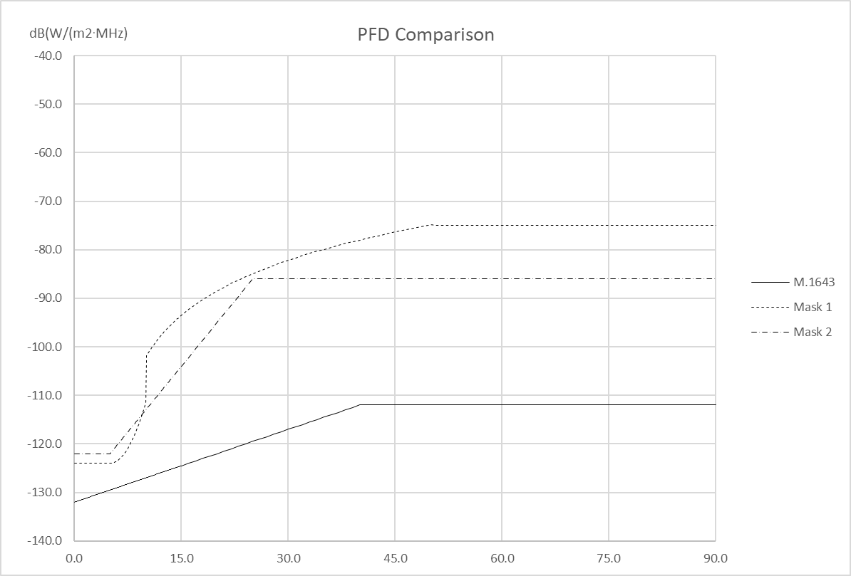
PFD Mask to Protect the Fixed Service
WP 5B is reviewing the ITU-R M.1643 based mask from Annex 2 of Resolution 155 (WRC-15). Alternate masks are being developed with the intent to review/revise the pfd mask during the next conference (WRC-19) as indicated in resolves 6
During its May 2017 meeting WP 5C provided WP 5B with the appropriate FS characteristics (5B/308) to be used in this pfd analysis
Further discussion will take place at the upcoming WP 5B meetings

Slide 8
At WRC 2015 Resolution 155 was adopted
RPAS/UAS System Considerations
  resolves
  5 that earth stations of UAS CNPC links shall operate within the notified and recorded
  technical parameters of the associated satellite network, including specific or typical earth stations of
  the geostationary FSS satellite network(s) as published by the Radiocommunication Bureau;
  6 that earth stations of UAS CNPC links shall not cause more interference to, or claim more
  protection from, other satellite networks and systems than specific or typical earth stations as
  indicated in resolves 5 as published by the Bureau;
  7 that, in order to apply resolves 6 above, administrations responsible for the FSS network
  to be used for UAS CNPC links shall provide the level of interference for the reference assignments
  of the network used for CNPC links upon request by an administration authorizing the use of UAS
  CNPC links within its territory;
WP 5B is developing CNPC Link characteristics to enable:
WP 5B to analyze compliance with the appropriate Radio Regulations
ICAO to perform its work on SARPs . Reference liaisons from RPASP/FSMP to WP 5B FSMP-WG/3-WP/04 and FSMP-WG/4 WP/12

Slide 9
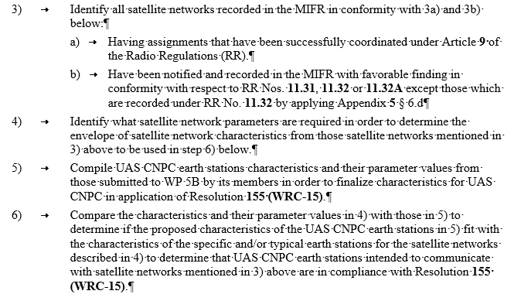
CNPC Link Characteristics
Guidelines extracted from Annex 27 of the May WP 5B meeting Chairman's Report 5B/305
During its May meeting WP 5B developed Guidelines on how RPAS/UAS CNPC Link characteristics should be developed.
3+4) All of the appropriately coordinated Earth stations in the MIFR will be reviewed to develop maximum and minimum values of key parameters that could affect interference and link performance
5) CNPC Link characteristics will be proposed
6) The MIFR derived Earth station characteristics will be compared with the proposed CNPC Link characteristics to see if the CNPC Link characteristics comply

Slide 10
At WRC 2015 Resolution 155 was adopted
ICAO Considerations
  Resolves
  11 that earth stations on board UA shall be designed and operated so as to be able to accept
  the interference caused by terrestrial services operating in conformity with the Radio Regulations in
  the frequency bands listed in resolves 1 without complaints under Article 15;
  12 that earth stations on board UA shall be designed and operated so as to be able to operate
  with interference caused by other satellite networks resulting from application of Articles 9 and 11;
  18 to consider the progress obtained by ICAO in the process of preparation of SARPs for
  UAS CNPC links, to review this Resolution at WRC-23, taking into account the results of the
  implementation of Resolution 156 (WRC-15), and to take necessary actions as appropriate;
ICAO needs to consider harmful interference in its SARPs
ICAO should attempt to complete its FSS related SARP amendments prior to 2023

