Slide 1
Alignment of ITU and ICAO frequency databases

Slide 2
Background
ITU Master Register is a worldwide frequency database for all services
Frequency Finder is worldwide database for aeronautical frequencies
In 2012 comparison between ITU and ICAO databases showed that ICAO data are more accurate and up-to-date
WRC-12 considered the matter and invited ICAO/ITU to align databases
WG-F discussed the issue in September 2012 and March 2014

Slide 3
Problems and Solutions
Problem 1: the format, structure and parameters of ICAO database and the MIFR are different. Solution: development of a notice generation tool for converting data and generating ITU notifications. Status: completed.
Problem 2: aviation authorities are not permitted to update Master Register. ITU administrations have no access to the ICAO database. Solution: make ICAO data available for ITU through Web. Status: ongoing
Problem 3: ITU administrations may have difficulties to compare the MIFR and ICAO data to identify updates to Master Register. Solution: development of a comparison tool. Status: completed. Both tools are linked in TerRaNotices.
Problem 4: aeronautical data are sensitive and shall not be publically available. Solution: 2 levels of protection (discussed further in this presentation). Status: ongoing

Slide 4
Update of ITU database (standard)
ITU database (MIFR)
BR IFIC*
Query data
ITU Administrations
(Regulators)
Publishing
Preparation of notifications
Notification
(T12, T13, etc.)
ITU Secured Web notification portal
TerRaNotices
* BR IFIC: BR International Frequency Information circular

Slide 5
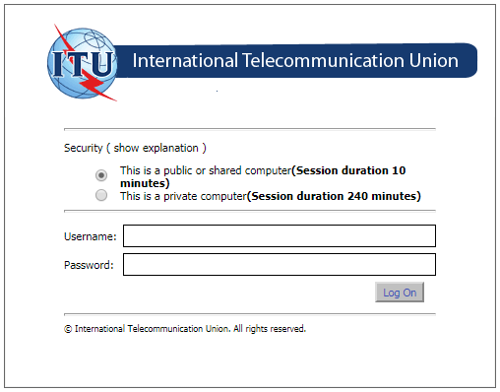
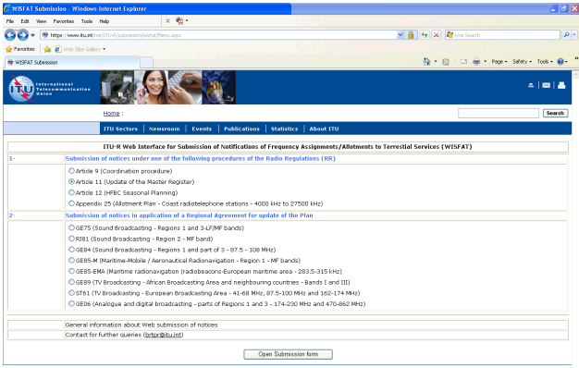
ITU Secured Web notification portal

Slide 6
Proposed interface with ICAO database
ICAO global database (Web,
Frequency Finder)
Secured data transfer`
every 2
weeks
ITU secured Web
Password
Adm. A can access only to its own ICAO data
ITU Administration
TerRaNotices
MIFR
Web
Notes:
To the date, the ICAO granted access to its database for the ITU. WE plan ITU intends to place the ICAO data on a secure ITU web service. There will be no possibility to consult the data directly. 2 levels of protection.
The ICAO data could be read only through ITU software TerRaNotices, which will have a link to this web service. Administrations will be permitted to work only with the data related to its country.
How telecom regulator learn about changes to ICAO database ? 2 ways: by regular running comparison tool. 2 there will be a unique key in the both fdatabases. Aviation authority could tell telecom regulator: please notify modifications to those keys.

Slide 7
ITU Terrestrial System overview
ITU database + Web (ICAO data)
Query data
Publishing
BR IFIC*
ITU Administrations
(Regulators)
ICAO data via
ITU Secured Web
Notification
(T12, T13, etc.)
ITU Web notification portal
TerRaNotices
1. Cross-comparison of ICAO and ITU data.
2. Generation of the correct notifices
Notes:
Role of aviation authorities
It will be fully up to the ITU administration to decide whether notify or not aeronautical frequencies. What we are doing is just to make available a mechanism and tools to enable such notifications. Recording in the MIFR could be helpful. For example, if there are sharing rules for aeronautical and PMSE are established how the telecom regulator will know about DME equipment? This could be through MIFR.

Slide 8
T h a n k y o u, Robert !

