Slide 1
Getting started

Slide 2
Login procedure
URL: http://stats.icao.int
User name: the initial of your first name plus your surname
Password: the password assigned to you

Slide 3
Terms and conditions
The first time you login you will be asked to agree to the ICAO Terms and conditions associated with this site.
Subsequently, you can review these at any time by clicking on the appropriate link on the right hand bottom of the Home page.

Slide 4
Home page
Buttons to select data module. Buttons with darkened legend are not available for selection.

Slide 5
Basic tools

Slide 6
Main tool bar Main icons
Clears all selections,
including
default values. Recommend to use the Reset button.
Lock/unlock
selections
Bookmark selections for later use or to share
Retrieves saved
bookmarks

Slide 7
View and download data
Resets data selection. Should be clicked before making a new selection. Unless changed, the data selection is kept for all relevant tabs (identified by green square in the tab)
Tabs indicate different views of the basic data
Active tab
indicating current view
Original data selection can be viewed in these tabs
Downloads whole data selection into an Excel spreadsheet
(double click on this object, then click on the Excel symbol)

Slide 8
Example of basic data

Slide 9
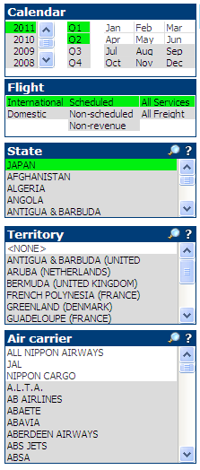
Selecting data
All selected items are shown with a green background. All other data which are available for that selection will be shown with a white background.
Default values: International, scheduled, all services
State(s) selected. For multiple selections (two or more States) use Ctrl-click
To go directly to the entity concerned click on the magnifying glass and type name of entity you want to search in the box.
After the time period and State(s) are selected, this window will show which carriers are available (white background). One can also skip State and select air carriers directly.
A white X in a red circle against an
entity (State, territory, air carrier)
signifies that that entity no longer exists.

Slide 10
Special icon - Tables
Clicking on this icon allows the same column to show different values, e.g. TKP- Passengers, TKP- Freight, TKP- Mail .

Slide 11
Special icon - Graphics
Clicking on this icon allows to move quickly between different views of the data; e.g. Air carrier, Aircraft manufacturer, Aircraft manufacturer groups

Slide 12
Create a bookmark to share data

Slide 13
Main body
Buttons to select data type. Data were split into three categories so that each one would fit into a single screen.
Current active view
Make sure data for the same time period are available in both years for dials to show the correct percentage change

Slide 14
Example of graphical page

Slide 15
Download and print graphs
Downloads data used in the graph to Excel.
Enable pop-ups.
Print graph

Slide 16
Selecting a sub-set
To select a particular sub-set of the data shown in a chart, use your mouse and, keeping your left hand button in the click mode, highlight the entities concerned. This will select the data corresponding to the entities which are contained in the highlighted section for further analysis.
Highlight

Slide 17
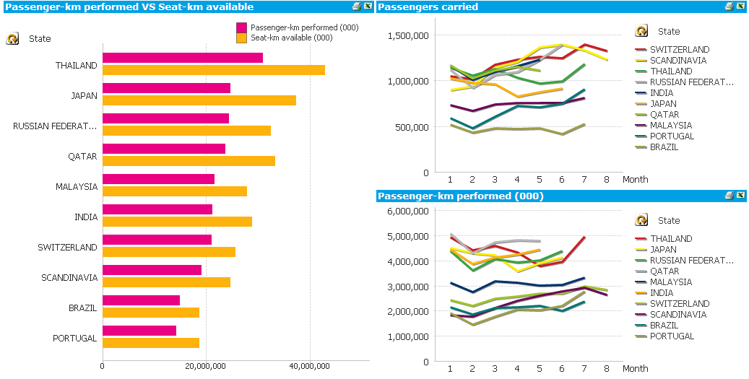
Selecting a sub-set (continued)
Data from the highlighted section in the previous slide

Slide 18
(ACT)

Slide 19
Special features
Toggles back and forth between Reported traffic to Total traffic, where:
Reported traffic are the data that were actually reported to ICAO; and
Total traffic represents the reported traffic plus the estimated data for the non-reporting air carriers

Slide 20
(ACT)

Slide 21
Special features
City-pair distance in km based on the coordinates of the principal airport in each city.
When selection is made on a from/to basis (e.g. from London to Paris), click on this button to see the data for the opposite direction (e.g. from Paris to London).

Slide 22
(ACT)

Slide 23
Special features
Shows the definition of the fiscal year for the selected air carriers
Shows the exchange rate used to convert the data from reported currency to US Dollars

Slide 25
Special features
The Reported data tab shows the accumulated total monthly traffic figures. This button allows to see the reported data for the individual months.
Please note that some airports only report a single annual set of figures.

Slide 27
Special features
List of air carriers which reported traffic data for the city-pairs selected.
When selection is made on a from/to basis (e.g. from London to Paris), click on this button to see the data for the opposite direction (e.g. from Paris to London).
City-pair distance in km based on the coordinates of the principal airport in each city.

Slide 28
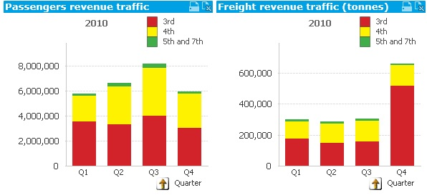
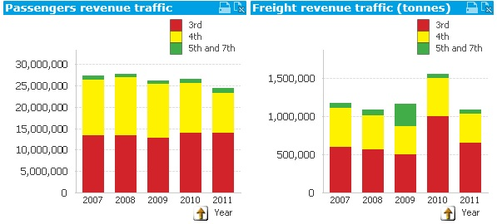
Special features
Toggle button to change the view from a quarterly trend in a single year to a trend over multiple years

Slide 30
Special features
Shows the definition of the fiscal year for the selected air carriers
Toggles back and forth between the Fleet and Personnel data for the air carriers selected

Slide 31
Additional information is available in the FAQ file
For assistance please contact
dataplus@icao.int

