Slide 1

FSMP-WG/17-WP/09
2023-08-30
Frequency Spectrum Management Panel (FSMP)
Seventeenth Working Group meeting
Cairo, Egypt, 30 August-7 September 2023
WRC-23 AI 1.7: Assumptions for “Reverse-link” Adjacent-band interference Studies
Prepared by Michael Tran
Date: 14 August 2023

Slide 2
BLUF: Bottom Line Up Front
Reverse link studies have used assumptions to show unacceptable interference to the AMS(R)S Space Station receiver using ITU-R Recommendations; however, using those same emission characteristics would result in unacceptable interference to the AM(R)S aircraft receiver.
We know the AM(R)S is not being interfered with today, so the out-of-band (OOB) emissions assumptions used in the AI 1.7 WRC-23 studies may not reflect what really operates
The systems operating on both sides of the 137 MHz frequency perform better than the generic ITU-R Recommendations for OOB emissions
  ITU-R Recommendations include adjacent-channel OOB emissions that are better than the generic recommendation
This presentation only discusses the assumptions used in ITU-R WP5B studies and FSMP inputs and does not suggest a regulatory course of action for WRC-23 Agenda Item 1.7 or any changes to ITU-R documents.
Notes:
Rec ITU-R SM.1541, Unwanted Emissions in OOB, recommends 4 that spectrum limits specified in this Recommendation should be regarded as generic limits, which generally constitute the least restrictive OOB emission limits. They are intended for use in bands where tighter limits are not otherwise required to protect specific applications (e.g. in areas having a high radiocommunications density). The spectrum mask in Annex 5 of Rec ITU-R SM.1541 is for 1-20 GHz band, not 137-138 MHz band.
The band 137-138 MHz is shared by 4 space services (SOS, MetSat, MSS, and SRS) (space-to-Earth) operating in channel assignments with the proposed 3 very large constellations (each constellation of 300+ satellites) for SOS, MSS, and MetSat. Such dense channels in only 1 MHz allocation will require steep adjacent-channel OOB attenuation to minimize the adjacent-channel interference. Rec ITU-R SM.1541 recommends 3 provides guidance for adjacent-channel OOB attenuation in Annex 1, where an example of adjacent-channel OOB attenuation is in Annex 1, appendix 1.
In the band 137-138 MHz, MSS is required to protect RAS in 150.05-153 MHz band (No. 5.208A & No. 5.208B). Other space services (SOS, SRS, and MetSat) also take this RAS protection into consideration. RAS protection requires very steep OOB attenuation near its channel edges in order to protect RAS in 150.05-153 MHz band (see SOS-SD measured spectrum mask in slide 10 to protect RAS).
Studies in WRC-23 AI 1.7 show interference to AMS(R)S SS receiver, but those emissions would also interfere with adjacent-channels of space services in 137-138 MHz band, as well as with adjacent-band terrestrial AM(R)S VDL-M2 at 136.975 MHz, so we know the systems operating on both sides of 137 MHz have to perform better than ITU-R SM.1541 recommendation. Slides 15 and 16 show that, when using adjacent-channel OOB attenuation (SM.1541, Annex 1, Appendix 1) together with RAS protection limits in 150.05-153 MHz band, the adjacent-band interference of space services in 137-138 MHz band didn’t exceed the protection levels of AMS(R)S SS receiver (with C/I = 15 / 20 / 30 dB).

Slide 3
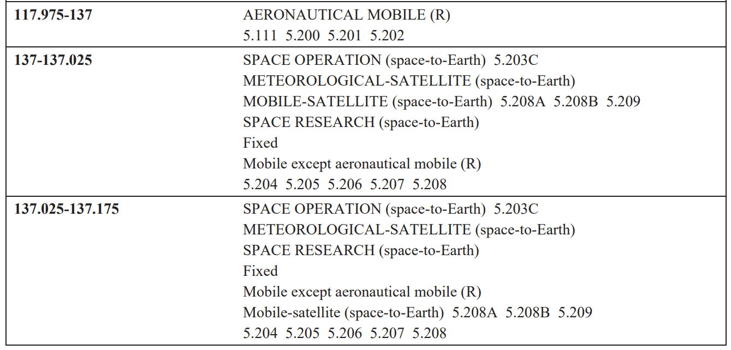
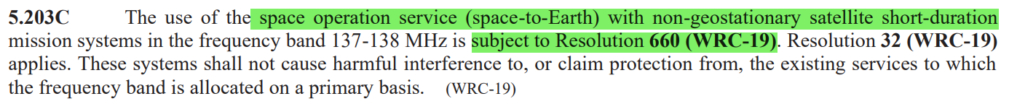
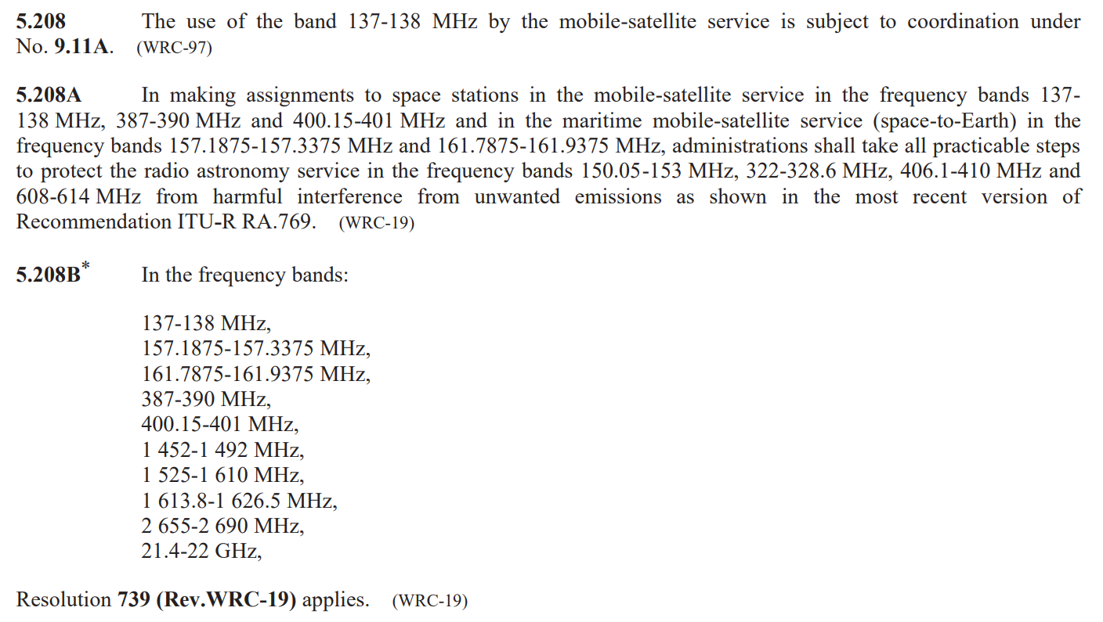
Radio Regulations – Allocation
FN 5.208A - ITU-R RA.769: -259 dBW/m²/Hz = -223 dBW/m²/4kHz in RAS 150.05-153 MHz
FN 5.208B - Res 739: -238 dBW/m² in 2.95 MHz = -266.7 dBW/m²/4kHz in RAS 150.05-153 MHz
3
Notes:
Key points:
The Allocations above 137 MHz are crowded with many satellites proposed to operate. Each system must have good OOB emissions or they won’t work with themselves or protect RAS.
The band 137-138 MHz is shared by 4 space services (SOS, MetSat, MSS, and SRS) (space-to-Earth) operating in channel assignments and in very large constellations of 300+ satellites each for SOS, MSS, and MetSat. Such dense channels of these 3 very large constellations in only 1 MHz allocation will require steep adjacent-channel OOB attenuation in order to minimize the interference to adjacent channels of itself and other space services in addition to co-channel interference and overlapping interference (due to different channel bandwidths of space services). Rec ITU-R SM.1541 includes an example of adjacent-channel OOB attenuation in Annex 1, appendix 1.
MSS is subject to No. 9.11A (No. 5.208) and is required to protect RAS in 150.05-150 MHz band (No. 5.208A & No. 5.208B). Other space services (SOS, SRS, and MetSat) also take into consideration of this RAS protection. RAS protection requires very steep OOB attenuation around 70 dB down near its channel edges in order to achieve more than 100 dB down in RAS 150.05-153 MHz band (see SOS-SD measured spectrum mask in slide 10).
NGSO SOS-SD is subject to Resolution 660 (WRC-19).

Slide 4
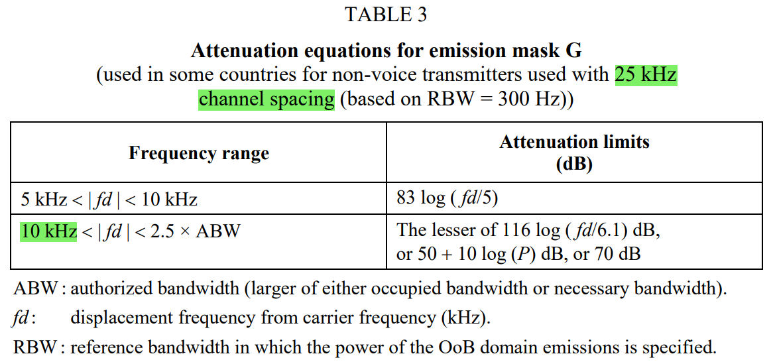
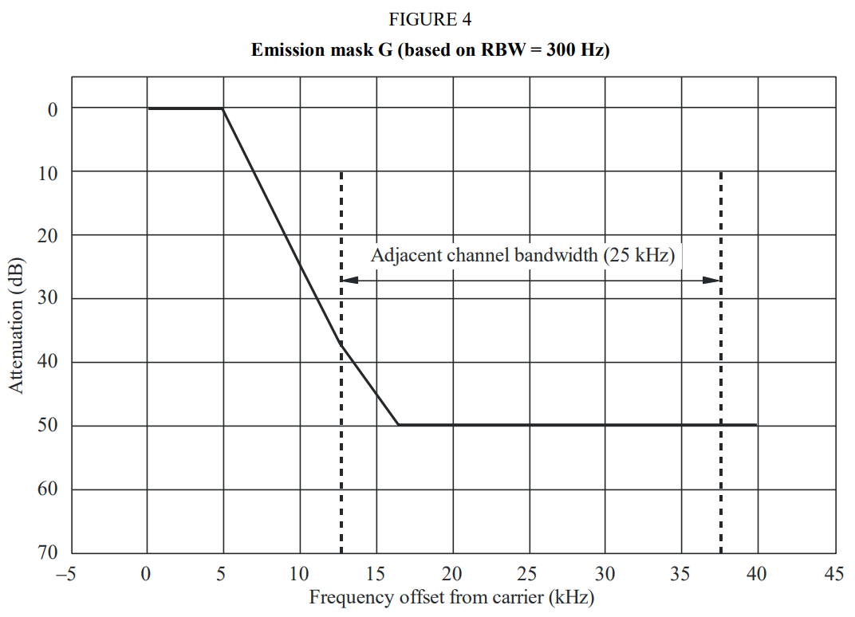
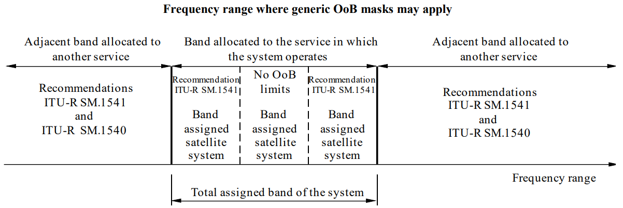
Rec SM.1541 – Unwanted emissions in OOB
Annex 1 – appendix 1
recommends
4 that spectrum limits specified in this Recommendation should be regarded as generic limits, which generally constitute the least restrictive OoB emission limits successfully used as national or regional regulations. These are sometimes called safety net limits. They are intended for use in bands where tighter limits are not otherwise required to protect specific applications (e.g. in areas having a high radiocommunications density). Applicability of Recs SM.1541 and SM.1540 in Annex 14.
Annex 5: OOB mask for SRS, SOS, EESS, s-E, in 1-20 GHz band, not 137-138 MHz band.
recommends
3 Methods to determine conformance to OOB emission limits – that the adjacent channel and alternate adjacent channel power method or OOB spectrum mask method described in Annex 1 should be used to determine conformance to OOB emission requirements.
Annex 14: Rec SM.1540 provides guidance in the case of emissions that are very close to the edges of the total assigned band and that have OoB domain emissions falling into an adjacent band allocated to another service.
4
Notes:
Key points:
1 SM.1541 provides recommendations for least restrictive generic limits AND recommendations for band edge and adjacent channel conditions.
2 Rec SM.1541 recommends 3 specifies Annex 1 for adjacent-channel OOB emission limits and Annex 1, Appendix 1 provides an example of very steep adjacent-channel OOB attenuation in order to minimize interference to very dense adjacent channels of 4 space services (SOS, MetSat, MSS, and SRS) in 137-138 MHz band. Note that the attenuation limits in Table 3 for systems with 25 kHz channel spacing is specified at 10 kHz, hence, within its channel edges (+/- 12.5 kHz from the channel center frequency).

Slide 5
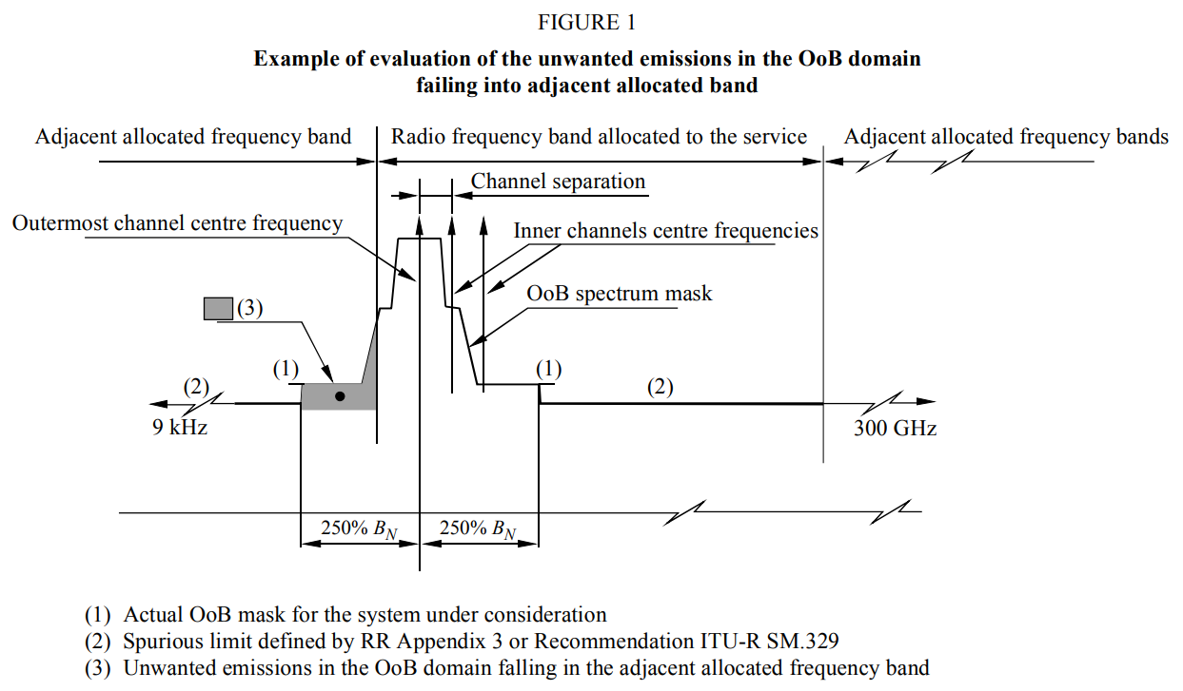
Rec SM.1540 – Unwanted emissions in OOB falling into adjacent allocated bands
Recommendation SM.1540 – Annex 1
recognizing
1.147 assigned frequency band: The frequency band within which the emission of a station is authorized; the width of the band equals the necessary bandwidth plus twice the absolute value of the frequency tolerance. Where space stations are concerned, the assigned frequency band includes twice the maximum Doppler shift that may occur in relation to any point of the Earth’s surface.
1.153 occupied bandwidth: The width of a frequency band such that, below the lower and above the upper frequency limits, the mean powers emitted are each equal to a specified percentage β/2 of the total mean power of a given emission. Unless otherwise specified in an ITU-R Recommendation for the appropriate class of emission, the value of β/2 should be taken as 0.5%.
recommends
1 that the necessary bandwidth, and preferably the overall occupied bandwidth, of any emission should be maintained completely within the band allocated to the service in question, including any offsets such as Doppler shift or frequency tolerances;
that the methodology described in Annex 1 should be
used as an example of a generic approach to addressing this problem.
Note: (3) in Figure 1 = 0.5% of total mean power of a given emission per RR No. 1.153. That is OOB mask down 23 dB at the allocated band-edge.
5
Notes:
Key Point:
For adjacent-band, need to use SM.1540, in addition to SM.1541 annex 1 appendix 1 and using the overall occupied bandwidth is preferred.
This would recommend the emission be at least 23 dB down at the band edge.

Slide 6
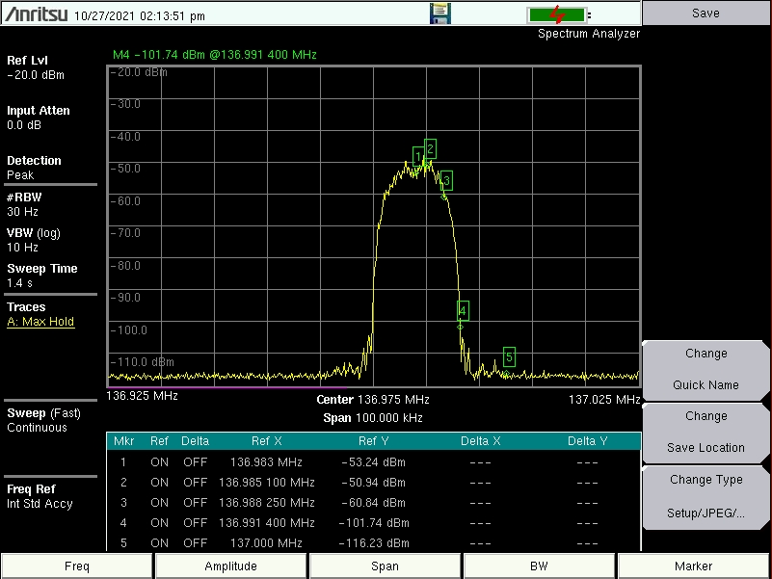
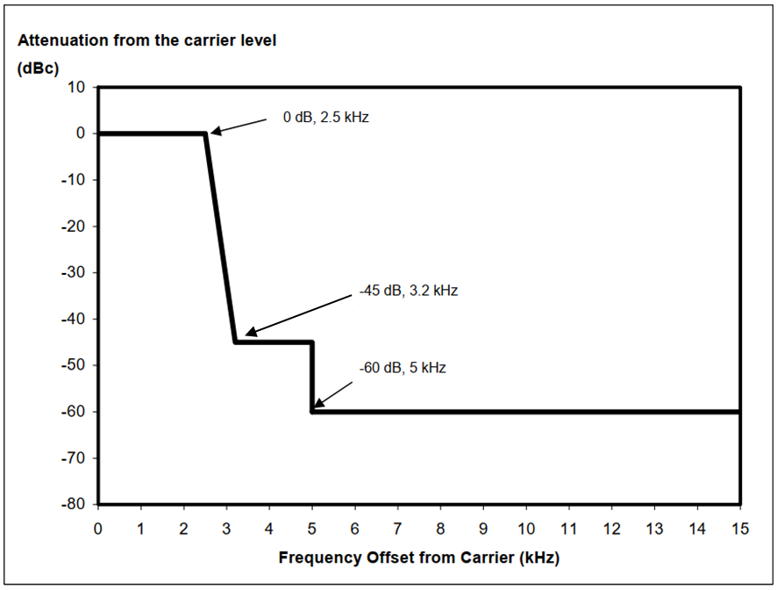
ICAO Annex 10 Volume 5, Chapter 4:
136.9-136.975 MHz is reserved for VHF data link (VDL)
136.975 MHz is reserved worldwide for VDL-M2 common signalling channel (CSC).
AMS(R)S SS VDL-M2 emission (14 kHz bandwidth) at 136.975 MHz is the worst-case channel to the services in 137-138 MHz.
AMS(R)S SS emission
Note: since adjacent-band protection criteria is much tougher than in-band protection criteria, adjacent-band interference study must analyze the interference at the center frequencies of victim receivers, in order to utilize the signal spectrum roll-off mask and any additional system filtering.
Spectrum mask for voice emission
Spectrum mask for VDL-M2 emission
Note: measured VDL-M2 (14 kHz bandwidth) spectrum mask is flat out after more than 60 dB down in 7 kHz from center frequency due to the noise setting of spectrum analyzer. Measured VDL-M2 spectrum mask should go further down beyond 7 kHz from center frequency.
Note: Both AM(R)S and AMS(R)S services meet the very steep adjacent-channel OOB attenuation within its channel edges, specified in Rec ITU-R SM.1541 recommends 3, Annex 1, Appendix 1.
6
Notes:
Key Point: The VDLM2 emissions are designed to have OOB emissions much better then the generic SM.1541 limits

Slide 7
Various protection levels used in studies for receivers in 137-138 MHz band
Service | MSS | MetSat | SOS | SRS
Protection level at receiver input, dBW/4kHz (from Table 11 of AI 1.7 Report in 1 kHz) | -166.7 | -166.8 | -158 (view1) -178 (view2) | -160 (view1) -180 (view2)
Demodulator implementation loss, dB | 3 | 0 | 0 | 0
Rx antenna gain, dBi | -0.5 | 10 | 12 | 3.2
Protection level at Rx antenna input, dBW/4kHz | -163.2 | -176.8 | -170 (view1) -190 (view2) | -163.2 (view1) -183.2 (view2)
dBW to dBW/m², dB | 4.2 | 4.2 | 4.2 | 4.2
Required PFD protection, dBW/m²/4kHz | -159 | -172.6 (view 1) -162.7 (Russia CPM) | -165.8 (view1) -185.8 (view2) -173.9 (Russia CPM) | -159 (view1) -179 (view2) -175.9 (Russia CPM)
From WRC-23 AI 1.7 Report and CPM text, the worst-case required PFD protection levels for ES receivers of MSS, MetSat, SOS, and SRS are shown in Table above. Note: some of these have time percentages.
7
Notes:
Key points: Some examples of protection levels used in the studies for adjacent-band services in the 137-138 MHz frequency band for comparison.

Slide 8
Various AM(R)S VDL-M2 adjacent-band protection levels for comparison purposes
Document 5B/481 Annex 24 provides the characteristics and in-band protection criteria (I/N = -10/-6 dB & aeronautical safety margin (6 dB)) for AM(R)S VLD-M2. This document does not have an adjacent-band protection criteria. There are examples of ITU adjacent-band protection criteria (I/N = -20 dB in ITU-R F758; I/N = -20 dB (1% of clear-sky system noise) in ITU-R S.1432; I/N = 1% of the protection criteria = -26 dB in ITU-R SA.1743 that can be used for comparison.
AM(R)S VDL-M2 adjacent-band protection level in 136-137 MHz
Station type | Base station | Aircraft
Thermal noise density, dBW/Hz | -204 | -204
Rx noise figure, NF, dB | 6 | 6
Receiver system noise density, dBW/Hz | -198 | -198
Assuming adjacent protection criteria, I/N, dB Note: -12 dB = -6 (I/N) -6 (ASM) | -10 / -12 / -20 | -10 / -12 / -20
Max RFI power density, dBW/Hz | -218 | -218
Max RFI power density, dBW/4 kHz | -182 | -182
dBW to dBW/m^2, in dB | 4.2 | 4.2
Receiver antenna gain, dBi | 2.2 | 0
Max RFI PFD at antenna input, dBW/m^2/4kHz | -170 / -172 / -180 | -167.8 / -169.8 / -177.8
Notes:
Key Points: Some potential max PFD levels for the AM(R)S that have been proposed in WP5B. These have not been agreed to by WP5B.

Slide 9
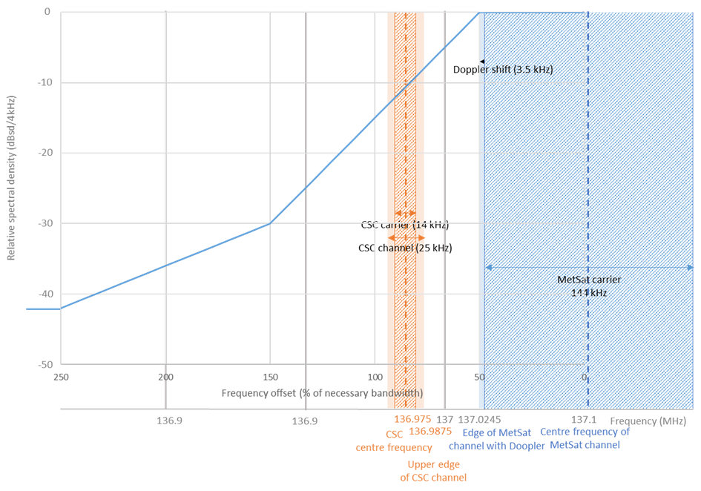
MetSat emissions to AMS(R)S Satellite receiver
-136 dBW/m²/4 kHz
MetSat (s-E) , 1 of studies in AI 1.7 report
Using RR No. 1.153, Recs SM.1540, SM.1541 Annex 1, 1.1, guidance is for the OOB mask to be at least 23 dB down at 137 MHz.
Rec SM.1541 annex 1 app 1 provides guidance for adjacent channel attenuation of (50 + 10 log(P) = -55 dB down) at its channel edge
PFD on Earth Surface = -136 dBW/m²/4 kHz
Metsat OOB emissions used in study would interfere to 6 SOS adjacent channels (view 1) and 10 SOS adjacent channels (Russia CPM view) and 5 MSS adjacent channels of 25 kHz, on each side of MetSat channel.
OOB emissions must be better than the generic mask to support systems that use more than one channel and multiple services
Finally, the MetSat OOB emissions studied would interfere with AM(R)S VDL-M2 CSC.
-146 dBW/m²/4 kHz
Range of AM(R)S VDL-M2 protection:
(-10 dB I/N) -167.8
(-12 dB I/N) -169.8
(-20 dB I/N) -177.8 dBW/m²/4 kHz
Note: per slide 7,
SOS protection is -165.8 (view 1) or -173.9 (Russia CPM view) dBW/m²/4kHz
MSS protection is -159 dBW/m²/4kHz
Notes:
Key Points: Using the OOB emission assumptions in the A1.7 WRC-23 studies for MetSat would interfere with the terrestrial VDLM2 aircraft receiver and we know this isn’t happening.

Slide 10
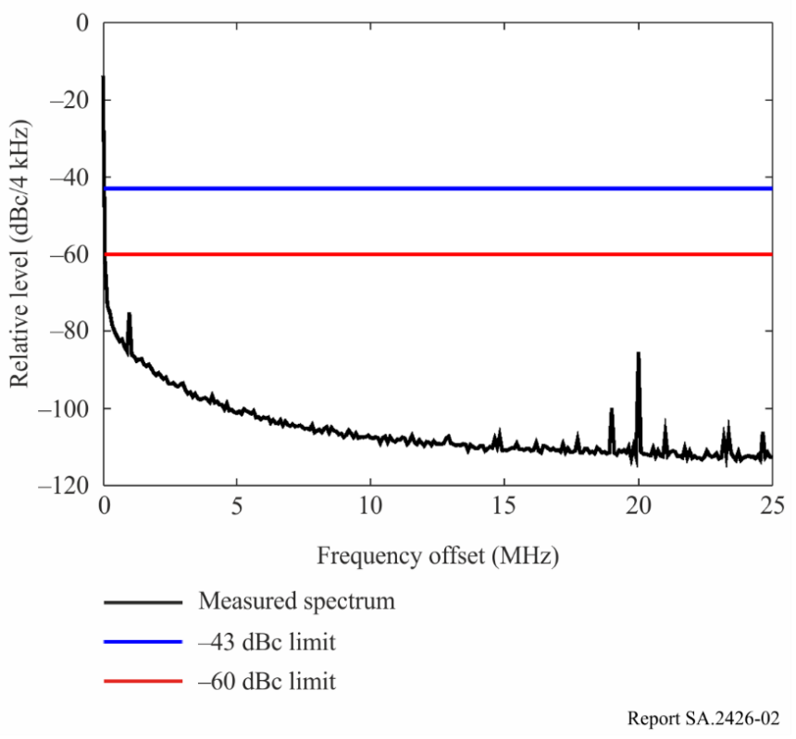
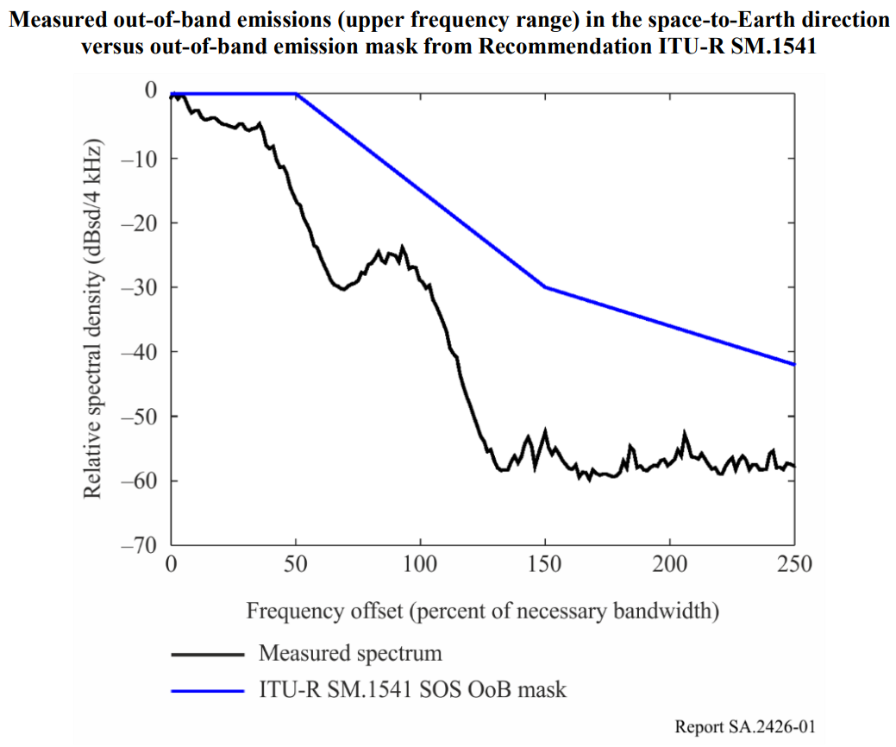
NGSO SOS-SD (s-E) – Resolution 660 (WRC-19)
Allocated band: 137.025 – 138 MHz
PFD = −140 dB(W/(m2 · 4 kHz)) at the Earth’s surface
Considering d): overall occupied BW completely in allocated band, including Doppler shift or frequency tolerances. Hence, for a 25 kHz channel BW, 1st channel center frequency is at 137.0375 MHz and a max necessary bandwidth is 18 kHz (25 – 2*3.5) using 3.5 kHz Doppler shift.
ITU-R Reports SA.2425, SA.2426, and SA.2427
NGSO SOS-SD
ITU-R RA.769: -259 dBW/m²/Hz (-223 dBW/m²/4kHz) in RAS 150.05-153 MHz
Res 739: -238 dBW/m² in 2.95 MHz = -266.7 dBW/m²/4kHz in RAS 150.05-153 MHz
Note: measured SOS-SD spectrum mask is flat out after around 60 dB down (23 kHz from center frequency) due to the noise setting of spectrum analyzer. Measured SOS-SD spectrum mask continues to go down quickly to around 70 dB down before slowing down to around 110 dB down (15 MHz away) to protect RAS in 150.05-153 MHz band. Since AMS(R)S is 62.5 kHz (347% SOS NBW of 18 kHz) away from SOS 1st channel center frequency, then the spectrum roll-off is likely around 70 dB down at 136.975 MHz.
10
Notes:
Key Points: The OOB emission assumptions used in the A1.7 (WRC-19) studies for SOS-SD would not interfere with the AMSRS sat receiver.

Slide 11
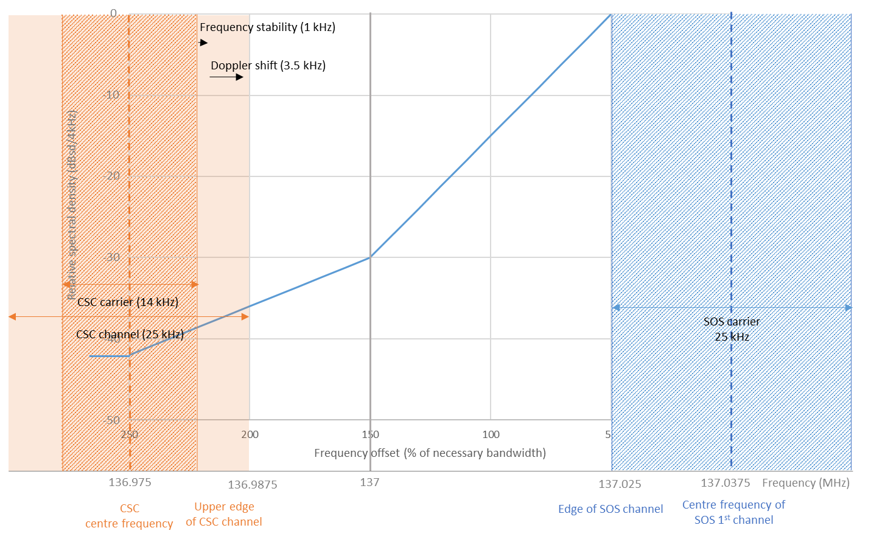
SOS emissions to AMS(R)S Satellite receiver
-140 dBW/m²/4 kHz
SOS (s-E), 1 of studies in AI 1.7 report
  max NBW = 18 kHz (25 – 2*3.5) per RR No. 1.147, not 25 kHz.
  Must use measured OOB mask from Report SA.2426 Figures 3 & 4 to protect RAS in 150.05-153 MHz since SOS OOB mask in SM.1541 Annex 5 is for 1-20 GHz band, not 137 MHz.
  This proposed mask will interfere to 1 SOS adjacent channel.
  SOS link budget do not support 18 kHz necessary BW and high altitude above 500 km.
Range of AM(R)S VDL-M2 protection:
(-10 dB I/N) -167.8
(-12 dB I/N) -169.8
(-20 dB I/N) -177.8 dBW/m²/4 kHz
Note: per slide 7,
SOS protection is -165.8 (view 1) or -173.9 (Russia CPM view) dBW/m²/4kHz
Notes:
Key Points: Using the OOB emission assumptions in the A1.7 WRC-23 studies for SOS would not interfere with the terrestrial VDLM2 aircraft receiver and we know this isn’t happening.

Slide 12
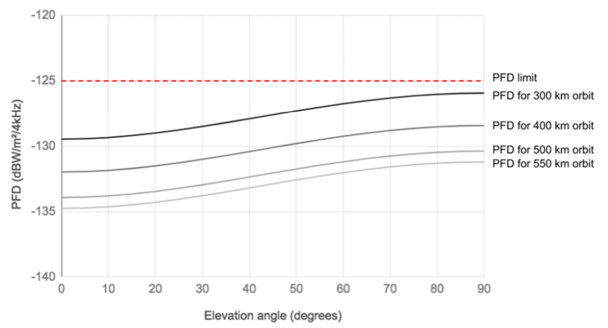
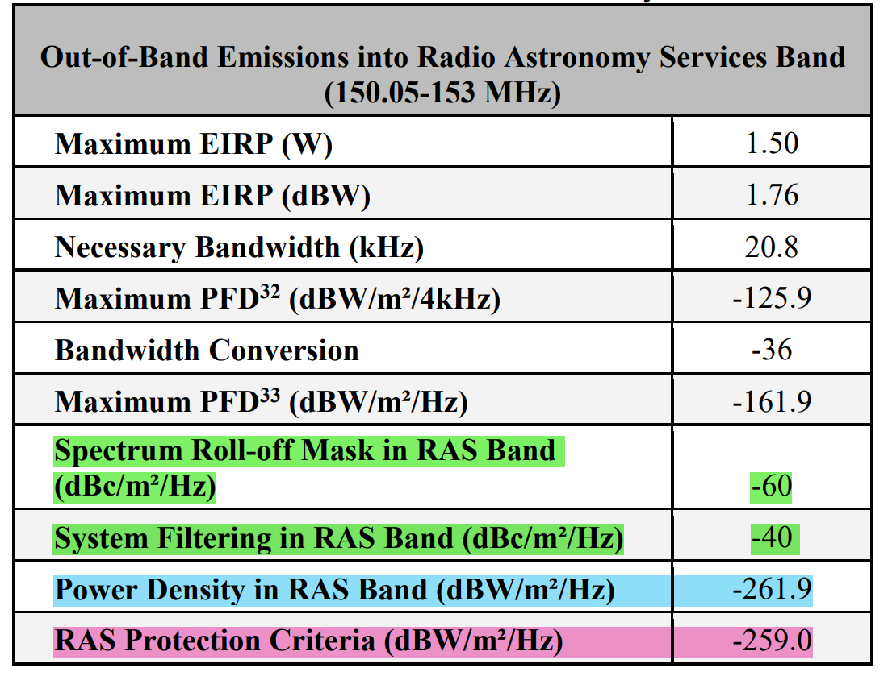
MSS necessary bandwidth | 19.2 kHz | 44 kHz
MSS channel bandwidth | 30 kHz | 55 kHz
MSS first channel centre frequency | 137.015 MHz | 137.0275 MHz
Number of MSS satellites operating in the first MSS channel | 9
MSS satellite duty cycle | 10 %
MSS satellite antenna gain | 0 dBi
MSS satellite antenna pattern | Omni
MSS satellite transmitting power | Adjusted so as to comply to the mandatory pfd of -140 dBW/m²/4 kHz (cf. Annex 1 of App 5)
Doppler Shift | 3.5 kHz
Number of MSS satellite planes | 9
Number of satellites/plane | 1
MSS (s-E)
Using SM.1541 Annex 1 appendix 1 guidance, the minimum MSS OOB channel attenuation would be around 50 + 10 log(P) = 50+1.76 = 51.76 dB down at 137 MHz. This attenuation will continue to around 70 dB at 136.975 MHz (25 kHz away)
Desired signal enhances its dynamic range thru transmit antenna gain and receiver antenna gain against receiver thermal noise in order to demodulate its data. Interferences from adjacent channels on a same MSS satellite are not white noise, pass thru transmit antenna and receiver antenna gains, set a non-white noise floor, and thus reduce the signal dynamic range. Using NF = 6 dB, rx noise floor is -204 + 6 = -198 dBW/Hz. Undesired aggregated adjacent channels RFI from a same MSS satellite should be below I/N=-20 dB (use I/N = -26 dB from 1 adjacent). Use receiver antenna gain of 12 dBi (to demodulate 44 kHz BW in 55 kHz channel), then adjacent channel attenuation = (-125-36)-4.2+12-(-198-26) = 70.8 dB
Good OOB emissions is required to support more than one channel and to protect RAS.
ITU-R RA.769: -259 dBW/m²/Hz (-223 dBW/m²/4kHz) in 150-153 MHz; Res 739: -238 dBW/m² in 2.95 MHz = -266.7 dBW/m²/4kHz in RAS
12
Notes:
Key points:
1 Good OOB emissions is needed to support more than one MSS channels on the same MSS satellite and to protect RAS.
2 Since each channel in 137-138 MHz will cope with co-channels, non-overlapping adjacent channels, and overlapping adjacent channels (due to channels of space services having different channel bandwidths), it is important that the undesired aggregated adjacent channels RFI from a same MSS satellite should be below I/N = -20 dB (same as adjacent-band protection criteria) in order to minimize the undesired adjacent channels RFI. Then a single undesired adjacent channel RFI is set to I/N = -26 dB. Therefore, MSS adjacent channel attenuation is {-125 (assumed MSS PFD) -36 (from 4 kHz to Hz) -4.2 (from dBW/m² to dBW) +12 (rx antenna gain) – (-198 (rx noise floor) – 26 (single undesired adjacent channel RFI)) = 70.8 dB. Note that (-198 – 26) = -224 dBW/Hz is the single undesired adjacent channel RFI level. Note that both AM(R)S and AMS(R)S have similar adjacent-channel OOB attenuation, around 70 dB at its channel edges.

Slide 13
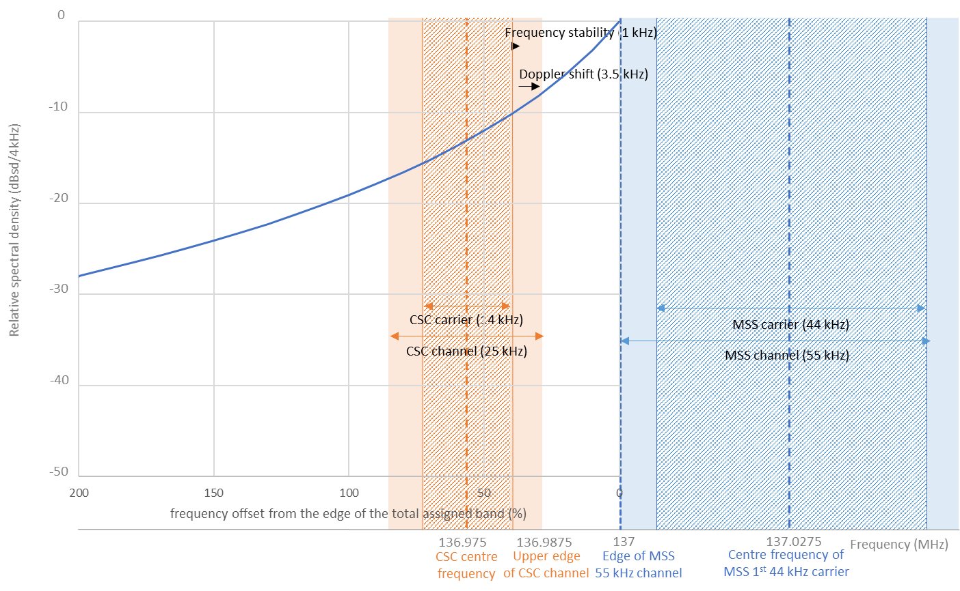
MSS emissions to AMS(R)S Satellite receiver
MSS (s-E), 1 of studies in AI 1.7 report
Using RR No. 1.153, Recs SM.1540, SM.1541 Annex 1, 1.1 OOB mask would be 23 dB down at 137 MHz.
Rec SM.1541 annex 1 appendix 1 recomends adjacent channel attenuation of (50 + 10 log(P) = -51.76 dB down) at its channel edge
If PFD = -140 dBW/m²/4kHz, this proposed mask will interfere to 3 SOS adjacent channels (view 1) and 5 SOS adjacent channels (Russia CPM view), on each side of a MSS channel.
This proposed mask will interfere to MSS adjacent channels.
This proposed mask will interfere with the AM(R)S VDL-M2 CSC.
-140 dBW/m²/4 kHz
-153 dBW/m²/4 kHz
Range of AM(R)S VDL-M2 protection:
(-10 dB I/N) -167.8
(-12 dB I/N) -169.8
(-20 dB I/N) -177.8 dBW/m²/4 kHz
Note: per slide 8,
SOS protection is -165.8 (view 1) or -173.9 (Russia CPM view) dBW/m²/4kHz
MSS protection is -159 dBW/m²/4kHz
Notes:
Key points:
1 Using the OOB emission assumptions in the A1.7 WRC-23 studies for MSS would interfere with the terrestrial VDLM2 aircraft receiver and we know this isn’t happening.
2 If MSS PFD is -125 dBW/m²/4kHz, then this proposed mask will interfere with more SOS adjacent channels and MSS adjacent channels.

Slide 14
Aircraft to AMS(R)S satellite – link budget
Table 10 of doc 5B/731 Annex 9 (AI 1.7 Report): aircraft uplink to AMS(R)S for VDL-M2
Minimum AMS(R)S received PFD over elevation 20-70 degrees
PFD = −134.1 dB(W/(m² · 14 kHz)) = −139.5 dB(W/(m² · 4 kHz))
AMS(R)S protection level
Comparing adjacent band protection C/I = 15/20/30 dB, AMS(R)S protection levels = -154.5/-159.5/-169.5 dB(W/(m² · 4 kHz))
Note: adjacent-band AMS(R)S satellite protection criteria is not yet developed for this band. In general, C/I protection criteria is normally used in ITU-R to protect the satellite receiver.
14
Notes:
Key points: Derivation of AMS(R)S protection levels for the proposed operational AMS(R)S elevation angles with several C/I protection criteria = 15 / 20 / 30 dB.

Slide 15
MetSat emissions to AMS(R)S Satellite receiver
MetSat altitude, km | 835
MetSat center frequency, MHz | 137.1
MetSat wavelength, m | 2.188
MetSat assigned bandwidth, kHz | 144
MetSat max EIRP, dBW | 9
MetSat max power density, dBW/Hz | -42.6
MetSat OOB attenuation, dB | -55 (note 1)
AMS(R)S altitude, km | 600
AMS(R)S - MetSat min separation, km | 235
Path loss, Lp = (4*pi*R)^2, dB*m² | 118.41
Received MetSat power density, dBW/m²/Hz | -216
Received MetSat power density, dBW/m²/4kHz | -180
AMS(R)S protection level, dBW/m²/4kHz (C/I = 15 / 20 / 30 dB) | -154.5 / -159.5 / -169.5
Exceedance, dB (note 2) | -25.5 / -20.5 / -10.5
MetSat (s-E), 1 of studies in AI 1.7 report
  inclination angle = 98.85º
  altitude = 835 km
  number of satellites / plane = 2
  Max power = 5 dBW
  max antenna gain = 4 dBi
  assigned bandwidth = 144 kHz
  assigned frequencies = 137.1 / 137.9125 MHz
  Peak EIRP power = 9 dBW / max power density = -42.6 dBW/Hz
  PFD on Earth = -136 dBW/m²/4 kHz
Note 1: Per SM.1541, Annex 1, Appendix 1, Table 3 - The lesser of 116 log ( fd/6.1) dB, or 50 + 10 log (P) dB, or 70 dB. For 150 kHz channel, fd = 75 kHz, the lesser of 116 log (75/6.1) = -126.4 dB or 50 + 5 = 55 dB or 70 dB. Since AMS(R)S CSC is 50 kHz away from MetSat channel edge, OOB attenuation is more than 59 dB.
Note 2: main beam (MB) to main beam RFI with 235 km min altitude separation. In reality, slant range should be much larger than min altitude separation for MB to MB RFI.
ITU-R RA.769: -259 dBW/m²/Hz (-223 dBW/m²/4kHz) in 150-153 MHz
Res 739: -238 dBW/m² in 2.95 MHz = -266.7 dBW/m²/4kHz in RAS
15
Notes:
Key point: There is guidance in SM.1541 that shows the OOB emissions can be much better.

Slide 16
MSS & SOS-SD emissions to AMS(R)S Satellite receiver
Parameters | MSS (s-E) (19.2/44 kHz) @ (137.015/137.0275 MHz) | MSS (s-E) (19.2/44 kHz) @ (137.015/137.0275 MHz) | SOS-SD DL (25 kHz channel) @ 137.0375 MHz
Satellite altitude, km | 300 | 550 | 300
PFD on Earth’s surface, dBW/m²/4 kHz | -140 (per 5B/804: RR Appendix 5, Annex 1) | -131.2 (note 3) | -140
OOB attenuation at 136.975 MHz, dB | 70 | 70 | 70
PFD at 136.975 MHz, dBW/m²/4 kHz | -210 | -201.2 | -210
Worst-case main beam AMS(R)S protection level, dBW/m²/4 kHz | -154.5 / -159.5 / -169.5 | -154.5 / -159.5 / -169.5 | -154.5 / -159.5 / -169.5
PFD exceedance, dB (Note 2) | -55.5 / -50.5 / -40.5 | -46.7 / -41.7 / -31.7 | -55.5 / -50.5 / -40.5
Required RFI separation, km (Note 1) | 0.5 / 0.88 / 2.8 | 2.5 / 4.4 / 14.1 | 0.5 / 0.88 / 2.8
AMS(R)S altitude, km | 600 | 600 | 600
Min altitude separation, km | 300 | 50 | 300 km
Interference? (Note 2) | No | No | No
Note 1: For every 6 dB higher, the distance is reduced by half. Hence, for MSS (s-E) case, the required RFI separation = 550 km / (2^(46.7/6)) = 2.5 km; 550 km / (2^(41.7/6)) = 4.4 km; 550 km / (2^(31.7/6)) = 14.1 km.
Note 2: no interference to AMS(R)S satellite receiver since minimum altitude separation is larger than the required RFI separation. In reality, slant range should be much larger than min altitude separation for MB to MB RFI.
Note 3: see slide 12 where PFD limit = -125 dBW/m²/4 kHz at 300 km or -131.2 dBW/m²/4 kHz at 550 km
ITU-R RA.769: -259 dBW/m²/Hz (-223 dBW/m²/4kHz) in 150-153 MHz; Res 739: -238 dBW/m² in 2.95 MHz = -266.7 dBW/m²/4kHz in RAS
16
Notes:
Key point: The services in the 137-138 MHz frequency band have to use more than one channel each and they have to allow each service to operate, so there are assumptions in satellite altitude that can be used to show AMSRS isn’t impacted. If AMSRS is impacted, the in-band 137-138 MHz services would impact themselves.

Slide 17
FSMP-WG/17-WP/09
2023-08-30
Summary
The OOB emissions used in some of the WRC-23 A1.7 studies would interfere with adjacent-channels of services in 137-138 MHz band, as well as with adjacent-band terrestrial AM(R)S VDL-M2 at 136.975 MHz, so we know the systems operating on both sides of 137 MHz perform better than the generic ITU-R SM.1541 recommendation.
The band 137-138 MHz is shared by 4 space services (SOS, MetSat, MSS, and SRS) (space-to-Earth) operating in channel assignments with the proposed 3 very large constellations (each constellation of 300+ satellites) for SOS, MSS, and MetSat. Rec ITU-R SM.1541 recommends 3 provides guidance for adjacent-channel OOB attenuation in Annex 1, where an example of adjacent-channel OOB attenuation is in Annex 1, appendix 1.
When using the guidance for adjacent-channel OOB attenuation (SM.1541, Annex 1, Appendix 1) together with RAS protection limits in 150.05-153 MHz band (required for MSS and only taken into consideration by SRS, MetSat, and SOS), the adjacent-band interference of services in 137-138 MHz band will not exceed the various protection levels proposed for the AMS(R)S SS receiver (with C/I = 15 / 20 / 30 dB). No changes to the ITU-R Recommendations are needed for compatibility.

