Slide 1
AFI Preparatory Workshop to ITU World Radiocommunication Conference 2019 (WRC-19)
Johannesburg South Africa, 4-5 September, 2018
Aeronautical Frequency Management in the AFI Region
François-Xavier SALAMBANGA
Regional Officer CNS ICAO WACAF-Dakar

Slide 2
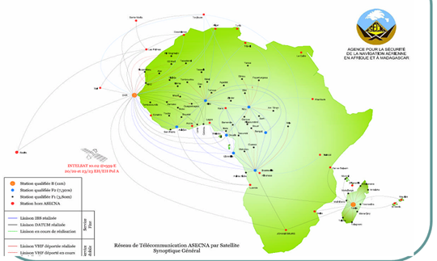
Outline
Framework and Scope for Aeronautical Frequency Management in the AFI Region
Frequency Assignment principles
Follow up and mitigation of interference
Preparation of ITU WRC-19
Regional main challenges
Next Steps

Slide 3
Framework and Scope
AFI Planning and Implementation Regional Group (APIRG) regional framework
AFI Frequency Management Group (AFI/FMG):
  Review of ICAO SARPs and Guidance Material
  Review and update AFI COM Lists database
  Develop AFI regional coordination strategies between States and stakeholders
  Coordinate with ATU and Regional Telecommunication Regulators associations WATRA, CATRA, CRASA;

Slide 4
Frequency Assignment principles
States to submit their request after pre evaluation on Frequency finder to Regional Offices;
Regional Offices cross check in the Data Base to prevent conflicting assignment within the region and with the neighboring Regions (EUR, MID);
Regional Offices maintain the regional Data Base enabling the update of the global Data Base

Slide 5
Follow up and mitigation of interference
States/Organizations report occurrences to Regional Offices
ICAO WACAF/ESAF assesse the occurrences and propose through Frequency Finder a re-assignment
The Data bases are updated after implementation and notification to the regional Office

Slide 6



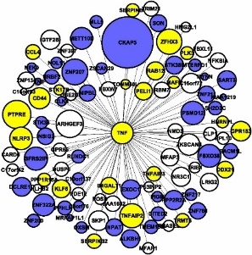

Preparation of ITU WRC-19
ICAO Position disseminated to States
  Reporting form developed for the follow up of actions
Active participation in ATU preparatory meetings
  ICAO ESAF/WACAF attended the ATU 1st and 2nd meetings and the ICAO position was considered as a working document position
  Participation in Sub regional coordination meetings

Slide 7
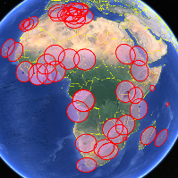
Regional main challenges
Low pace of implementation of APIRG conclusion/Decisions on spectrum operation and protection;
Although some successful coordination is noted in some States (South Africa, Senegal, Cameroon..) the pace of liaison of CAAS with the national Authority of Regulation of Telecommunication remains low
Low participation in spectrum related events: Meeting, Workshop, Seminars, National coordination meeting, ATU and sub regional preparatory meetings…

Slide 8
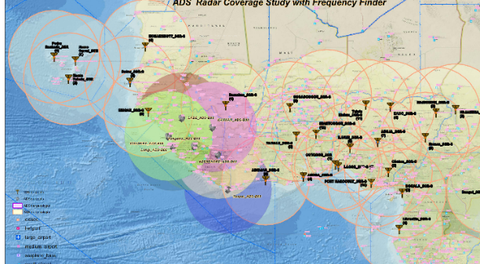
Regional main challenges
Lack of systematic reporting of case of interference from non aeronautical users;
Lack of coordination between CAAs and the operators (ANSPs, Airlines, Aerodromes operators…)
Insufficient education on the spectrum management machenissms

Slide 9
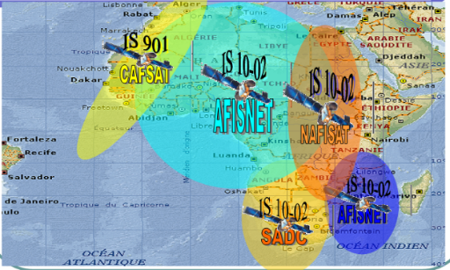
Next Steps
ICAO will continue the sensitization of States and stakeholders on the assignment operation and protection of aeronautical spectrum as scarce critical safety related resource ;
CAAs to strengthen their collaboration with the national Authority of Regulation of Telecommunication and with the aeronautical spectrum users;
CAAs to ensure their effective participation in national coordination meetings on spectrum and make provision for the attendance of their representative to regional spectrum related events;
The closer forthcoming event is the 3rd ATU preparatory meeting for WRC-19 (Cairo, 17-21 September 2018)

