Slide 1

FSMP-WG/17-IP/12
2023-08-30
Frequency Spectrum Management Panel (FSMP)
Seventeenth Working Group meeting
Cairo, Egypt, 30 August-7 September 2023
Agenda Item 4: Radio Altimeter Issues
Development of Aircraft Radio Altimeter Interference Analysis Methodology Due to Sub-6 5G Mobile Communication Systems
Prepared and Presented by Shunichi Futatsumori, Electronic Navigation Research Institute
Date: 23 August 2023

Slide 2
Summary
The radio altimeter-interference analysis methodology due to 5G mobile communication systems has been investigated.
This slide includes current progress and updates conducted by a research project of the ENRI.
Using the measured electromagnetic interference characteristics of radio altimeters under Japanese frequency conditions (FMSP-WG15-IP03) and a detailed airport model, the interference conditions are estimated in three-dimensional space.
We calculated the worst interference scenario when installing 5G base station antennas at hypothetical locations using an actual airport model.
Consequently, a low altitude and close distance to the base station affected the radio altimeter.
Depending on the topographical conditions of the airport, it is confirmed that there are areas where the difference in interference margin due to distance and altitude from the base station is reversed.
This presentation discusses the development the analysis methodology. The detailed results will be presented in the future FSMP WG.

Slide 3
Analysis conditions
Aircraft radio altimeter
  The interference tolerance mask (ITM) for the analysis is calculated based on the measured electromagnetic interference characteristics of 12 radio altimeters for large fixed-wing aircraft (reported in FMSP-WG15-IP03).
  Twelve radio altimeters are not modified for the interference susceptibility.
  ITM at 4.05 GHz, which stands for the 100-MHz guard band, is used for the analysis.
  A 6-dB ICAO safety margin and the radio altimeter antenna-radiation pattern (not considering the pitch/roll of the aircraft) are used.
5G base station
  Macro-cell base station (EIRP:60.8 dBm/MHz）
  A maximum radiation pattern of ITU-R M.2101 model.
  The antenna placed on the obstacle clearance surface (OCS).
Airport model
  Three-dimensional model based on the Geospatial Information Authority of Japan.

Slide 4
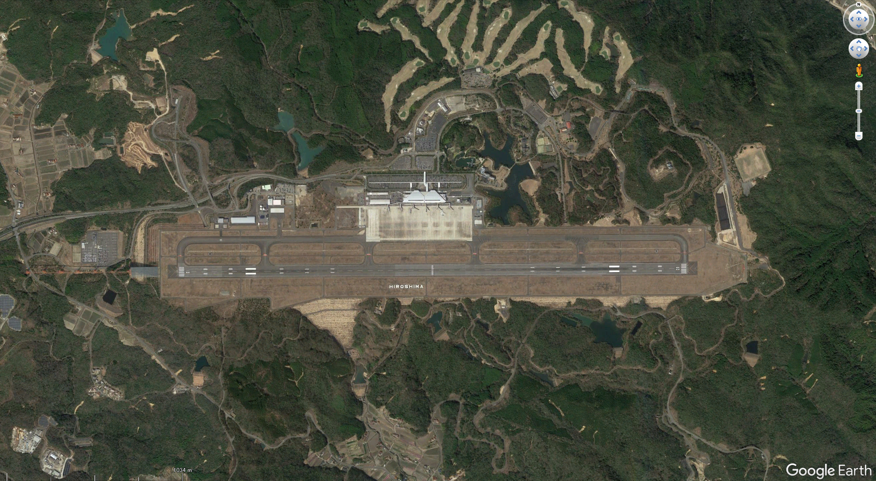
Example of an actual airport in Japan
X
Origin (0 ,0, 0)
D
3000 m

Slide 5
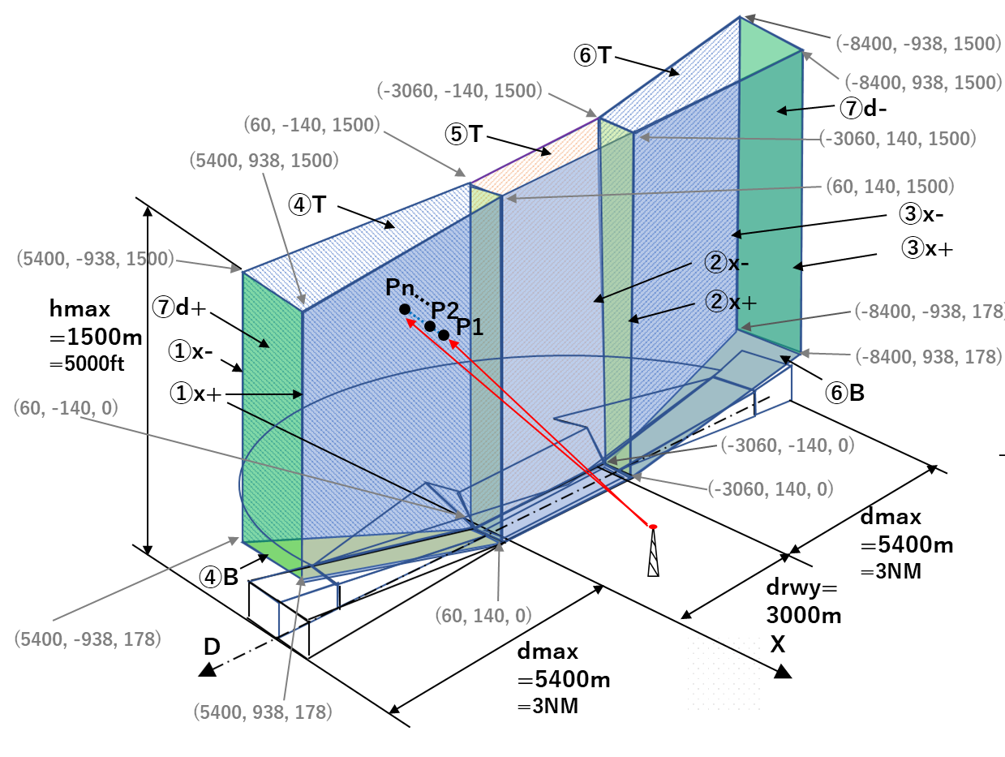
Analysis space
Location of the base station antenna: (D, X, H) = (0,227,35)

Slide 6
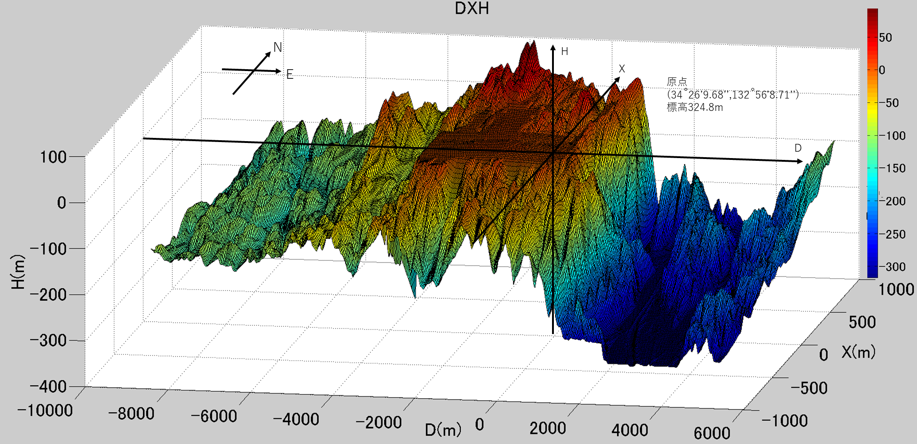
Three-dimensional airport model
Origin (0 ,0, 0)

Slide 7
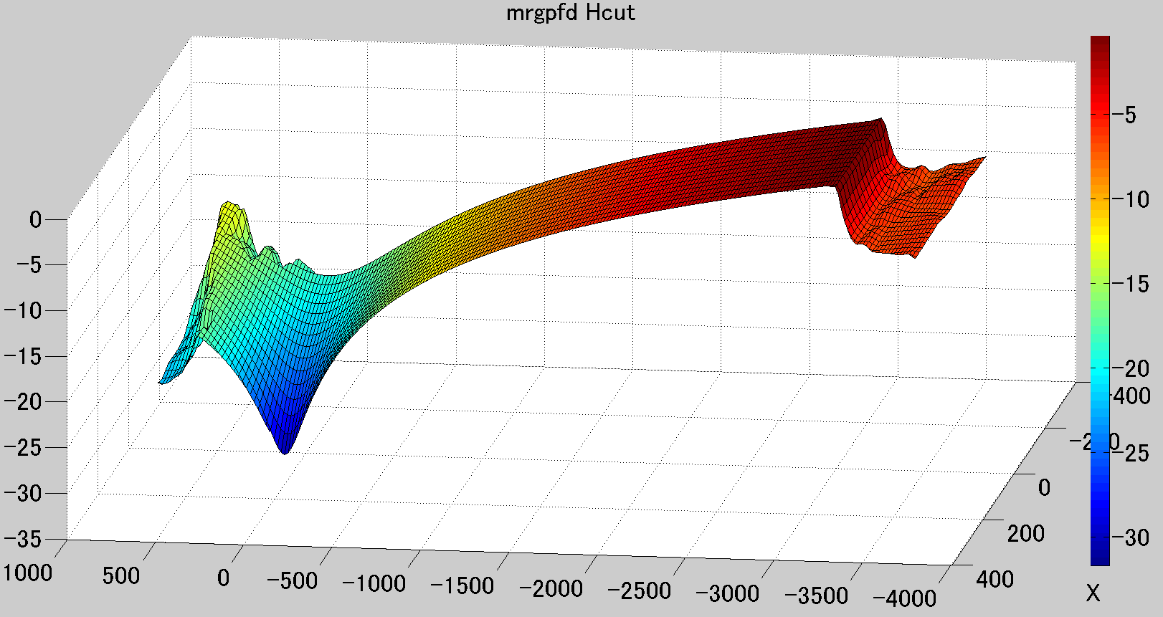
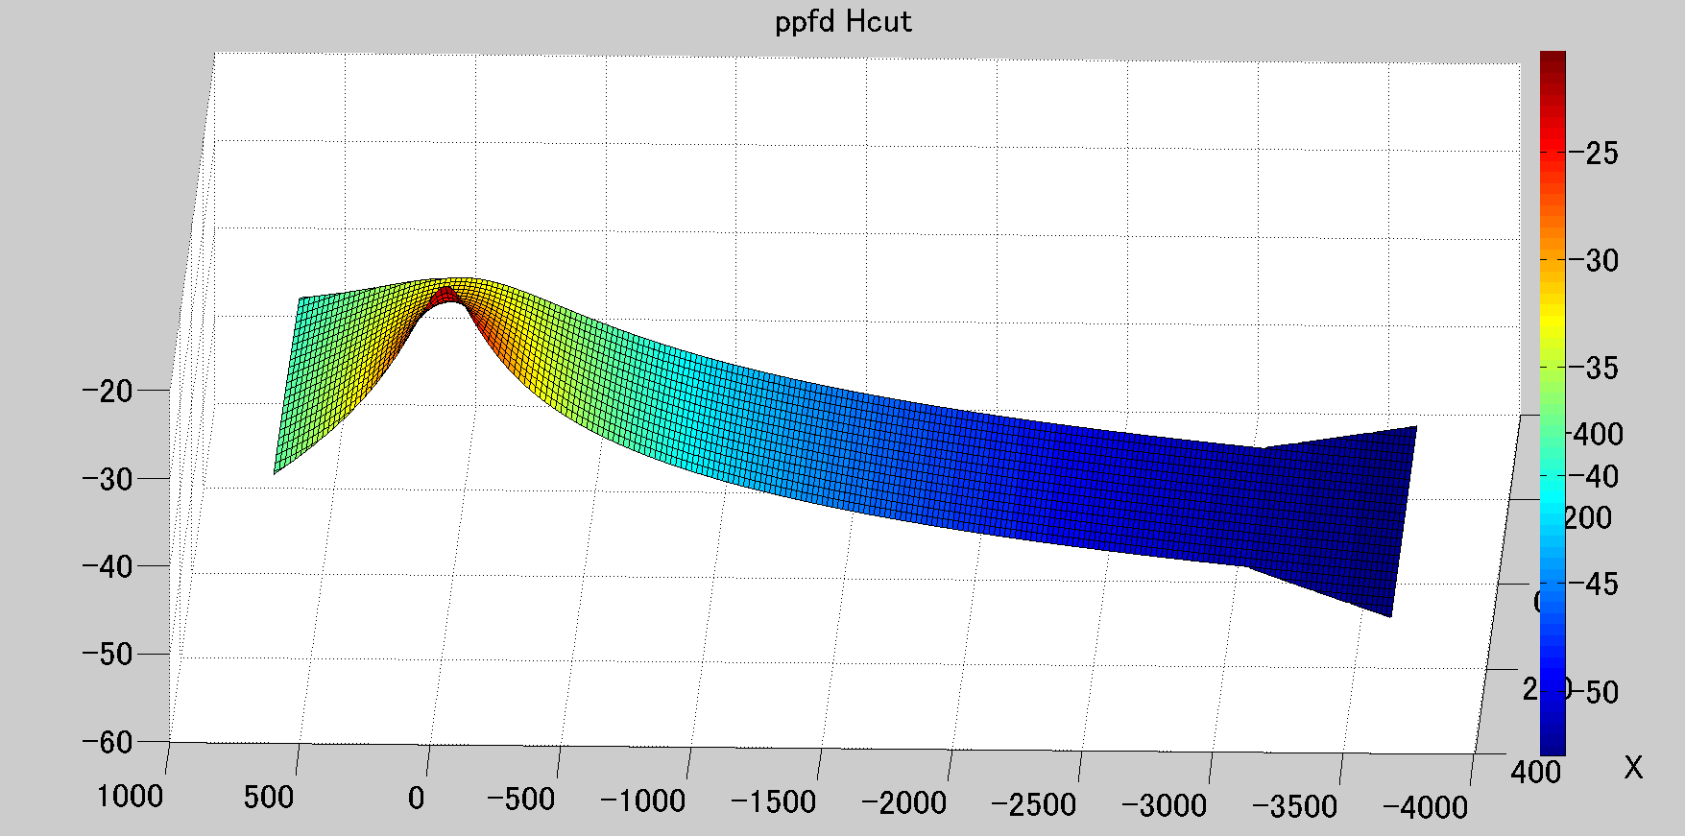
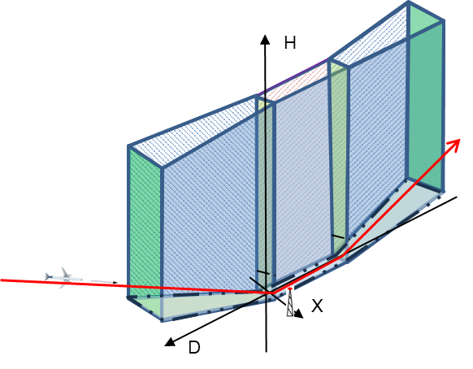
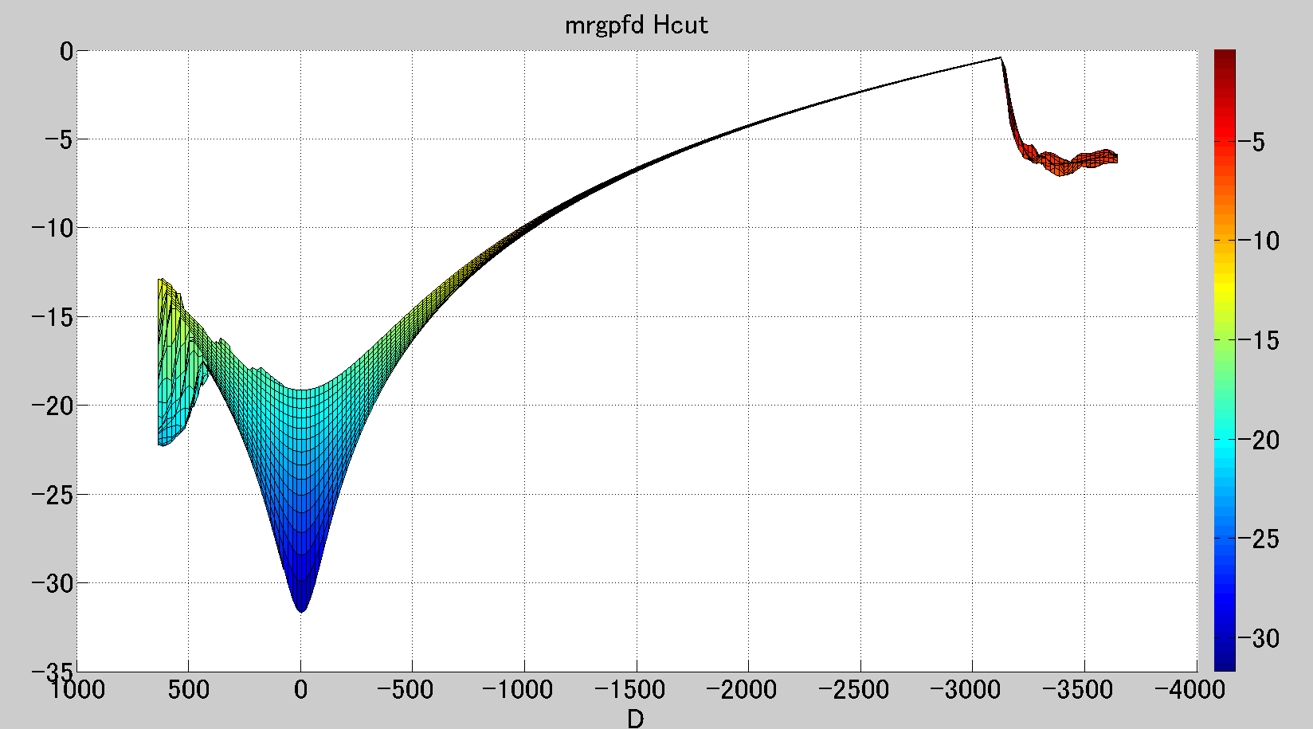
Analysis results on the H-plane (H = 20 m)
Interference margin
Power flux density of the 5G base station signal
Strength of interference signal (power flux density at RA antenna)
(dB)
(dBW/m^2/MHz)
X(m)
X(m)
Interference margin
D(m)
D(m)
(dB)
Depending on the conditions, the low interference margin is observed at a distance far away from the base station antenna
D(m)
The minimum interference margin is obtained at the closest position.
Note that these results are based on the evaluation model and does not reflect the actual location of the base station at the airport.

Slide 8
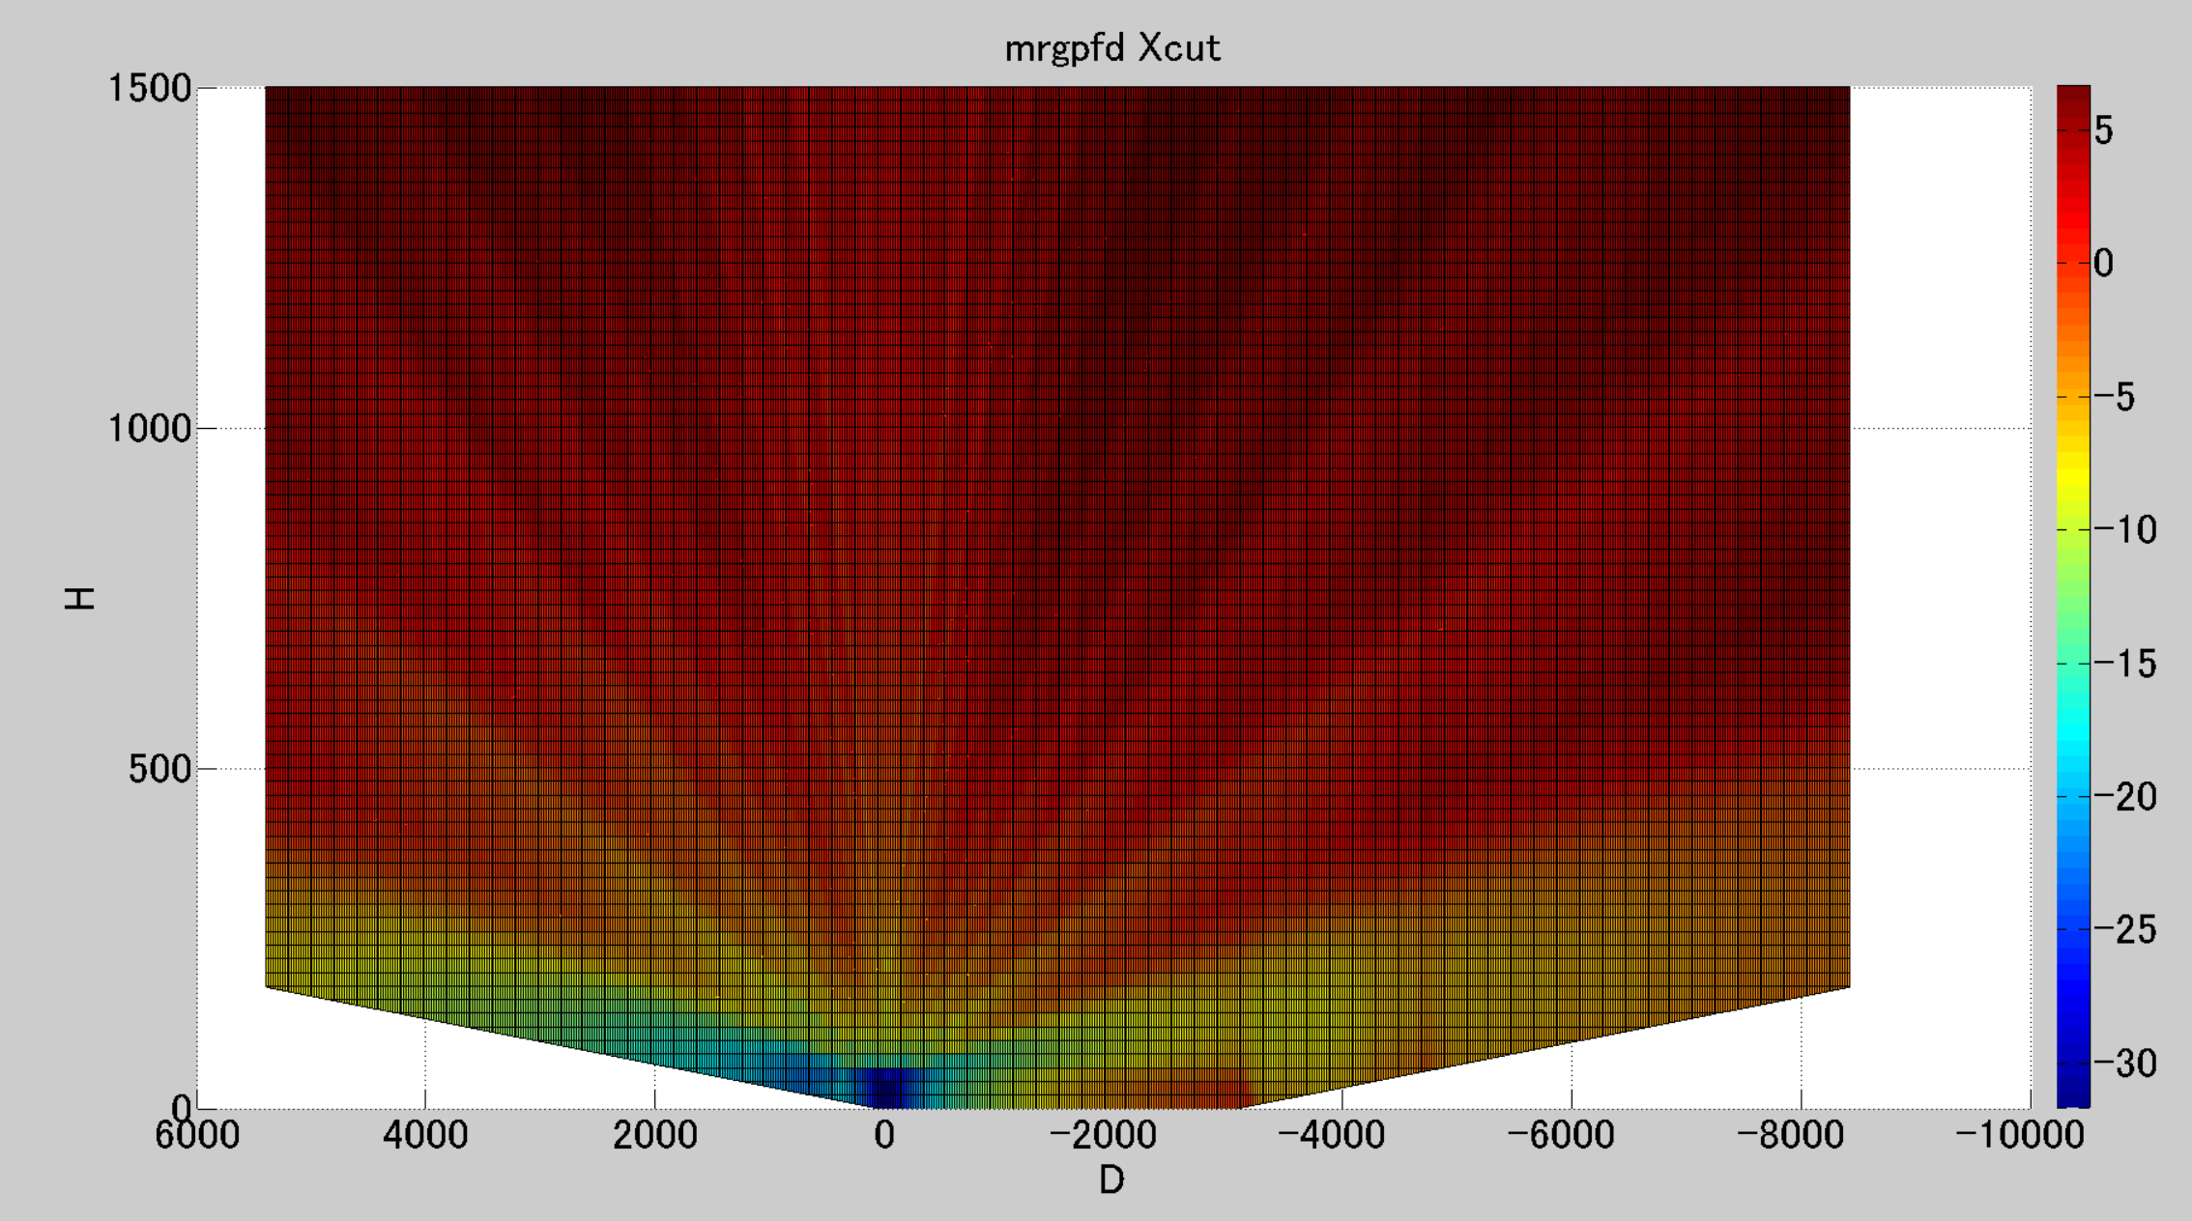
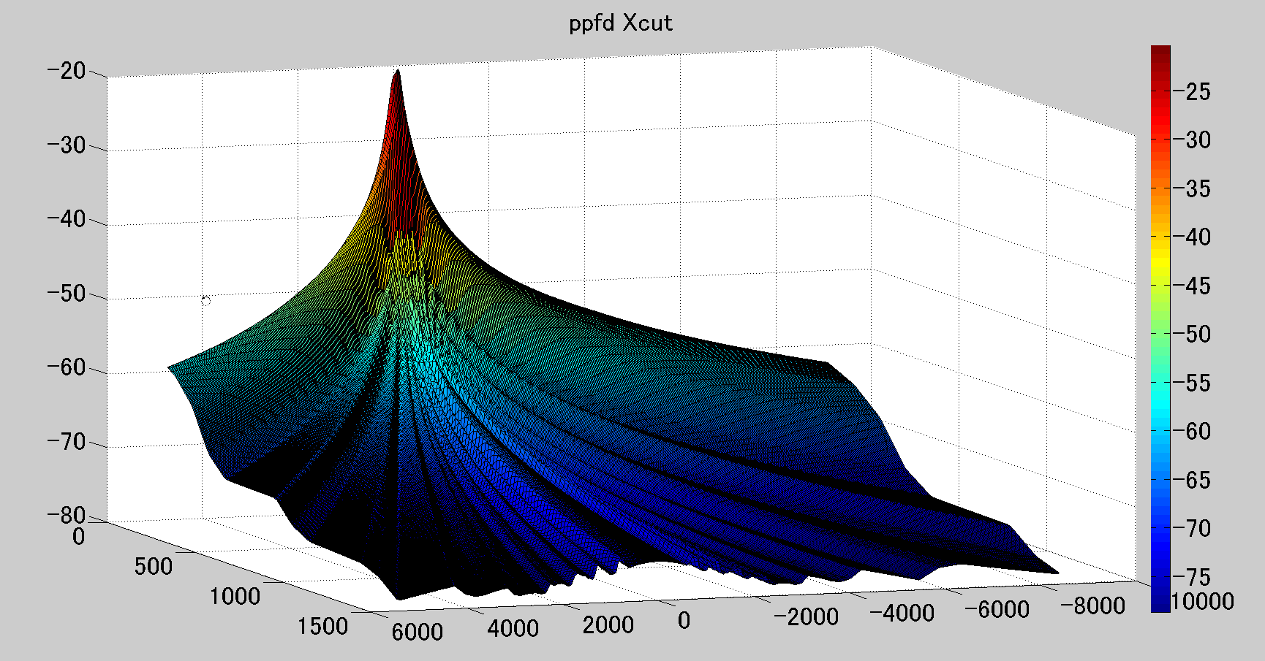
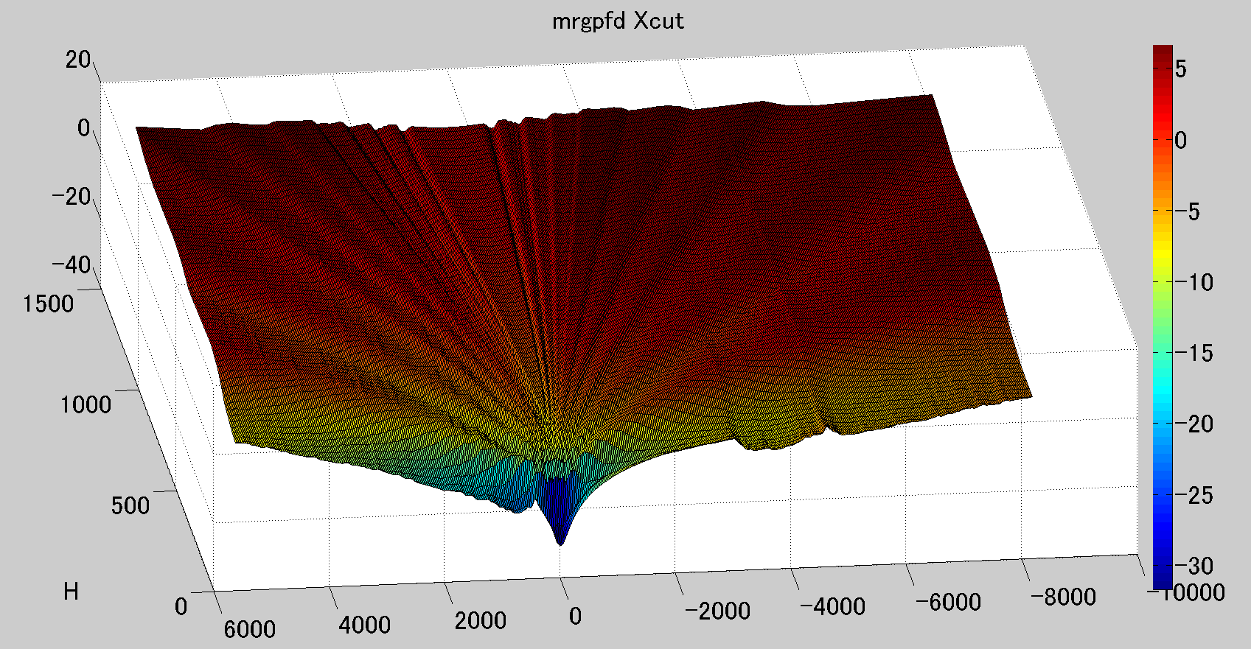
Analysis results on the X-plane (X = 140 m)
Interference margin
Power flux density of the 5G base station signal
(dBW/m^2/MHz)
(m)
H(m)
(m)
Interference margin
(dB)
Depending on the conditions, the low interference margin is observed at a far distance from the base station antenna
H(m)
(m)
D(m)
The minimum interference margin is obtained at the closest position.
Note that these results are based on the evaluation model and does not reflect the actual location of the base station at the airport.

Slide 9
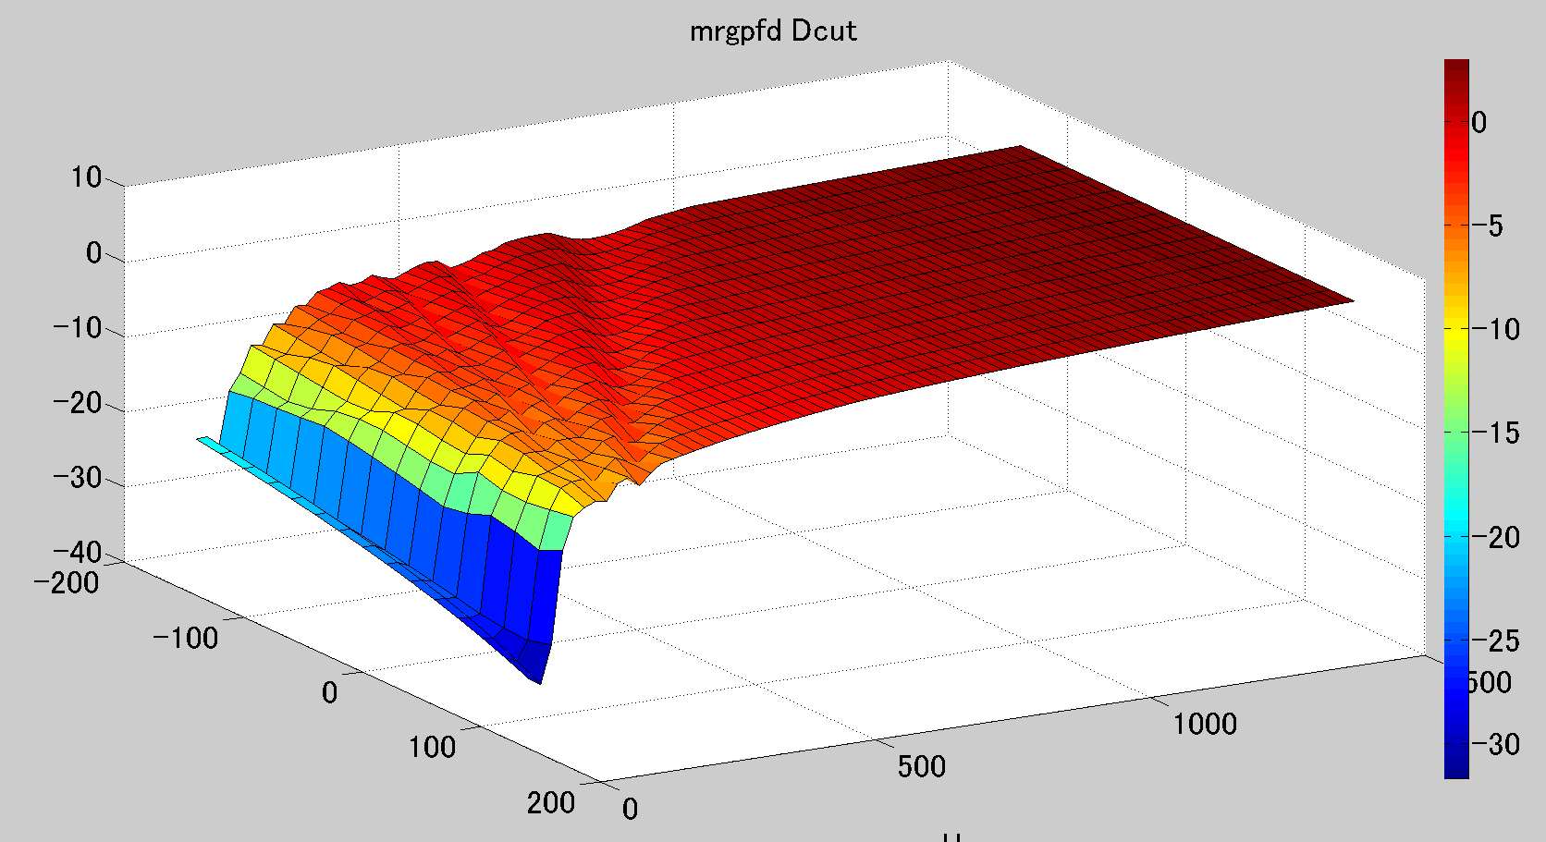
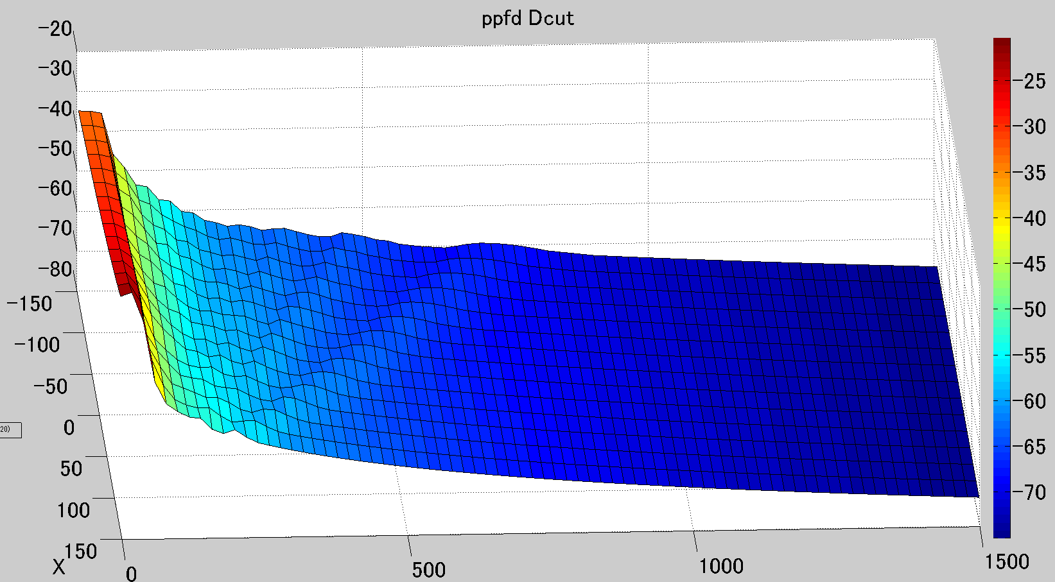
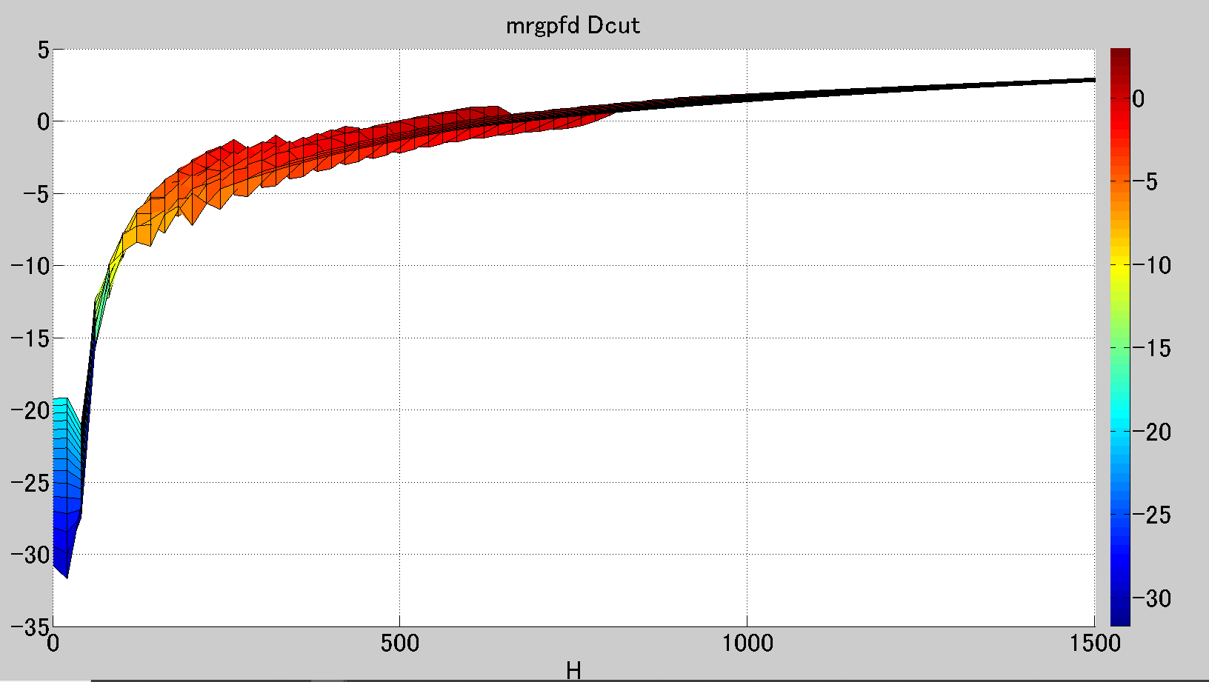
Analysis results on the D-plane (D = 0 m)
Interference margin
Power flux density of the 5G base station signal
(dBW/m^2/MHz)
(dB)
X(m)
X(m)
H(m)
H(m)
Interference margin
H(m)
(dB)
Note that these results are based on the evaluation model and does not reflect the actual location of the base station at the airport.
The minimum interference margin is obtained at the closest position.

