Slide 1
Remotely Piloted Aircraft Systems Panel
WG2 - C2 Link
Status and Future Work
FSMP WG/9 22 - 30 August 2019

Slide 2
C2 Link SARPS Status and Work Plan
Status of C2 Link related SARPs
SARPs for Annex 10 Volume 5
Key topics in first package of SARPs
Future Work Plan
Candidate C2 Link technical solutions
Manual on C2 Link communications

Slide 3
C2 Link SARPS Status
The first package of C2 Link SARPs (AN-WP/9825) has been approved by the ANC (in June) and is now being sent to states for a six-month review period
RPAS C2 Link SARPs included in a new Volume (VI) in Annex 10
New Volume VI is organized in a similar manner to other volumes in Annex 10
  Part I, C2 LINK PROCEDURES – How systems are used
  Part II, C2 LINK SYSTEMS – Technical specification of the systems
The first package of SARPs focusses on Procedures with future packages focusing on Systems
Some additions were required in Volume V regarding the use of frequency bands by C2 Links which were coordinated with the FSMP

Slide 4
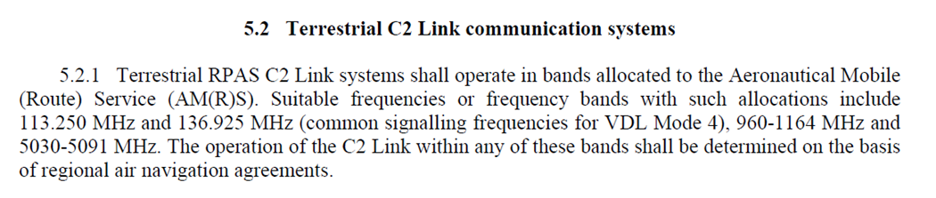
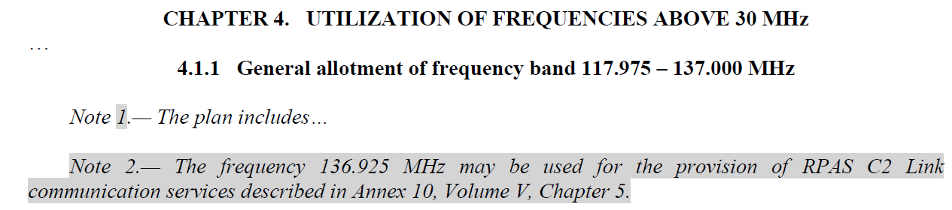
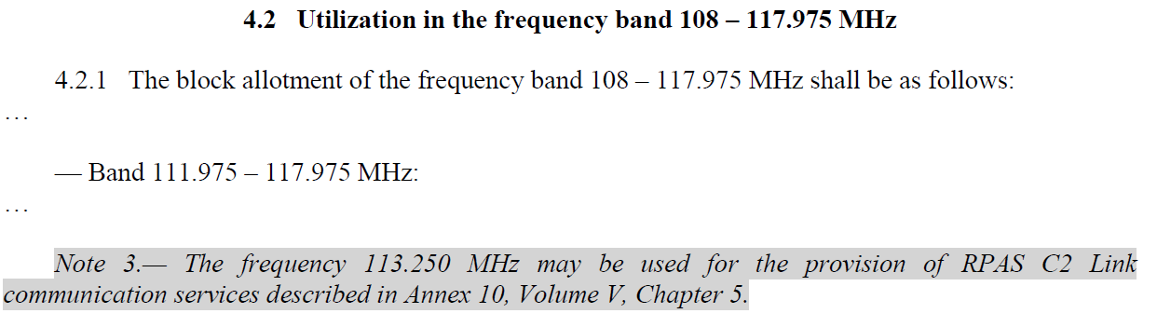
Amendments to Volume V of Annex 10

Slide 5
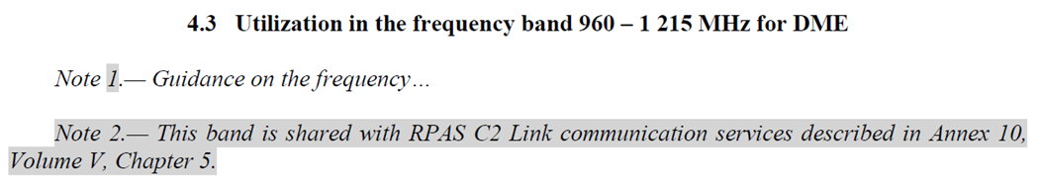
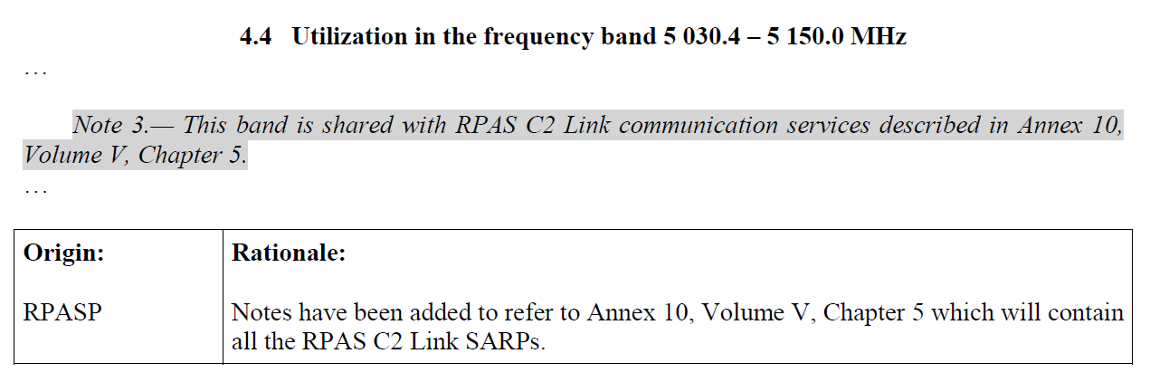
Amendments to Volume V of Annex 10

Slide 6
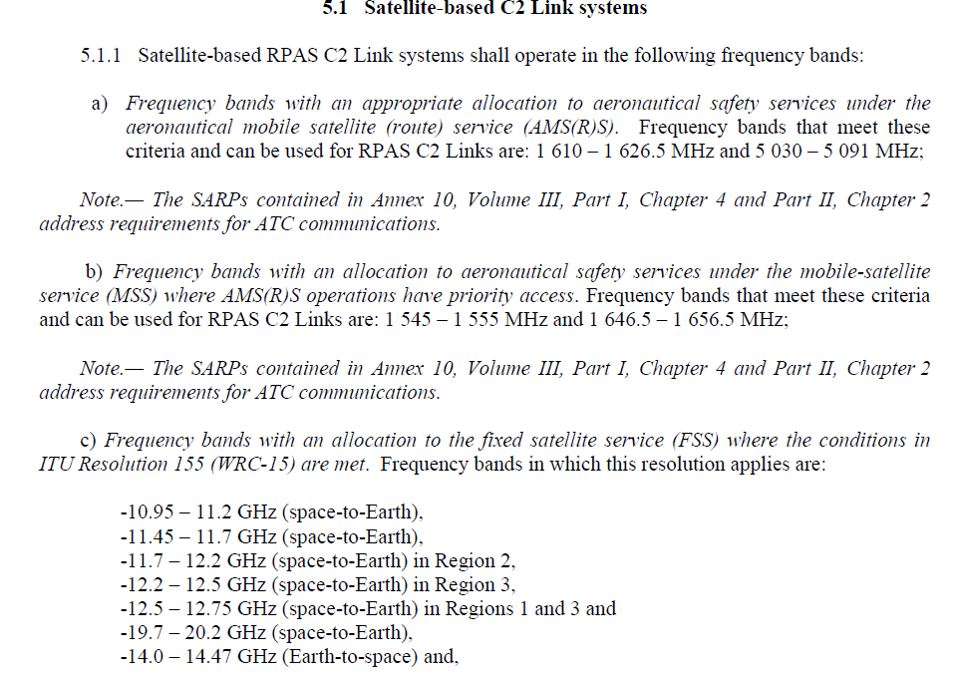
Amendments to Volume V of Annex 10

Slide 7
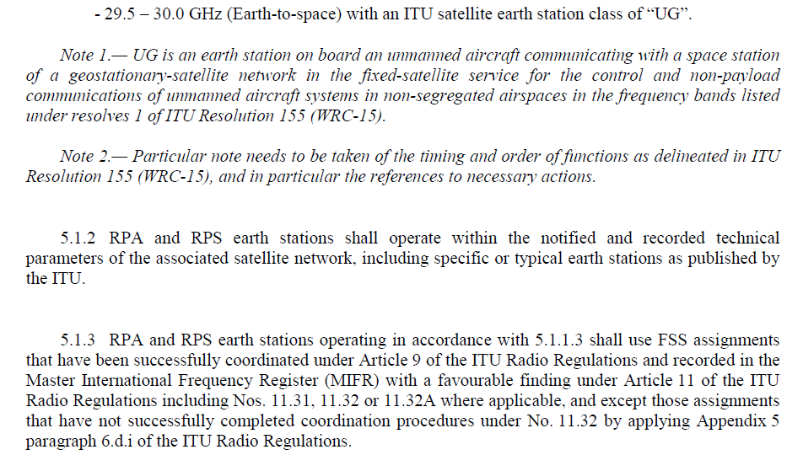
Amendments to Volume V of Annex 10

Slide 8
C2 Link SARP amendment proposals

Slide 9
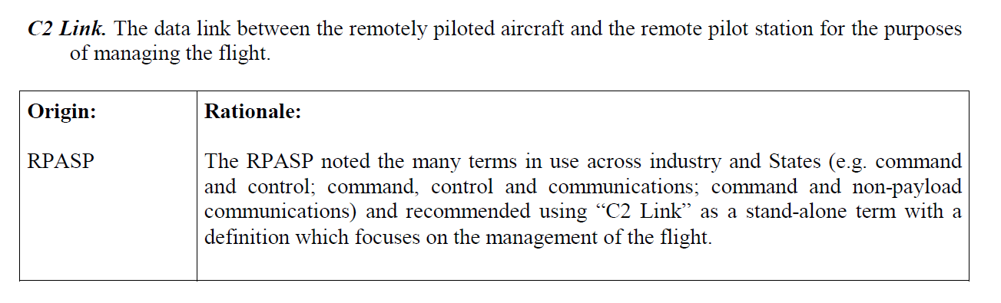
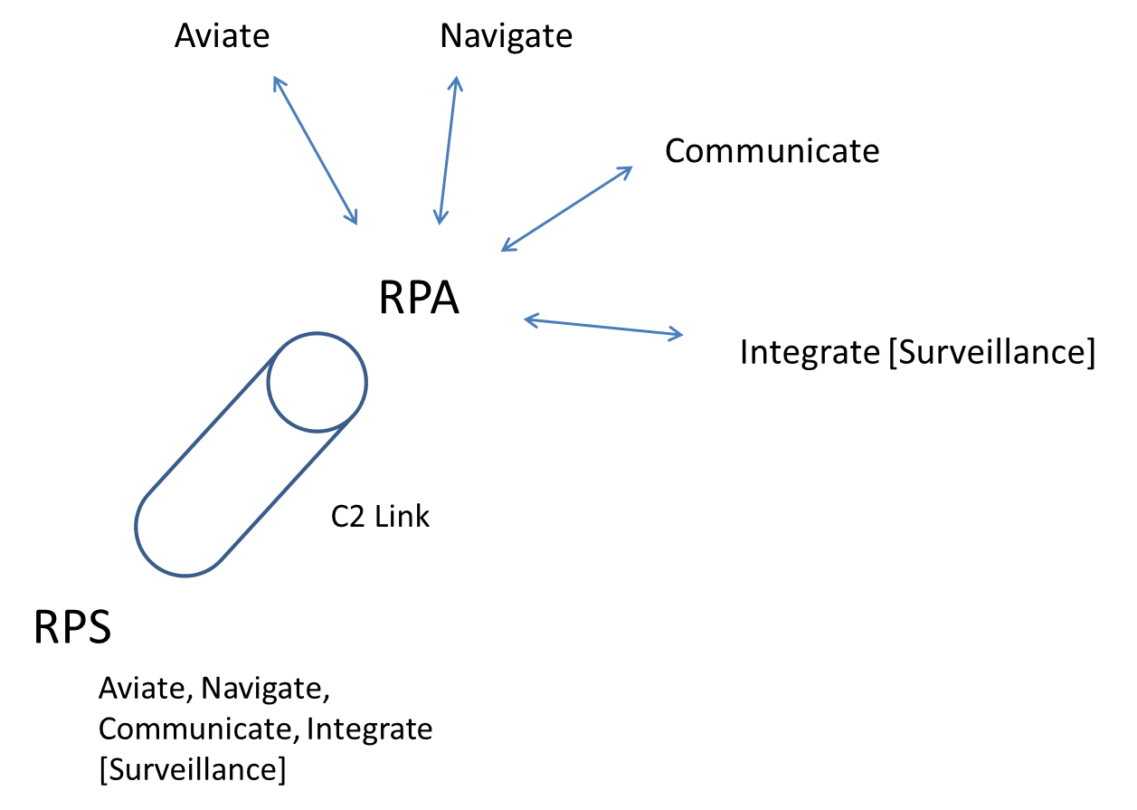
The C2 Link
The C2 Link is the logical connection, however realized, used for the exchange of information between the remote pilot station and the remotely piloted aircraft, to enable the remote pilot to safely integrate the RPAS into the global aviation, communication, navigation and surveillance operational environment

Slide 10
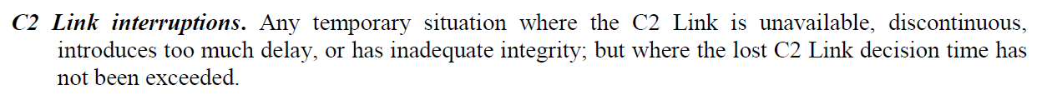
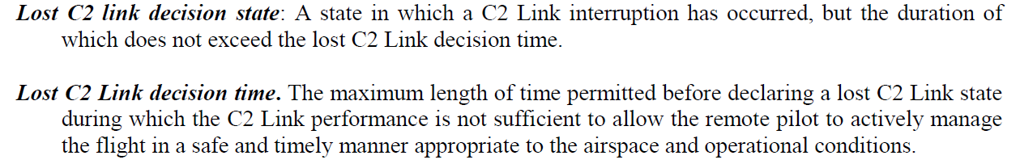
The Lost C2 Link

Slide 11
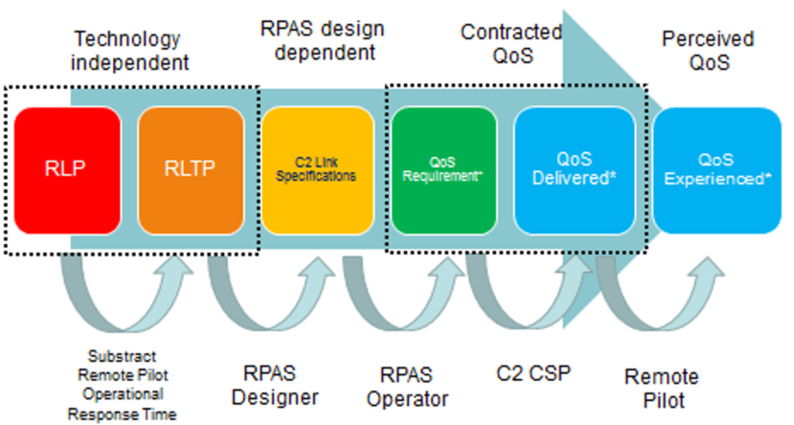
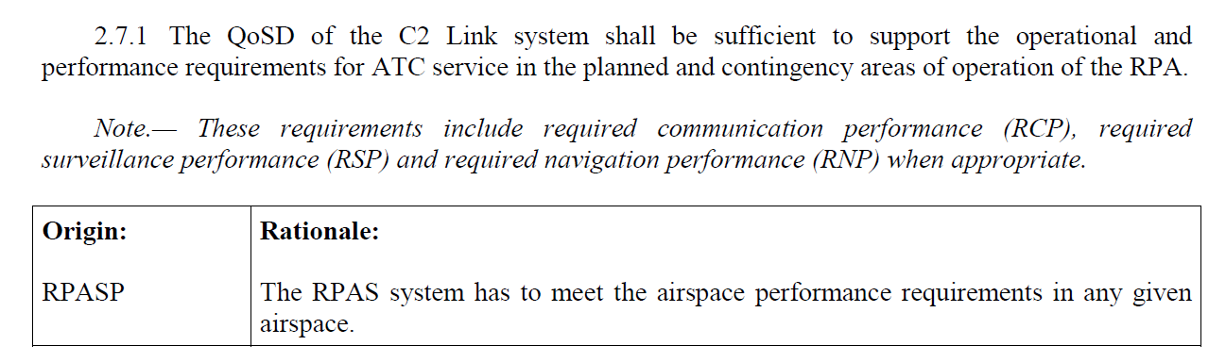
C2 Link Service and Provision

Slide 12
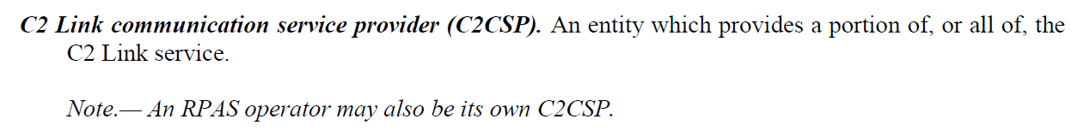
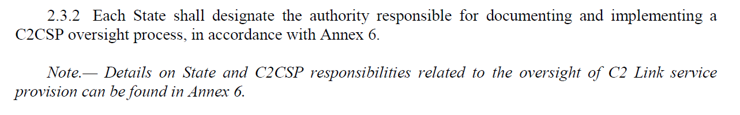
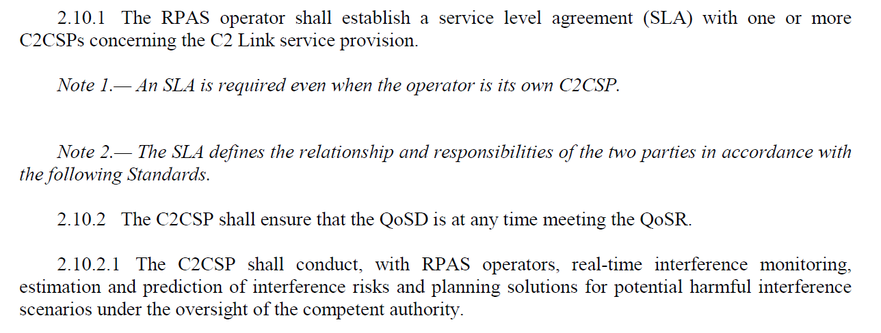
The C2 Link CSP

Slide 13
C2 Link SARPS Future Work Plan
WG2 has limited time and resources so is not planning to develop its own technical solutions for the C2 Link
WG2 plans to assess and adopt technical solutions developed by internationally recognized Standards Development Organizations that do have the resources to validate their technical solutions
These technical solutions must have been demonstrated to achieve the Required Link Performance appropriate for their intended operations
National regulators will be responsible for the approval of the use of such systems in accordance with the high level SARPs described in the various ICAO Annexes covering e.g.
  Airworthiness
  Operations
  C2 Link technical requirements (from ICAO, ITU and SDOs)

Slide 14
C2 Link SARPS Future Work Plan
WG2 has begun its work on System SARPs for Part II of Annex 10 Volume VI
  Chapter 3 = Ku and Ka Band FSS Satellite Systems
  Chapter 4 = C Band Satellite Systems
  Chapter 5 = C Band Terrestrial Systems
  Chapter 6 = Self Organized Airborne Systems
Proposals from various member states are being considered as candidates for these systems
  Chapter 3 = Ku and Ka Band FSS based on ITU-R Resolution 155
  Chapter 4 = C Band Satellite Systems based on EUROCAE ED-265
  Chapter 5 = C Band Terrestrial Systems based on RTCA DO-362
  Chapter 6 = Self Organized Airborne Systems based on VDL Mode 4

Slide 15
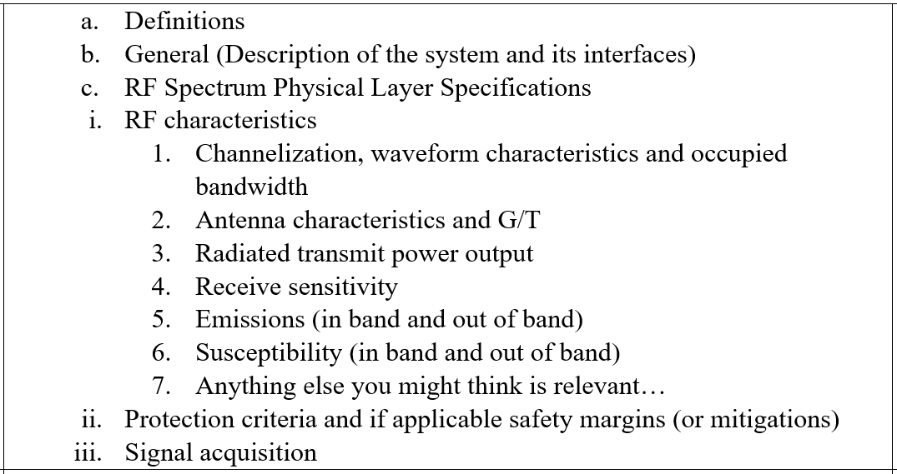
C2 Link SARPS Future Work Plan
To ensure compatible operation between the various C2 Link technical solutions and other systems that share the same allocation Chapters 3, 4, 5 and 6 SARPs will (at a minimum) contain the Physical Layer performance requirements for each technical solution
WG2 is still discussing if interoperable operation is required and if so what additional (higher OSI layer) SARPs would be required

Slide 16
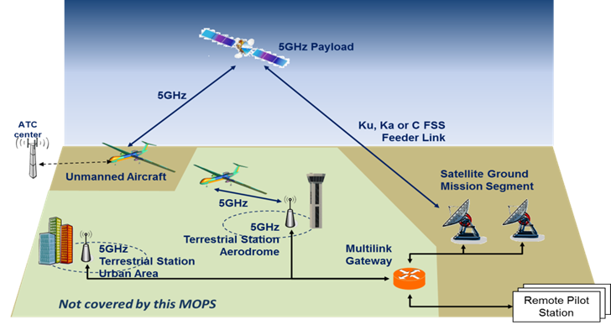
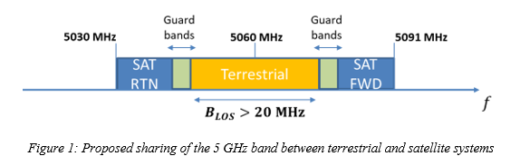
C Band SATCOM Systems
MOPS only requires 20MHz separation between UA transmit and receive bands

Slide 17
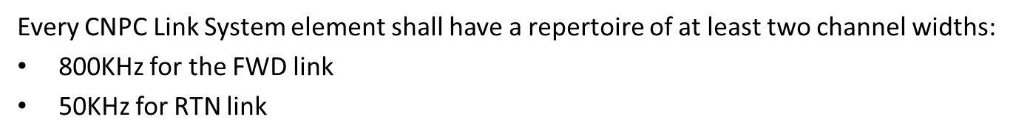
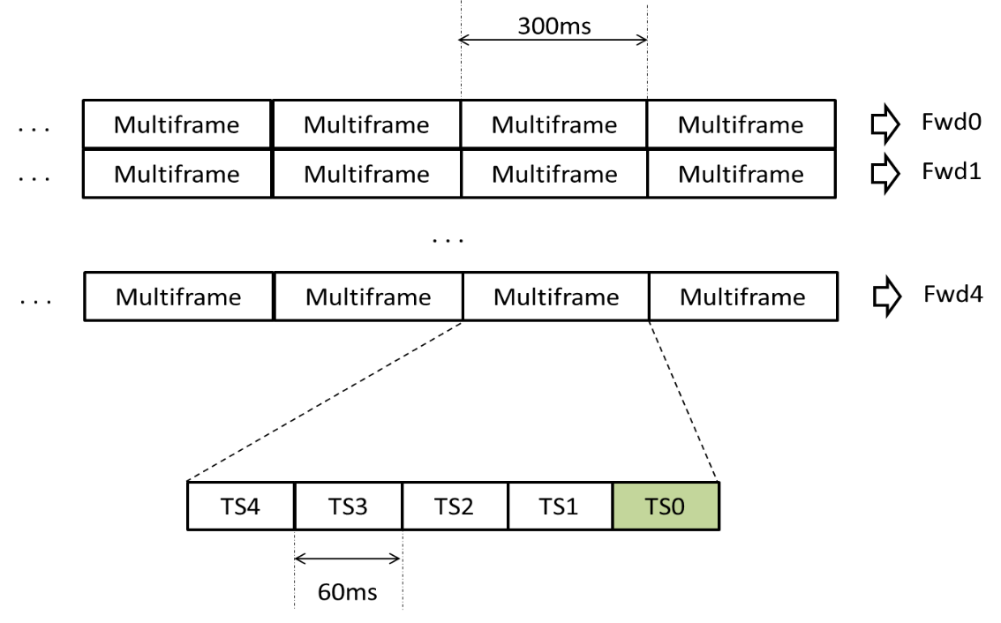
C Band SATCOM Systems
Mandates (at a minimum) the following channels widths
Forward Link
Each UA does not get a dedicated Forward Link 60ms timeslot in every 300ms Multifare but TS0 is a broadcast to all UA telling them in which slot to listen for their telecommands

Slide 18
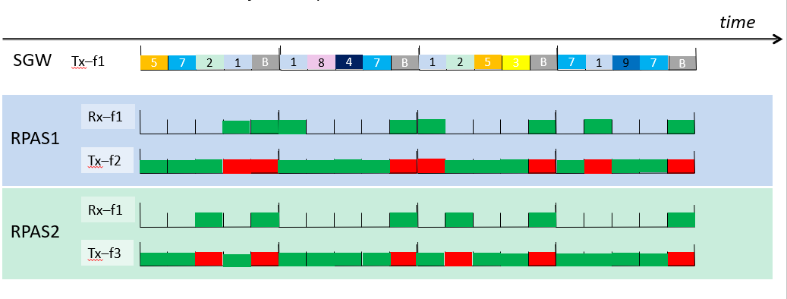
C Band SATCOM Systems
Return Link
The UA can transmit in any of the Return Link 60ms time slots other than the SGW Broadcast (B) time slot or the time slots that the SGW has identified it will use to transmit to the UA

Slide 19
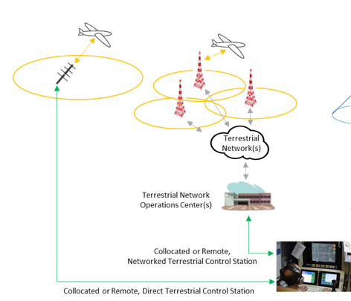
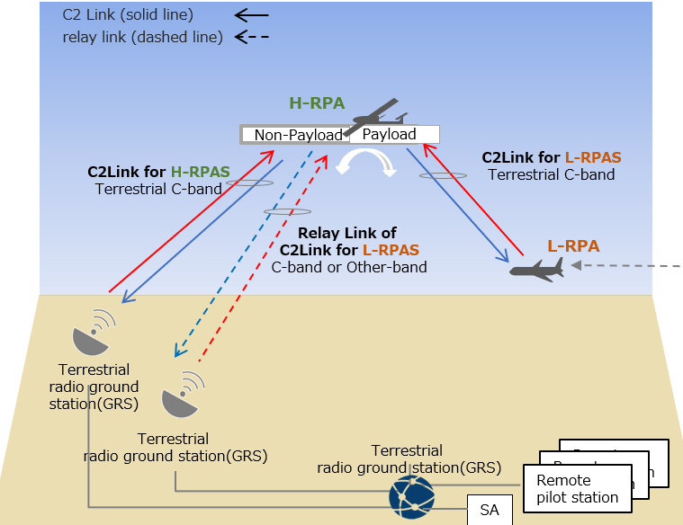
C Band Terrestrial Systems
Considering Point to Point, Networked and Relayed C2 Links

Slide 20
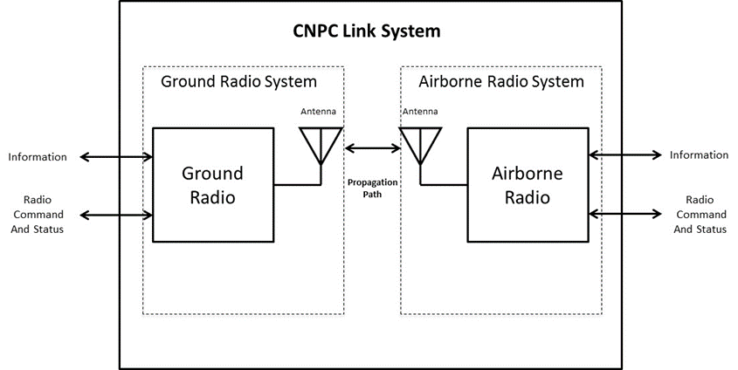
C Band Terrestrial Systems
The primary intended function of CNPC Link Systems is to provide CNPC Link capabilities supporting UAS information exchanges that allow the pilot to safely control, monitor, and manage the UA. This primary function includes capabilities and services associated with the CNPC Link System Physical Layer and some services associated with the CNPC Link System Datalink Layer. This MOPS describes the features and characteristics needed by the CNPC Link System to achieve a ground-based communication functionality to support UAS operation.

Slide 21
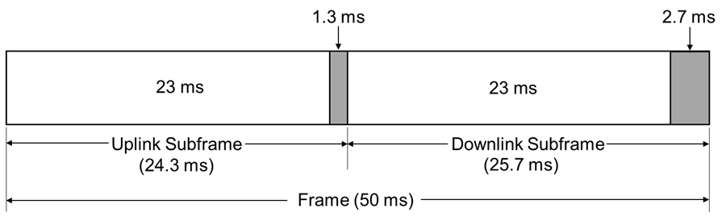
C Band Terrestrial Systems
All ground radios transmit simultaneously in the Uplink Subframe
All airborne radios transmit simultaneously in the Downlink Subframe
Time Division Duplexing was selected to provide multiple UAS access to the frequency bands since Frequency Division Duplexing would require large and expensive filtering on every UA (and in every Ground Station). Guard bands associated with the filtering of uplink and downlink sub-bands would cause inefficient use of the spectrum
A 50 msec TDD frame was selected as it would provide low latency (for voice and control support) and enable the link to recover quickly particularity in the terrestrial multipath fading environment

Slide 22
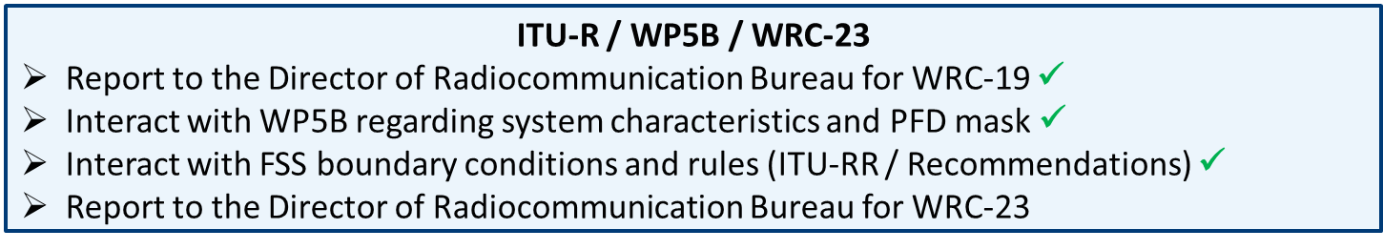
Ku and Ka Band FSS Systems
EUROCAE
RTCA
Safety Study
Environment
ITU-R: Characteristics
RPASP/ICAO: Clear Sky Link Analysis
EUROCAE
RTCA
MASPS
FSMP
ITU-R: Sharing, I/N & PFD
RPASP/ICAO:
Analysis with Impairments
2019
2020
2021
2022
2023
ITU-R:
WRC-23 Studies
RPASP/ICAO:
SARPs
Manuals & Guidelines
ITU-R:
WRC-23

Slide 23
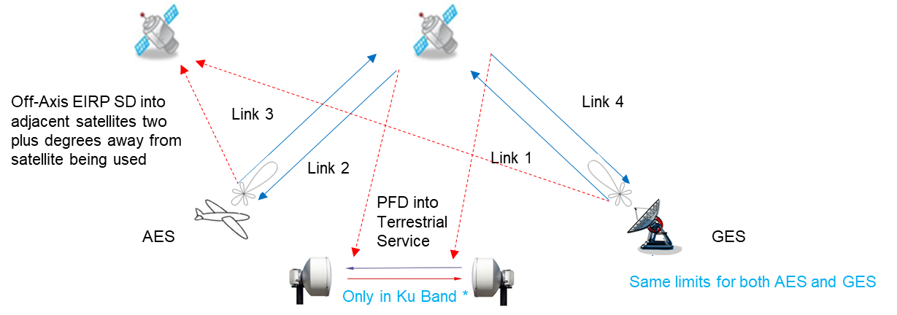
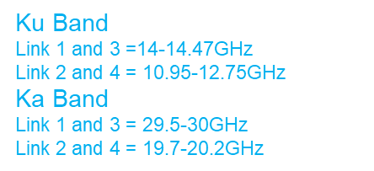
Ku and Ka Band FSS Systems
Links 1 and 3 must meet the Off-Axis EIRP SD limits set by ITU-R
  ITU-R Article 22.26 and ITU-R Recommendations S.524 and S.728
  * Link 3 may also have PFD limitations in certain bands and in certain regions – Annex 2 to Resolution 155
Links 2 and 4 must meet the PFD limits set by ITU-R
  ITU-R Article 21.16 for Ku Band
  No ITU-R limit in Ka Band so using the same value as in ITU-R Article 21.16 for Ku Band

Slide 24
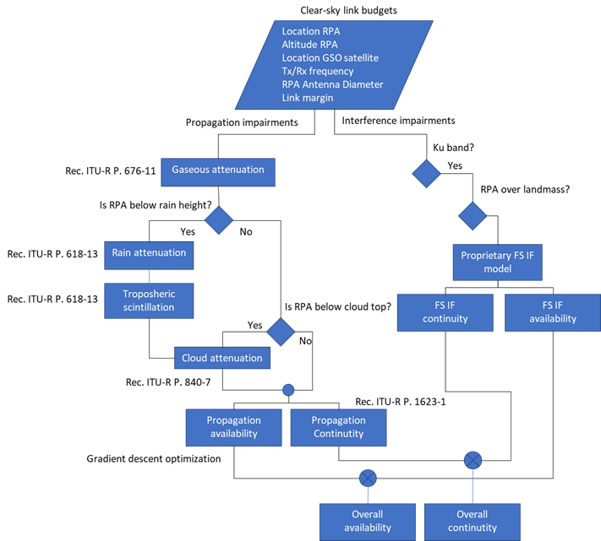




Ku and Ka Band FSS Systems
1) Clear Sky Link Budgets to determine if the forward and return links have positive margin derives from:
Ku band: 2 satellite types, 2 transponder settings, 2 UA types, 2 UACS types, 2 antenna patterns, 3 elevations, 5 flight heights, 3 uplink masks = 1440
Ka band: 2 satellite types, 2 transponder settings, 2 UA types, 2 UACS types, 2 antenna patterns, 3 elevations, 5 flight heights, 1 uplink masks = 480
giving in total 1920 link budgets
2) Those from step 1 with positive link margins will then be assessed to see if they achieve adequate performance with impairments
Link 2/3
Link 1/4
IF into link 2
Time Varying Rain, Cloud, and Interference Impairments

Slide 25
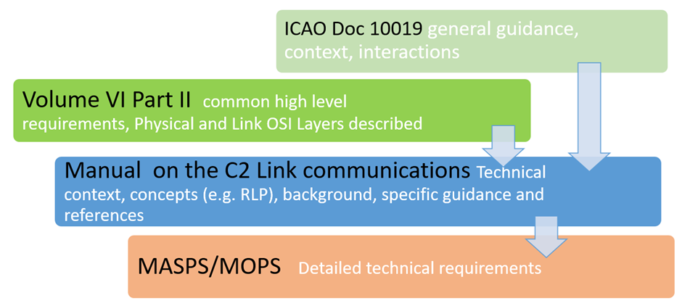
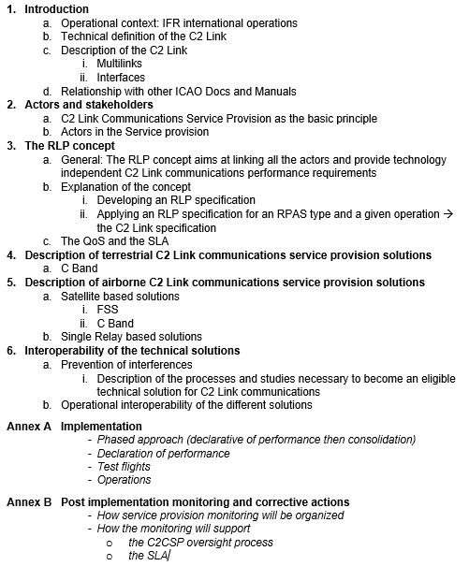
C2 Link SARPS Future Work Plan
Manual on C2 Link communications

Slide 26
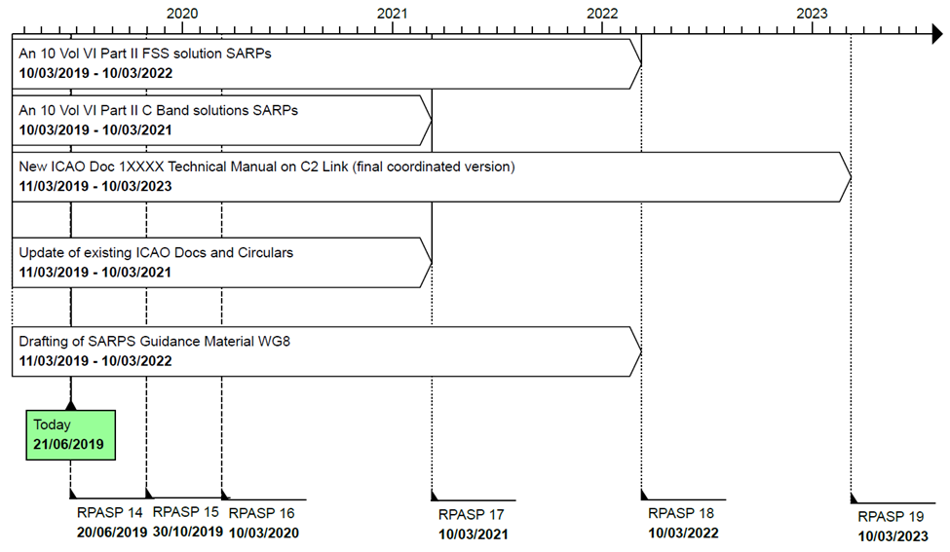
WG2 Future Working Schedule

