Slide 1
Engineering Lab Development
Accident and Incident Investigation Group (AIIG)
14 SEP 2022

Slide 2
OUTLINE
1
Role of Engineering in Aviation Investigation
2
AIB Engineering Lab Current Capabilities
3
Future Upgrade and Development
4
Lab Development Challenges

Slide 3
Role of Engineering in Aviation Investigation

Slide 4
Investigation Groups - Doc 9756
Section 7
Operations Group
Aircraft performance
Trajectory analysis
Flight and ground path
Section 10
Flight Recorders Group
Flight recorder recovery
Read-out of flight recorders
Analysis of flight recorders data
Section 16
Systems Group
Examinations of systems
Memory preservation of system computer
Aircraft stability and control
Section 17
Structures Group
Wreckage reconstruction
Metallurgy analysis
Crashworthiness
Section 19
Powerplants Group
Engine and power systems
Auxiliary Power Unit ( APU)
Fuel analysis
Section 20
Site Survey Group
Evidence collection
Wreckage distribution plotting
Aerial photography

Slide 5
AIB Engineering Lab Current Capabilities

Slide 6
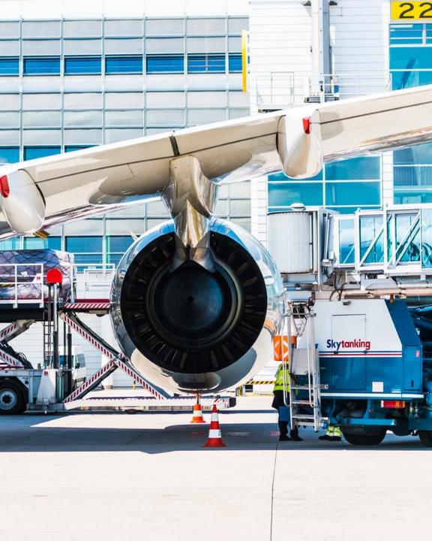
IDENTIFY
Determine and verify needed data
Engineering Lab Objective
PROCESS
Collect, preserve, prepare, and analyze
Identify and process reliable data and material with highest capability to provide factual information on which an investigation could be built upon
DATA
Electronics, instruments, recorders
MATERIAL
Fluid, structures, metallic and non-metallic
CAPABILITIES
Equipment, software, and facility
FACTUAL INFORMATION
Interpreted data without findings, conclusions or causal factors
INVESTIGATION
Investigated occurrences, safety studies, and technical assistance

Slide 7
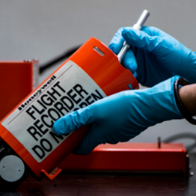
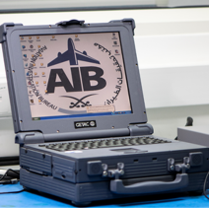
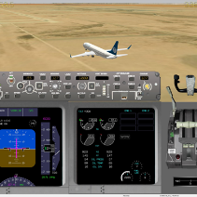
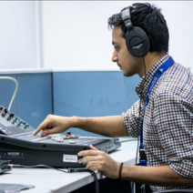
Flight Recorder
Reception & Preparation
Download & Processing
Animation
Audio Listening
Obtaining custody of flight recorders is one of the primary tasks of engineering lab members, the task includes the recovery and preparation
Flight information is retrieved from the Flight Data Recorders (FDR) and processed to obtain raw data
Data is transformed from its raw format to engineering values to produce plots , and 3D simulations using virtual model
Cockpit Voice Recordings (CVR) are listened and transcribed to investigate the communication in the flight deck

Slide 8
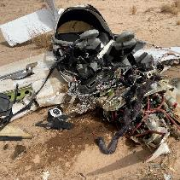
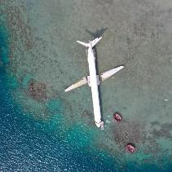
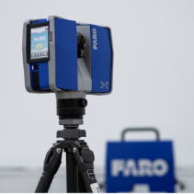
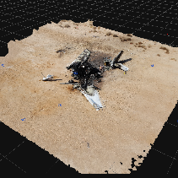
Photography
Digital Photography
Aerial Photography
3D Scanning
3D Modeling
Digital photography is used throughout the investigation process for evidence collection and documentation purposes
Aerial Photography is an advanced technology that captures the whole site including the surroundings, the initial impact point, and the final location
3D Scanning is used for wreckage and site survey purposes as part of field investigation and flight path reconstruction
3D Modeling is a visual demonstration of the flight path built upon factual data collected from flight data recorder (FDR) and 3D scanning photography

Slide 9
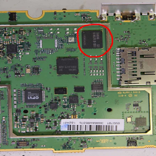
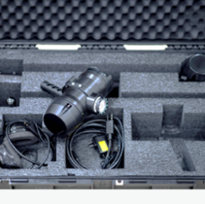
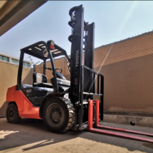
Supporting Functions
Damaged Devices
Underwater Search and Recovery
Wreckage Handling
Capabilities to handle and retrieve data from damaged flight recorders, avionic systems, and electronic devices
Diver Pinger Receiver and Surface Acoustic Receiver trace the audio signals omitted from the Underwater Locator Device to locate flight recorders under water
A dedicated area to store and prepare the wreckage that includes cutting, lifting and transporting equipment

Slide 10
AIB Engineering Lab Future Upgrade and Development

Slide 11

Incentive
Project Overview
Grow our scope of expertise
Increase competence in evidence processing
Be up to date with the aviation industry advancement
Description
Project:
AIB Laboratories
Upgrade
and Development
Initiative: Achieve the highest aviation security and safety levels including the full compliance with the international safety standards
Program: National Industrial Development and Logistics
Vision: 2030
Our aim is to establish advanced engineering laboratories that will transform our current capabilities to the next level. This transformation will be achieved by establishing four dedicated laboratories and upgrading the existing one to support the investigation process. The project focuses on enhancing human and facility resources.
Engineering Laboratories
Flight Recorders
Avionics
Photography
Wreckage Handling
Metal & Material

Slide 12
Flight Recorder
Reception & Preparation
Reception & Preparation
RJI DPR – 275, RJI STI-350
Ultrasonic cleaner, Heating oven
General facility and tooling upgrades
Download & Processing
Download & Processing
RPGSE, PI, RSU II, Universal, MARS
Insight Analysis, FAS
HHMPI, EHHDLU, EAFR, RDI
Teledyne FDM, Insight Analysis
Animation
Animation
Insight Animation
FAS
Insight Animation
CEFA
Audio
Audio
Sony Sound Forge
SONY Spectralayers Pro

Slide 13
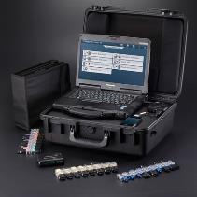
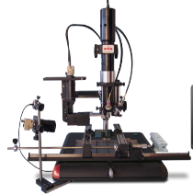
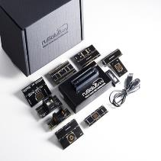
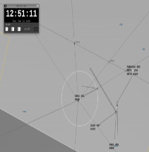
EAM
Avionics/Systems
Personal Devices
Solder / De-solder
NVM
ATC
UFED TK
ruggedized mobile forensic solution
Android, iOS, BlackBerry & SIM
PDR IR-E3
Vacuum Placement System
Noncontact, IR Sensor & preheating
RUSOLUT VNR READER
Universal socket to read NAND memory of any existing and future package
INDRA
A tool to retrieve the data from the ATC systems and replay the controller display

Slide 14
Photography
DJI Mavic & Phantom Fleet
Photography Studio
Multimedia Editing Station

Slide 15
Metal and Material
Section 4
Part 1 : Preparation
Part 2 : Imaging
Part 3 :
Testing
Part 4 :
Utilities
Cutting machine
Polishing
Grinding
SEM
Stereo Microscope
Reflected light Microscope
Transmission light Microscope
General Lab balance
Spark-OES
Micro-hardness tester
Fume hood
Drying station
Air compressor

Slide 16
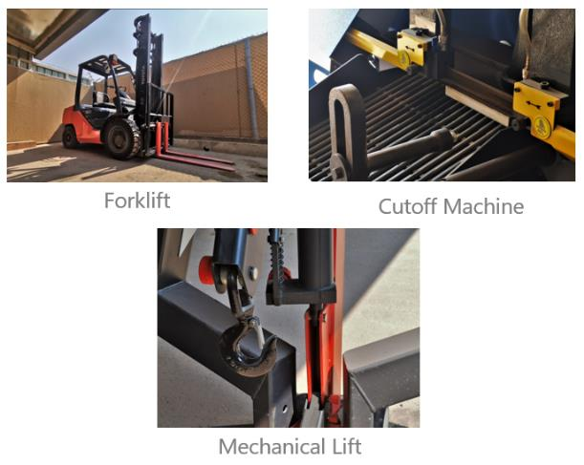
EAM
Wreckage Handling
A newly built comprehensive workshop to prepare the samples before conducting further analysis by cutting, cleaning or else depending on the required process

Slide 17
AIB Engineering Labs Reorganizing Project
Define Value proposition
01
02
Observe and collect data
5
STEPS
For Reorganizing
AIB Engineering Labs
03
04
Process Modeling
Job Modeling
05
Change and Implementation Plan

Slide 18
Lab Development Challenges

Slide 19
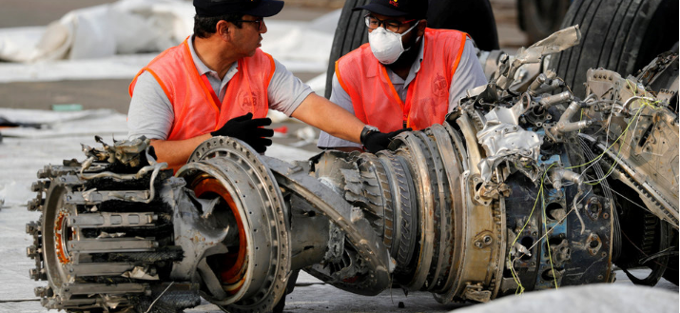
Challenges of Lab Upgrade
Software Selection
Audio Analysis
Coverage
Environmental Factors
Result Accuracy
Human Capital

Slide 20
Q & A

Slide 21
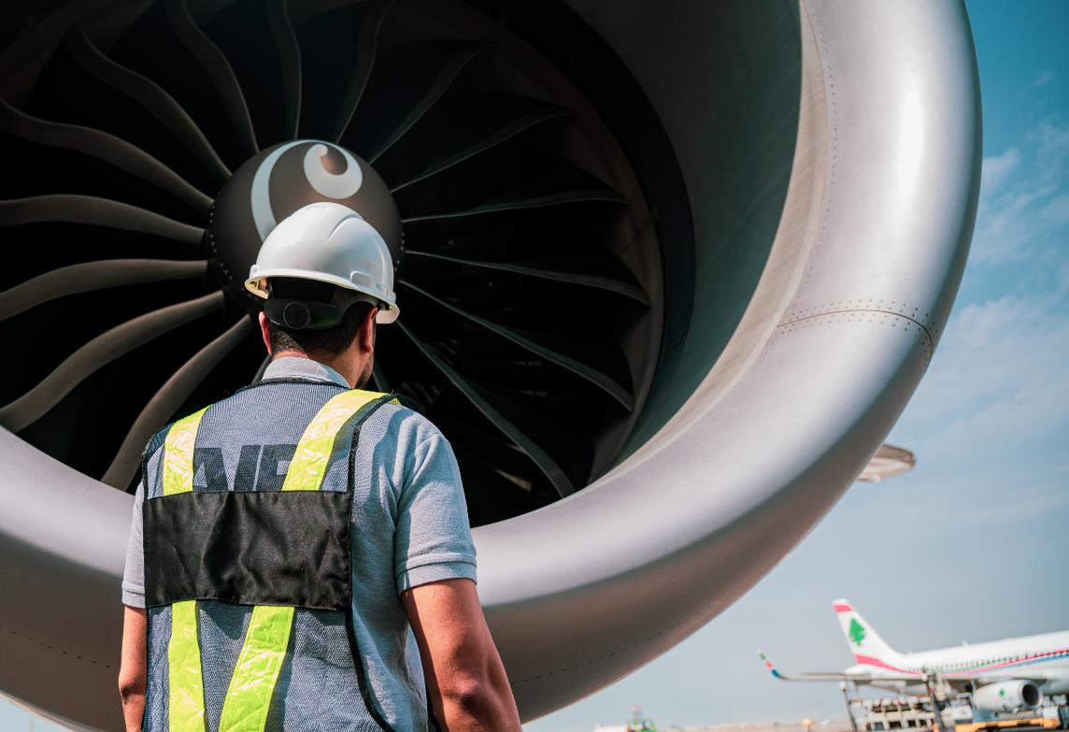


Aviation Investigation Bureau
Kingdom of Saudi Arabia
Thank You

