Slide 1
Academic Upset Training

Slide 2

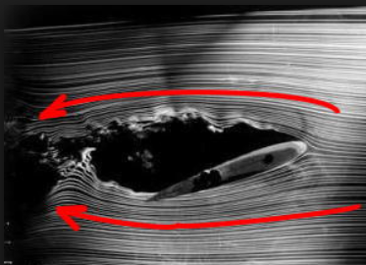
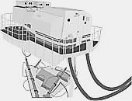
Top Points
An ounce of prevention
is worth a pound of cure
Reducing angle-of-attack is THE most
important pilot action in an upset event
Pilot upset training in simulators
must account for their limitations
“I’ll have an ounce of prevention”
Notes:
Much of this course discusses the “cure” which is the recovery from a full stall or upset if it was not prevented, as that is the new part of the rule. Of course, we try to get better at prevention too, which has been around since the Wright Bros.

Slide 3
Outline
Definitions
Aerodynamics
  Trim
  Dihedral effect
  Speed stability
  Performance considerations
  Roll stability
Notes:
These are the main topics that will be covered.

Slide 4
Outline, continued
Stalls
Upsets without stall
Loss of reliable airspeed
Pilot monitoring
Instructor operating station

Slide 5
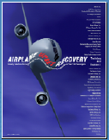
Definitions
Upset:
  Unintentionally exceeding parameters normally experienced in line operations or training:
    Pitch > 25 degs nose up or > 10 degs nose down
    Bank > 45 degs
    Within above, but at airspeeds inappropriate for the conditions
from Airplane Upset Recovery Training Aid, Ed. 2
Notes:
Key word is unintentional
So, if you intend to bank to 50 degs, is that an upset?

Slide 6
Definitions
Full stall condition – any one, or combination, of the following:
  A nose-down pitch that cannot be readily arrested, which may be accompanied by an uncommanded rolling motion
  Buffeting of a magnitude and severity that is a strong and effective deterrent to further increase in angle of attack
  The pitch control reaches the aft stop for 2 sec and no further increase in pitch attitude occurs when the control is held full aft, which can lead to an excessive descent rate
  Activation of a stall identification device (e.g., stick pusher)
Adapted from part 25.201
Notes:
Important, as a commercial transport stall is often not like a C172 stall where you get a pitch break. So, pilots need to learn recognition, which has been a problem
So, for a transport aircraft to be certified…it must have a pitch break, or a deterrent buffet, reach an aft stop for 2 secs with no more pitch, or a pusher activation

Slide 7
Definitions
Stall characteristics
  must be able to produce, and correct, roll and yaw up to the stall
  no abnormal pitching
  for wings level stalls, the amount of roll between stall and completion of recovery < 20 degs
  for turning stalls, roll during recovery must not be more than
    60 degs in direction of turn, or 30 degs in opposite direction, if deceleration is 1 kt/sec or less
    90 degs in direction of turn, or 60 degs in opposite direction, if deceleration is more than 1 kt/sec
Adapted from part 25.203
Notes:
I note these, as there are myths out there, some in writing that say a stalled condition includes
Lack of pitch authority and/or roll control
Inability to arrest the descent rate

Slide 8
Definitions
Extended envelope training
  Maneuvers and procedures conducted in a simulator that may extend beyond the limits where typical simulator performance and handling qualities have been validated with heavy reliance on flight data to represent the actual aircraft
Energy State
  How much kind of energy (kinetic, potential, or chemical) the airplane has at any given time
Negative transfer of training
  When knowledge or skills learned in the classroom or in the simulator impede those necessary in the aircraft
Notes:
From Flying magazine “when a person takes one skill from a particular skill set — let’s say being shrewdly analytical while speaking with colleagues about a project — and uses that skill while doing something similar — like listening to your spouse vent about a particularly rough day and reflexively applying that same kind of incisive analysis to that situation”

Slide 9
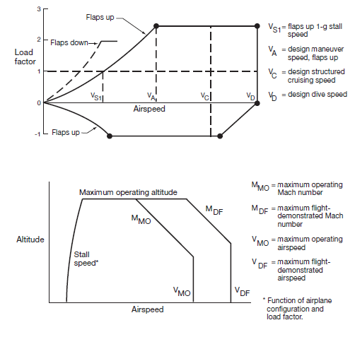
Aerodynamics
Notes:
Explain V-n diagram. Typical flight going 1g left to right. Left side is stall speed, which goes up with g…and obviously it is just for one particular weight. Right side is dive speed, often set by flutter, but drag rise on supercritical wings is so marked that it is hard to go that fast in level flight.
What is important for UPRT are three things: (1) look what happens when you unload…stall speed drops…no stall speed at 0g. (2) 2.5g’s is the symmetric limit. If you are rolling while a g-meter reads 2.5g, then one wing is pulling more than 2.5g’s. These are asymmetric g’s, and they should be avoided. Thus, unload before rolling. It was an issue in an incident I will show later; (3) maneuver speed – below that speed, you cannot pull more than 2.5g for one-sided inputs

Slide 10

Aerodynamics
Y
Lateral load factor =
W
V
Y=
Y_{body}+
Y_{δ}
Y_{body}
Y_{δ}
AA587 example
Notes:
Lateral load factor. Same thing, but in a different direction.
Two components, one arising from arising airplane motion. One arising from control inputs.
In quite a few simulators, pilots will not feel much of the lateral load factor. That can affect how aggressive they might be during training versus how aggressive they might be in the actual aircraft.
AA587 is an example, where some people believe that had the simulator been a more faithful representation of the aircraft, perhaps the in-flight aggressiveness might have been less.

Slide 11
Aerodynamics
Trim
Nagoya, 1994 – China Airlines #140
Notes:
China Airlines A300 Nagoya: A/P off. F/D and A/T on. F/O flying and likely triggered go-around mode, which engages A/P. Captain said go-around triggered and told F/O to retard a little and disengage. F/O retarded and disengaged A/T. Doesn’t cancel go-around and A/P remains engaged and commands aircraft to go-around attitude unless pilot commands another A/P mode on MCP. Stabilizer went to full nose up. Meanwhile thrust reduced and aircraft descended. Captain calls for A/T engagement, thrust increases causing aircraft to reach 52 degs pitch, stalls at 1800 ft and not able to recover, as full nose-down elevator could not overcome the pitch up from the stabilizer and pitch up from the below-the-wing-mounted engines.

Slide 12
Aerodynamics
Trim
Nagoya, 1994 – China Airlines #140
ATR & Saab 340 icing incidents/accidents
Important to understand potential insidious effects of the trim system in your aircraft
  will discuss in simulator

Slide 13
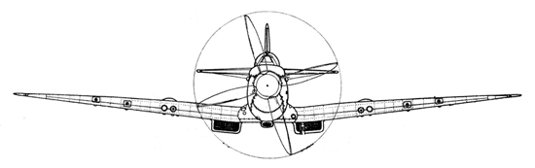
Aerodynamics
Dihedral effect
What is it?
Notes:
In the simplest terms, you can see that relative wind from the left pushes up on the left wing and down on the right wing.
If we weren’t in level flight, but say we were descending, the sideslip would push up on both wings, but less so on the right wing.
Either way, the airplane rolls to get rid of that sideslip.

Slide 14
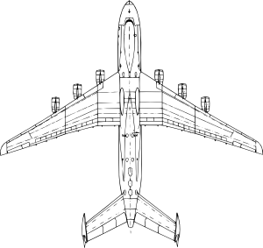
Aerodynamics
Dihedral effect
Things to know for commercial transports…
Swept wing increases
dihedral effect
Notes:
Basically, the point here is that a commercial transport will react in roll when you put on a sideslip much more than you are probably used to.

Slide 15
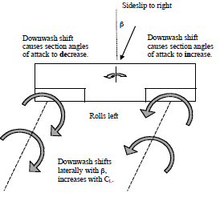
Aerodynamics
Dihedral effect
Things to know for commercial transports…
Swept wing increases
dihedral effect
Increasing AoA increases
dihedral effect
Notes:
Basically, the point here is that a commercial transport will react in roll when you put on a sideslip much more than you are probably used to.

Slide 16
Aerodynamics
Dihedral effect
Things to know for commercial transports…
Swept wing increases
dihedral effect
Increasing AoA increases
dihedral effect
Once you get it going, it’s like a train, it’s hard to stop
Notes:
Basically, the point here is that a commercial transport will react in roll when you put on a sideslip much more than you are probably used to.

Slide 17
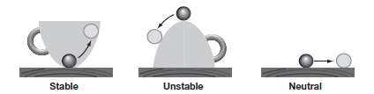
Aerodynamics
Stability
Tendency to return if moved from trim and released
Notes:
Important to not get below min L/D speed: temp awareness, use A/P in ways to keep bank angle low at cruise, VS mode
If you get there, need to take immediate action: reduce bank, maximum continuous thrust, descend
Q20: So, will an airplane’s roll stability typically degrade near stall? What might that tempt you to do?

Slide 18
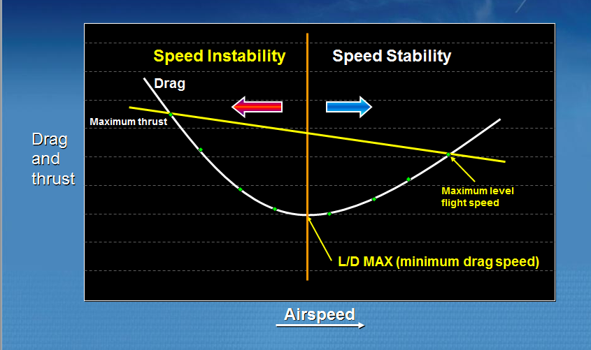
Aerodynamics
Speed stability
Notes:
L over D Max:
The lowest point on the total drag curve (as shown in figure 1) is known as L over D max or Vmd--minimum drag speed. It is approximately equivalent to the clean holding speed for your current altitude and weight. For example, for the Airbus, this would be the “green dot” speed, or Vfto.
Speed faster than L over D max is considered normal flight, or the “front side of the power-drag curve.” In this regime, adding power causes the plane to go faster.
The speed range slower than L over D max is known as slow flight, which is sometimes referred to as the “back side of the power-drag curve” or the “region of reverse command,” because in this region, it takes more power to go slower.
Normal flight (faster than L over D max) is inherently stable with respect to speed.
When operating in level flight at a constant airspeed with constant thrust setting, any airspeed disturbance (such as turbulence) will result in the airspeed eventually returning to the original airspeed when the pilot has not changed the total thrust.

Slide 19
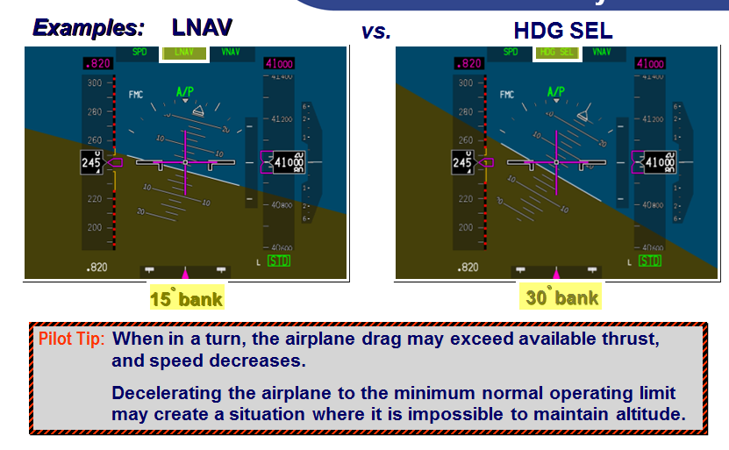
Aerodynamics
Performance considerations
Notes:
For airplanes with real-time bank angle protection, the bank limiting function is only available when in LNAV. The use of LNAV will ensure bank angle is limited to respect buffet and thrust margins (note the 15 degree bank) and the airspeed remains within the operating envelope.
However, the use of other automation modes, such as Heading Select or hand flying, may cause bank angles that result in buffeting. On the right, when in a 30 degree turn, the airplane drag may exceed available thrust. Note how the operating margin has been critically reduced and that the same airspeed is now in the amber band.
This is why it is important to be aware of your climb capability for bank angle and buffet boundary protection and when in Heading mode above FL 310, to always use half-bank mode (if available).
Pilot Tip: In a turn, the airplane drag may exceed available thrust, and speed decreases, as on the right. If the airplane decelerates to the minimum normal operating limit, it may be impossible to maintain altitude.
Note, the angle of attack margin is shown between the high and low-speed speed tapes. The speed tapes will always give AOA margin as the stick shaker is compensated for mach.

Slide 20
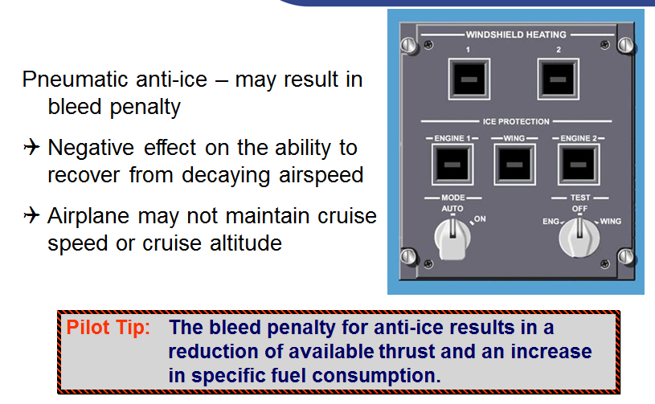
Aerodynamics
Performance considerations
Notes:
It must be remembered that pneumatic anti-ice robs the engine of bleed air. While bleed air is available at any time the engine is operating, it comes at a price.
Power is required from the turbines to heat and compress the high pressure air that is bled from the engines.
The penalty for air taken from the engine before going into the combustion chambers is a reduction in available thrust and an increase in specific fuel consumption.
Appropriate and judicious use of anti-ice equipment at high altitude is very important.
One must be aware of the fact that the use of anti-ice has a negative effect on the ability of an airplane to recover from a decaying airspeed situation.
In some cases, it may not be possible to maintain cruise speed or cruise altitude at high altitude with anti-ice on.
Pilots should also be aware of the specific flight planning parameters for their particular flight.

Slide 21
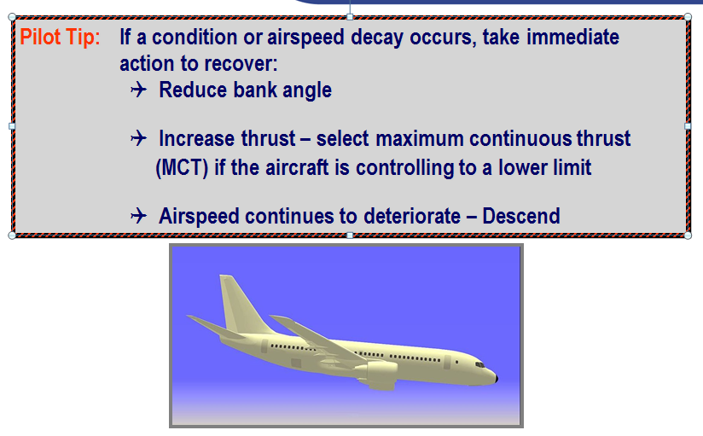
Aerodynamics
Performance considerations

Slide 22
Aerodynamics
Roll stability
Lift
Coefficient
Rear
View
AoA
Notes:
One of the most important points in this academic course is a discussion of roll stability. The reason for that is an understanding roll stability can be used a vital recognition cue that you may be in a stalled condition.
Loss of roll stability was a factor in Colgan 3407, AF447, and Air Asia 8501. While hypothetical, one wonders if, had the crews in those accidents understood roll stability, if it might have help them to take the proper control actions.
On the left, we have an aircraft flying straight and level, and we are looking at it from behind. That is, it is flying into the page.
On the right, we have a simple lift curve, that is, lift coefficient versus angle of attack.
Let’s say we are flying along here at the angle of attack and lift coefficient shown by the green circle on the lift-curve on the right. Both wings are at the same angle of attack, so both wings are developing the same lift as shown by the green arrows on the left and right wings of the airplane.

Slide 23
Aerodynamics
Roll stability
Lift
Coefficient
Rear
View
AoA
Notes:
Now let’s say we get an atmospheric disturbance that causes the right wing to drop, the motion of which is shown by this little blue arrow by the right wing.
As a result of this uncommanded right roll, what new angle-of-attack do the right and left wings experience?
Well, since the right wing is going down, the air relative to it is going up. So, the right wing is seeing more angle-of-attack in this roll than it was seeing before when it was flying straight and level.
By the same token, air is moving downwards relative to the left wing as it rises due to the uncommanded roll. So, the left wing is seeing less angle-of-attack than it saw prior to the roll rate.

Slide 24
Aerodynamics
Roll stability
Lift
Coefficient
Rear
View
AoA
Notes:
If we put these new wing angles-of-attack on the lift curve slope, we see that the right wing develops more lift (red triangle and red arrow on right wing) as a result of this roll disturbance, and the left wing develops less lift (blue square and blue arrow on left wing) as a results of this roll disturbance.
Now, we ask ourselves if this is a stable or unstable situation. We are disturbed from our straight and level trim. As a result of that disturbance, due the forces and moments that arise have a tendency to return us to trim, or do they have a tendency to move us further away from trim?
The answer is that there is a tendency to return back to trim, as the change in lift on the left and right wings is such that the airplane is resisting this roll disturbance. More lift is on the right wing, and that slows down the uncommanded roll rate.
This is a good thing. The airplane is stable in roll here. It makes an airplane easier to fly with such stability, as it allows a pilot to divert his/her attention to other tasks without constantly focusing on keeping the roll attitude at a particular orientation.

Slide 25
Aerodynamics
Roll stability
Lift
Coefficient
Rear
View
AoA
Notes:
Ok, now let’s say for the sake of argument that we are stalled but developing the same lift coefficient as before. While it would be hard to keep the airplane in this condition, as the flow would be unsteady, etc., work with me here, as this is a simplified discussion of the aerodynamics in an idealized situation.
Ok, both wings develop the same lift as before in this condition…even though we are stalled.

Slide 26
Aerodynamics
Roll stability
Lift
Coefficient
Rear
View
AoA
Notes:
Now, you probably see where we are going with this.
Let’s add the same roll disturbance as before, so the right wing drops as a result.
Again, from this disturbance, the right wing sees more AoA and the left wing sees less AoA than in the straight and level condition.
But look what happens to the lift now on the left and right wing. The right wing becomes more stalled and sees less lift now, while the left wing is becoming less stalled, so it experiences more lift.
Now from a stability perspective, you can see that the lift on the left and right wing is causing the aircraft to roll even further away from trim.
This is classic roll instability, and it is the reason we are doing full stall recoveries instead of just approach-to-stall recoveries. Some ask “why do both, since the stall recovery procedure is identical in either case?” The answer is that the airplane does not tempt you stray from the proper recovery procedure in the “roll stable” case of an approach-to-stall recovery. However, the airplane may tempt you to try and control the roll axis in the “roll unstable” case of a full stall recovery. Since it is human nature to try and control something that is running away from here, and here the roll axis might be running away from you in the unstable case, pilots can be tempted to control the roll axis instead of the potentially counter-intuitive action of reducing angle-of-attack. Reducing the angle of attack to unstall the airplane will bring the roll stability back and make aircraft stability and control easier.

Slide 27
Aerodynamics
Roll stability
Lift
Coefficient
Rear
View
AoA
Notes:
Let’s take it further. Let’s say a pilot is tempted to control the roll axis when stalled.
The right wing drops. Now, you as a good pilot tries to stop the right wing from dropping by putting in left wheel to raise the wing.
What happens now aerodynamically? The right aileron drops and the left aileron rises.
Now, geometrically, the right wing is now at an even higher angle-of-attack with the left wheel input, and the left wing is at a lower angle of attack.
From the lift curve, you can see this just makes the situation worse, and the right wing drops even further. This is roll reversal (the non-aeroelastic kind).
For those that think this is only an academic point, they should watch the final seconds of the Colgan video. Watch what happens with the roll attitude at the same time that you watch the pilot wheel inputs. You will see large roll attitudes to the right at the same time that the wheel is full left, and vice versa. Classic roll instability.
Or, watch the AF447 reconstruction. While a big airplane like an A330 will not have the dramatic roll response like a Q400, you will see instance of full left or right sidestick input when the airplane is lumbering in the other roll direction during the period it is stalled. Also, emphasis on maintaining wings level and the difficulty of doing so is self-evident in the CVR. Knowledge of roll instability may have been an important stall recognition cue.
The same can be said for the Air Asia accident. An inability, or inordinate difficulty, to control the roll axis occurred after the airplane was stalled.
This point might be over-dramatized, as we see instances in the simulator stall training periods where pilots are tempted to control the roll axis first in a roll off…and everything usually turns out fine. If you are a little past the stall point, the airplane still has roll control, as it must in order to be certified. Yet, we repeat the stall maneuver if we see pilots do that. Even though it worked out for them in the simulator, the point here is to teach good form that works in all cases so as to stay out of trouble in potentially critical situations. The bottom line is that knowledge is power on this point.

Slide 28
Why?
Colgan 3407
Displayed speed
margin decreases
Unexpected
shaker
and pusher
Pilot
pulls
Lack of
attention
Lack of
proper response
Unstable
rolling
Tries to
control roll
Lack of
understanding
?
Lack of
proper response

Slide 29
Stalls
So, are we really stalling airplanes in the U.S.?

Slide 30

Stalls
So, are we really stalling airplanes in the U.S.?
Notes:
Members of the Commercial Aviation Safety Team (e.g., Southwest, United, etc) can access ASIAS to determine the frequency of stall warnings and compare that industry-wide rate against their own as a quality metric if they wish.

Slide 31
Stalls
So, are U.S. operators stalling airplanes?
2009
2010
2011
2012
2013
2014
2015
2016
2017
2018
2019
Stall &
Stick Pusher
Guidance
Notes:
If you’ve taken our course, you know that in the U.S. we have had at least 8 stalls in the last 7 years.
These are just the ones I find out about….I suspect there are more. It’s easy to measure stall warnings from FOQA data. It is harder to measure full stalls.
These are anecdotal…the ones I know about.

Slide 32
Stalls
So, are U.S. operators stalling airplanes?
CRJ 200
stall
2009
2010
2011
2012
2013
2014
2015
2016
2017
2018
2019
Stall &
Stick Pusher
Guidance
Notes:
If you’ve taken our course, you know that in the U.S. we have had at least 8 stalls in the last 7 years.
These are just the ones I find out about….I suspect there are more. It’s easy to measure stall warnings from FOQA data. It is harder to measure full stalls.
These are anecdotal…the ones I know about.

Slide 33
Stalls
So, are U.S. operators stalling airplanes?
CRJ 200
stall
B757
stall
2009
2010
2011
2012
2013
2014
2015
2016
2017
2018
2019
Stall &
Stick Pusher
Guidance
Notes:
If you’ve taken our course, you know that in the U.S. we have had at least 8 stalls in the last 7 years.
These are just the ones I find out about….I suspect there are more. It’s easy to measure stall warnings from FOQA data. It is harder to measure full stalls.
These are anecdotal…the ones I know about.

Slide 34
Stalls
So, are U.S. operators stalling airplanes?
CRJ 200
stall
B757
stall
CRJ 700
stall
2009
2010
2011
2012
2013
2014
2015
2016
2017
2018
2019
Stall &
Stick Pusher
Guidance
Notes:
If you’ve taken our course, you know that in the U.S. we have had at least 8 stalls in the last 7 years.
These are just the ones I find out about….I suspect there are more. It’s easy to measure stall warnings from FOQA data. It is harder to measure full stalls.
These are anecdotal…the ones I know about.

Slide 35
Stalls
Know of 8 full stalls in part 121 operations
(everyone recovered) in last 7 years
DHC-8
stall
CRJ 200
stall
B757
stall
CRJ 700
stall
B757
stall
CRJ 700
stall
737
stall
2009
2010
2011
2012
2013
2014
2015
2016
2017
2018
2019
Stall &
Stick Pusher
Guidance
CRJ 900
stall
Notes:
If you’ve taken our course, you know that in the U.S. we have had at least 8 stalls in the last 7 years.
These are just the ones I find out about….I suspect there are more. It’s easy to measure stall warnings from FOQA data. It is harder to measure full stalls.
These are anecdotal…the ones I know about.

Slide 36
Frequency of stalls that I know of
(part 121 operations)
Stall
Stall warning
Lift
Coefficient
1 in 10,000,000 hrs
1 in 100,000 hrs
Angle of attack
Notes:
A lot is the same between the U.S. and Europe for UPRT, but some key differences remain
Biggest hurdle we face is convincing experienced professionals that they may not know everything
Scenarios are worth their weight in gold, but finding new ones is as intensive as finding a new bitcoin

Slide 37
How good does a pilot have to be?
Stall
Stall warning
For unrecoverable stall to
be 1 in 1,000,000,000 hrs,
pilot can fail 1 in 100
Lift
Coefficient
1 in 10,000,000 hrs
1 in 100,000 hrs
Angle of attack
Notes:
A lot is the same between the U.S. and Europe for UPRT, but some key differences remain
Biggest hurdle we face is convincing experienced professionals that they may not know everything
Scenarios are worth their weight in gold, but finding new ones is as intensive as finding a new bitcoin

Slide 38
Stalls
What does a stall fundamentally depend on?
  Airspeed?
  Bank angle?
  Load factor?
  Altitude?
  Gross weight?
  Angle of attack?
  Mach number?
  Configuration or contamination (e.g., flap or slat position or ice)?

Slide 39
Stalls
What does a stall fundamentally depend on?
  Airspeed
  Bank angle
  Load factor
  Altitude
  Gross weight
  Angle of attack
  Mach number
  Configuration or contamination (e.g., flap or slat position or ice)
Notes:
Stalls depend on AoA, Mach, config/contam.
Q3: So, wing stall fundamentally depends on AoA, Mach, and configuration or contamination

Slide 40

Stalls
Angle of attack
Stall warning system*
Mach
Stick shaker or
Airbus “stall stall <cricket>”
Configuration
or contamination
* - can be a little more complicated that this…asymmetric flap and thrust bias (flaps down)
and a speedbrake input
Notes:
Self-respecting stall warning systems use AoA, Mach, and configuration/contamination to drive the stall warning system.

Slide 41
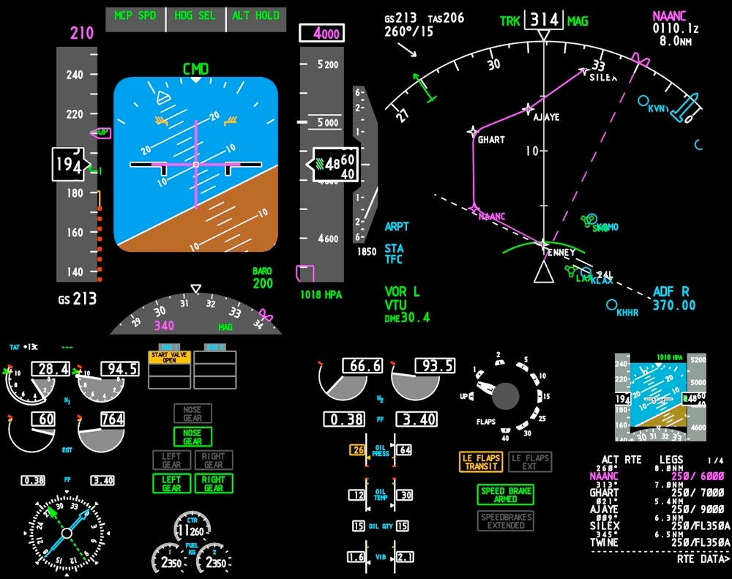
Angle of attack margin
AoA
margin
to stall
warning
Notes:
If you have a “modern” PFD, there are at least three ways to teach and use AoA to improve a pilot’s prevention skills:
The barber pole is driven by the same inputs as the stall warning system, since when the barber pole reaches the airspeed digits, the stall warning activates. Therefore, the visual distance between the top of the barber pole and the airspeed digits is an indication of AoA margin to a stall warning.
Same for the pitch-limit-indicator.
If you switch on the flight-path symbol, the angle between pitch attitude and the flight path symbol is basically AoA (without winds).
So, we don’t teach AoA awareness as much as we should, but here are three ways to do so.

Slide 42
A320 stall warning
Aural stall warning and Vsw
Conf not 0, degraded laws
15
Aural stall warning,
Conf 0, degraded laws
10
Vsw,
Conf 0, degraded laws
AoA
(deg)
5
0
0
0.2
0.4
0.6
0.8
Mach No.
Normal law
Aural stall warning, 23 deg AoA, Conf not 0
Aural stall warning, 15 deg AoA, Conf 0
Notes:
On single aisle Airbus aircraft, Vsw and the speed trigger for the aural stall warning are calculated differently and independently.
Vsw is Mach compensated in the FACs, and the aural warning is calculated by the FWS based on AoA and slat position.
On single aisle Airbus aircraft, if both FACs are lost, or when the FACs send invalid data, the Vsw display is replaced by SPD LIM. Aural warning is still functional in these cases if FWS is provided with AoA info.

Slide 43
Stalls
Physical confusion…
  Airspeed?
    Can stall at any speed
Notes:
Template applies regardless of altitude. If you are really low and stalled, you can push and hit the ground softer or you can pull and hit the ground harder
Q12: So, to maintain altitude in a banked turn, does lift need to be greater than weight? Does that amount of lift required depend on altitude?

Slide 44
Stalls
Physical confusion…
  Airspeed?
    Can stall at any speed
  Bank angle?
    Can stall at any attitude
Notes:
Template applies regardless of altitude. If you are really low and stalled, you can push and hit the ground softer or you can pull and hit the ground harder
Q12: So, to maintain altitude in a banked turn, does lift need to be greater than weight? Does that amount of lift required depend on altitude?

Slide 45
Stalls
Physical confusion…
  Airspeed?
    Can stall at any speed
  Bank angle?
    Can stall at any attitude
  Load factor?
    Can get load factor from both AoA and speed
Notes:
Template applies regardless of altitude. If you are really low and stalled, you can push and hit the ground softer or you can pull and hit the ground harder
Q12: So, to maintain altitude in a banked turn, does lift need to be greater than weight? Does that amount of lift required depend on altitude?

Slide 46
Stalls
Physical confusion…
  Airspeed?
    Can stall at any speed
  Bank angle?
    Can stall at any attitude
  Load factor?
    Can get load factor from both AoA and speed
  Altitude?
    Wing does not care what the altitude is
Notes:
Template applies regardless of altitude. If you are really low and stalled, you can push and hit the ground softer or you can pull and hit the ground harder
Q12: So, to maintain altitude in a banked turn, does lift need to be greater than weight? Does that amount of lift required depend on altitude?

Slide 47
Stalls
Physical confusion…
  Airspeed?
    Can stall at any speed
  Bank angle?
    Can stall at any attitude
  Load factor?
    Can get load factor from both AoA and speed
  Altitude?
    Wing does not care what the altitude is
  Gross weight?
    Stall speed goes up with weight…but wing stalls at same AoA
Notes:
Template applies regardless of altitude. If you are really low and stalled, you can push and hit the ground softer or you can pull and hit the ground harder
Q12: So, to maintain altitude in a banked turn, does lift need to be greater than weight? Does that amount of lift required depend on altitude?

Slide 48
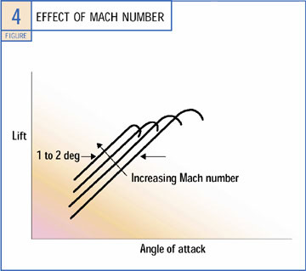
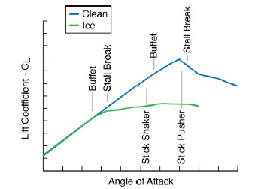
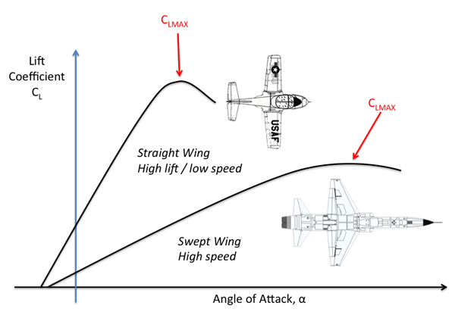
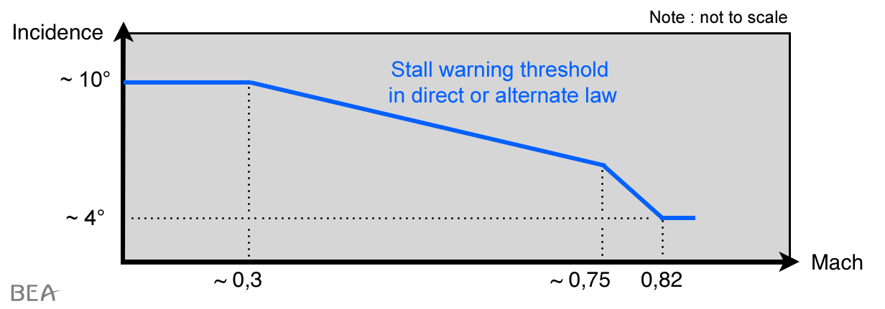
Stalls
Configuration
or contamination
Angle-of-attack
Mach
Notes:
Left curve: Straight wing is what you are most familiar with. Lift reduces past a particular AoA. Notice how curve flattens out with sweep, and that is one of several effects that can make stall ID more difficult in a swept wing, since if you have a break, it is not as pronounced.
Middle curve: As you get closer to speed of sound, flow gets sonic over upper surface, and a shock is created, which breaks down the flow and lift. It can cause a reduction in the stall AoA and the amount of lift you can get as you increase Mach. As a result, the indicated speed at which you will stall in 1g flight will go up with Mach. Naturally you will see that with increasing altitude as your Mach increases. Very much wing-design dependent.
This effect also is an issue in some aircraft types. Stick shakers provide a warning by firing before the stall AoA. All of them will change the AoA activation point with configuration, as your stall AoA will change. But some models, the MD-80 for instance, does not account for Mach effects in the shaker. So, it is possible to stall at high Mach numbers before you get a stick shaker. Typically this is handled by operational procedures. On other models, stall warning activation can vary dramatically. Bottom figure is from the AF447 report and applies to the A330.
Last curve: I think you all know how flaps and slats affect stall angle of attack (slats alone increase it, flaps alone decrease it), but here is how ice affects it. With ice, the lift curve gives up before the clean-wing maximum lift coefficient. And this can be a shaker issue too, as the shaker doesn’t know if the wing has iced up. So, you could stall before getting the shaker.
All of these examples are intended to show that you need to be familiar with the stall identification cues. They are not like a C172 necessarily, and if the rare situation occurs where your stall protection system has not prevented you from stalling, your knowledge can be used as a backup.
Q7: So, it is possible to stall a transport without getting shaker first (icing…non-Mach compensated shaker)

Slide 49
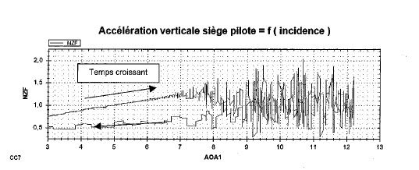
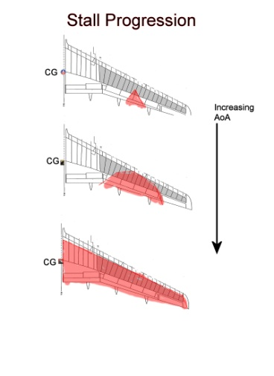
Stalls
Important identification cues…based on earlier stall definition
Pitch break
Strong buffet
Control stop, no more pitch
Pusher activation
2
G’s
1
0
4
8
12
AoA (degs)
Notes:
Template applies regardless of altitude. If you are really low and stalled, you can push and hit the ground softer or you can pull and hit the ground harder
Stalls depend on AoA and Mach. Disambiguate speed, load factor, GW (shows how vary in AFM), turns, altitude, etc. Talk about AFM stall speeds.
Template NO LONGER HAS MINIMIZES LOSS OF ALTITUDE

Slide 50
Stalls
Recovery template, abridged
Autopilot and autothrottle | Disconnect
Nose down pitch control Nose-down pitch trim | Apply until stall warning eliminated As needed
Bank | Wings level
Thrust | As needed
Speed brake/spoilers… | Retract
Return to desired flightpath
Procedure developed by
Boeing, Airbus, Bombardier, ATR and Embraer
Notes:
Note that rudder is not mentioned
Q4: Rudder causes sideslip, which then causes rolling motions that are surprising and difficult to control…and that can lead to cyclic inputs and exceeding structural limits
Q2: This recovery technique is the same regardless of altitude.
Q13: True or false, the key to properly recovering from stalls is to minimize loss of altitude?

Slide 51
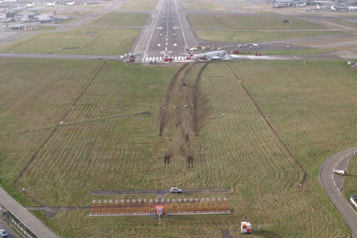
British Airways #38, Jan. 2008
Notes:
Ice accretion restricted fuel flow to both engines, and it did not manifest itself until less that a minute before touchdown.
Engines did not respond to full throttle when the airspeed fell below the approach speed. 10 secs prior to touchdown (150 ft AGL), they got the shaker, and the co-pilot did the right thing by pushing the column forward.

Slide 52
Why?
Air Asia 8501
Circuit breaker pulling
In effort to clear
repeated failure
? – [airplane
does not return
to normal law…
pulls and stalls]
Lack of
understanding
Unstable
rolling
Tries to
control roll
Lack of
understanding
?
Lack of
proper response

Slide 53
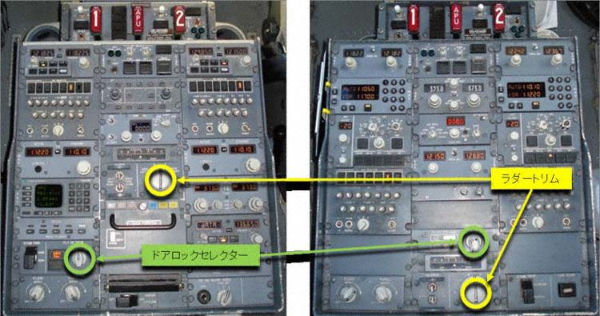
Upsets without stall
Rud trim
Cockpit door
B737-700
B737-500
Notes:
NH140 at FL410 from Naha to Tokyo on Sept 6, 2011. On autopilot in LNAV VNAV…which seems to have stayed engaged but dropped to CWS mode as it got shaker.
Captain out of cockpit, and when he returned, co-pilot inadvertently pushed rudder trim switch left instead of rotating cockpit door release left (4 inches apart). Co-pilot had been flying 737-500, which apparently has different locations of the trim and door unlock controls, with the -500’s door position being in proximity to the -700’s trim switch. 6 secs left followed by 2 sec neutral followed by 6 seds left. Rudder reached its maximum deflection for that condition.
Rolled to 132 degs and pitched 35 degs nose down. Lost 6,300 ft altitude.
Excessive speed of 0.828 Mach (slightly exceed Mmo of 0.82) and it pulled 2.68g’s (exceeding 2.5g)
Two flight attendants admitted to hospital with flesh wounds. Nothing abnormal found in post-flight inspection.

Slide 54
Upsets without stall
Recovery techniques
Troubleshooting the cause is secondary to initiating the recovery
Crew communication between assists in recovery actions
Use primary and performance instruments when analyzing situation
Notes:
Prevention, prevention, prevention…don’t wait
Inverted recovery technique and why
Recognize and confirm are still key first actions.

Slide 55
Upsets without stall
Recovery techniques
Analysis process is
  Communicate with crew members
  Locate the bank indicator
  Determine pitch attitude
  Confirm attitude by reference to other indicators
  Assess the energy
Notes:
Can assess energy buildup (or decay) with the speed trend vector.

Slide 56
Upsets without stall
Recovery techniques
Nose-high, wings-level recovery technique #1a
  A/P and A/T disengage
  Apply nose-down elevator to achieve nose-down pitch rate…may require full nose-down input (not normally necessary to go below 0g)
Nose-high, wings-level recovery technique #1b
  A/P and A/T disengage
  Apply nose-down elevator AND trim to achieve nose-down pitch rate…may require full nose-down input (not normally necessary to go below 0g)
Nose-high, wings-level recovery technique #2
  A/P and A/T disengage
  For under-wing-mounted engines, reduce thrust until nose-down pitch rate is achieved
Notes:
Manufacturers recommend using the elevator to get the nose down as your first option, rather than bank. Two reasons: (1) Boeing did a study showing that the sideslip that develops in the simulator when you teach the bank technique end up exceeding the allowable sideslip in order to remain within the programmed simulator envelope. That caused concerns about negative transfer of training; (2) On-aeroplane upset training providers have found instances of when they teach the bank technique that some pilot reflexively pull when they bank, so they turn a non-stall upset recovery into a stall upset recovery.
So, manufacturers are recommending using bank only when elevator or thrust reduction are insufficiently getting the nose down.

Slide 57
Upsets without stall
Recovery techniques
Nose-high, wings-level recovery technique #3
  A/P and A/T disengage
  Bank to establish nose-down pitch rate
    Between 30 to 60 degs bank should be sufficient
    Avoid bank angles greater than 60 degs
Be aware of simulator limitations

Slide 58
Upsets without stall
Recovery techniques
Nose-low, banked recovery technique
  A/P and A/T disengage
  Push…unload to relieve excessive positive load
  Roll to approaching wings level
  Apply nose-up elevator; trim as necessary
  Adjust thrust and drag as necessary
Target pitch rate using pitch-limit-indicator (if available), or approximately takeoff rotation rate

Slide 59
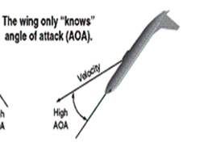
Upsets without stall
Recovery techniques
High bank angle/inverted flight
  NOTE: The maneuver is controversial due to its unlikelihood. However, it reinforces useful principles of AoA. Key is to unload then roll.
  A/P and A/T disengage
  Push…unload to relieve excessive positive load
  Roll to nearest horizon
  When approaching wings level, pull by applying nose-up elevator and trim as necessary
  Adjust thrust and drag as necessary
Again, guide pitch rate with either PLI, if available, or takeoff rotation rate to stay within g-limits (unless ground contact is imminent)
Notes:
Why do we push first when inverted: (1) increases roll control authority so that you can get the wings back level fast; (2) buys some stall margin should the ensuing recovery be less than optimal; (3) buys some structural margin in case some pilots inadvertently (and incorrectly) are tempted to do a little rolling pullout
Q6: Push-roll-pull-power
Q5: Those are consensus upset recovery techniques. Because everyone agrees on the recovery, does that mean we should wait for the upset to be fully developed before taking action? No.

Slide 60
Question
You are flying a B737. Flaps are up. Airspeed is unreliable.
Pitch attitude = 4 degs
Both engines = 75% N1
10
10
75.0
75.0
?
30000
8
8
6
6
10
10

Slide 61
Question
You are flying a B737. Flaps are up. Airspeed is unreliable.
Pitch attitude = 4 degs
Both engines = 75% N1
10
10
75.0
75.0
?
30000
8
8
6
6
10
10
Are you in safe flight?
Notes:
Not necessarily. Could be at an extremely high AoA, and it that case, memory pitch/power settings will not save you

Slide 62
Loss of reliable airspeed—AF447
UTC 2:10:15 – Right seat says “We haven’t got a good display of speed”
UTC 2:10:22 – Left seat says “Alternate law protections”
UTC 2:10:27,28 Left seat says “Watch your speed, watch your speed”
UTC 2:10:33 – Left seat says “According to all three you are going up so go back down” Right seat “okay”
UTC 2:10:51 – First stall warning
UTC 2:10:56 – Right seat calls and goes to TOGA [Airplane does not have available thrust to help at this point]
UTC 2:11:21 – Left seat says “But we’ve got the engines what’s happening?”
UTC 2:11:32 – Right seat says “I don’t have control of the airplane anymore now”
UTC 2:11:41 – Right seat says “I have the impression we have the speed”
UTC 2:11:42 – Captain enters and says “Er what are you doing?”
UTC 2:11:46 – Left seat says “We lost all control of the aeroplane we don’t understand anything we’ve tried everything”
UTC 2:12:04 – Right seat says “I have the impression that we have some crazy speed no what do you think?”
UTC 2:12:07 – Left seat says “No above all don’t extend” Right seat says ok
UTC 2:12:23 – Captain says “The wings to flat horizon the standby horizon”
UTC 2:12:32 – Captain says “No you climb there you are climbing”…perhaps he is referring to pitch attitude
UTC 2:12:43 – Captain says “it’s impossible”
UTC 2:12:48 – Right seat says “Yeah yeah yeah I’m going down no?”
UTC 2:12:54, 56: Captain says “Get the wings horizontal” Right seat says “That’s what I am trying to do”
UTC 2:12:58: Right seat says “I am at the limit with the roll”…then dual input
UTC 2:13:38: Captain says “careful with the rudder bar there”
UTC 2:13:39: Left seat says “Climb climb climb climb”
UTC 2:13:40-41: Right seat says “But I’ve been at maxi nose up for awhile”
UTC 2:13:42: Captain says “No no no don’t climb”
UTC 2:13:43: Left seat says “so go down”
UTC 2:13:45: Left seat says “so give me the controls the control to me controls to me”
UTC 2:14:05: Captain says “watch out you are pitching up there”
UTC 2:14:06: Captain says “you are pitching up” Left seat says “I’m pitching up” Right seat says “Well we need to we are at four thousand feet:
UTC 2:14:16,17: They get “sink rate and pull up”
UTC 2:14:18: Captain says “Go on pull”
UTC 2:14:23: Right seat says “We’re going to crash. This can’t be true”
UTC 2:14:26: Captain says “10° pitch attitude”
Notes:
Failure to promptly recognize and respond to erroneous indications can result in loss-of-control.
Can cause reversion in flight control mode. Understanding of relationship between air data system, autopilot, and flight director is essential for safe management of the problem.
Flight crew awareness of typical speed/pitch/thrust/fuel flow/climb or descent rate characteristics for the stage of flight is the most effective way of detecting unreliable airspeed indications e.g.:
- airspeed increasing with typical climb pitch attitude and power setting;
- airspeed decreasing with typical descent pitch attitude and power setting;
- Abnormal AutoThrust or Autopilot behavior, including disconnection;
Unexpected stall warning (since stall warning is based on angle-of-attack and configuration, it is independent of airspeed indications),
an unexpected overspeed warning or simultaneous stall AND overspeed warnings;
an unexpected speed/aerodynamic noise relationship.
Response: Keep the aircraft away from the low-speed and high-speed ends of the flight envelope
Disconnect the Autothrust, Autopilot, and Flight Director;
Revert to safe default parameters for pitch attitude and thrust setting;
Every effort should be made to remain in VMC.
Fly the approximate pitch and power normally expected at that stage of flight…memory item
Refer to QRH for best pitch and power until problem is resolved

Slide 63
Why?
Air France 447
Left seat: “We’ve lost the the the speeds so…alternate law protections”
Unreliable
airspeed
procedure
not applied
Lack of
proper response
Right seat: “We haven’t got a good display… of speed”
Unreliable speed
Intermittent stall warning
High rate of descent
Buffeting
Lack of
understanding
“I have the impression
that we have some crazy speed”
Unstable
rolling
Tries to
control roll
Lack of
understanding
?
Lack of
proper response

Slide 64
Pilot monitoring
See
“Standard Operating Procedures and Pilot Monitoring Duties for Flight Deck Crewmembers” Advisory Circular 120-71B
“Monitoring Matters” CAA Paper 2013/02
“A Practical Guide for Improving Flight Path Monitoring” Flight Safety Foundation

Slide 65
Instructor training
By law, instructors need additional training…this is the guidance
From Upset Prevention and Recovery Advisory Circular
  Limitations of simulator (part 121.414)
  Instructor operating station
  History of events
  Energy management
  Spatial disorientation
  Distraction
  Recognition and recovery strategies
  Recognition and correction of pilot errors
  Type-specific characteristics
  OEM recommendations
  Operating environment
  Startle and surprise
  Assessing proficiency
Notes:
Q18: Can airlines decide for themselves whether their instructors need additional training?

Slide 66
Instructor operating station
Notes:
Discuss pieces

Slide 67
Simulator limitations
Need to stay within valid training envelope
G cues are seriously lacking

Slide 68
Startle/surprise
What’s the difference? Does anyone really care?
star•tle: An uncontrollable, automatic muscle reflex, raised heart rate, blood pressure, etc., elicited by exposure to a sudden, intense event that violates a pilot’s expectations
  Example: BAM! You wince, and maybe cower, after a bird hits your windshield
sur•prise: An unexpected event that violates a pilot’s expectations and can affect mental processes used to respond to the event
  Example: The “what’s it doing now” question for your autopilot
So, startle can lead to surprise, but it does not have to
You can have surprise without startle

Slide 69


Startle/surprise
Eyebrows lowered
Startle
Eye-lids tightened and closed
Lips stretched horizontally
Surprise
Eyebrows raised
Raised upper lids, and widened eyes
Open jaw, lips relaxed

Slide 70
Startle/surprise
Fair to say we are interested mostly in surprise
Hard, but not impossible, to do in simulation
Key is to create an expectation…and then violate it
Paper by Casner suggests change it up, train for surprise, turn off automation, and reevaluation testing practices
Casner, S, et. al., “The Effectiveness of Airline Pilot Training for Abnormal Events,”
Human Factors, Vol. 55, No. 3, June 2013, pp. 477-485
Notes:
Change it up – abandon the idea of practicing and testing abnormal events in the same way every time. Allow pilots to practice recognizing them and choosing and recalling the appropriate response when presented with different forms in which each event might naturally present itself.
Train for surprise – Several researchers have argued that performing in surprise situations represents an additional competence area that requires special practice focused on pilots’ attentional behavior and sensemaking in surprise situations.
Turn off automation – If automation provides assistance in abnormal recognition, pilots would likely benefit from exposure to these events without the automation operative to ensure pilots can recognize the situation rather that simply respond to an alert.
Reevaluate testing practices – Memorize and test practices not only result in poor learning but can also present the illusion that real learning has taken place when it has not. Be aware of training content that devotes time to drill and practice of specific questions rather than critical thinking.

Slide 71
Conclusions
An ounce of prevention
is worth a pound of cure
Reducing angle-of-attack is THE most
important pilot action in an upset event
Pilot upset training in simulators
must account for their limitations
“I’ll have an ounce of prevention”
Notes:
Hopefully, if you are good at preventing at upset, you will never have to recover from one. We will show you some tips in the Aerodynamics Section.
Much of this course discusses the “cure” which is the recovery from a full stall or upset if it was not prevented, as that is the new part of the rule. Of course, we try to get better at prevention too, which has been around since the Wright Bros.

