Slide 1
Backup Procedure
Workshop on Interregional OPMET Data Exchange
Between ICAO MID & EUR-Region
Vienna, Austria, 23./24.October 2014
Notes:
Give overview about EUR-system
Some already are familiar with it
Show how MET-data exchange works
Present procedures that might be implemented in MID as well

Slide 2
Overview
Planned Backup Procedure in EUR-Region
Planned Backup Procedure in MID-Region
Notes:
Responsibilities of centres as well as of certain individuals responsible of defined management roles

Slide 3
Backup Procedure EUR-Region (1)
Responsibilities
ROC | Backup-ROC
London | Toulouse
Toulouse | Vienna
Vienna | London

Slide 4
Backup Procedure EUR-Region (2)
General Impact of a ROC Outage
No compilation and distribution of national OPMET data
No distribution of all validated OPMET data to SADIS (only valid for ROC London)
Centers in the AoRs of the ROC will not be supplied with OPMET-data
Centers in the AoRs of the ROC will not have their OPMET-data disseminated
OPMET data from the IROG-AoR will not be available in the EUR-region
EUR-OPMET data will not be provided to the IROG-AoR

Slide 5
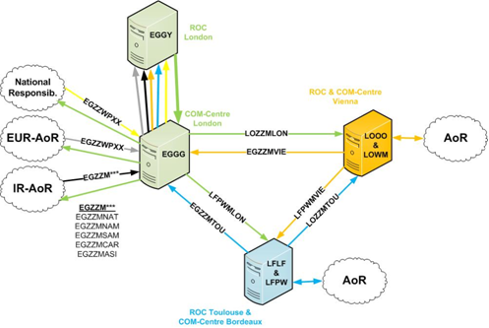
Backup Procedure EUR-Region (3)
Normal Operations

Slide 6
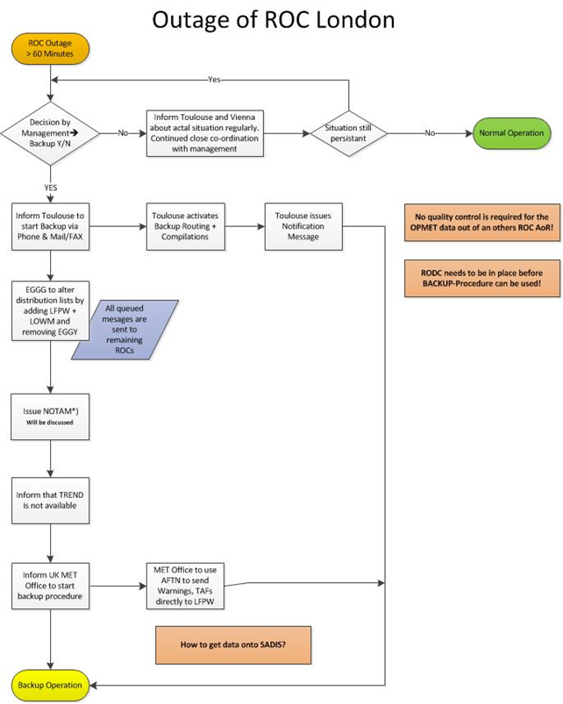
Backup Procedure EUR-Region (4)
Procedure in case of Outage of ROC London(initial info after 15-20min.)

Slide 7
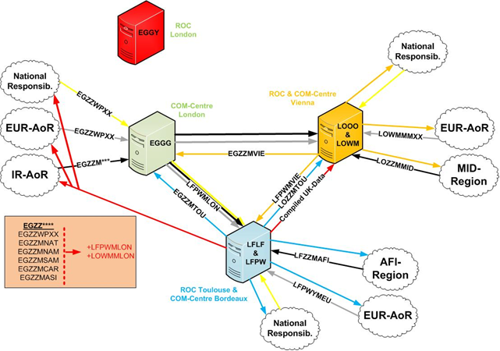
Backup Procedure EUR-Region (5)
Backup Operations

Slide 8
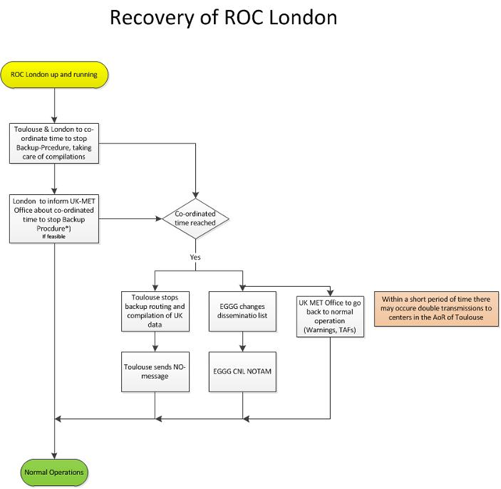
Backup Procedure EUR-Region (6)
Recovery from Backup Operations

Slide 9
Backup Procedure MID-Region (1)
Proposal provided by ROC Jeddah

Slide 10
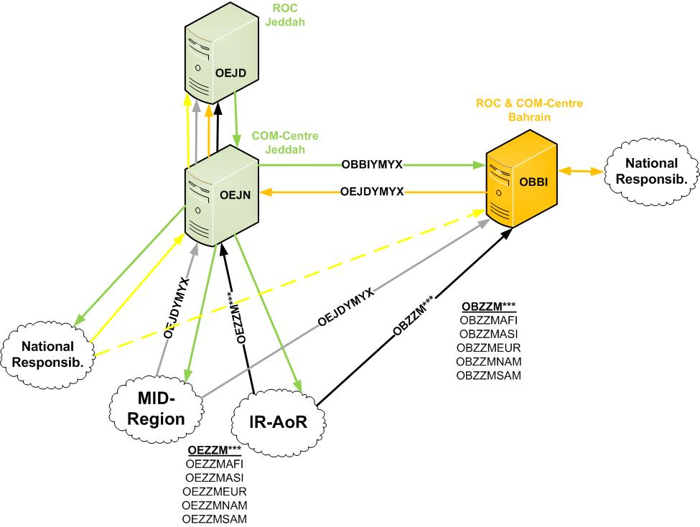
Backup Procedure MID-Region (2)
Normal Operations MID-Region

Slide 11
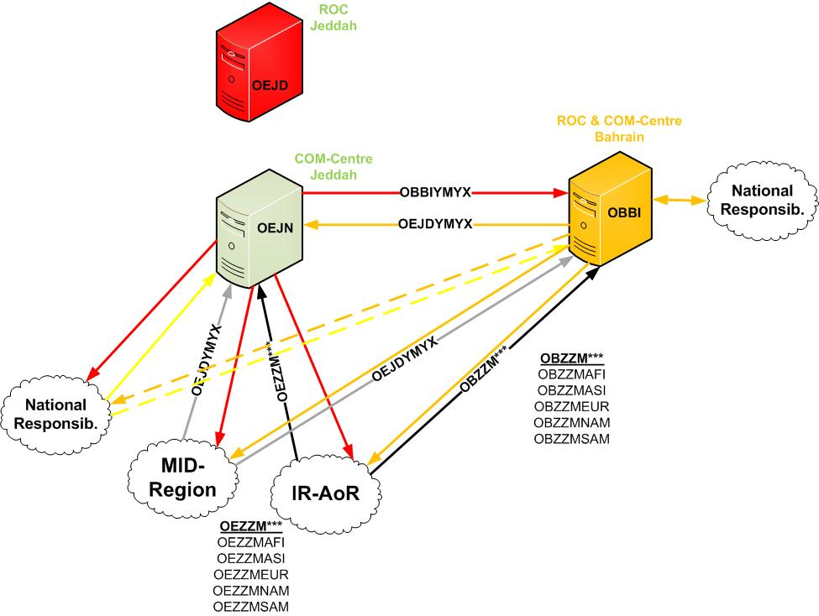
Backup Procedure MID-Region (3)
Normal Operations MID-Region

