Slide 1
ICAO Aviation Data Analyses Seminar
Middle East (MID) Regional Office
27-29 October
ICAO Strategic Objective: Economic Development of Air Transport
ICAO Statistics Programme
Economic Analysis and Policy (EAP) Section
Air Transport Bureau (ATB)

Slide 2
New ICAO Strategic Objective
Economic Development of Air Transport
Objectives:
To foster the development of a sound and economically viable air transport system
New SO reflects the needs for ICAO’s leadership in developing and harmonizing the global regulatory framework
Helps focus ICAO’s work to meet the need of Member States and aviation stakeholders
Key activities :
  Economic policy, air transport regulation and oversight:
    Develop air transport policy/guidance
    Promote harmonization
  Financing of the air transport system (user charges and taxes)
  Funding of air transport infrastructure
  Aviation data, forecasting and analysis
    Collect and disseminate data and statistics
    Develop traffic forecasts
    Conduct economic analysis
Notes:
In line with the vision and mission of ICAO for the 2014-2016 triennium aiming at achieving the sustainable growth of the global civil aviation system, the Council adopted a new Strategic Objective for 2014 to 2016 triennium, specifically covering air transport activities, namely: Economic Development of Air Transport, aimed at fostering the development of a sound and economically viable air transport system
This new Strategic Objective reflects the needs for ICAO’s leadership in developing and harmonizing the air transport regulatory framework at the global level
It helps to focus the work of ICAO in the air transport field to meet the needs of the Member States and aviation stakeholders, including helping to create a better regulatory and operation environment for the sustainable development of the air transport sector.
A harmonized regulatory environment, it is all what is about the 6th Worldwide Air Transport Conference and the recommendations to be achieved by ATConf/6 are expected to support the implementation of the new Strategic Objective of the Organization, Economic Development of Air Transport.

Slide 3
Monitoring Air ICAO SOs:
Aviation Data a Vital Tool
Air Navigation
Capacity & Efficiency
Environmental
Protection
POLICIES
MARKET ANALYSIS
FORECASTING
Sustainable Air transport
Development
Safety
STATISTICS
Economic Development
of air transport
Security and
Facilitation
ICAO : an independent and reliable source of information on civil aviation matters

Slide 4
If you cannot measure it,
You cannot improve it.
Sir Benjamin Kelvin

Slide 5
Principles governing international statistical activities (UNO)
High quality Statistics and accessible for all
Impartial & strictly based on highest professional standards
Public informed about mandate for Statistics work
Concepts, definitions, classifications, sources, methods and procedures, transparent for users
Use of appropriate and cost-effective sources & methods for data collection
Confidentiality rules strictly kept and data used for Statistical purposes only

Slide 6
Best practices
Know your data sources
Understand the meaning of the data
Know the data limitations and make allowances for them
Apply UNO principles related to Statistics
If in doubt, ask

Slide 7
The ICAO Statistics Programme

Slide 8

Mandate for the
ICAO Statistics Programme
Chicago Convention (Art. 54, 55, and 67)
“Each contracting State undertakes that its international airlines shall, in accordance with requirements laid down by the Council, file with the Council traffic reports, cost statistics and financial statements showing among other things all receipts and the sources thereof.”

Slide 9
ICAO Statistics Programme Foundations
Assembly Resolutions (A38-14, App. B):
  Whereas the development of ICAO’s validation and storage Integrated Statistical Database provides Contracting States and other users with an efficient online system for the retrieval of statistical data;
  Requests the Council, calling on national experts in the relevant disciplines as required, to examine on a regular basis the statistical data collected by ICAO and etc…
Council
Air Transport Committee
Assembly
Statistics Division
Statistics Panel

Slide 10
Why Do We Need Statistics?
Monitor ICAO Strategic Objectives
  Air travel safety rates
  The environmental impact on air transport (fuel efficiency)
  The sustainable air transport development (traffic growth, financial situation, etc..)
Analyze the air transport market
Assess the impact of new regulations
Forecasting
Plan the development of airport and ANS facilities
Negotiate bilateral agreements
Implement future strategies
Calculate the individual financial contribution of States

Slide 11

Sources of Data
For each State:
http://www.icao.int/sustainability/pages/eap-sta-excel.aspx
ANSP
Air carrier
Airport
Traffic – Form L
Finance – Form K
Traffic – Forms A, A-S, B and C
Fleet and personnel – Form D
Finance – Form E-F
Fuel consumption – Form M
State
Traffic – Forms I and I-S
Finance – Form J
Civil aircraft registered – Form H
Aviation personnel – Form N
Different data sources for different purposes
Each has different coverage, level of detail, limitations on use, and produced on their own cycle
All forms +
Other data providers
Traffic, Fleet, Financial data
etc. …

Slide 12
Statistics Collection and Dissemination
Analysis, modelled missing data,…
collection, verification
States
Forms submission
States
EAP
(ISDB database)
validation
ICAODATA+
External stakeholders
clarification, correction, reminders
EAP/ATB

Slide 13

The Size of the Industry
in 2013
3.1 billion passengers
49 million tonnes of freight
1 400 scheduled airlines
26 000 aircraft in service
About 3 900 airports
173 air navigation services providers
Traffic is for scheduled services in 2013
Source: ICAO and ATAG
13

Slide 14
Air Transport Development
+5.5%
growth rate vs. 2012
5.8 trillion RPK
Scheduled commercial traffic
Source: ICAO Annual Reports of the Council (preliminary figures)
Total (international and domestic) services

Slide 15
World Air Transport in 2013
3.1billion
32 million
+4.5%
vs. 2012
+1.2%
vs. 2012
Passengers carried
Commercial flights performed
5.8trillion
186billion
+5.5%
vs. 2012
+0.4%
vs. 2012
Revenue Passenger-Kilometres
Freight Tonne-Kilometres
Source: ICAO Annual Report of the Council 2013 (preliminary figures)
Total (international and domestic) services
Scheduled commercial traffic

Slide 16
Air Transport Regional Overview
2013
Aircraft departures (million)
Passengers carried (million)
3.1billion
32 million
-0.4%
+3.1%
+4.5%
vs. 2012
+1.2%
vs. 2012
-0.4%
+3.5%
+4.9%
+7.8%
+6.3%
+8.0%
-1.3%
+0.9%
Passengers carried
Commercial flights performed
+0.4%
+5.7%
Revenue Passenger-Kilometres (billion)
Freight Tonne-Kilometres (billion)
5.8trillion
186billion
+5.5%
vs. 2012
+0.4%
vs. 2012
+4.6%
-0.1%
+4.4%
+4.0%
+11.2%
+12.0%
+7.7%
+0.2%
+2.0%
-4.9%
Revenue Passenger-Kilometres
Freight Tonne-Kilometres
+6.7%
+2.7%
Source: ICAO Annual Report of the Council 2013 (preliminary figures)
Total (international and domestic) services
Scheduled commercial traffic

Slide 17
International Tourism Development
1,087million
+5%
International tourist arrivals
+52 million
Vs. 2012
International Tourist Arrivals
(million)
52% of international tourists are travelling by air and for small islands up to 85%
Source: World Tourism Organization (UNWTO)

Slide 18
World Top 15 Airlines in 2013
5 carriers from North America
5 carriers from Asia/Pacific
4 carriers from Europe
1 carrier from Middle East
2 low-cost carriers: Southwest and Ryanair
Highest growth → Emirates
with +15.8 % RPK growth in 2013 vs 2012
- 0.5%
+ 2.0%
+ 15.8%
+ 1.6%
+5.4%
+ 1.3%
+ 0.5%
+ 4.7%
+ 8.6%
+ 6.0%
+ 8.7%
+ 6.7%
+ 10.9%
+ 2.6%
- 0.5%
Note: scheduled services Source: ICAO Form A and ICAO estimates
Total (international and domestic) services

Slide 19
World Top 15 Airports in 2013
- 2.1%
+ 0.6%
10 airports in North America
(including the Top 5)
4 airports in Europe
(3 of them recorded negative growth)
1 airport in Asia/Pacific:
Beijing (PEK)
+ 4.3%
+ 1.6%
- 4.9%
+ 1.9%
+ 1.1%
- 1.3%
- 0.8%
- 3.9%
- 2.0%
- 0.7%
+ 0.6%
- 3.2%
- 2.0%
Note: scheduled and non-scheduled services Source: ACI
Total (international and domestic) services

Slide 20
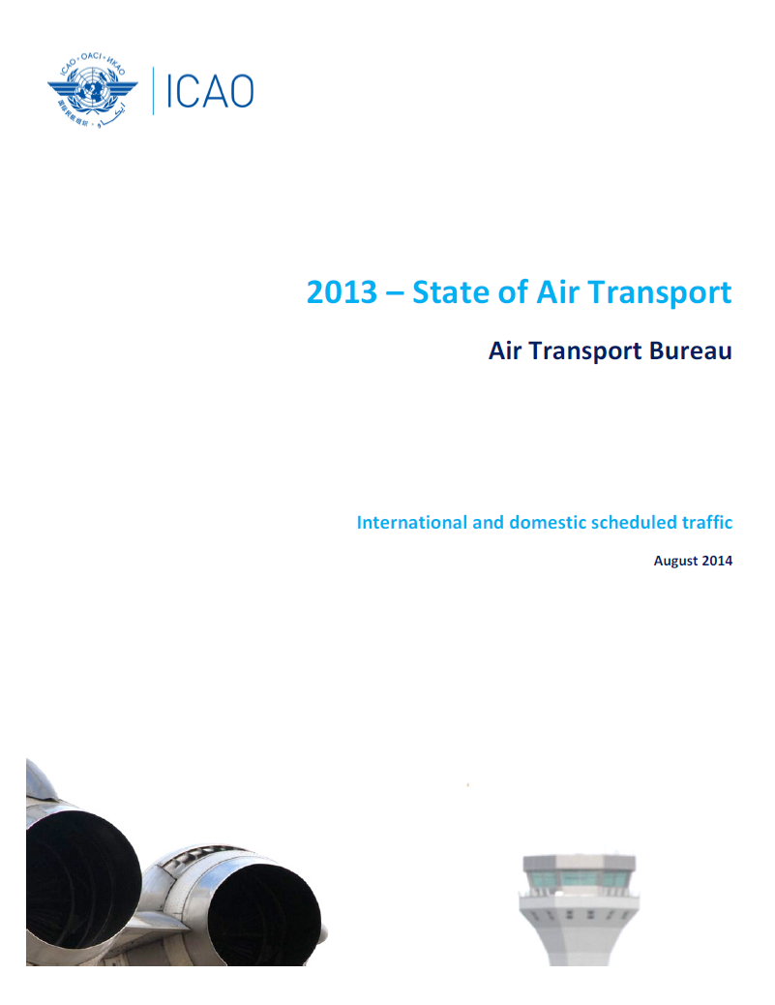
State of Air Transport
New document
Regional and world analysis of
Air Transport of the previous year.

Slide 21
ADAP/1 (ex-STAP/15)
Montréal - April 2014
First Meeting of the Aviation Data and Analysis Panel (ADAP/1)
New challenges:
Enhancement of the ICAO Statistics Programme’s Forms in collaboration with International Organizations in order to harmonize as much as possible the Forms sent to ICAO Member States in a view of rationalization of the requests sent by ICAO and other International Organizations.
Creation of a Multi-Disciplinary Working Group for the development of a single set of long-term forecasts for ICAO
Impact on the way of working of the TFGs at a regional level

Slide 22


E-learning Courses
on Statistics Activities
This course will introduce to some of the most important data series which ICAO collects.
Objective: this course aims to:
  provide to those who need to collect or make use of international air transport statistics a basic understanding of the standard terminology used, how these data are collected and what they represent;
Doc 9060: e-Learning courses reference material (Statistics Manual)

Slide 23
Statistics Derived Products
Indicators for monitoring purposes such as Liberalization pace
Air Transport
Statistics
Enhanced transparency of aviation policies
Forecasts & economic analyses and studies

Slide 24
Dissemination and use of Aviation Data

Slide 25
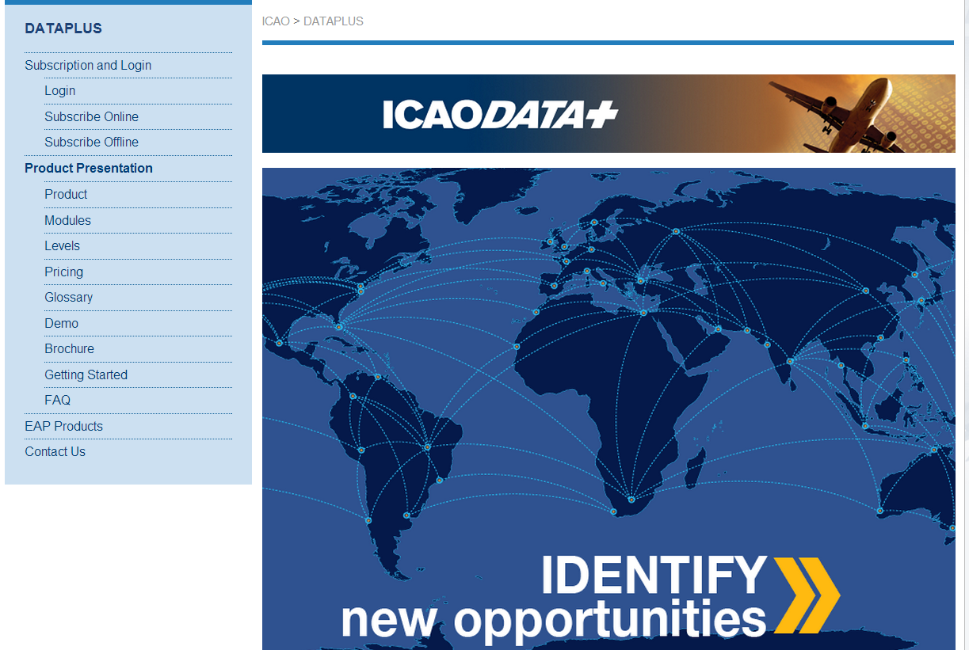
ICAODATA+
Disseminate reliable and independent data
stats.icao.int
Notes:
The main tool for dissimination of the raw data.
Behind this tool ?
191 member States
A unique information system to verify and validate the data
➔ Reliable data and independent data

Slide 26

6 modules are available
ICAODATA+
AIR CARRIER TRAFFIC
TRAFFIC BY
FLIGHT STAGE
AIR CARRIER
FINANCES
AIRPORT TRAFFIC
ON-FLIGHT ORIGIN
AND DESTINATION
AIR CARRIER FLEET
AND PERSONNEL
Notes:
6 modules: …..
Draw you attention on air carrier traffic
Not only the available capacity but also the traffic performed

Slide 27
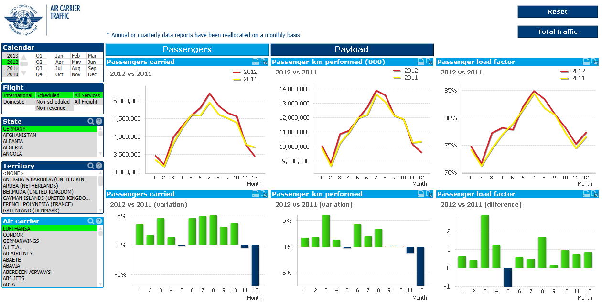
Analyze the air transport markets
ICAODATA+ : Analysis Tools
Notes:
Snapshot of the air carrier traffic module (later for the others)

Slide 28
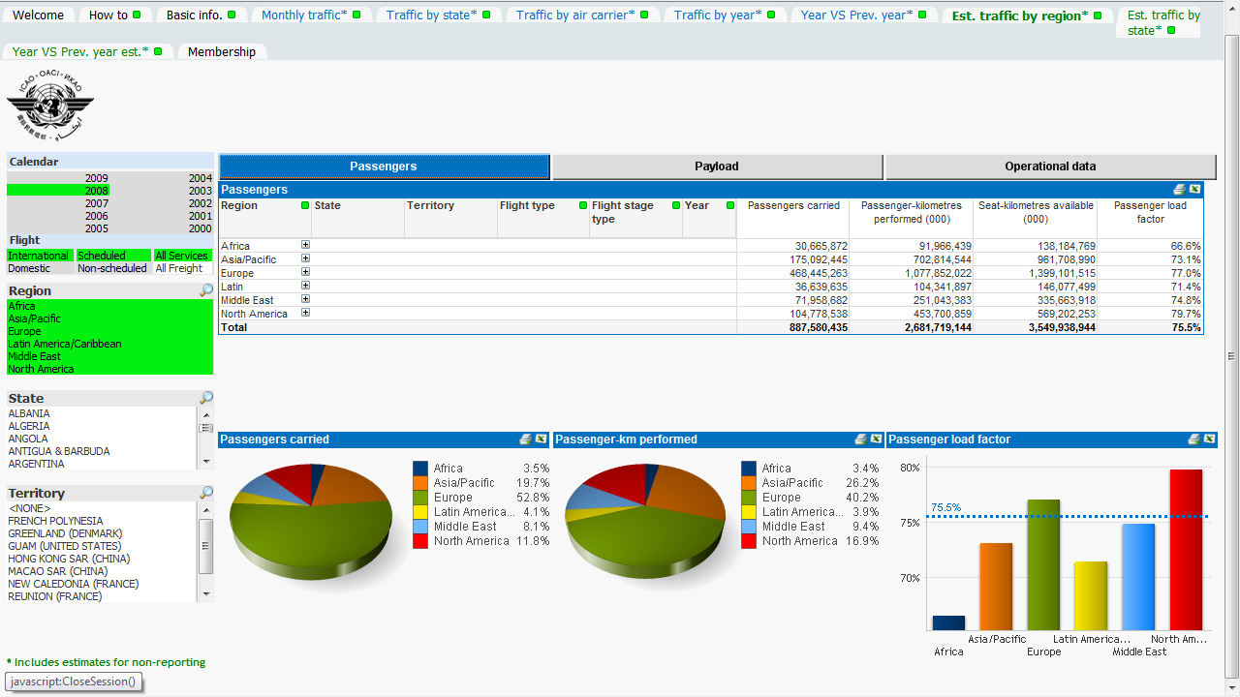
Benchmarking for Regional Data

Slide 29
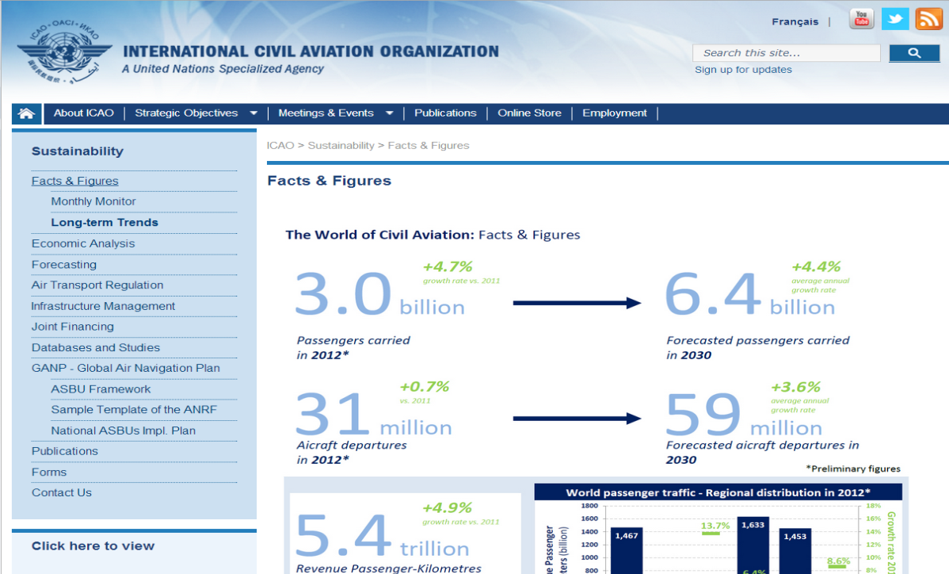
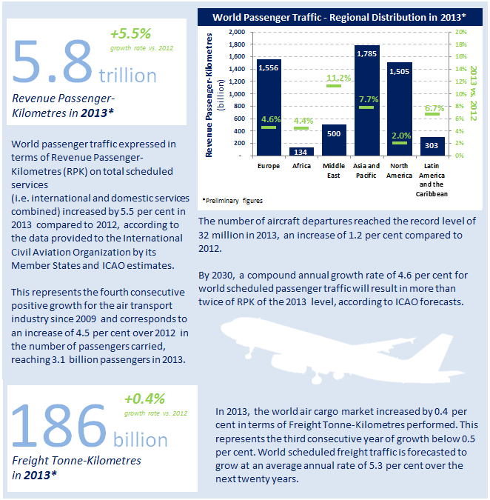
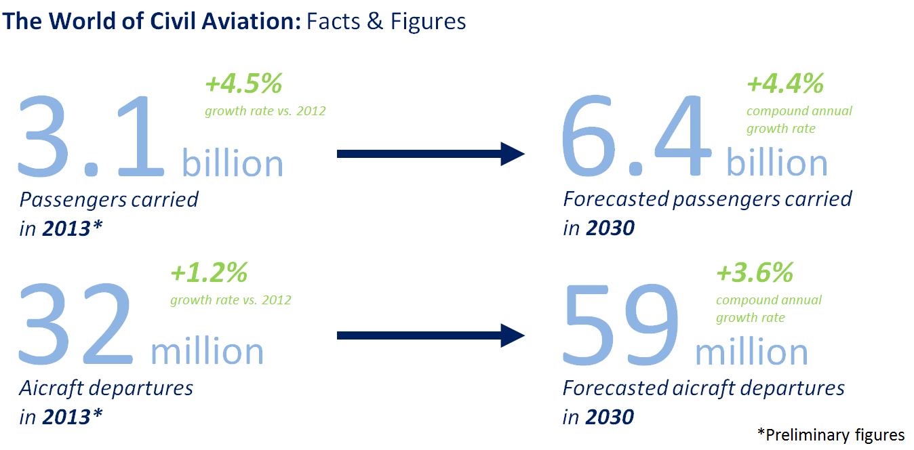
Analyze the air transport market
ICAO Website: Facts & Figures
Analysis
Key figures

Slide 30
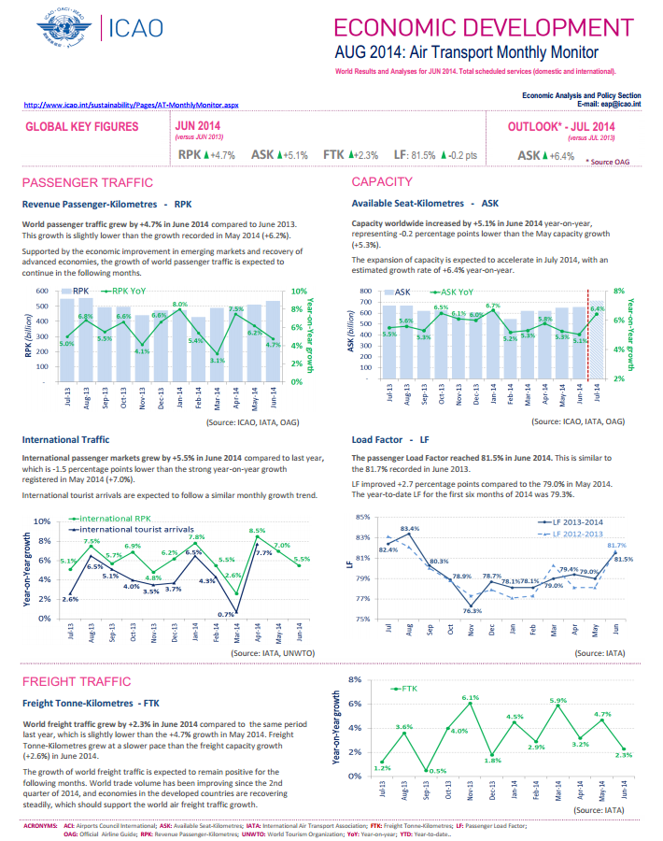
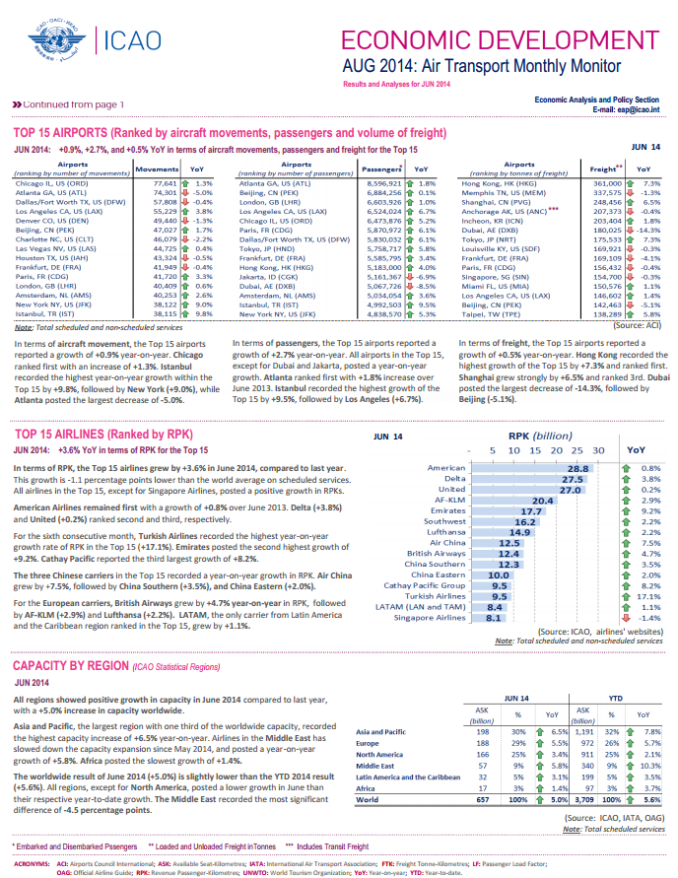
ICAO Website: Monthly Monitor
The ICAO Monthly Monitor is available online
Notes:
We have recently developped a monthly monitor
Quantitative analysis but also qualitative analysis
=> Each indicator is analysed

Slide 31
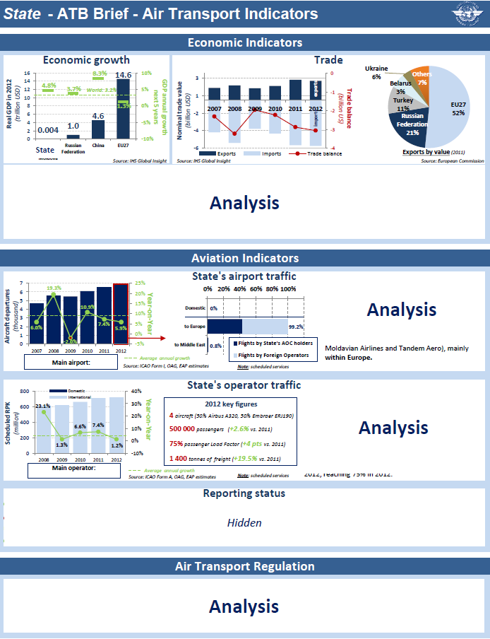
Economic and Air Transport Indicators
Snapshots and analyses of economic indicators at a State level
Snapshots and analyses of air transport indicators at a State level
Reporting status at the State level
Air transport regulation matters and development
Notes:
We qre also providing high level analysis : for intance here on a State level
-> not only traffic data, but also economical data such as GDP, GDP growth, international trade

Slide 32
Forecasting activities

Slide 33
Background
Assembly Resolution A38-14
Appendix C : Forecasting, planning and economic analyses
The Assembly:
Requests the Council to prepare and maintain, as necessary, forecasts of future trends and developments in civil aviation of both a general and a specific kind, including, where possible, local and regional as well as global data, and to make these available to Contracting States and support data needs of safety, security, environment and efficiency
Requests the Council to develop one single set of long term traffic forecast, from which customized or more detailed forecasts can be produced for various purposes, such as air navigation systems planning and environmental analysis;

Slide 34
Why Do We Need Forecasts?
Positive results in aviation are driven by sound decisions; Forecasts are essential for planning purposes
Decisions must be supported by good analysis and information
Good Analysis and Information must be based on good analytical models and data

Slide 35
World Economy vs.
Air Passenger and Cargo Traffic
RPK
A relationship that expresses traffic in terms of GDP closely replicates the historical traffic.
FTK
GDP
Traffic Forecasts
*: World total scheduled services
**: World Real GDP at Purchasing Power Parity

Slide 36
ICAO Website:
Medium-Term Forecasts
Total (domestic and international) scheduled traffic
Mid-July ever year:
Information posted on the ICAO website
Press release

Slide 37
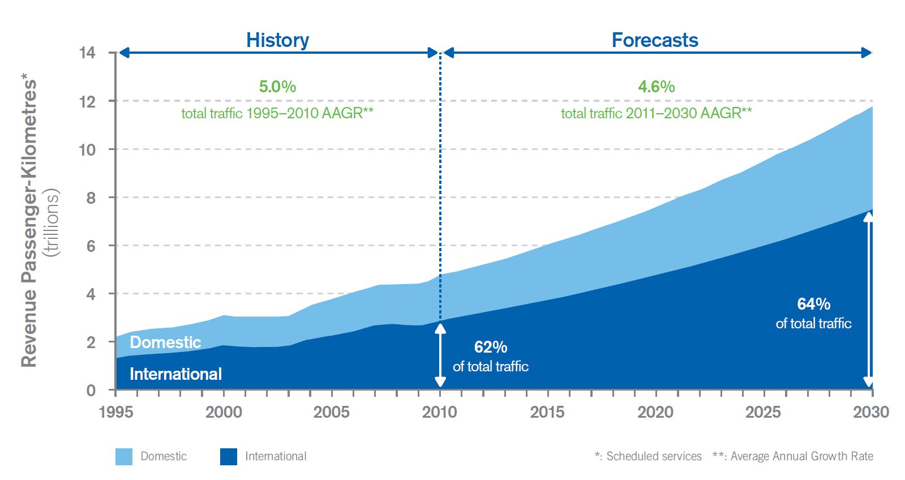
Passenger Traffic Forecasts for the Horizon 2030
Source: Cir 333, Global Air Transport Outlook to 2030 - GATO

Slide 38
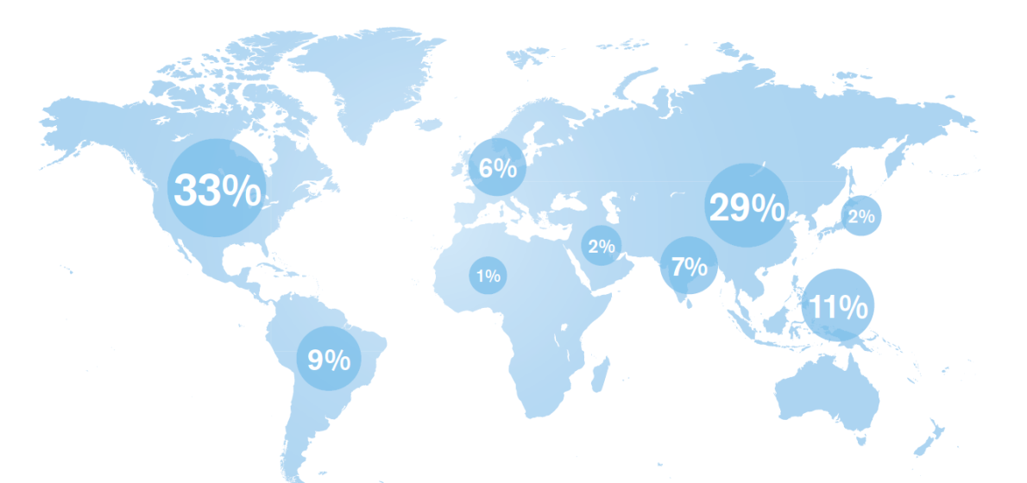
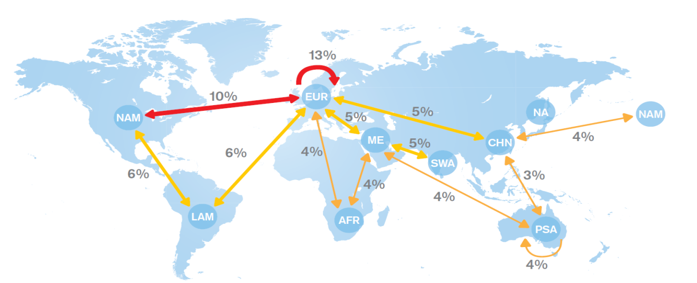
Long-Term Air Traffic Forecasts: “GATO”
RPK distribution in 2030
Domestic
International
Source: Cir 333, Global Air Transport Outlook to 2030 - GATO

Slide 39

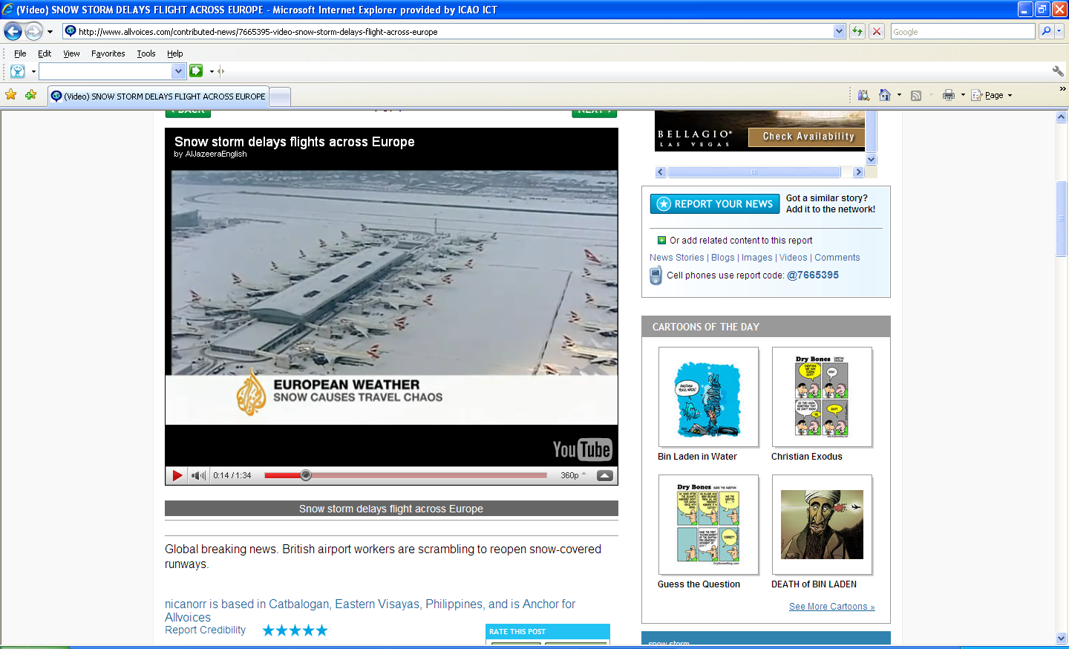

Unpredictable Circumstances
Some examples:
The European volcanic ash cloud
Snow storms in Europe
Japanese earthquake and tsunami
Europe’s sovereign debt crisis
Political unrest in the Middle East
Continuous higher oil prices
Increasing tax burdens placed on aviation, etc…
” killing the goose that lays the golden eggs “
Notes:
Air transport for the past few years was not spared of unpredictable and challenging circumstances.
The volcanic ash cloud, snow storms in Europe and the Japanese earthquake and tsunami were all central challenges to air transport globally.
Europe’s economic debt crisis, political unrest throughout the Middle East and the escalating fuel prices, despite some recent relief, continue to affect traffic and overall performance in different degrees.
And last but not least, the unsubstantiated levies on aviation which is often referred to as ” killing the goose that lays the golden eggs “. The proliferation of taxes are burdens placed on aviation which have all negative impact on air transport.

Slide 40

Long-Term Air Traffic Forecasts: “GATO”
Past decade air transport trends
Demand drivers analysis
  Economic growth
  Liberalization
  Low Cost Carriers
  Improving technologies
Challenges for air traffic development
  Fuel prices
  Airport/ANSPs capacity constraints
  Competition and inter-modality
Forecasts
  Structure and methodology
  Passenger and cargo
  Results and analysis by route group
PASSENGERS
AND CARGO TRAFFIC
Available at:
www.icao.int
Notes:
The new ICAO Global Air Transport Outlook to 2030 (GATO) summarizes the latest and most expansive passenger and freight traffic forecasts ever produced by ICAO. Designed to help regulators and the aviation industry respond to evolving passenger and shipper needs over the next 20 years, this unique document benefits from an expanded system of routes and more sophisticated econometrics techniques, the worldwide expertise of ICAO and the extensive data provided by ICAO’s Member States; in short, the most advanced techniques and the timeliest information.
ICAO forecasts have considered many divergent and opposing viewpoints and, while they readily confirm the present optimism of airlines and aircraft manufacturers, they are, in every way, balanced, independent, comprehensive and objective. Although the forecasts themselves receive the major emphasis of this document, it further contains, various market trends and analyses, taking into account economic growth, technological change, market liberalization, the growth of low cost carriers, airport congestion and oil prices, amongst others. Finally, the GATO examines the major factors that promote or impede the growth of civil aviation and how they influence the resulting forecasts.

Slide 41
The Personnel Requirement Forecasting Process
Fleet growth rates
Staff ratios
2010 fleets
2030 fleets
2030 staff
Traffic forecasts
A/C movements
forecasts
Annual training
requirements
Annual training
capacities
Shortage or
surplus
Attrition rates

Slide 42
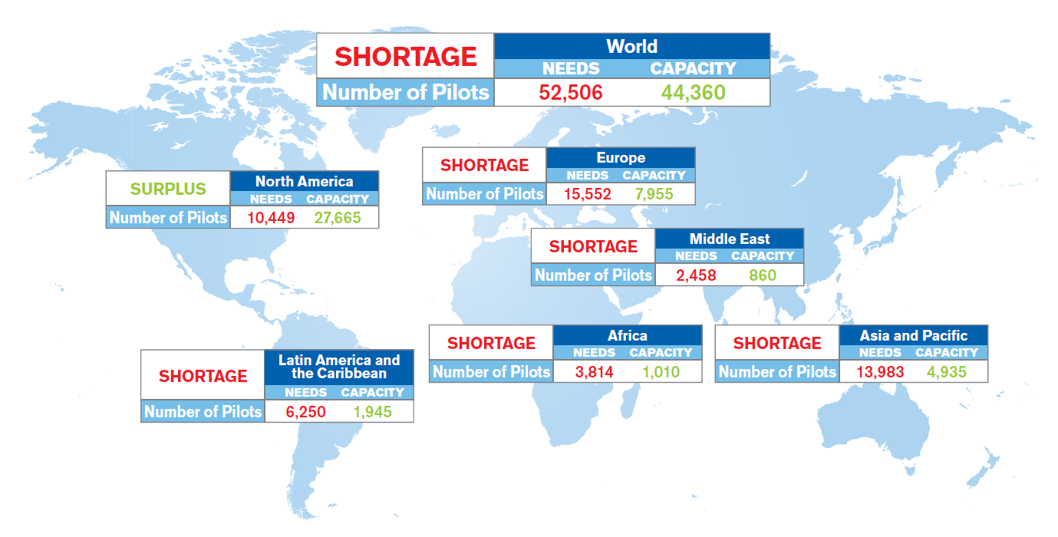
Future Licensed Personnel:
Surplus or Shortage
Pilots needs and training capacity in 2030
1)Estimate of average annual needs for 2010 to 2030 period based on various world fleet categories:
→ Regional and business jets, Turboprops, Single aisle, Twin aisles and Freighters
2)Training capacity is based on current figures without any incremental effect due to planned additional capacities

Slide 43

Licensed Personnel Forecasts
ICAO vision for
Next Generation Aviation Professionals
The need for reliable statistics
The « Best and the Brightest »
Facilitating the use of competency-based approaches
Removing regulatory obstacles
A coordinating mechanism is required
Available at:
http://store1.icao.int

Slide 44
Support to Planning and Implementation Regional Groups (PIRGs)
Regional Traffic Forecasting Groups (TFG):
Specific forecasts of traffic and aircraft movements
Meet the requirements of the PIRGs
Used in the planning of air navigation systems in ICAO’s regions
TFGs reports available on the ICAO website at:
www.icao.int/sustainability/Pages/eap-fp-regional-traffic-forecasting-groups

Slide 45
Forecasting for Environmental protection
SUPPORT TO CAEP:
Participation in
the Forecast and Economic Analysis Support Group (FESG)
of the Committee on Aviation Environmental Protection (CAEP)
provision of input in terms of aviation data toward the development of global long-term traffic and fleet forecasts for environmental analyses
review of a global constrained forecasting model for potential use in support of environmental assessment of the potential impact of constraints.

Slide 46
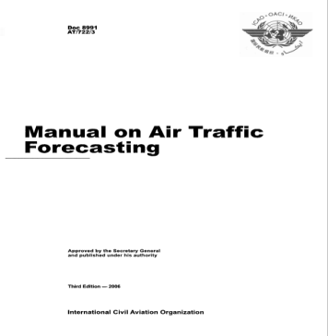

E-learning courses
on forecasting activities
Forecasting Aviation activities
  address key demand and supply issues
  assess forecasting methodologies
  discuss future strategies
e-Learning courses reference material

Slide 47
Economic Analyses

Slide 48
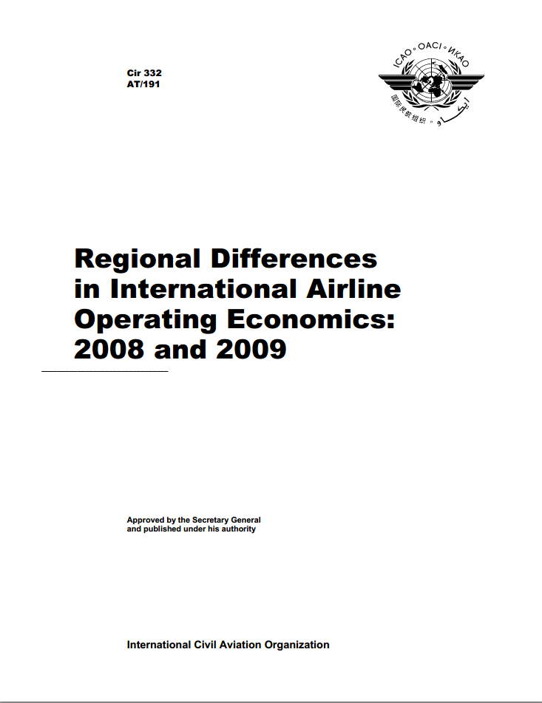
Studies on Regional Differences in International Airline Operating Economics
Scope of the studies
analyses how differences in operations and input prices may affect their levels and the impact that changes in costs may have on air transport tariffs, on a regional basis.
all international routes aggregated into 17 route groups.
passenger, freight and mail yield data for scheduled services
regional differences in the costs on a route group basis
major causes of regional differences in costs
Used by IATA for prorating airline passenger revenues from interline journeys
Notes:
SPans2007

Slide 49
ICORAS
ICAO
CO₂
Reporting and
Analysis System
ICORAS
A joint project in the Air Transport Bureau between
  Environment (ENV)
  Economic Analysis and Policy (EAP) Section

Slide 50
Background of ICORAS Project
Assembly Resolutions of A37
A37-19:
Aspirational goal of 2% fuel efficiency gains per year
Report CO₂ emissions from international aviation to United Nation Framework Convention on Climate Change (UNFCCC)
Measure progress on annual fuel efficiency
Measure progress toward keeping net CO₂ emissions at same level from 2020
A37-20 – Appendix B:
Need for the Organization to collect data from State on annual aviation fuel consumption

Slide 51
Reporting and Analysis System
Member States
Through the ICAO Statistics Programme:
  Form M: Form on performed fuel consumption by commercial air carriers
clarification, correction, reminders
collection, verification,
validation
Integration of the reported performed fuel consumption into a model developed by ICAO
Performed fuel consumed
validated by ICAO covers
half of the world international scheduled traffic*
*: expressed in 2011 Revenue Tonne-Kilometers

Slide 52
ICORAS - Data Inputs
Reported performed data
ICAO Air Transport Reporting Forms
Estimated data
TRAFFIC
Form A: Traffic by commercial air carriers
Form C: Traffic by flight stage
Form M*: Traffic and fuel consumption by commercial air carriers
TRAFFIC - world coverage
Annual Report of the Council
(>90% of performed traffic reported in Form A)
OAG (airline schedules)
FUEL - world coverage
ICAO Fuel formula (developed in-house)
Revenue Cost Analysis (RCA)
FUEL
Form M: Traffic and fuel consumption by commercial air carriers
ICORAS
Integration of actual performed fuel consumption with modelled fuel consumption developed by ICAO
Measure progress toward 2% annual fuel efficiency improvement aspirational goal
  *The Council in its 190th Session in May 2010 approved the recommendations of STA/10 for the collection of Form M starting from the year 2010

Slide 53


Definitions
of International Aviation…
For example,
Ninth Freedom Right or “stand alone” cabotage is:
Ninth Freedom Right: Operate only in a foreign State
≠ A
  It represents:
  International traffic for ICAO
  Domestic traffic for UNFCCC
Source: Doc 9626 - Manual on the Regulation of International Air Transport

Slide 54
…and Impact on the Different Reporting Systems
ICAO Member States report fuel consumption of their own air carriers and not by State of Departure
To properly report to UNFCCC, the fuel consumption by State of Departure of the Aircraft needs to be derived

Slide 55
ICORAS Preliminary Results

Slide 56
ICORAS and Form M Benefits
Form M provides valuable and standardized information on both traffic and corresponding fuel consumed
Enables comparison with actual measured data thus aligning fuel burn estimates with actual fuel consumed data
Sophisticated validation routines of ICORAS improves accuracy and consistency of results
Facilitates reporting of fuel burn and associated fuel efficiency metric harmonized with the ICAO RTKs calculated on a yearly basis
Can produce results reflecting:
  Reduced Fuel burn due to efficiency improvements achieved by operators from many basket of measures
  Reductions in fuel burn due to operational improvements
  Emissions aligned with actual operations and traffic instead of schedules and sample data sets
Could support the analysis of the Global Market-Based Measures (MBM - Strawman scheme)
A better coverage of accurate reported data from Member States
increases the scope and strength of the ICORAS benefits

Slide 57
Next Steps
Encourage States to report in a timely and accurate manner to the ICAO Statistics Programme
2) Consider the best approach to integrate
  non-scheduled traffic and
  business jet data
into the ICORAS system.

Slide 58
Aviation Data and Analysis Panel
1st meeting
ADAP/1

Slide 59
ADAP/1
Held in Montréal from 14 to 17 April 2014
It was attended by panel members, alternates, advisers, and observers from 23 States and 6 international organizations.
the panel examined eight items under its agenda:
  Agenda item 1: Developments since the Tenth Session of the Statistics Division (STA/10)
  Agenda Item 2: Report on the outcome of the Sixth Worldwide Air Transport Conference (ATConf/6)
  Agenda Item 3: Overall review of the ICAO Statistics Programme: relevance, rationalization and harmonization
  Agenda Item 5: Development of an appropriate set of aviation data, including forecasts, taking into account the needs expressed by States, internal users and by the industry
  Agenda Item 6: Review of the current reporting status with respect to ICAO air transport reporting forms
  Agenda Item 7: Dissemination of air transport data and protection of Intellectual Property and associated revenues
  Agenda Item 8: Future work
The panel reached forty recommendations for States and ICAO

Slide 60
ADAP/1: Amendments in the current air transport reporting Forms
Form A-S, (Traffic - Commercial Air Carriers): correction of an editorial error,
Form B, (On-Flight Origin and Destination):
  ICAO should continue to treat the data collected as confidential and that data should not be published earlier than six months after the end of the quarterly reporting period concerned;
  ICAO should collect data by airline and not by group of airlines;
  a new column be added, in order to collect data for non-scheduled services on the same sheet as that used for the collection of scheduled data;
  data, unless otherwise requested by the reporting State, be published by airline;
Form EF (Financial Data – Commercial Air Carriers):
  ICAO should eliminate the split between revenue for scheduled and non-scheduled traffic (items 1 and 2) and no longer detail item 7 (depreciation and amortization), with the addition of “(total)” at the end of item 2;
Form M (Fuel Consumption and Traffic):
  the definition presented in pertaining to fuel consumed be changed, adding “In few cases” before “If on-board measurement systems”; and
Form H (Civil Aircraft on Register), Form I (Airport Traffic) - Part II, Forms L (En-route Services Traffic Statistics) and N (Aviation Personnel, Licensing and Training) be discontinued

Slide 61
ADAP/1: Outcome of the 6th Worldwide Air Transport Conference (ATConf/6)
In a view to support the recommendation of Sixth Worldwide Air Transport Conference (ATConf/6), the Panel recommended (Recommendations ADAP/1-2 and 1-8 refer) that:
  ICAO ensure appropriate coordination between ADAP, the Air Transport Regulation Panel (ATRP) and the Multi-disciplinary Working Group on the economic challenges linked to the implementation of the aviation system block upgrades (MDWG-ASBUs) in relation to aviation data requirements, in order to identify existing databases or studies that could support the work and harmonize the needs related to aviation data and analysis required for the implementation of ATConf/6 recommendations.

Slide 62
ADAP/1: Cooperation and coordination with other international Organizations
With ACI, IATA, UNTWO, among various international organizations
  Common Form with ACI
  relationship between tourists and passengers with UNWTO
  UNWTO and ICAO should continue working together in order to enhance the monitoring of travel facilitation, taxation and connectivity
  cooperate with all relevant organizations, including the UNWTO, with respect to the development of the air transport connectivity indicator
with a view to developing a framework by which the contribution of civil aviation to the economy could be analysed, ICAO should collect, by means of a State letter, data related to, inter alia, the aviation contribution to the Gross Domestic Product (GDP), the employment level in the sector, and the funding and financing investments in infrastructure;
an ad-hoc working group should be created to analyse the possible submission of data directly to ICAO through a dedicated server;

Slide 63
ADAP/1: Appropriate set of Aviation Data, including Forecasts
an ADAP working group entitled Multi-disciplinary Working Group on Long-term Traffic Forecasts (MDWG-LTF) be established and work in collaboration with the Secretariat in the development of a single set of long-term traffic forecasts, from which their users can produce customized or more detailed forecasts for various purposes, such as air navigation systems planning and environmental analysis. This collaborative effort would be in the manner of the group providing a consensus view of the traffic forecasts for each traffic flow and models developed to generate such forecasts that would be incorporated in the single set of long-term forecasts to be submitted to 39th Session of the ICAO Assembly;
the development of the forecasting process should take into account the needs of States and the Organization and various ICAO entities such as the regional Traffic Forecasting Groups (TFGs) and the Committee on Aviation Environmental Protection (CAEP);
the timeline for the development of a single set of traffic forecasts be communicated to the group in order to have the forecasts ready by the 39th Session of the ICAO Assembly;

Slide 64
ADAP/1: Improvement of the Reporting Status
States and the Secretariat should continue to cooperate closely in solving problems in order to improve the coverage and quality of reporting on ICAO Air Transport Reporting Forms
ICAO enhance cooperation with international organizations on coordination of the respective data collections
States should be requested to adhere strictly to ICAO reporting instructions and to make use of the appropriate Air Transport Reporting Forms as well as associated electronic tools when reporting data to ICAO
ICAO improve the regulatory framework of the Statistics Programme by creating and implementing dedicated Standards and Recommended Practices (SARPs)
ICAO continue to propose, organize, and conduct on a regular basis, ICAO Statistics Programme training for Member States based on the Reference Manual on the ICAO Statistics Programme (Doc 9060)

Slide 65
ADAP/1: Dissemination of Air Transport Data
ICAO should disseminate a State letter reminding Member States that the data collected and processed by the Organization, in accordance with the Chicago Convention, may be commercialized by ICAO as approved by the Council, unless ICAO has been advised by a State that the data submitted are commercially sensitive.
Such State letter should also specify that confidentiality, whenever requested by States, will be maintained on data provided to ICAO.

Slide 66
ADAP/1: other work
for statistical purposes, when an air carrier does not have a factor which represents the average mass of the passenger plus both the normal and excess baggage allowance, that 100 kilograms be used for conversion purposes.
the guidelines of a business model of Low Cost Carriers be refined and submitted to ADAP for review and that the list of LCCs will be submitted to States for approval; and
ICAO undertake the tasks related to the economic analysis area with a view to improving World Air Service Agreements (WASA) and the Tariffs for Airports and Air Navigation Services (Doc 7100) on-line, as well as enhancing the Revenue-Cost Analysis (RCA) system;
States provide replies to the questionnaires to ensure quality results of the studies on regional differences in international airline operating economics; and
ICAO continue its work on air transport connectivity and develop an air transport connectivity indicator.

Slide 67
© ICAO All rights reserved.
This document and all information contained herein is the sole property of ICAO. No intellectual property rights are granted by the delivery of this document or the disclosure of its content. This document shall not be reproduced or disclosed to a third party without prior permission of ICAO. This document and its content shall not be used for any purpose other than that for which it is supplied.
The statements made herein are based on the mentioned assumptions and are expressed in good faith. Where the supporting grounds for these statements are not shown, ICAO will be pleased to explain the basis thereof.

