Slide 1
Continuous Climb Operations (CCO) Saulo Da Silva
SIP/ASBU/2012-WP/27
Workshop on preparations for ANConf/12 − ASBU methodology
(Bangkok, 14-18/Nadi, 21-25 May 2012)

Slide 2
Intended Audience
Intended audience:
air navigation service providers;
aircraft operators;
airport operators; and
aviation regulators.

Slide 3
Objectives
Provide guidance on continuous climb operations (CCO) to harmonize their development and implementation.

Slide 4
Overview
What is a CCO?
Rationale
Understanding CCO
Procedure design
Specific issues
References

Slide 5
What is a Continuous Climb Operations
CCO is an aircraft operating technique enabled by airspace design, procedure design and facilitation by ATC, enabling the execution of a flight profile optimized to the performance of the aircraft.
The optimum vertical profile takes the form of a continuously climbing path.

Slide 6
Continuous Climb Operations - Rationale
The climb phase uses a significant proportion of the total flight fuel and, efficiencies in this phase could provide significant economy of operation and environmental benefits in terms of both noise and emissions.

Slide 7
Understanding Continuous Climb Operations (CCO)
Continuous Climb Operations:
Are enabled by airspace design, procedure design and ATC facilitation
Requests collaboration between stakeholders
Allows aircraft to attain initial cruise flight level at optimum air speed with climb engine thrust settings set throughout the climb

Slide 8
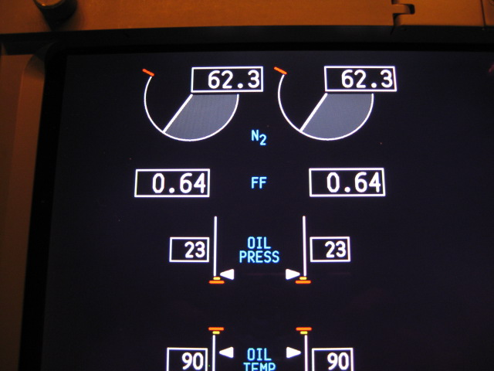
Understanding Continuous Climb Operations (CCO)
Increase efficiency, flight predictability and airspace capacity
Reduces noise, fuel burn, emissions and controller-pilot communications
Maintain safety

Slide 9
Understanding Continuous Climb Operations (CCO)
Ideally the departure design is such that arriving traffic is able to descend at their optimum descent profile
Before any CCO trials or operations commence, the proposed implementation needs to be the subject of a local safety assessment.

Slide 10
Procedure and airspace design
Need an understanding of the optimum profiles for aircraft operating at the airport
Avoid height and speed constraints that prevent efficient climb profiles
Avoid the need to resolve potential conflicts between the arriving and departing traffic flows through ATC height or speed constraints.

Slide 11
Optimum Vertical Path
The optimum climb gradient will vary depending on:
type of aircraft
its actual weight
the wind
air temperature
atmospheric pressure
other dynamic considerations
CCO should be codified as a Standard Instrument Departure (SID) so that both pilots and controllers have a fixed consistent procedure to refer to in advance.

Slide 12
Conventional vs. CCO
Conventional Departure
Continuous Climb Operations
Top of Climb
Top of C limb
Level flight segments
Optimized Segment(s)

Slide 13
Trade-offs
Between CCO and CDO
Consider that a level segment for an aircraft in descent would normally burn less fuel than for the same duration of level segment for an equivalent aircraft in climb.
Balance will depend on local characteristics (e.g. extent of level flight in both phases, significance of noise in the areas affected)

Slide 14
Collaboration
Objectives should be collaboratively identified by:
airspace users, ANSPs, airport operators as well as by government policy
may involve local communities, planning authorities and local government

Slide 15
Restrictions
To not compromise safety and capacity, it may not always be possible to fly fully optimized CCO.
The aim should be to maximize CCO to the extent possible, while not adversely affecting safety and/or capacity.

Slide 16
Restrictions
Factors such as other traffic flows, terrain, restricted airspace, aircraft performance, and noise abatement requirements will all serve to modify the design of the theoretical most efficient path, often preventing the realization of the shortest path or the most efficient climb.

Slide 17
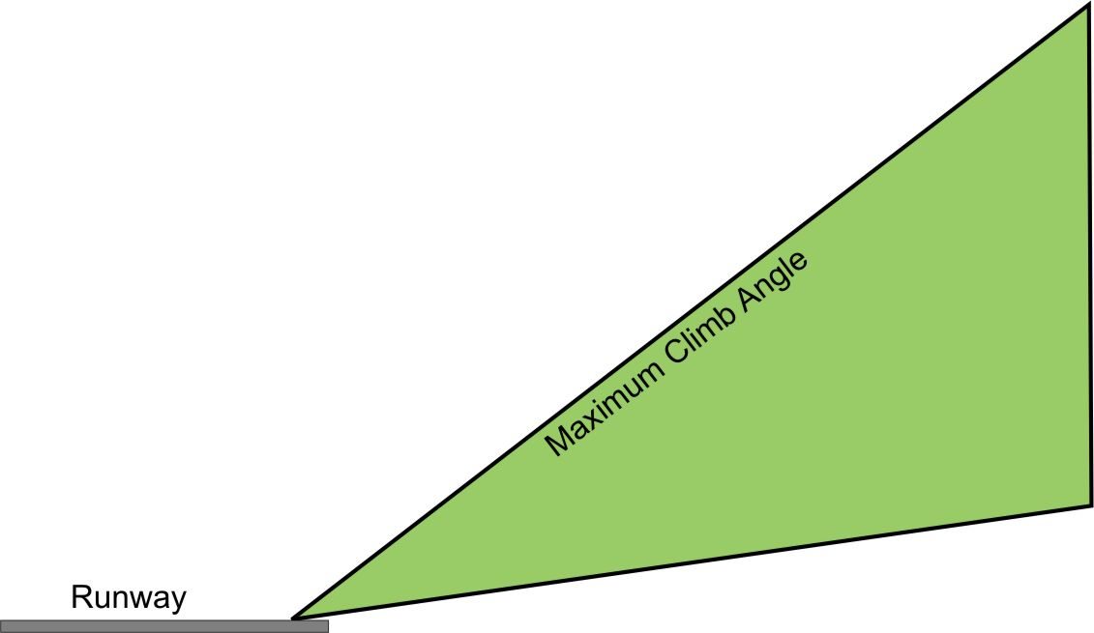
Basic CCO
Allows for unrestricted climb rates for all aircraft
Requires a significant amount of vertical airspace be set aside to protect the climb
May also extend the route in order to give lower performing aircraft the distance necessary to clear obstacles

Slide 18
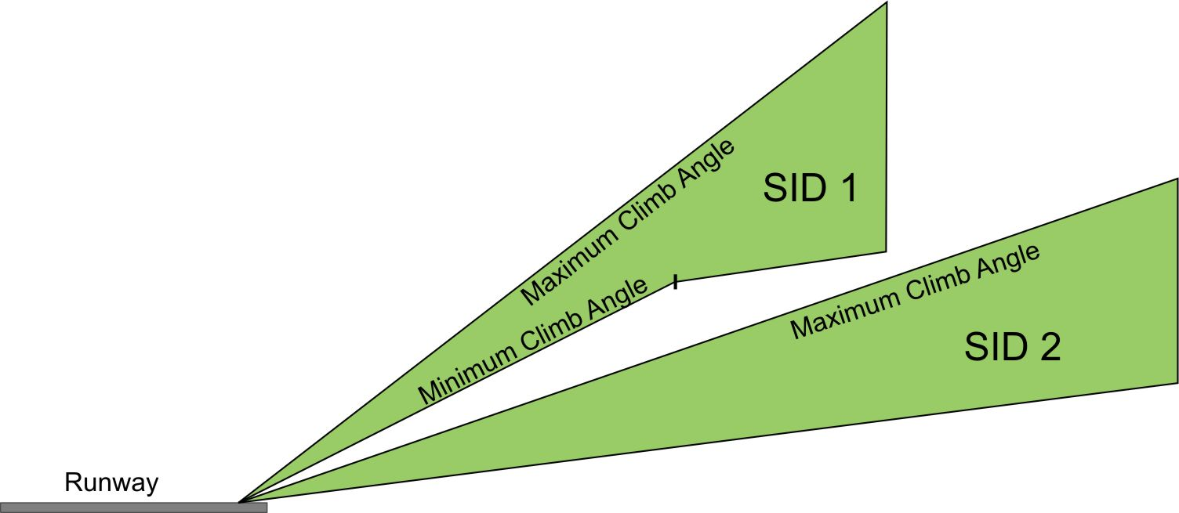
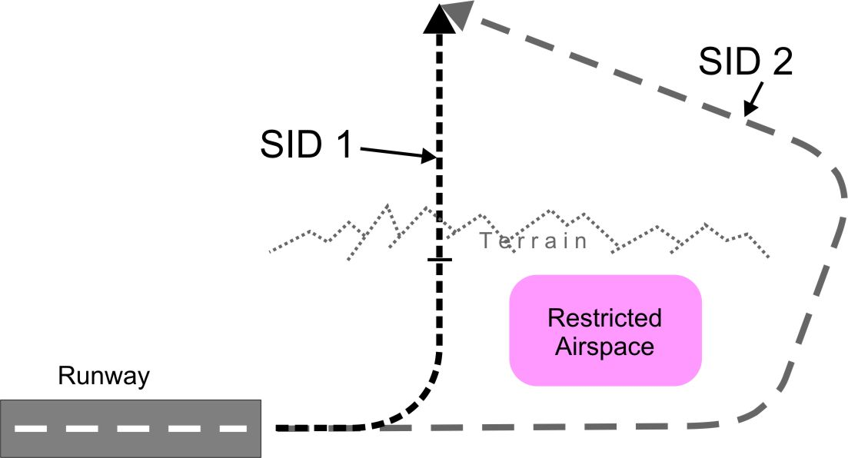
Enhanced CCO
Design with multiple climb gradients
Profile view
Top view

Slide 19
Specific issues
Airspace/procedure design
Departure route designed to allow the crossing of other flows of traffic to one of more runways and one or multiple airports in the Terminal system, at ranges from the runway(s) that the crossing traffic flows will be naturally separated by height when climbing or descending along their optimum profile.

Slide 20
Specific issues
Flight operation
Unrestricted climb to cruise flight level with no speed restrictions is also desirable but may not be achievable
Pilot’s ability to conduct a CCO depends also on the ATC clearance to be followed, either tactically or by published procedures.

Slide 21
Specific issues
ATC techniques
Execution of published CCO requires flexible airspace design and sectorisation with sufficient room to allow the aircraft to ascend in accordance with the parameters computed by the FMS.

Slide 22
References
Doc 4444 – PANS-ATM
Doc 9426 - Air Traffic Services Planning Manual
Doc 9613 – Performance-based Navigation (PBN) Manual
Doc 9931 - Continuous Descent Operations (CDO) Manual
Continuous Climb Operations (CCO) Manual (under development)

