Slide 1
Remotely-Piloted Aircraft Systems
SIP/ASBU/2012-WP/23
Saulo Da Silva
Workshop on preparations for ANConf/12 − ASBU methodology
(Bangkok, 14-18/Nadi, 21-25 May 2012)

Slide 2
Convention on International Civil Aviation
Article 8
Pilotless aircraft
No aircraft capable of being flown without a pilot shall be flown without a pilot over the territory of a contracting State without special authorization by that State and in accordance with the terms of such authorization. Each contracting State undertakes to insure that the flight of such aircraft without a pilot in regions open to civil aircraft shall be so controlled as to obviate danger to civil aircraft.
= on board

Slide 3
UASSG
TORs:
…to assist the Secretariat in coordinating the development of ICAO Standards and Recommended Practices (SARPs), Procedures and guidance material for civil unmanned aircraft systems (UAS), to support a safe, secure and efficient integration of UAS into non-segregated airspace and aerodromes.

Slide 4
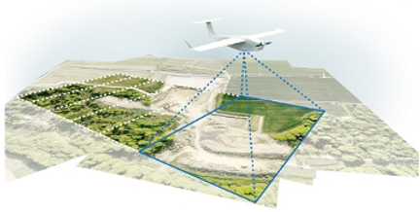
Unmanned Aircraft Systems (UAS) (Circular 328)
Unmanned aircraft are aircraft!
All aircraft flown without a pilot on board are subject to Article 8
Licensed remote pilot required for integration

Slide 5
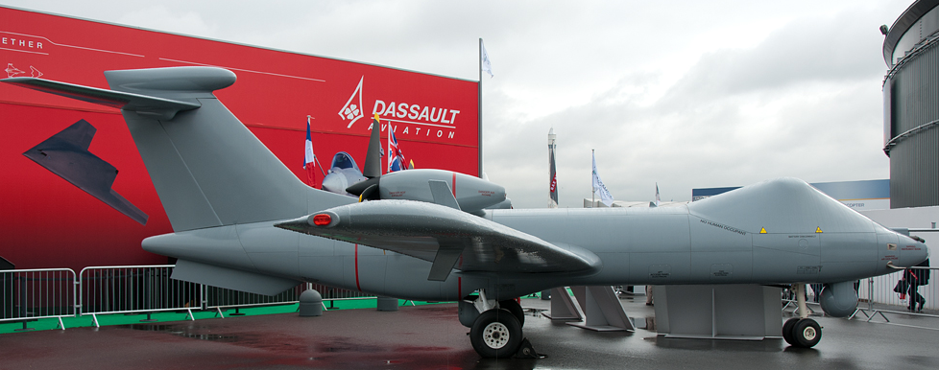
Unmanned Aircraft Systems (UAS) (Circular 328)
RPA are a subset of UA; remote pilots are new category of pilots
Fundamental safety requirements are the same, manned or unmanned
Safety and security integral to data links

Slide 6
Assembly Resolution A36-13, Appendix G
The Assembly resolves that:
pending the coming into force of international Standards respecting particular categories, classes or types of aircraft or classes of airmen, certificates and licences issued or rendered valid, under national regulations, by the Contracting State in which the aircraft is registered shall be recognized by other Contracting States for the purpose of flight over their territories, including landings and take-offs.

Slide 7
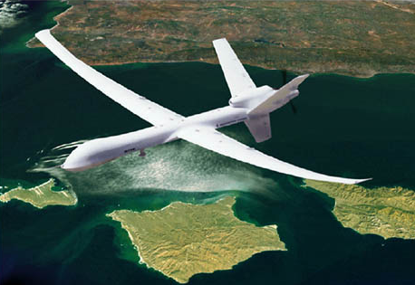
Work in Progress
Concepts for airworthiness certification
Operator approval
Communications requirements (C2, ATC, etc)
Collision and hazard avoidance / detect and avoid

Slide 8
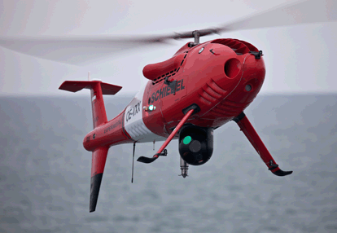
Work in Progress
Remote pilot licensing
ATM, Annex 2 Appendix to facilitate special authorizations
Terminology – on-going

Slide 9
UASSG membership
Australia, Austria, Brazil, Canada, China, France, Germany, Italy, Netherlands, New Zealand, Norway, Russian Federation, Singapore, South Africa, Sweden, U.K., U.S., CANSO, EASA, EUROCAE, EUROCONTROL, IAOPA, ICCAIA, IFALPA, IFATCA, NATO, UVS Intl.

Slide 10
Opportunities to Expedite
Press ahead with bilateral/multi-lateral efforts; BUT
Continue support to ICAO UAS Study Group with the same talent for continuity with international efforts
Address regional recognition of national certificates
Support ICAO position on frequency spectrum for WRC-2012
Ensure harmonization with SESAR and NextGen

Slide 11
Upcoming events
12th Air Navigation Conference (AN-Conf/12) 19-30 November 2012, Montreal
RPAS Symposium 2nd quarter 2014, Montreal - TENTATIVELY

Slide 12
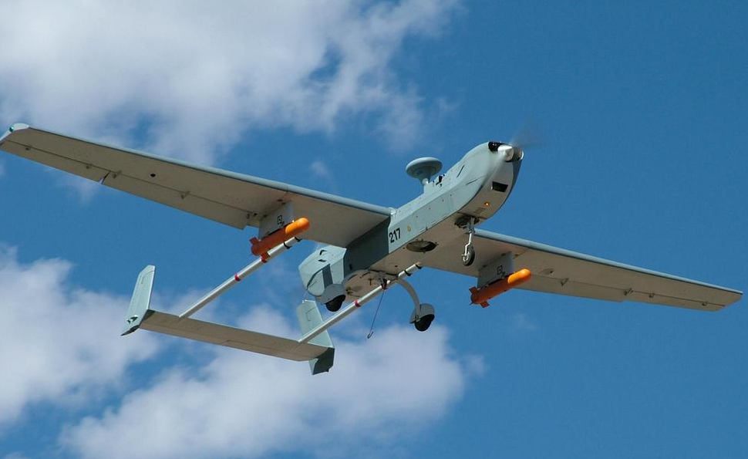
Bottom Line
International Standards are fundamental; States and industry are deeply involved in these efforts
Bilateral/regional efforts can be a first step
Speed up international efforts by dedicating resources..

