Slide 1
Webmaster's Guide: Embed GIS Maps with Java Tutorial and Walkthrough w/Examples
How to Add Java-based GIS Maps to Your Webpages

Slide 2
Guide to Tutorials
For Java-based GIS Maps, use this tutorial
Maximum customization and configuration
For Adobe Flash Maps, use "Beginner's Guide"
For a very simple FIR, use the Quick Start FIR
Copy and paste one line of HTML shown below
Copy and paste code in the yellow boxes
<iframe height="600"src="http://gis.icao.int/FIRMSD"width="100%"</iframe>

Slide 3
Embed Java-based gis maps

Slide 4
Benefits and Maps
Client is Java-based, so it works cross-platform
Java maps give more control and configuration
Use the code in the following slides to render maps on the following subjects:
Flight Information Region (FIR) Global
Language Proficiency Requirements Status
WGS-84 Compliance
Flight Plan (FPL) Status
Traffic Flow Services
SCAN

Slide 5
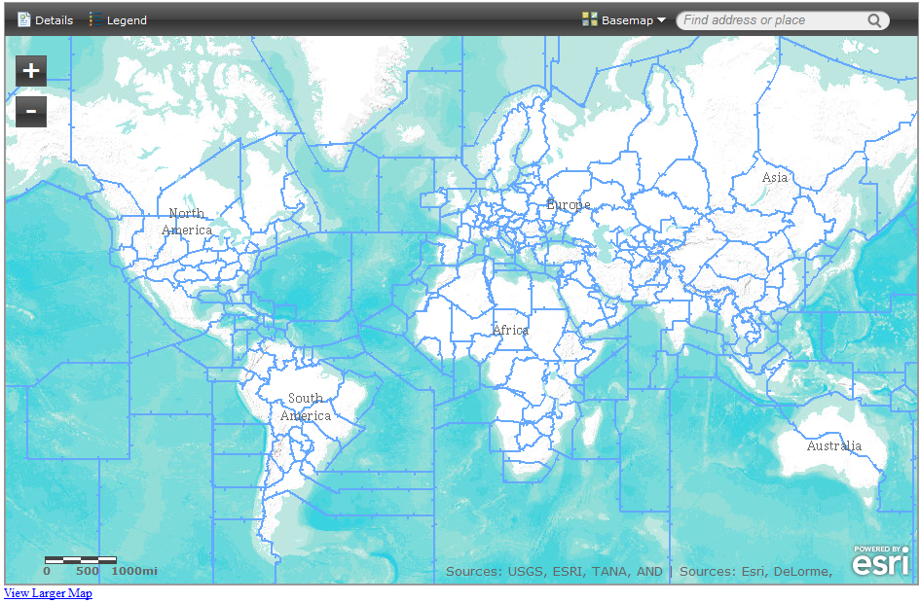
FIR Global
<iframe width="940" height="600" frameborder="0" scrolling="no" marginheight="0" marginwidth="0" src="http://www.arcgis.com/home/webmap/templates/OnePane/basicviewer/embed.html?webmap=724dfc8916604483a0ab06b4f3cbe57f&gcsextent=-180,-76.3104,180,83.7348&displayslider=true&displayscalebar=true&displaylegend=true&displaydetails=true&displaysearch=true&displaybasemaps=true"></iframe><br /><small><a href="http://www.arcgis.com/home/webmap/viewer.html?webmap=724dfc8916604483a0ab06b4f3cbe57f&extent=-180,-76.3104,180,83.7348" style="color:#0000FF;text-align:left" target="_blank">View Larger Map</a></small></iframe>

Slide 6
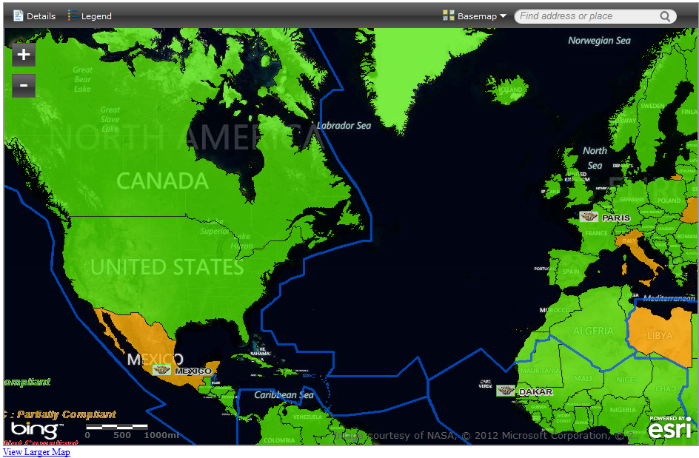
WGS-84
<iframe width="940" height="600" frameborder="0" scrolling="no" marginheight="0" marginwidth="0" src="http://www.arcgis.com/home/webmap/templates/OnePane/basicviewer/embed.html?webmap=9885f8bf33434879b7afec57d2e5d687&gcsextent=-175.6601,-20.4043,64.2814,76.8563&displayslider=true&displayscalebar=true&displaylegend=true&displaydetails=true&displaysearch=true&displaybasemaps=true"></iframe><br /><small><a href="http://www.arcgis.com/home/webmap/viewer.html?webmap=9885f8bf33434879b7afec57d2e5d687&extent=-175.6601,-20.4043,64.2814,76.8563" style="color:#0000FF;text-align:left" target="_blank">View Larger Map</a></small>

Slide 7
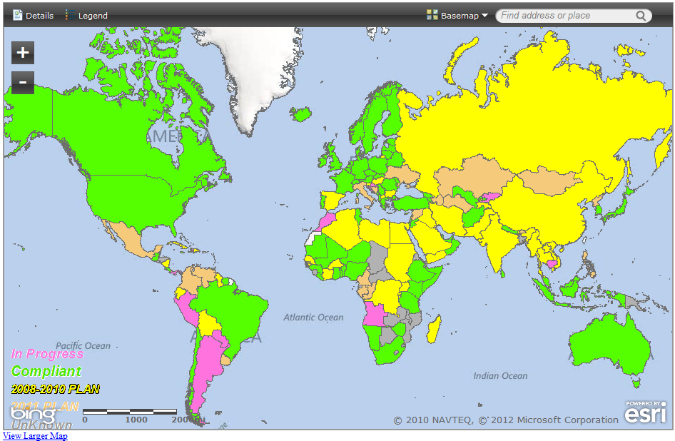
Language Proficiency Requirements
<iframe width="940" height="600" frameborder="0" scrolling="no" marginheight="0" marginwidth="0" src="http://www.arcgis.com/home/webmap/templates/OnePane/basicviewer/embed.html?webmap=c25219712f0d4c4a83b537f26ae0da8a&gcsextent=-180,-74.3548,180,84.5246&displayslider=true&displayscalebar=true&displaylegend=true&displaydetails=true&displaysearch=true&displaybasemaps=true"></iframe><br /><small><a href="http://www.arcgis.com/home/webmap/viewer.html?webmap=c25219712f0d4c4a83b537f26ae0da8a&extent=-180,-74.3548,180,84.5246" style="color:#0000FF;text-align:left" target="_blank">View Larger Map</a></small></iframe>
Notes:
<iframe width="940" height="600" frameborder="0" scrolling="no" marginheight="0" marginwidth="0"
src="http://www.arcgis.com/home/webmap/templates/OnePane/basicviewer/embed.html?
webmap=c25219712f0d4c4a83b537f26ae0da8a&gcsextent=-180,-
74.3548,180,84.5246&displayslider=true&displayscalebar=true&displaylegend=true&displaydetails=tr
ue&displaysearch=true&displaybasemaps=true"></iframe><br /><small><a
href="http://www.arcgis.com/home/webmap/viewer.html?
webmap=c25219712f0d4c4a83b537f26ae0da8a&extent=-180,-74.3548,180,84.5246"
style="color:#0000FF;text-align:left" target="_blank">View Larger Map</a></small></iframe>

Slide 8
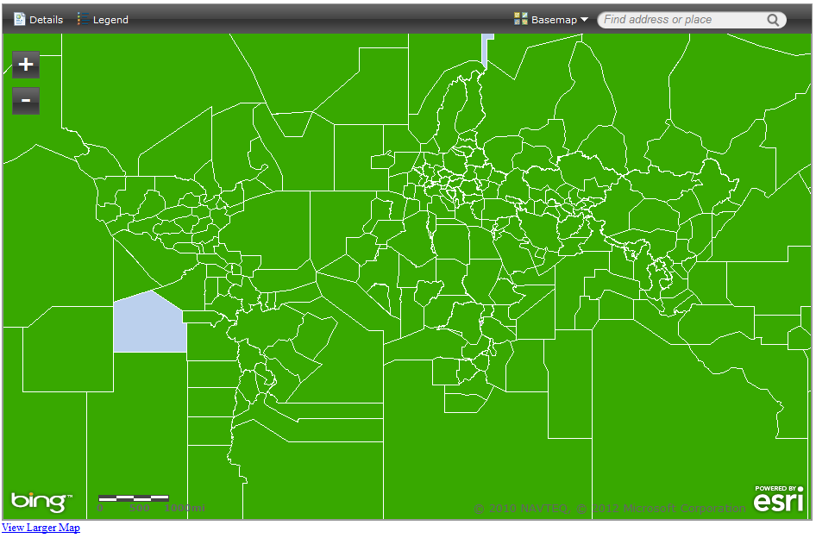
Flight Plan Status (zoom for details)
<iframe width="940" height="600" frameborder="0" scrolling="no" marginheight="0" marginwidth="0" src="http://www.arcgis.com/home/webmap/templates/OnePane/basicviewer/embed.html?webmap=efa98892aedd4516ad2b94eb8a476bcc&gcsextent=-180,-77.8788,180,82.9187&displayslider=true&displayscalebar=true&displaylegend=true&displaydetails=true&displaysearch=true&displaybasemaps=true"></iframe><br /><small><a href="http://www.arcgis.com/home/webmap/viewer.html?webmap=efa98892aedd4516ad2b94eb8a476bcc&extent=-180,-77.8788,180,82.9187" style="color:#0000FF;text-align:left" target="_blank">View Larger Map</a></small></iframe>

Slide 9
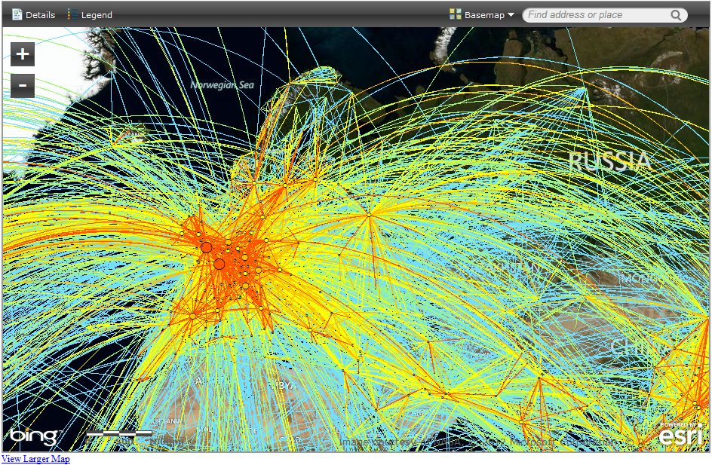
Traffic Flow Services
<iframe width="940" height="600" frameborder="0" scrolling="no" marginheight="0" marginwidth="0" src="http://www.arcgis.com/home/webmap/templates/OnePane/basicviewer/embed.html?webmap=7fb950e1c21349e7aaf740498d79b85f&gcsextent=-80.387,-9.2105,149.3591,78.8828&displayslider=true&displayscalebar=true&displaylegend=true&displaydetails=true&displaysearch=true&displaybasemaps=true"></iframe><br /><small><a href="http://www.arcgis.com/home/webmap/viewer.html?webmap=7fb950e1c21349e7aaf740498d79b85f&extent=-80.387,-9.2105,149.3591,78.8828" style="color:#0000FF;text-align:left" target="_blank">View Larger Map</a></small>

Slide 10
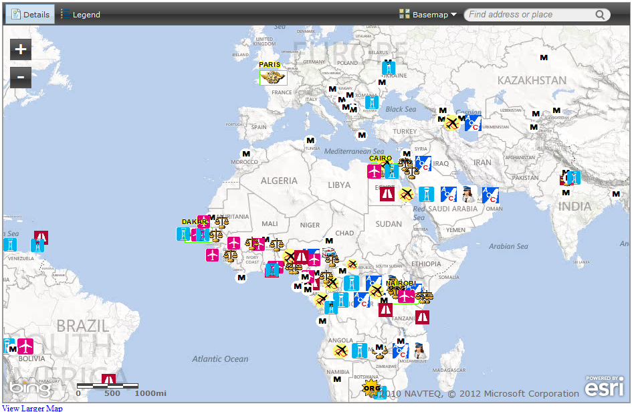
SCAN
<iframe width="940" height="600" frameborder="0" scrolling="no" marginheight="0" marginwidth="0" src="http://www.arcgis.com/home/webmap/templates/OnePane/basicviewer/embed.html?webmap=9623e72ea1b1428399e1d1b7802dba5e&gcsextent=-103.2715,-45.3367,126.4746,67.204&displayslider=true&displayscalebar=true&displaylegend=true&displaydetails=true&displaysearch=true&displaybasemaps=true"></iframe><br /><small><a href="http://www.arcgis.com/home/webmap/viewer.html?webmap=9623e72ea1b1428399e1d1b7802dba5e&extent=-103.2715,-45.3367,126.4746,67.204" style="color:#0000FF;text-align:left" target="_blank">View Larger Map</a></small>

Slide 11
Part 1: Position the Map – Extent Coordinates
Change how the map starts – the central point – by editing the Extent Coordinates
FIR for ICAO CAR region below
<iframe src="http://gis.icao.int/firmsd?extent=-13580000 190000 -
5772000 3903000"></iframe>

Slide 12
…Extent Coordinates
Use the extent coordinates below to show
AFI: -6240000 -3156000 9375000 4270000
ASIA: 4858000 -1026000 20474000 6400000
CAR: -13580000 190000 -5772000 3903000
SAM: -15109000 -5975000 506000 1451000
EUR: -1564000 4105000 14051000 11531000
MID: 1037000 1080000 8845000 4793000
NAM: -19202000 3037000 -3587000 10463000
NAT: 12231000 4332000 3384000 11758000
Notes:
LPR
-27941955 -10077827 27239464 15086465
GENERAL
-14148000 -6077000 17082000 8775000
AFI
-6240000 -3156000 9375000 4270000
ASIA
4858000 -1026000 20474000 6400000
CAR
-13580000 190000 -5772000 3903000
SAM
-15109000 -5975000 506000 1451000
EUR
-1564000 4105000 14051000 11531000
MID
1037000 1080000 8845000 4793000
NAM
-19202000 3037000 -3587000 10463000
NAT
-12231000 4332000 3384000 11758000
MEXICO OFFICE
-11041157 2205690 -11040695 2205904
San Francisco
-13638000 4541000 -13632000 4551000
Louisville, Kentucky
-9559973 4601704 -9529513 4621654
Los Angeles
-13211400 3993400 -13119200 4056100
Japan
13917200 3452300 16908700 5477600
Lisbon
-1039800 4665500 -993700 4696800
Chile
-8732266 -8111526 -6810170 -1859588

Slide 13
Customization options

Slide 14
Customize the Code Overview
Edit the code to customize
Refer to the unchanged code below (FIR)
The following slides identify elements to change
<iframe width="940" height="600" frameborder="0" scrolling="no" marginheight="0" marginwidth="0" src="http://www.arcgis.com/home/webmap/templates/OnePane/basicviewer/embed.html?webmap=724dfc8916604483a0ab06b4f3cbe57f&gcsextent=-180,-76.3104,180,83.7348&displayslider=true&displayscalebar=true&displaylegend=true&displaydetails=true&displaysearch=true&displaybasemaps=true"></iframe><br /><small><a href="http://www.arcgis.com/home/webmap/viewer.html?webmap=724dfc8916604483a0ab06b4f3cbe57f&extent=-180,-76.3104,180,83.7348" style="color:#0000FF;text-align:left" target="_blank">View Larger Map</a></small></iframe>

Slide 15
Part 2: Size, borders, margin
Examples
width="940"
height="600"
frameborder="0"
scrolling="no"
marginheight="0"
marginwidth="0"

Slide 16
Part 3: Display Elements
Set the elements to display (true)
displayslider=true/false
displayscalebar=true/false
displaylegend=true/false
displaydetails=true/false
displaysearch=true/false
displaybasmaps=true/false

Slide 17
Part 4: Include Link to Larger Map
…<small>…
<a href="http://www.arcgis.com/home/webmap/viewer.html?webmap=724dfc8916604483a0ab06b4f3cbe57f&extent=-180,-76.3104,180,83.7348" style="color:#0000FF;text-align:left" target="_blank">View Larger Map
</a>
</small>
</iframe>

Slide 18
Contacts
GLasnier@icao.int (GIS)
MMorawski@icao.int (GIS Assistant)
KHorst@icao.int (Tutorial)

Slide 19
end

