Slide 1


Notes on the data

Slide 2
Data
ICAO started collecting statistics on civil aviation in 1947. Over time data series were modified, new ones were added and some were deleted according to the needs of States and the Organization. Data in electronic form did not become available till the 1970’s.
The table on the right shows the reporting period for each data series and the first year of data which are available in ICAOdata+ for the six modules concerned.

Slide 3
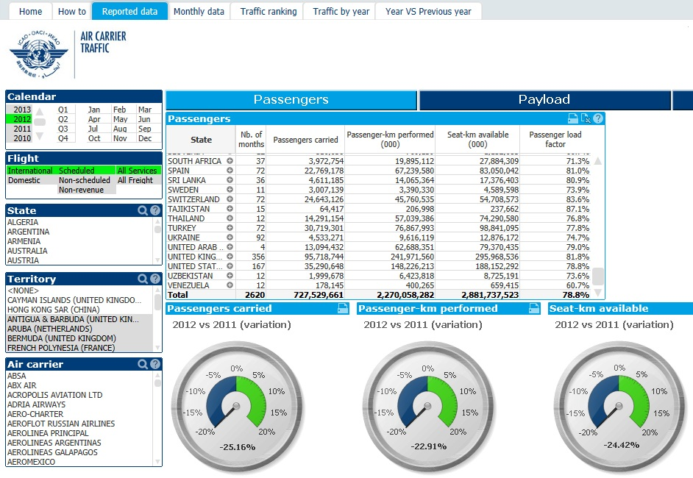
Data (cont.)
On the right is a partial view of the first screen for air carrier traffic. As indicated by the tab on the top, this view is for reported data. The numbers in the table show the overall totals for each column for the year 2012. The dials at the bottom show the percentage change for the same data for 2011. Note that the only selections made refer to period and flight. No selections are shown for State or air carriers.
The dials would appear to suggests that between 2011 and 2012 international scheduled passenger traffic decreased by over 20 per cent; is this correct?
No. Those changes refers to the reported data. Unfortunately the reported data which ICAO receives each year may vary in terms of the number of carriers and time period received. Hence this comparison is not carried out on a like with like basis. To ensure that this is the case one needs to select the same air carriers and months for both years.
Comparable overall traffic and capacity totals including non-reporting air carriers are estimated by ICAO and shown by clicking the Total traffic button (see next slide).

Slide 4

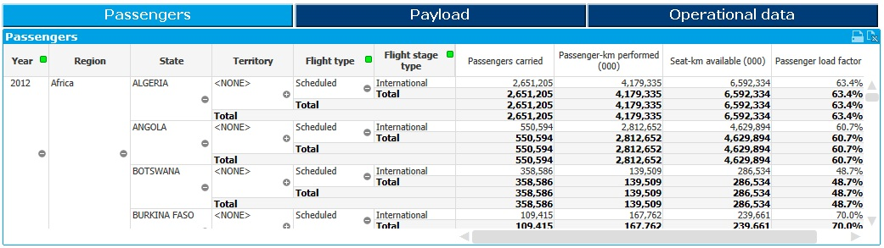
Country and Regional totals
Clicking on the Total traffic button shown in the air carrier traffic module will take the user to the area containing the total consolidated estimated traffic and capacity data for the air carriers of each country. In addition to reported data these figures also include traffic and capacity estimates for non-reporting air carriers.
The country total figures are further grouped into the six ICAO statistical regions; namely:
Africa
Asia/Pacific
Europe
Latin America/Caribbean
Middle East, and
North America
The regional traffic and capacity data shown present in the traffic module represent the worldwide traffic carried by the air carriers based in each region; NOT the traffic carried between regions.

Slide 5
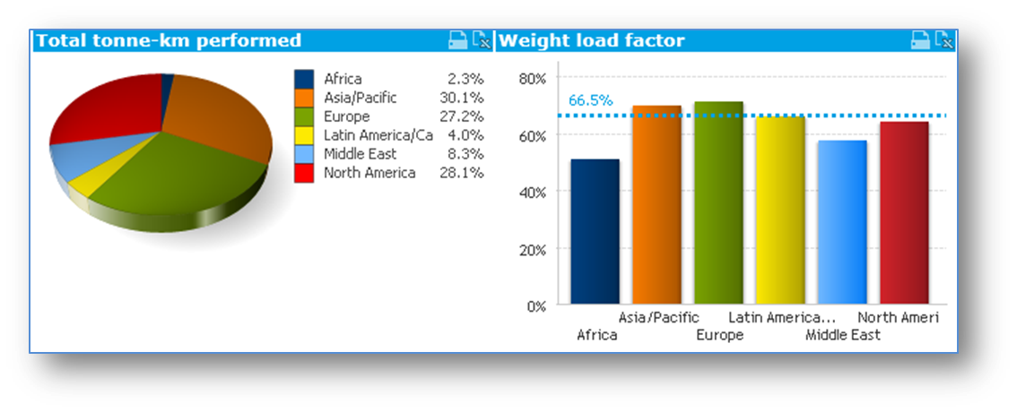
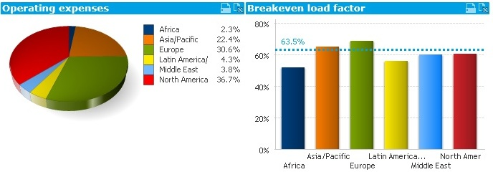
Regional and world totals
All modules in ICAOdata+ show reported data. Hence the need to be very careful when interpreting percentage changes between two or more time periods.
Only the air carrier traffic and financial modules contain total estimated figures for reporting and non-reporting air carriers at a regional and world level. These are accessed through the Total traffic button in the air carrier traffic module and the Regional results button in the air carrier finances module.

Slide 6
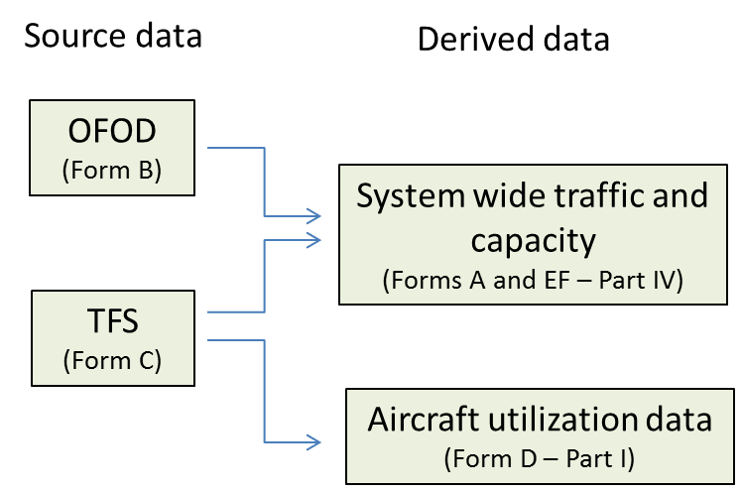
Air carrier data
Air carrier traffic and capacity data
ICAO collects air carrier data using different reporting Forms. These data are often related and, for the data to be correct, these relationships have to be respected.
In this context it is important to note that the OFOD and TFS data (respectively known in ICAO as Reporting Forms B and C) contain the necessary information to derive all other traffic and capacity data which appears in other forms such as Form A – Air carrier traffic, Form D – Part I, Fleet and the traffic and capacity portion of Form EF – Finances (Part 4).
While the data relationship across the various reporting Forms applies to the whole traffic, ICAO collects Forms B and C only for international services, consequently the comparability with the other forms is limited to these operations

Slide 7
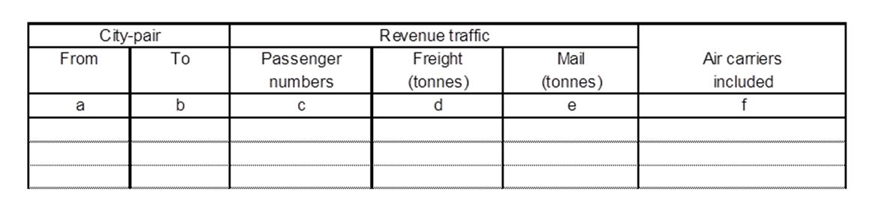
OFOD
On-Flight Origin and Destination (OFOD)
ICAO collects on a quarterly basis on-flight origin and destination (OFOD) data for the international scheduled and, from 2012, non-scheduled operations of individual commercial air carriers.
The revenue traffic shown in OFOD is classified by city-pair taking as a basis the points of embarkation and disembarkation from a flight (i.e. the operation of an aircraft on a flight-stage or a number of flight-stages with an unchanging flight number) identified in the boarding pass issued and used, or the shipment document.

Slide 8
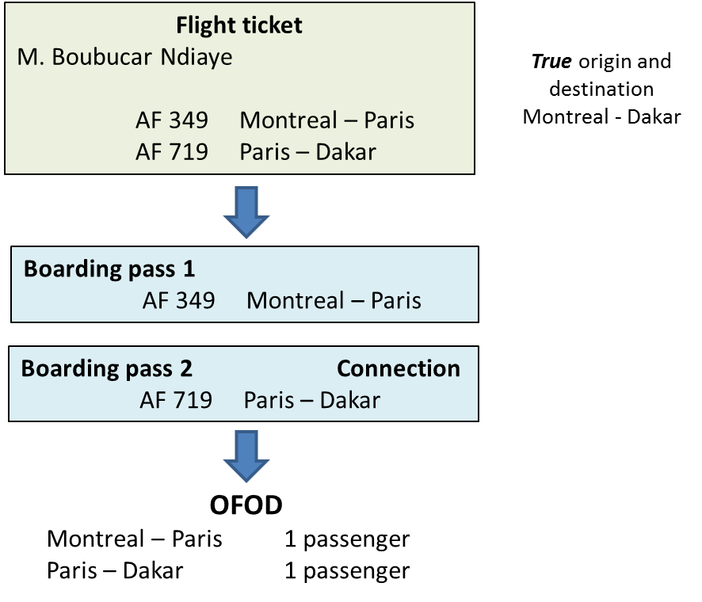
Counting passengers
Air carrier passengers numbers carried are counted on the basis of the numbers reported in OFOD.
For statistical purposes, a passenger, who during his or her journey needs to transfer to another flight (i.e. a flight with a different flight number) to complete his or her trip becomes a new passenger with its own on-flight origin and destination. For example, a passenger travels from Montreal to Dakar. As there are no direct flights between these two cities, the passenger has to travel via Paris, where he/she changes flights. Hence, in the OFOD report this passenger will appear twice; once under Montreal – Paris, and a second time, as another completely unrelated passenger, under Paris – Dakar.
The true origin and destination of passengers can be obtained from large computer reservation systems (CRSs), such as Sabre and Amadeus, which contain all the necessary information for tracking the whole travel itinerary of a passenger and hence identify his/hers true origin and destination. (in the case of our passenger above, Montreal to Dakar).

Slide 9
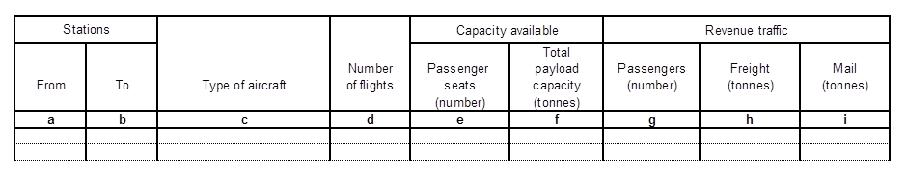
TFS
Traffic by Flight Stage (TFS)
Traffic by flight stage (TFS) data for the international scheduled services of commercial air carriers is collected on an annual basis.
Revenue traffic data (passengers, freight and mail) reported for TFS represents the traffic on-board the aircraft on each flight stage (regardless of the on-flight origin and destination of the traffic). So, a passenger (or a tonne of freight and mail) flying between Montreal and Amman on a flight with routing Montreal-London-Amman will appear on two stages: once on the stage Montreal – London, and a second time on the stage London - Amman.

Slide 10
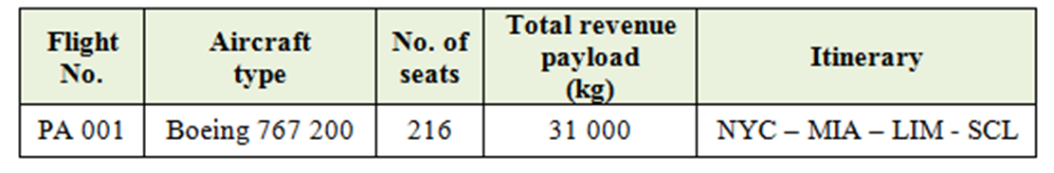
Relationship between OFOD and TFS
Air carrier: PA (United States)
The best way to illustrate the relationship between the data reported on each one of the two reporting Forms, OFOD and TFS, is through a simple example.
Let us assume that there is a flight PA 001 with the following itinerary:
New York (NYC) - Miami (MIA) - Lima (LIM) - Santiago de Chile (SCL)
where PA is a carrier with principal place of business in the United States. For the purpose of this exercise also assume no traffic restrictions apply. The flight is performed with a Boeing 767-200 with 216 seats and a total payload capacity of 31 tonnes.
(Please note that air carrier and flight data are fictitious).
Flight data

Slide 11
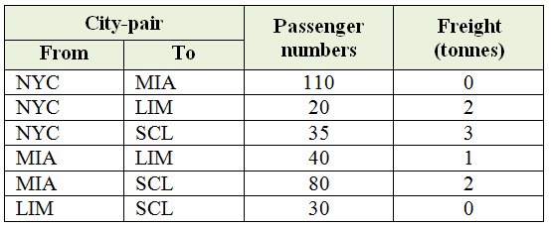
Relationship (cont.)
OFOD traffic data
The OFOD traffic data for flight PA 001 shows that:
165 passengers boarded the aircraft in NYC: 110 with destination MIA, 20 with destination LIM and 35 with destination SCL
120 passengers boarded the aircraft in MIA: 40 with destination LIM and 80 with destination SCL
30 passengers boarded the aircraft in LIM with destination SCL
The table also shows the OFOD traffic for the freight carried on this flight

Slide 12
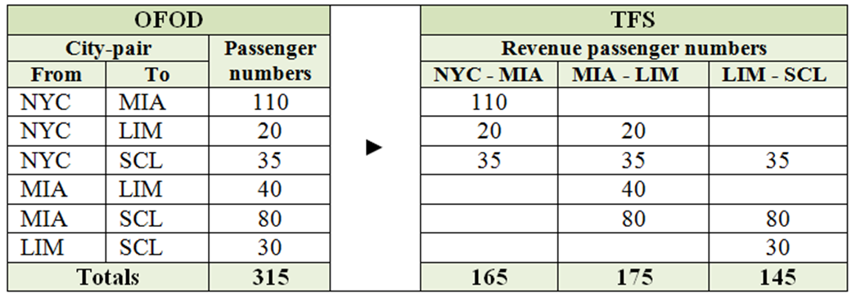
Relationship (cont.)
Relationship between OFOD and TFS
The table on the right shows for our example how the OFOD passenger traffic can be mapped into the TFS data. The TFS table shows the three flight stages of flight PA001. Under each flight stage heading one has to place the passengers numbers which are on board the aircraft during that flight stage.
Lets take all the passengers departing from NYC. All these passengers, adding up to 165, must appear on the flight stage NYC – MIA.
The next stage is MIA – LIM. The 110 passengers that were going from NYC to MIA are no longer there as they all disembarked in MIA. Those going from NYC to LIM and SCL are still on-board. In addition we now must include the passengers which boarded this flight in MIA also for LIM and SCL. Hence the number of passengers on this flight stage are 175.
Finally, for the last stage the number of passengers on board are 145.

Slide 13
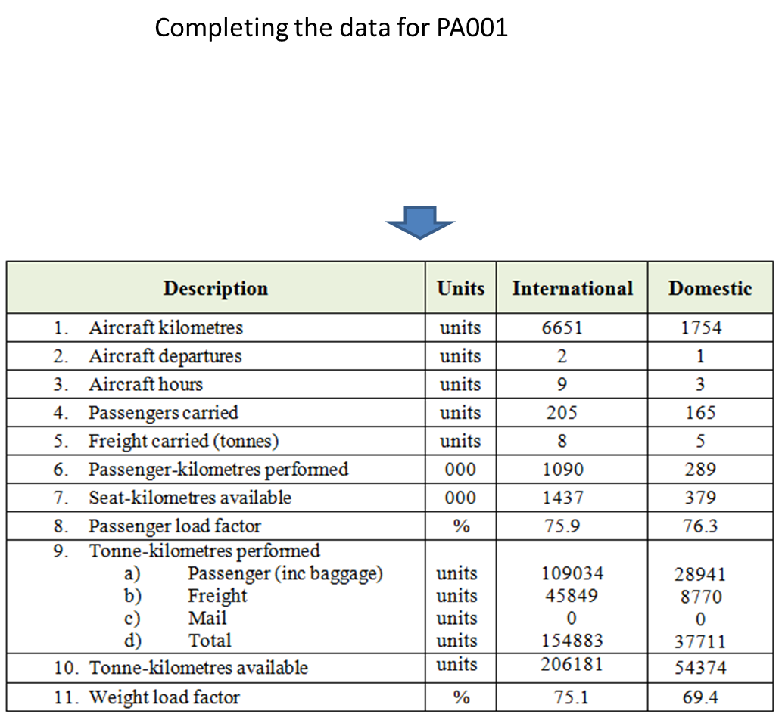
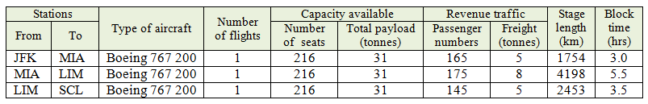
Air carrier traffic
The bottom table on the right shows what the data for flight PA001 would look like in the air carrier traffic module, which in ICAO is referred to as Form A.
The number of passengers and freight carried come from the OFOD data shown for flight PA001.
Now taking the TFS data for flight PA001 and adding the flight stage distance and the block hours one can complete the data required for the air carrier traffic module.
Using the same criteria and applying the appropriate passenger mass plus baggage (for this example 100kg), one can then complete the rest of the table.
The load factors are derived from the traffic data in the table.

Slide 14
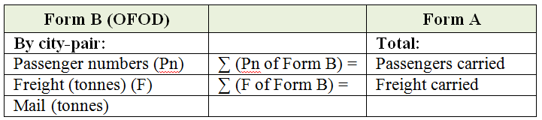
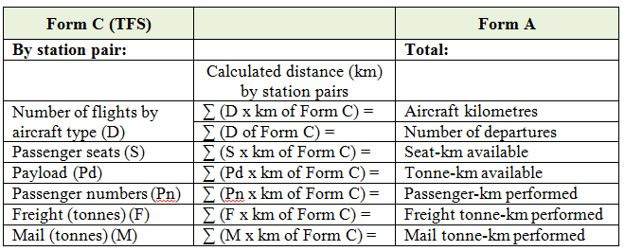
Summary
Relationship between Forms B and A
The relationship between OFOD, TFS and the air carrier traffic module (form A) can be summarised by the tables shown on the right.
Relationship between Forms C and A

Slide 15
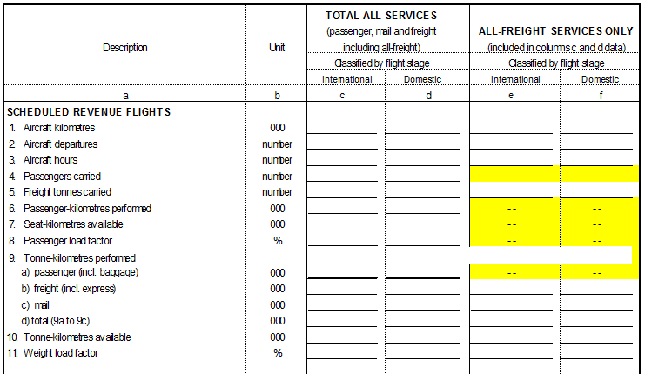
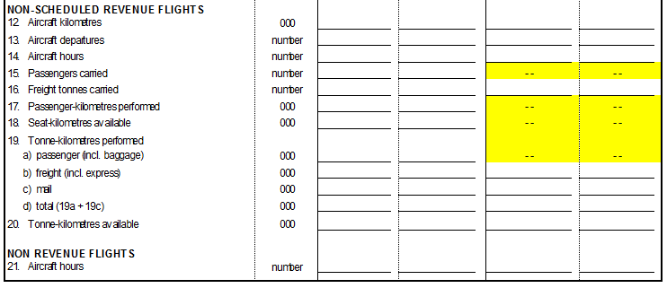
Air carrier traffic module
System wide commercial air carrier traffic data - Form A
The air carrier traffic data are classified into international and domestic flight stages for:
All services: i.e. covering passenger services (carrying passengers freight and mail) and all-freight services; and
All-freight services, i.e. services operated by aircraft dedicated to the carriage of freight
In addition the revenue flights identified above are further subdivided into scheduled and non-scheduled revenue flights.

Slide 16
Some data issues
Air carrier with subsidiaries in different States
As a United Nations specialized agency ICAO members are States. Consequently statistics are primarily collected from a State point of view and are published under each State name. With globalization, some air carrier companies no longer serve as a flag carrier of a single State but may also own subsidiaries which are carriers of other States, for example, LAN Airlines.
This carrier started out as the national carrier of Chile. Today it has subsidiaries based in four other Latin American countries: Argentina, Colombia, Ecuador and Peru. For ICAO statistics each of these States has to submit the data for the LAN Airlines subsidiary based in their State, namely: LAN Argentina, LAN Colombia, LAN Ecuador and LAN Peru. Their traffic will then be shown under the appropriate State. Users should therefore be aware of this when comparing data published by ICAO and those presented by other entities as the latter may show consolidated traffic data for LAN Airlines as a single entity.

Slide 17
Some data issues (cont.)
Multinational carriers
In the past, needing to deal at a State level meant that traffic data for air carriers owned by a group of States, such as Gulf Air or SAS had to artificially be allocated to each of the countries which participated in the ownership of these carriers. This allocation was done on the basis of the shares each country owned of the multinational carrier concerned.
Gulf Air originally owned by Bahrain, Oman, Qatari, and the United Arab Emirates (collectively identified as the Gulf State) is now owned by a single State: Bahrain.
SAS has been reorganized into four companies under the SAS Group name, Three of them, SAS Sweden, SAS Denmark, and SAS Norway are each located in one of the three Scandinavian countries and their traffic is published under the name of the States concerned. The fourth one, Scandinavian International has remained a multinational entity and as such its traffic is reallocated to the three Scandinavian countries in the proportion of their shareholding in the company.
Air carrier partially owned by two or more States
Where Scandinavia is the collective name for:
Denmark + Norway + Sweden

Slide 18
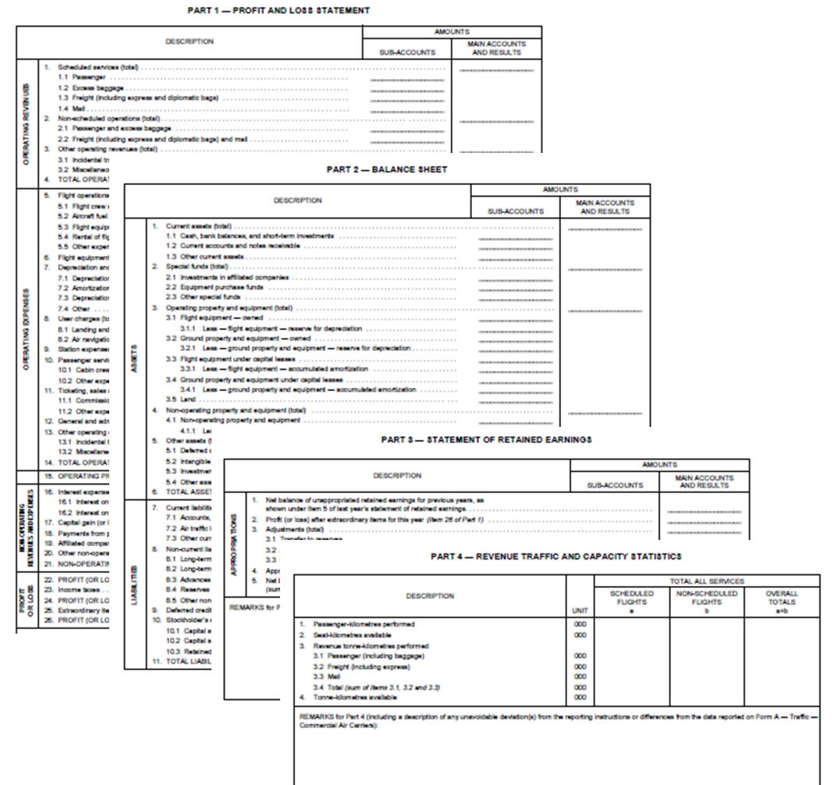
Air carrier finances module
In 1947, ICAO introduced a data collection on air carrier financial data which would offer the possibility to identify revenues and expenses and also allow them to be directly compared with the related traffic carried and capacity offered. The latter allows to calculate the corresponding operating revenue yields and unit costs which can be used to evaluate the performance of the carrier concerned over time and also compare its figures with those from other air carriers.
Commercial air carrier financial data are collected by ICAO through Reporting Form EF. The Form covers several financial statements as well as the traffic and capacity figures related to the financial data These are:
Part 1 – Profit and Loss statement;
Part 2 – Balance sheet;
Part 3 – Statement of retained earnings; and
Part 4 – Revenue traffic and capacity statistics

Slide 19
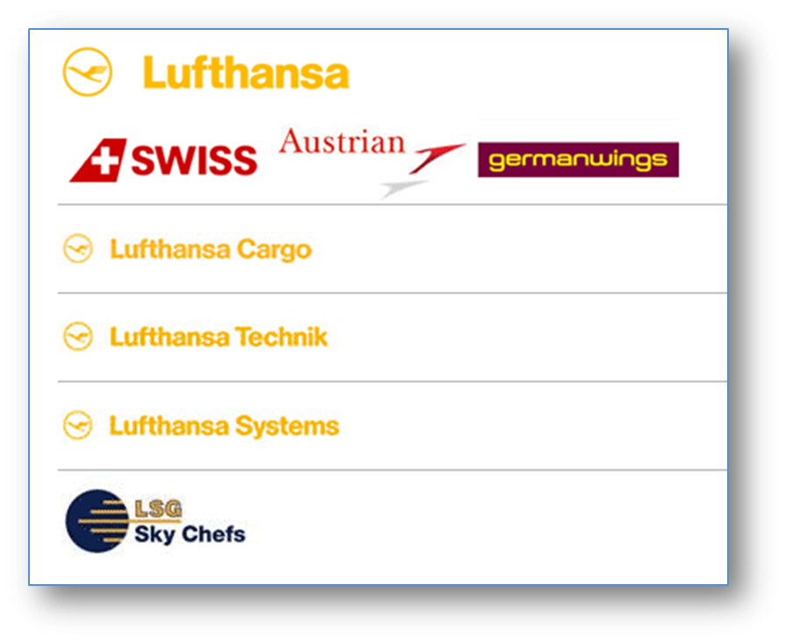
Group of companies
If the air carrier is part of a group of companies encompassing other related activities, such as aircraft maintenance, catering, and/or reservation systems, only the activities pertaining to the air carrier as a provider of commercial air transport services should be covered in the Form EF.
However, in some cases some financial data, such as the balance sheet, cannot be reported separately for the air carrier entity alone. Consequently only the operating data (revenues and expenses) shown in the profit and loss statement (Part 1) refer to the air carrier activities. The non-operating items as well as the other financial data shown in the balance sheet (Part 2) and in the statement of retained earnings (Part 3) may be for the group as a whole.
Because of these issues, all of the graphical analysis shown in ICAOdata+ is limited to the cost and expenses shown in the Profit and Loss statement.

Slide 20
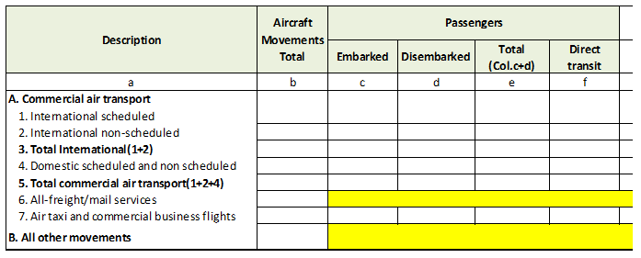
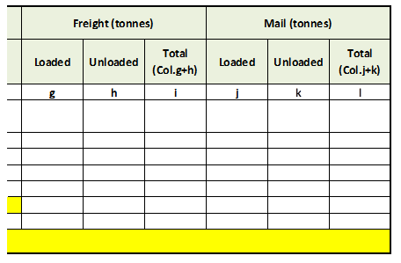
Airport traffic module
Airport traffic (Form I – Part I)
Airport traffic data only covers the main international airports in a State. However, as from 2012 they must also includes those international airports with a major domestic component.
Part I of the reporting form is shown on the right. The form has been split so that it can fit in the available space.
This is the only ICAO Form that was affected by the change in the definition of air transport activities adopted by ICAO in 2009.
As from 2012, air taxi and commercial business flights are included in each of the appropriate commercial air transport items (2 to 5) and shown separately under air transport commercial traffic (row 7). Until 2012 these flights were considered as part of General Aviation (GA) and thus shown under All other movements.

Slide 21
- END -

