Slide 1

Regional Activities for ADS-B
ASIA/PAC Region
April 2011
Yeo Cheng Nam
Director (Aeronautical
Telecommunications & Engineering)

Slide 2
Contents
Applications for ADS-B
Regional Activities Overview
Equipage of Singapore Registered Operators

Slide 3
Applications for ADS-B
Ground Surveillance Applications
  To enhance ATS in non-radar areas
    Reduce separation
    Enhance situation awareness
  To enhance ATS in radar areas
    Faster update rate available
    Back up existing radars
  Airport surface surveillance
  To support ATC tools
    More timely ATC alerts
  For verification of radar accuracy
  For monitoring of NTZ
Notes:
Not all applications are approved as on now. But the potential is there.

Slide 4
Applications for ADS-B
Aircraft to Aircraft Surveillance Applications
  Enhance traffic situational awareness on the airport surface
  Enhance visual separation on approach
  In trail procedures in oceanic airspace
  Enhance traffic situational awareness during flight operations
  Enhance sequencing operations
Notes:
In trail procedure is a procedure whereby ADS-B enabled aircraft can climb and descend through otherwised blocked flight levels.

Slide 5
Regional Activities Overview
States and ANSPs covered under the overview
  Australia
  Brunei Darussalam
  China
  Fiji
  Hong Kong. China
  Indonesia
  Malaysia
  Myanmar
  New Caledonia
  Pakistan
  The Philippines
  Republic of Korea
  Singapore
  Chinese Taipei
  Thailand
  USA
  Viet Nam

Slide 6
Australia (Upper Airspace Project)
Installed 29 ADS-B Stations:
  Thursday island, Gove, Doongan, Broome, Karratha, Mornington Island, Tennant creek, Balgo, Telfer, Newman, Meekatherra, Bilabong, Leonora, Warburton, Ayers rock, Alice Spring, Mt Isa, Esperance, Caiguna, Nullabor, Woomera, Birdsville, Broken hill, Jackson, Bourke, Longreach, Bundaberg, Oodnadatta, Lord Howe Island
Receiving data from 4 Indonesian Stations:
  Kintamani, Waignapu, Saumlaki, Merauke

Slide 7
Australia (Upper Airspace Project)
UAP has been commissioned & operational
Applicable of 5NM separation using ADS-B from operational sites.
Coverage is currently available across the whole continent from 29 ADS-B sites, 1 WAM and 4 from Indonesia.

Slide 8
Australia
(Wide Area Multi-Lateration)
Installed WAM in:
  Tasmania with 14 receivers.
  Sydney with 16 receivers.

Slide 9
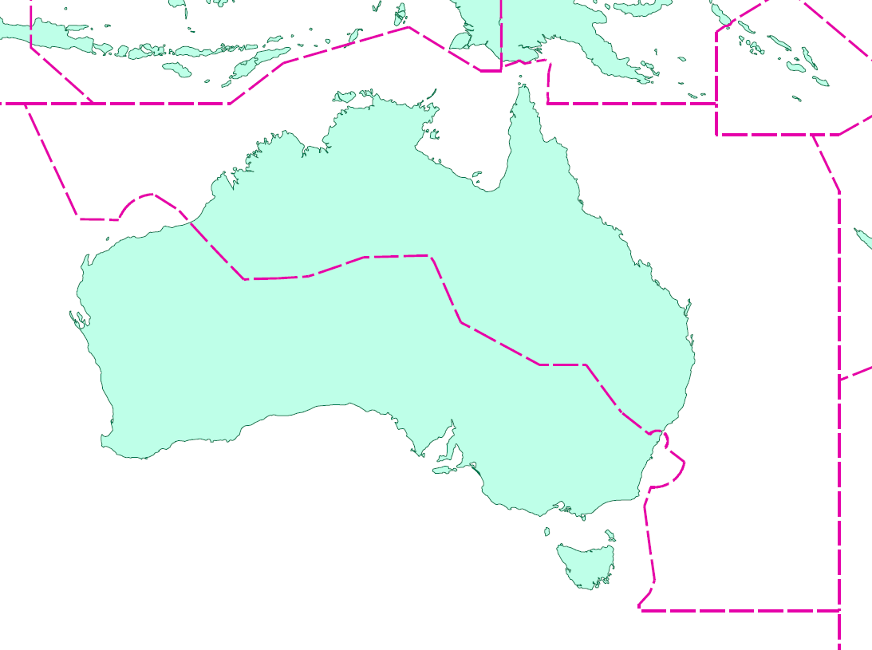
Saumlaki
Merauke
Kintamani
Waignapu
Gove
Thursday Island
Mornington Island
Doogan
Broome
Balgo
Tennany Creek
Mt Isa
Karratha
Telfer
Newman
Longreach
Alice Spring
Birdsville
Bundaberg
Meekatharra
Warburton
Ayers Rock
Billabong
Jackson
Oodnadatta
Leonora
Bourke
Lord Howe
Nullabor
Woomera
Caiguna
Esperance
Broken Hill
Sydney
Tasmania

Slide 10
Brunei Darussalam
Plan to install an ADS-B station to backup ATC surveillance system
Brunei
Information correct as of Feb 2009

Slide 11
China
To install ADS-B ground stations at:
  Lhasa Kanbala, Lhasa Airport, Linzhi Airport, Changdu Damala and Kangding Airport
Civil Aviation Flight University of China (CAFUC):
  Installed 7 ADS-B stations
  Equipped ADS-B on about 160 aircrafts
Installed ADS-B trial ground stations in:
  Chengdu and Jiuzhai
Installed ADS-B ground station within Sanya FIR
Information correct as of Apr 2011

Slide 12
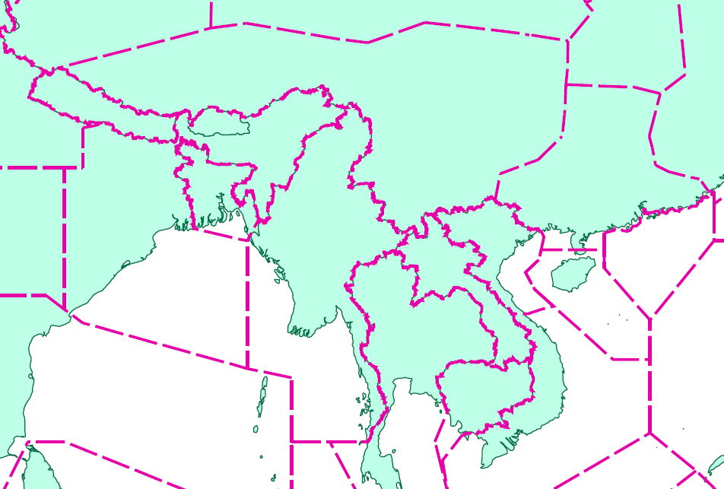
Changdu Damala
Lhasa Airport
Jiuzhai
Linzhi Airport
Kangding Airport
Chengdu
Lhasa Kambala
Xisha

Slide 13
Fiji
New ATM system (AURORA) installed and in operation in Nadi ATM Centre
Installed 11 ADS-B ground stations (3 of them with interrogators)
Issue ADS-B equipage mandate for aircraft operating in controlled airspace with effect from 20 Dec 2013
Only 3 of the 45 Fiji-registered aircrafts are ADS-B equipped, the rest are expected to be equipped after Dec 2013
Information correct as of Feb 2011

Slide 14
Hong Kong, China
Plan to install an ADS-B station
Mandate ADS-B carriage by end 2013
  for aircraft flying over L642/M771
Mandate ADS-B carriage by end 2014
  for all aircraft flying within the Hong Kong FIR
Mandate ADS-B carriage after 2015 (TBC)
  for low flying aircraft, including general aviation aircraft and helicopters.
Information correct as of Aug 2010

Slide 15
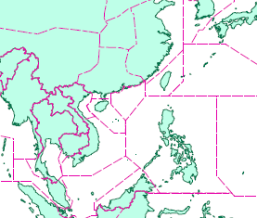
Hong Kong

Slide 16
Indonesia
Installed 30 ADS-B Stations in (as of Feb 2011):
  Banda Aceh, Medan, Pekanbaru, Palembang, Matak, Natuna, Soeta Jakarta, Tarakan, Cilacap, Kintamani, Pontianak, Pangkalan Bun, Palu, Makassar, Waingapu, Kupang, Alor, Ambon, Sorong, Merauke, Saumlaki, Galela, Manado, Biak, Timika, Kendari, Surabaya, Semarang, Banjarmasin and Balikpapan.
Receiving data from 4 Australian ADS-B Stations
  Broome, Doogan, Gove, Thursday Island
Information correct as of Feb 2011

Slide 17
Indonesia
Plans:
  To set up ADS-B Implementation Team Task Force for ADS-B Planning.
  In short term, DGCA Indonesia has a plan to use ADS-B for ATC Situational Awareness in Makassar Air Traffic Service Center (MATSC).
  Cross FIR Operational Data Sharing as the initial application of ADS-B Services in Indonesia.
  After successful implementation of ADS-B for situational awareness, Indonesia will implement ADS-B for provision of separation services.
Information correct as of Feb 2011

Slide 18
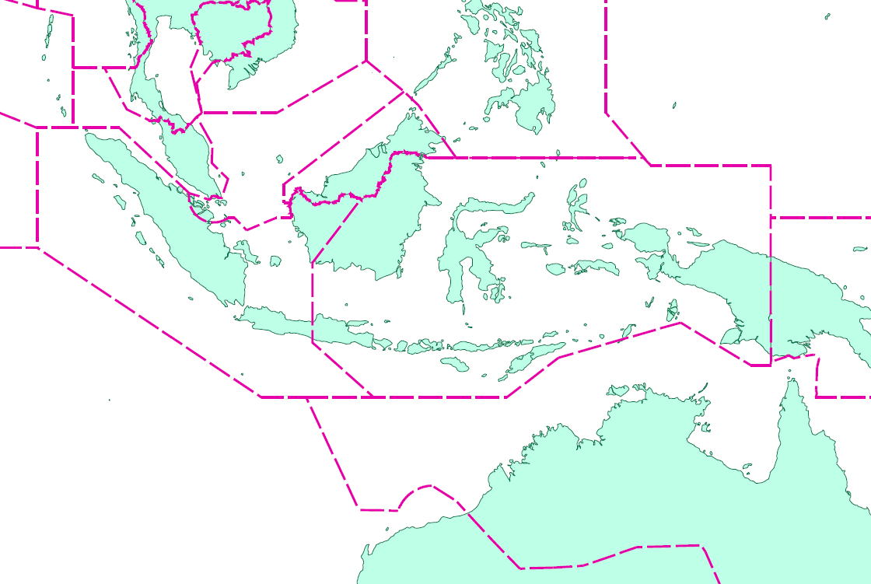
Natuna
B Aceh
Medan
Matak
Tarakan
Manado
Galela
Pekanbaru
Pontianak
Balikpapan
Palu
Sorong
Biak
Palembang
Banjarmasin
Pangkalan Bun
Kendari
Ambon
Timika
Soeta Jakarta
Semarang
Makassar
Surabaya
Saumlaki
Cilacap
Alor
Merauke
Makassar
Waingapu
Kupang
Thursday Island
Gove
Doogan
Broome

Slide 19
Malaysia
Installed Multi-lateration and ADS-B in Terengganu Airport (commissioned end-2009).
To upgrade ATM system by Sep 2011 to integrate with ADS-B.
Information correct as of Apr 2011

Slide 20
Myanmar
Myanmar has plans to install ADS-B stations at
  Lashio
  Sittwe
  Kyaing Tone
  Pathein
  Coco
The Project is expected to start in 2012 and complete by 2015

Slide 21
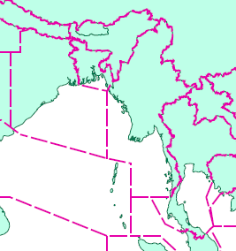
Lashio
Sittwe
Kyaing Tone
Pathein
Coco

Slide 22
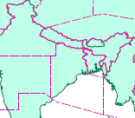
Nepal
Replacement of Radar by 2013
Plans to install 1 ADS-B ground station by 2018
  Tribhuvan International Airport
Tribhuvan
Information correct as of Apr 2011

Slide 23
New Caledonia
ADS-B installation plans as follows:
  Installed 3 ground ADS-B stations in 1H 2010
  ADS-B controller positions available since 30 Jul 2010 at Tontouta and Magenta airports
  For situation awareness & search and rescue
Information correct as of Apr 2011

Slide 24
Pakistan
Installed 1 trial ADS-B station at Karachi ACC for one year
Information correct as of May 2009

Slide 25
Papua New Guinea
Commencing ATMS modernisation program including plans to deploy ADS-B as its primary surveillance source
Plans to install 6 ADS-B ground stations by 2013
  Mt Nauwein
  Mt Dimodimo
  Burns Peak
  Mt Mission
  Mt Konokalang
  Lorengau
Information correct as of Apr 2011

Slide 26
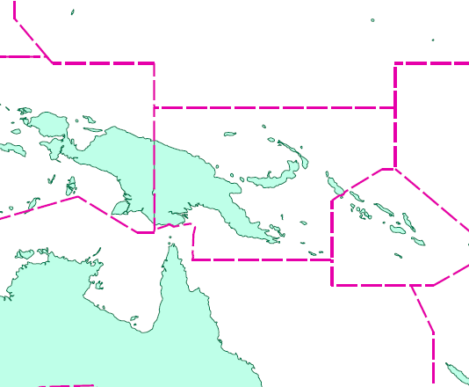
Lorengau
Mt Konokalang
Mt Mission
Mt Dimodimo
Mt Nauwein
Burns Peak

Slide 27
The Philippines
Installed a new Mode-S SSR radar:
  Capable of processing 1090ES ADS-B reports
  Range of 100NM
  Intend to include ADS-B capability in other Mode S SSR station
Plan to install ADS-B stations by 2012 in:
  Manila and Puerto Princesa
Another possible site is Quezon Palawan*
Information correct as of May 2009
* Information correct as of Aug 2010

Slide 28
Manila
Puerto Princesa
Quezon Palawan

Slide 29
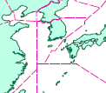
Republic of Korea
Installed 4 ADS-B stations at Incheon International Airport.
44 ADS-B vehicle transmitters are installed for vehicle monitoring
6 portable ADS-B vehicle transmitters are available for future use
Incheon
Information correct as of Apr 2011

Slide 30
Singapore
Installed 1 ADS-B station and ADS-B processor in Singapore
Implementing a new ATM System with ADS-B processing capability by late 2012
Purchased a stand-alone controller position to conduct operational trial starting from 2011
Issued Aeronautical Information Circular on plans to implement ADS-B operations after 2013.

Slide 31
Singapore

Slide 32
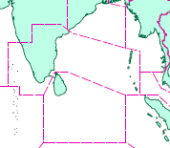
Sri Lanka
Has plans to install 1 ADS-B ground station by end-2012
  Pidurutalagala (~2500m)
Pidurutalagala
Information correct as of Apr 2011

Slide 33
Chinese Taipei
Installed 6 ADS-B trial stations at:
  Yang-Ming Mountain (Taipei), Hua Lian, Tai-Tung, Kao-Shung, Tai-Chung and Kin-Men
Installed Airport Multi-lateration at
  Kinmen Airport with 6 sensors
  Taoyuan Airport with 16 sensors
Perform trials on Wide-Area Multi-lateration using the 6 ADS-B trial stations.

Slide 34

Yang-Ming mountain, Taipei
Kin-men Island
Tai Chung
Hua Lian
Kao Shung
Tai Tung

Slide 35
Thailand
Planning to install 22 ADS-B ADS-B:
  Ubon Ratchathani, Hat Yai, Udon Thani, Chumphon, Trang, Samui (Surat Thani), Chiang Mai, Chiang Rai, Khon Kaen, Phitsanulok, Doi Inthanon (Chiang Mai), Nakhon Ratchasima, Sakhon Nakhon, Buriram, Suvarnabhumi (Samut Prakan), Donmuang (Bangkok), Hua Hin (Prachuap Khiri Khan), Phuket, Narathiwat, Trad, Nakhon Sawan, and Ranong.
Information correct as of Feb 2009

Slide 36

Chiang Mai
Chiang Mai
Doi Inthanon
Ubon Thani
Phitsanulek
Sakhon Nakhoh
Nakhon Sawan
Khon Kaen
Nakhon Ratchasima
Ubon Ratchathani
Donmuang
Buriram
Suvarnabumi
Trad
Hua Hin
Chumphon
Ranong
Surat Thani
Phuket
Trang
Hat Yai
Narathiwat

Slide 37
United States of America
Ground Stations
  Deployment of nearly 800 sites is under way
  Upgrades for the 4 US ATM systems with 1 in operational now.
ADS-B out
  Final Rule published in May 2010
  In general, whereever an SSR transponder is required today, ADS-B out will be required in 2020.
ADS-B in (validation projects)
  In trail procedures
  Visual separation on approach
  Traffic situational awareness on airport surface

Slide 38
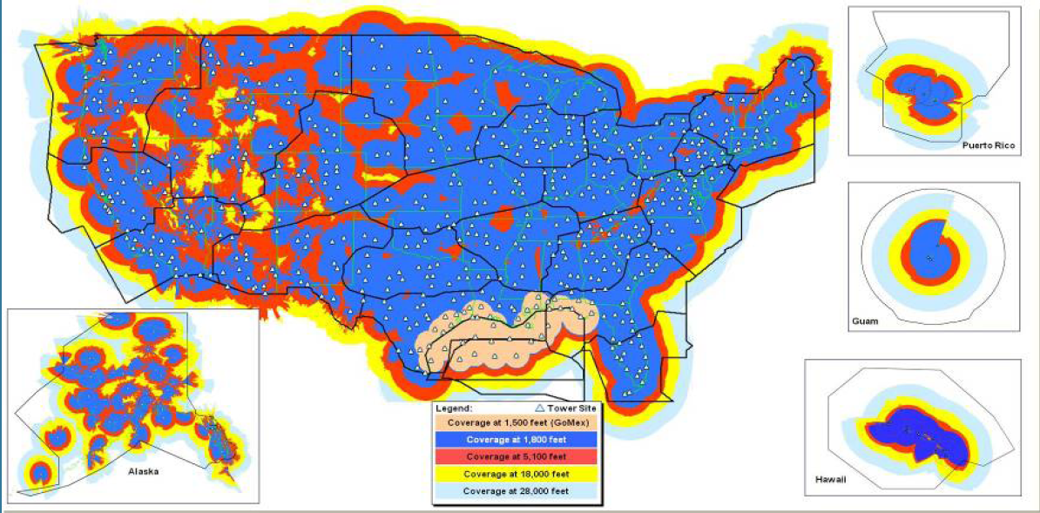
Picture obtained from Air Services Australia

Slide 39
Viet Nam
Plan to install ADS-B station at Con Son by 2011
Plan to install two ADS-B stations in the Eastern part of Ho Chi Minh FIR
Plan to upgrade ATM system in Ho Chi Minh to integrate with ADS-B
Plan to install new ATM system with ADS-B processing capability in Ha Noi
Information correct as of Dec 2010

Slide 40
Con Son Island

Slide 41
Equipage on Singapore Registered Operators
Survey was made with the Singapore registered operators.
Results of the survey are shown in the following slides.
Information is purely based on declaration by operators and should not be construed as Flight Operations Approval.

Slide 42

ADS-B equipage
 | Singapore Airlines*
Aircraft Type | No of Aircrafts | ADS-B fitted | (%)
A330 | 19 | 19 | 100%
A345 | 5 | 5 | 100%
A380 | 19 | 19 | 100%
B747 | 9 | 9 | 100%
B777 | 74 | 74 | 100%
 | Singapore Airlines Cargo**
Aircraft Type | No of Aircrafts | ADS-B fitted | (%)
B744F | 11 | 11 | 100%
* Information correct as of 13 Aug 2010
**Information correct as of 18 Aug 2010

Slide 43


ADS-B equipage
 | Silkair*
Aircraft Type | No of Aircrafts | ADS-B fitted | (%)
A319 | 11 | 3 | 27%
A320 | 6 | 2 | 33%
 | Jetstar**
Aircraft Type | No of Aircrafts | ADS-B fitted | (%)
A320 | 12 | 10 | 83%
*Information correct as of 2 Sep 2010
**Information correct as of 12 Jan 2011

Slide 44

ADS-B equipage
 | Tiger Airways
Aircraft Type | No of Aircrafts | ADS-B fitted | (%)
A320* | 13 | 13 | 100%
 | Jett8
Aircraft Type | No of Aircrafts | ADS-B fitted | (%)
B747F** | 2 | 0 | 0%
Total No of Aircrafts | ADS-B fitted | (%)
181 | 165 | 91%
*Information correct as of 24 Feb 2011
**Information correct as of 13 Jan 2011

Slide 45
Thank you

