Slide 1
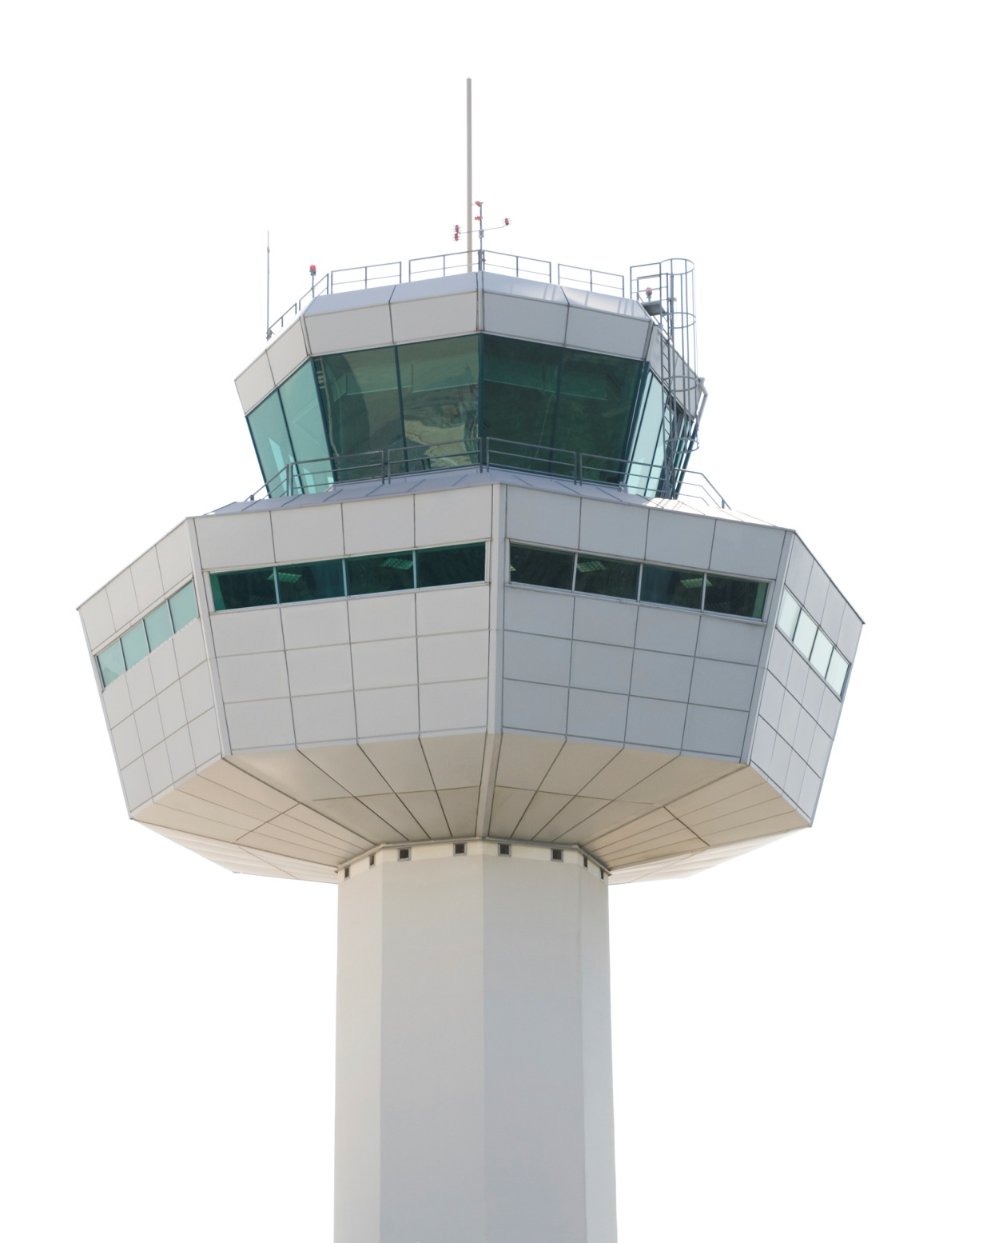
ASBUs Block 1 Overview
The CANSO Viewpoint
Eugene Hoeven
Director ICAO Affairs
ICAO Liaison Office
Pre-AN-Conf/12 Workshop
Montreal, 16-17 November 2012

Slide 2
The AN-Conf/12 Objective
Acknowledge Block 0
Agree to Block 1
Endorse Strategic Direction to Blocks 2 & 3
Notes:
The “Aviation System Block Upgrades” initiative is the best approach to reach our goals:
Enables global interoperability (which is our goal)
Develops clear solutions (block upgrades)
Establishes a transition plan (it’s a well thought out way for going forward)
Proposed approach is not a one-size fits all:
Modules are organized into flexible and scalable building blocks
Can be introduced and implemented in a State or a region depending on the need and level of readiness
Recognizes that all the modules are not required in all airspaces (important for some regions), but some may need a global mandate and synchronisation
Proposed approach is not a one-off exercise:
A planning process with regular review/updates
Decisions made concern implementation for mature items only, work for the others
Like GOOGLE, make ASBUs a VERB in your vocabulary
Take and Give back!

Slide 3
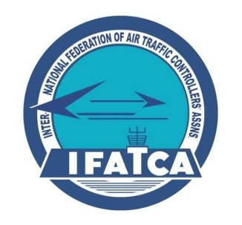
The ASBUs has been a Team Effort
Notes:
So ICAO invited all those that responded to our call for those that had MATURE programs to participate in an informal Technical Team to begin the dialog on how best to start this process.
Thank the Technical Team, as this briefing is a product of THEIR work. And we initiated a Challenge Team to challenges OURSELVES to begin to think about how to synchronize the investments that will be needed from all of the stakeholders to bring the future into reality.

Slide 4
What is a Block Upgrade?
Air & Ground
Equipment / Systems
Air & Ground
Standards / Procedures
Measurable Operational Improvement
Positive
Business Case
Operational approval / certification
Notes:
A BLOCK IS INTENDED TO ORGANIZE A GROUP OF ELEMENTS INTO AN OPERATIONALLY DRIVEN, COST EFFECTIVE UPGRADE THAT IS:
Clearly defined and measurable operational improvement
Equipment and/or systems needed onboard the aircraft and on the ground to make it happen,
Accompanying airborne and ground procedures including new separation minima
A positive business case over a clearly defined period of time
And an operational approval or certification path
At the same time, it is clear that all ICAO states do have the same immediate requirements for operational capabilities. So the Blocks were constructed as:
Modules are organized into flexible and scalable building blocks
Which can be introduced and implemented in a State or a region depending on the need and level of readiness
Recognizing that all the blocks/modules are not required in all airspaces (important for some regions)
And that some may need investment synchronisation possibly spurred by a global mandate

Slide 5
The Block Upgrades
Performance Improvement Areas
Block 0
(2013)
Block 1
(2018)
Block 2
(2023)
Block 3
(2028 & >)
Airport Operations
Globally Interoperable Systems and Data
Optimum Capacity and Flexible Flights
Efficient Flight Path

Slide 6
Block 1 (2018)
4 Main Performance improvement areas:
Greener Airports (6 modules)
Globally interoperable systems & data (3 modules)
Optimum capacity & flexible flights (5 modules)
Efficient flight path (3 modules)
Block 1 will serve as the enabler and foundation for the envisioned future aviation systems

Slide 7
Performance
improvements
Approval
Plan
Procedures
Technology
Transition
Strategy
Business
case
Regulatory
approvals
Operational
Trial
Module
Notes:
Each Module consists of:
An approval plan for the intended performance improvement; including the metric with which to measure success
Coupled with the necessary procedures, air and ground
And the necessary technology, air and ground
As well as a transition strategy
Supported by a positive business case
And a regulatory approval plan
That can be demonstrated in a global operational trial

Slide 8
Technology
Business
case
Regulatory
approvals
Operational
Trial
Approval
Plan
Procedures
Transition
Strategy
Performance
improvements
2013
2014
2015
2016
2017
Greener Airports
Global Introp Systems & Data
Optimum Capacity & Flex Flights
Efficient Flight Path
Remote TWR
FF-ICE 1
In-trail ADS-B
OPDs
A-SMGCS
SWIM
Dynamic ATS Routing
Initial 4DT
A-CDM
Digital AIM products
CDM+Flt.Planning
RPAs
Wake Vortex
Interval Management
Notes:
These are Block 1 Capabilities that are not available yet- but what we can AGREE on.
The reason these PI are in Block 1 is because one (or more) of these key elements are not ‘mature’
PI must also be globally acceptable (e.g. Remote TWR)
Highlights the need for global standards (In-Trail ADS-B)
New Technologies- Transition from ILS to GBAS (supported by Standards & Approvals)

Slide 9
Challenge - How to Get There?
Budget considerations - Block 1 modules involve technology insertion either in ground/air or both
Block 1 has strong dependency on moving to network based data communications
Regional synchronization of equipage and capabilities essential to achieve much of Block 1
Global standards can alleviate the risks and ensure interoperability between regions and ANSPs
Aviation System Block Upgrade – Block I
Notes:
Need text explaining what is holding us back

Slide 10
The CANSO Position
Need for Global Interoperability is very clear:
Avionics-Ground system: very long lead time
Ground-Ground stakeholders: more connectivity desired
Diverse regional requirements need greater recognition:
Seamless operations require synchronized investment across multiple FIRs
Many States have particular needs, priorities, and approaches not always shared by others
Need for STANDARDS NOT MANDATES

Slide 11
The CANSO Position
Unification of Global Initiatives
Focus of NextGen, SESAR, CARATS, FIANS, CNAS, et. al.
Concentrated, focused, modular, complete
Harmonization of Timeframes and Capability
Globally between regions and larger actors
Regionally between neighbors
Domestically between States and ATC stakeholders
Business Case
Justification for internal action
Cross-organizational stakeholder buy-in
Supports Cost-Benefit Analyses

Slide 12
Block 1 Capabilities
We can agree on….
Wake Turbulence Separation
A-SMGCS to ATSA-SURF – A-SMGCS L4 & SVS
A-CDM to Gate to Gate CDM
Remote AD Control
AMAN –DMAN
FF-ICE, FIXM before departure to full CFRO, full FF-ICE & SWIM
AIXM to ATM using XML/UML

Slide 13
Block 1 Capabilities
Requires further planning….
SWIM - pockets of SWIM or rich data sharing?
Free Routings
ATFM Solutions
ATSA AIRB & VSA to ASEP to SSEP
‘New ACAS’ that supports TBO & SURF
OPDs in Complex or Metroplex
4D TRAD
RPAS Integration + Lost link, Detect & Avoid technology

Slide 14
thoughts… feedback to ANSPs
Cross-reference ATM plans with ASBUs
Focus on Operational Improvements, not Technology
Start talking to the Regulator NOW!
Consult with GA, Military, stakeholders,…
Look at Training requirements; involve controllers early!
Work to Regional Agreements
Metrics and CBAs are ‘key’ to success
Address your Safety Net requirements

Slide 15
Challenges to Global Harmonization
It is critical that future ATM technologies be compatible and interoperable (Standards)
Integration of new technologies, systems, procedures and concepts into domestic airspace (mixing new with old)
Regional collaboration to coordinate modernization technologies and time lines (cross- boundary and multilateral harmonization)
Service Provider and Operator investment required to realize full benefits (infrastructure, avionics, procedures)
ICAO, CANSO and others must continue leadership role in promoting cross-regional harmonization (ICAO Block Upgrades)
Notes:
SO…. in Summary, this panel is about pitfalls…..BUT, I would prefer to talk about them as challenges!! Is is a Challenge but ALSO an opportunity!!
We all know that it is critical that technologies be compatible and integrated….this is in a word, about being Interoperable……
We applaud the leadership efforts ICAO is taking in their Block Upgrade Initiative and we want to ensure they continue to champion the efforts to develop future ATM standards for the global community. We need to ensure the standards are developed in a timely manner and be ready when we and You – the Industry needs them..
We all know too well the fiscal challenges that ATM modernization poses on many countries, especially the developing nations…we need to be able to not only develop but deploy affordable and effective solutions….
Finally, its about environmental protection and steward ship…while we continue to modernize, we must do so in an environmentally friendly and green way……

Slide 16
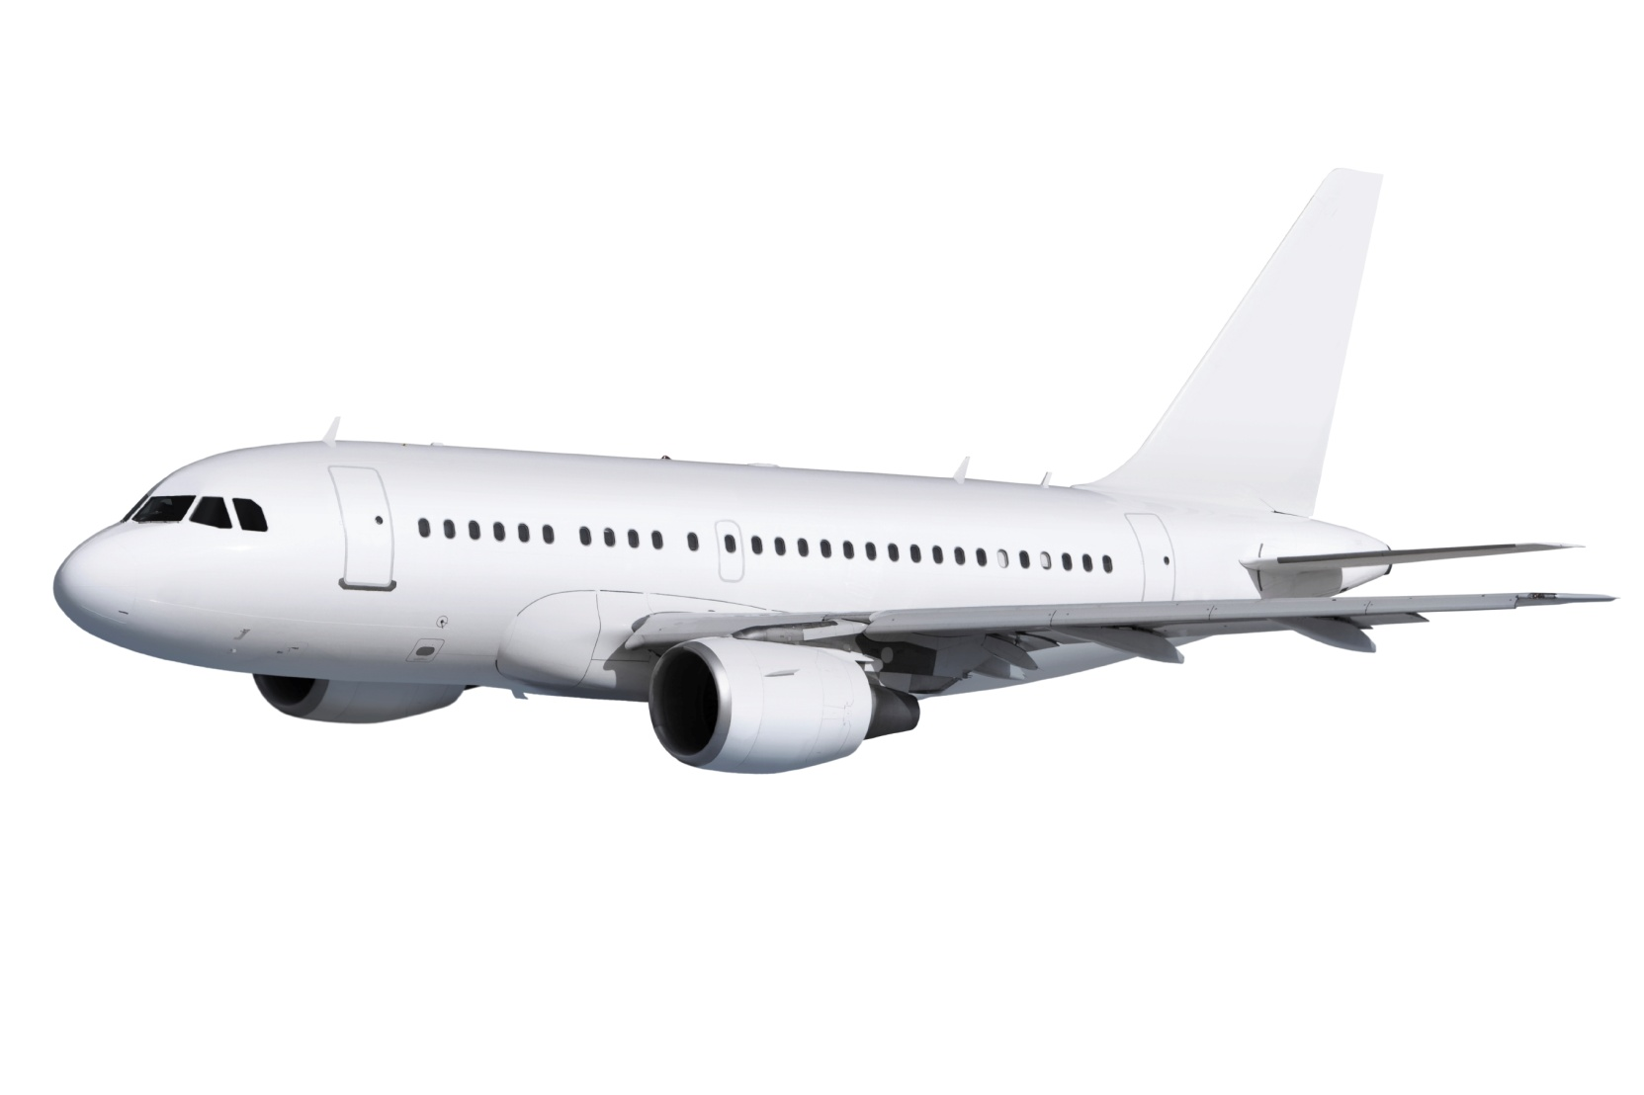
Notes:
Ultimately, it’s about achieving a better performing ATM.
And, providing a safe and efficient service to the ultimate customer.

Slide 17
Thank you!

