Slide 1
Air Transport Reporting Forms for Airports
ICAO Strategic Objective: Economic Development of Air Transport
ICAO Aviation Data Analyses Seminar
Middle East (MID) Regional Office
27-29 October
Economic Analysis and Policy (EAP) Section
Air Transport Bureau (ATB)

Slide 2

Preliminary
Airport
Direct Transit
(passengers land and take-off with the same flight number)
Transfer Passenger
(passengers land and take-off with different flight numbers)
Terminating
Originating

Slide 3
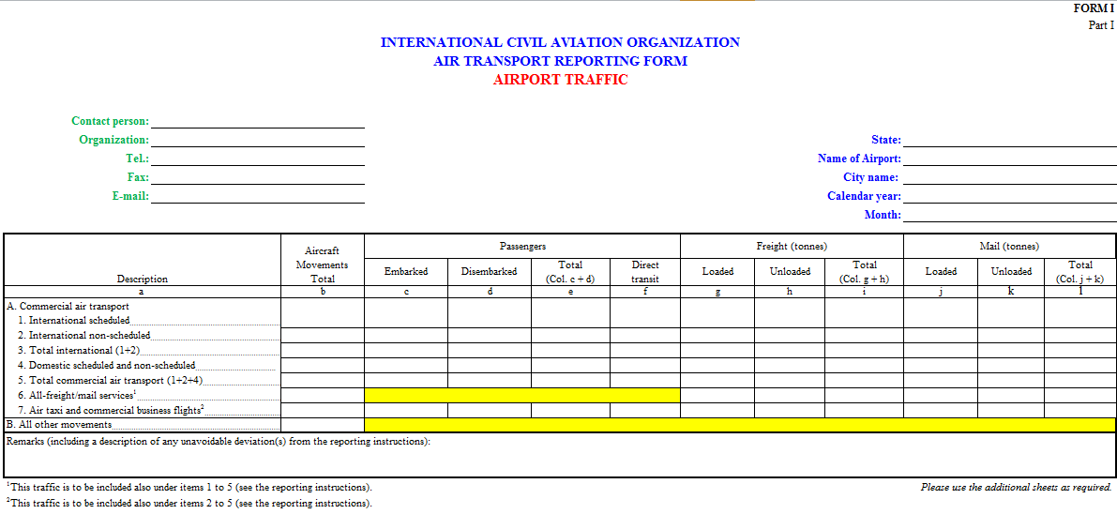
Form I
Airport Traffic
Airport, contact and reporting period information
Break-down of services (international scheduled, international non-scheduled, all-freight,…)
Passengers
Freight
Mail

Slide 4
Airport Traffic
Form I (monthly)
Form I
Who Reports and When?
Who reports monthly?
Each of the airports that is open to international commercial traffic
Those principal airports whose combined international traffic is 90% of all the international traffic units (scheduled and non-scheduled) of total airports in the State
AND
Each one of the airports whose total registered international traffic is at least 1000 traffic units
  Filed within two months of the end of the reporting month
When?

Slide 5
Form I
Airport Traffic
  The first part of Form I will be modified according to the new common ICAO-ACI form presented at the ADAP.
  The second part of Form I (Origin and Destination) is not presented as the Aviation Data and Analysis Panel (ADAP) recommended to discontinue it.

Slide 6
Form I
ICAO-ACI Collaboration
What is kept in the new ICAO-ACI form

Slide 7
Form I
ICAO-ACI Collaboration
What is kept in the new ICAO-ACI form

Slide 8
Form I
ICAO-ACI Collaboration
All-cargo services will not differentiate the mail from the freight

Slide 9
Form I
ICAO-ACI Collaboration
Simplification of the form

Slide 10

Form I
ICAO-ACI Collaboration
NEW FORM I
ICAO-ACI
Transfer Passengers: Passengers arriving and departing on a different aircraft, or on the same aircraft bearing different flight numbers. They are counted TWICE: upon arrival and departure
New items from ACI original form
Notes:
The inclusion of new items and the deletion of certain items is based on the following principles:
Greater granularity of data
Items that are demand driven
Minimize response burden –even though we increased the number of items, we put only those items that are demand driven from user
The last but also one of the most important factors is a common approach and potentially a single database on airport traffic statistics
The highlighted items are essentially the new items.

Slide 11
List of Air Transport Reporting Forms for Airports
Form | Title
I | Airport Traffic
J | Airport Financial Data
Blank forms and instructions available at: http://www.icao.int/sustainability/Pages/eap-sta-excel.aspx

Slide 12
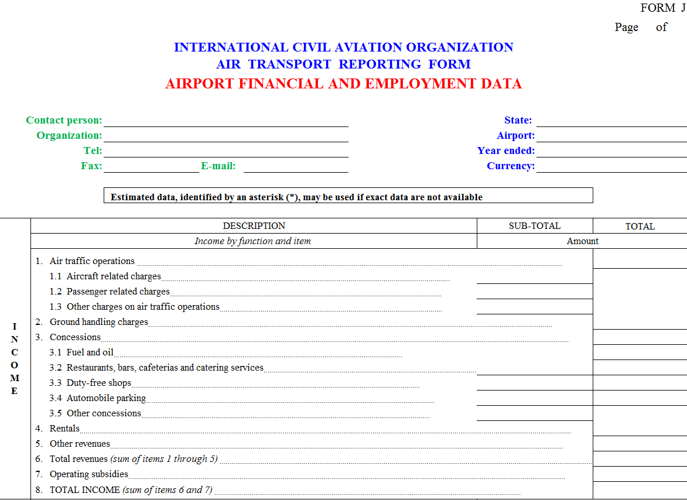
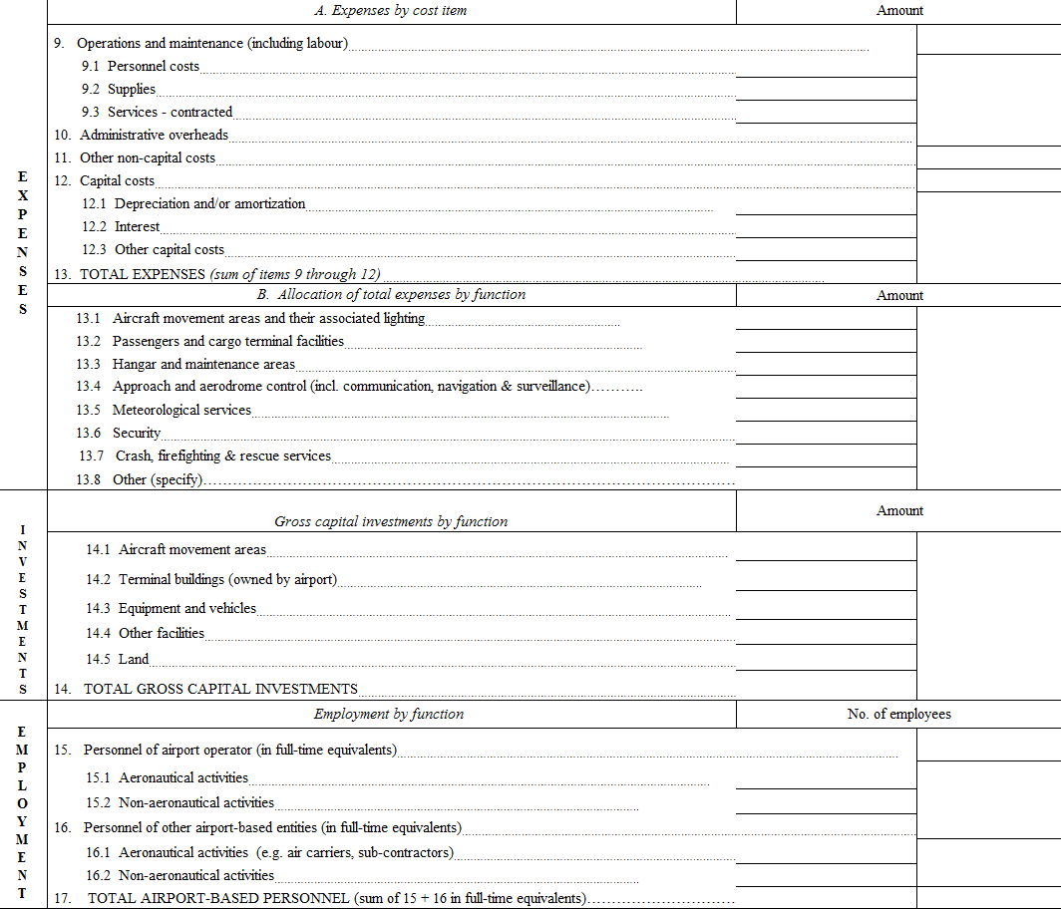
Form J
Airport Traffic
Airport, contact and reporting period information
Expenses
Investment
Employment
Income

Slide 13
Airport Financial Data
Form J (annual)
Form J
Who Reports and When?
Who reports monthly?
All airports open to international commercial traffic which are required to submit a monthly Form I
  Filed within six months of the end of the reporting period
When?

