Slide 1
State of the Air Transport in 2013
ICAO Strategic Objective: Economic Development of Air Transport
ICAO Aviation Data Analyses Seminar Middle East (MID) Regional Office 27-29 October
Economic Analysis and Policy (EAP) Section
Air Transport Bureau (ATB)

Slide 2
The air transport industry
The air transport industry is not only
a vital engine of global socio-economic growth
but is also of vital importance as a catalyst for economic development,
creating direct and indirect employment,
supporting tourism and local businesses, and
stimulating foreign investment and international trade.

Slide 3
Economic benefits of aviation
58.1million
$2.4 trillion
Jobs supported by aviation worldwide
Global economic impact*
*including direct, indirect, induced and tourism catalytic
Source: Air Transport Action Group (ATAG), 2014

Slide 4
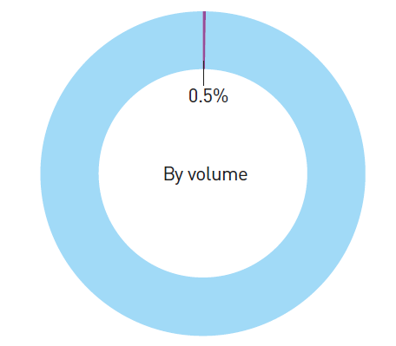
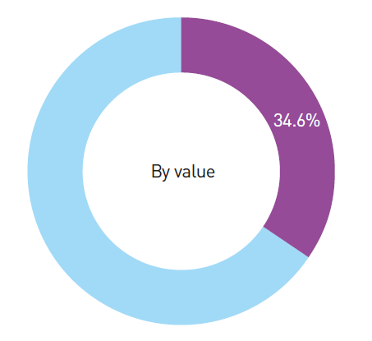
World international cargo shipment
Volume of world international cargo shipment
Value of world international cargo shipment
Aviation
Surface modes
Aviation
Surface modes
Source: Air Transport Action Group (ATAG), 2014

Slide 5
Economic development in 2013
Real GDP Quarter-on-Quarter growth
(2013 vs. 2012)
+2.5% = 2013 vs. 2012 Real GDP annual growth
GDP growth rate
Economic growth recorded an increasing trend over the successive quarterly growth rates of 2013
Source: IHS Global Insight

Slide 6
Commercial air transport fleet in 2013
Turbojets:
- 88% of world fleet in 2013
- this share increased every year since 2004
Number of aircraft*
88%
2013:
- 1 500 aircraft deliveries
- More than 3000 aircraft net orders
for the world’s major aircraft manufacturer
85%
*Active and parked aircraft are included; aircraft having a maximum take-off mass of less than 9 000 kg (20 000 lbs) are not included
Source: Reed Business Information (RBI), aircraft manufacturer websites

Slide 7
Air carrier financial results in 2013
Airline operating revenues in 2013:
717 billion USD
+1.7% vs. 2012
Airline operating results in 2013:
3.5% of operating revenues
+0.9 p.p.* vs. 2012
*percentage points
Source: ICAO Annual Report of the Council 2013

Slide 8
Air Transport Development
+5.5%
growth rate vs. 2012
5.8 trillion RPK
Source: ICAO Annual Reports of the Council
Scheduled commercial traffic
Total (international and domestic) services

Slide 9
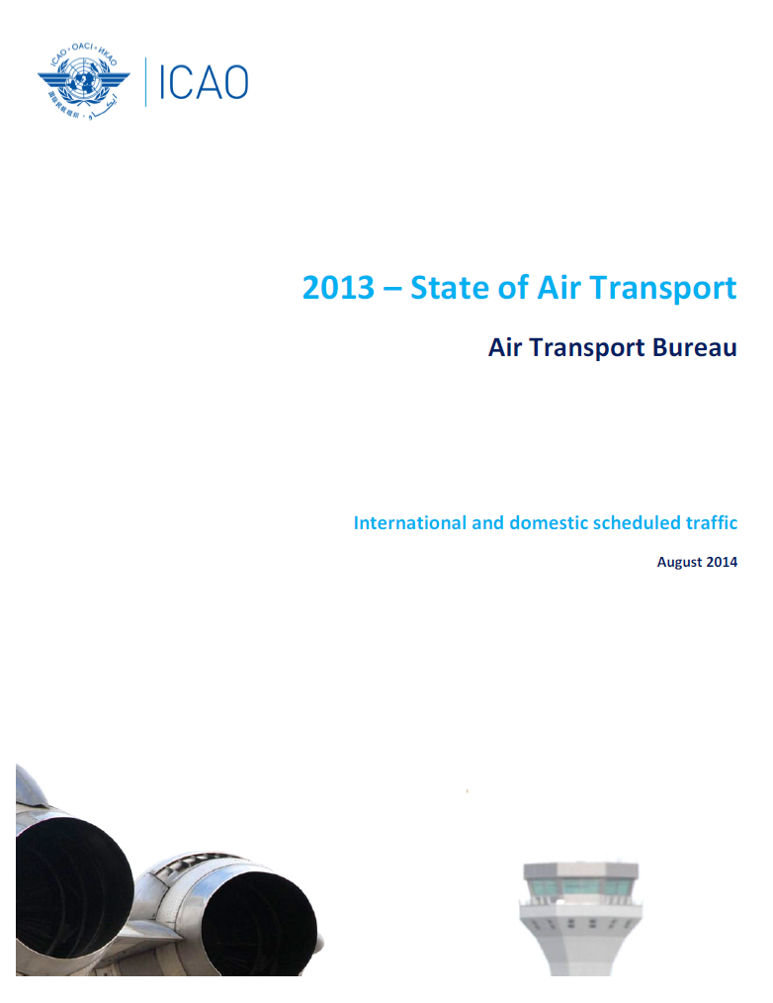
2013 - State of Air Transport
Annual analysis on a world and regional level
63 pages of comprehensive analysis and key figures of air transport
For each ICAO Statistical Region:
Passenger and cargo traffic for 2011, 2012 and 2013
Top 15 States, airlines and airports in 2013
Evolution of LCC market penetration in the last 10 years

Slide 10
World Air Transport in 2013
3.1billion
32 million
+4.5%
vs. 2012
+1.2%
vs. 2012
Passengers carried
Commercial flights performed
5.8trillion
186billion
+5.5%
vs. 2012
+0.4%
vs. 2012
Revenue Passenger-Kilometres
Freight Tonne-Kilometres
Source: ICAO Annual Report of the Council 2013
Scheduled commercial traffic
Total (international and domestic) services

Slide 11
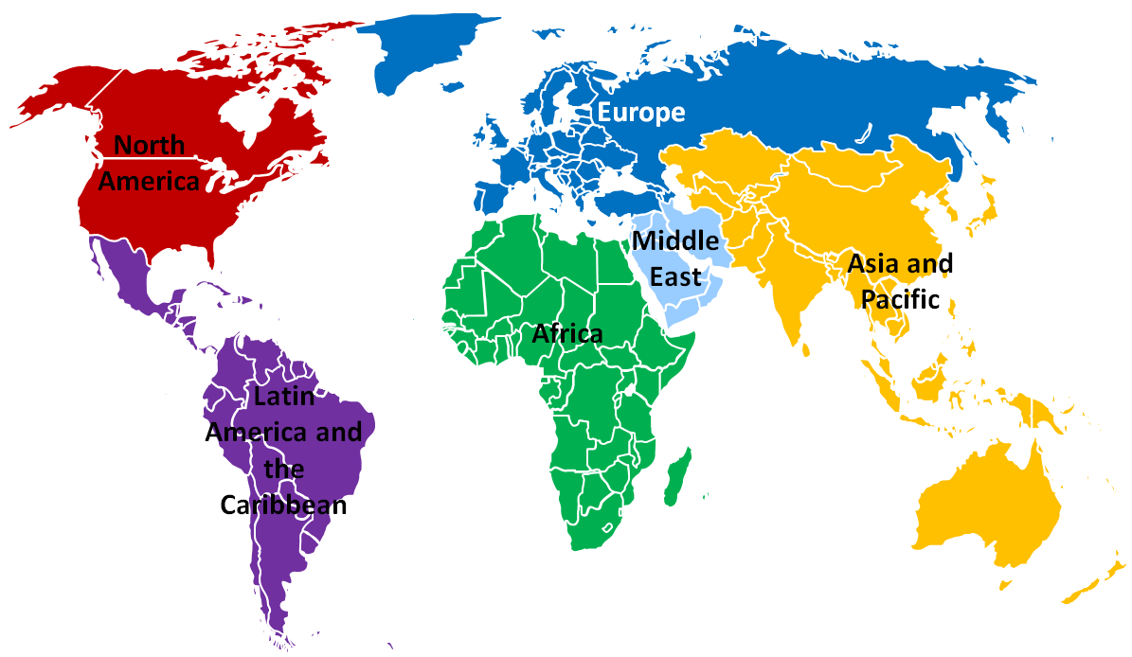
ICAO Statistical Regions

Slide 12
World Air Transport in 2013 by Region
Aircraft departures (million)
Passengers carried (million)
3.1billion
32 million
-0.4%
+3.1%
+4.5%
vs. 2012
+1.2%
vs. 2012
-0.4%
+3.5%
+4.9%
+7.8%
+6.3%
+8.0%
-1.3%
+0.9%
Passengers carried
Commercial flights performed
+0.4%
+5.7%
Revenue Passenger-Kilometres (billion)
Freight Tonne-Kilometres (billion)
5.8trillion
186billion
+5.5%
vs. 2012
+0.4%
vs. 2012
+4.6%
-0.1%
+4.4%
+4.0%
+11.2%
+12.0%
+7.7%
+0.2%
+2.0%
-4.9%
Revenue Passenger-Kilometres
Freight Tonne-Kilometres
+6.7%
+2.7%
Source: ICAO Annual Report of the Council 2013
Scheduled commercial traffic
Total (international and domestic) services

Slide 13
Passenger traffic: Worldwide distribution (1/2)
Analysis
Since 2010:
Asia/Pacific ranks 1st
Since 2012:
Europe ranks 2nd
Middle East has gained market share every year
Source: ICAO Annual Reports of the Council
Scheduled commercial traffic
Total (international and domestic) services

Slide 14
Passenger traffic: Worldwide distribution (2/2)
Distribution in Revenue Passenger-Kilometres
2007
1st: North America
2nd: Asia/Pacific
3rd: Europe
2013
1st: Asia/Pacific
2nd: Europe
3rd: North America
Source: ICAO Annual Reports of the Council
Scheduled commercial traffic
Total (international and domestic) services

Slide 15
Freight traffic: Worldwide distribution (1/2)
Analysis
in 2013:
Asia/Pacific’s FTK share is 40%
Europe ranks clearly 2nd
North America declined
Asia/Pacific declined in 2011 and 2012
Middle East has gained market share every year
Source: ICAO Annual Reports of the Council
Scheduled commercial traffic
Total (international and domestic) services

Slide 16
Freight traffic: Worldwide distribution (2/2)
Distribution in Freight Tonne-Kilometres
2007
1st: Asia/Pacific
2nd: North America
3rd: Europe
2013
1st: Asia/Pacific
2nd: Europe
3rd: North America
Source: ICAO Annual Reports of the Council
Scheduled commercial traffic
Total (international and domestic) services

Slide 17
World Top 15 Airlines in 2013
5 carriers from North America
5 carriers from Asia/Pacific
4 carriers from Europe
1 carrier from Middle East
2 low-cost carriers: Southwest and Ryanair
Highest growth → Emirates
with +15.8 % RPK growth in 2013 vs 2012
- 0.5%
+ 2.0%
+ 15.8%
+ 1.6%
+5.4%
+ 1.3%
+ 0.5%
+ 4.7%
+ 8.6%
+ 6.0%
+ 8.7%
+ 6.7%
+ 10.9%
+ 2.6%
- 0.5%
Note: scheduled services Source: ICAO Form A and ICAO estimates
Total (international and domestic) services

Slide 18
World Top 15 Airports in 2013
- 2.1%
+ 0.6%
10 airports in North America
(including the Top 5)
4 airports in Europe (3 of them recorded negative growth)
1 airport in Asia/Pacific:
Beijing (PEK)
+ 4.3%
+ 1.6%
- 4.9%
+ 1.9%
+ 1.1%
- 1.3%
- 0.8%
- 3.9%
- 2.0%
- 0.7%
+ 0.6%
- 3.2%
- 2.0%
Note: scheduled and non-scheduled services Source: ACI
Total (international and domestic) services

Slide 19
Inter-region capacity offered
from Europe to the World
FROM EUROPE:
1st destination : to North America (-6.6 pts)
Fastest growth destinations during 2004-2013: to Middle East and to Africa → 41% share in seats in 2013
Distribution of seats offered among regions is relatively balanced
Note: direct and non-direct flight excluding restrictions - Source: OAG
Scheduled commercial traffic
Total (international and domestic) services

Slide 20
Inter-region capacity offered
from Africa to the World
FROM AFRICA:
1st destination : to Europe (-7.1 pts) → more than 60% of seats offered
Fastest growth destination during 2004-2013: to Middle East → 29% share in seats in 2013 (+8 pts)
Distribution of seats offered among regions is very unbalanced
Note: direct and non-direct flight excluding restrictions - Source: OAG
Scheduled commercial traffic
Total (international and domestic) services

Slide 21
Inter-region capacity offered
from Middle East to the World
FROM MIDDLE EAST:
1st destination : to Asia/Pacific (-1.7 pts)
Fastest growth destination: to Latin America/Caribbean (UAE/Qatar to Brazil/Argentina) → few seats
Distribution of seats offered among regions is relatively unbalanced
Note: direct and non-direct flight excluding restrictions - Source: OAG
Scheduled commercial traffic
Total (international and domestic) services

Slide 22
Inter-region capacity offered
from Asia/Pacific to the World
FROM ASIA/PACIFIC:
1st destination in 2013 : to Middle East (+13 pts) → to Middle East was 3rd in 2004
Fastest growth destination: to Middle East and to Africa → few seats to Africa
Distribution of seats offered among regions is relatively unbalanced
Note: direct and non-direct flight excluding restrictions - Source: OAG
Scheduled commercial traffic
Total (international and domestic) services

Slide 23
Inter-region capacity offered
from North America to the World
FROM NORTH AMERICA:
1st destination: to Latin America/Caribbean (-1.6 pts)
Fastest growth destination: to Middle East and to Africa → few seats offered
Distribution of seats offered among regions is relatively unbalanced
Note: direct and non-direct flight excluding restrictions - Source: OAG
Scheduled commercial traffic
Total (international and domestic) services

Slide 24
Inter-region capacity offered
from Latin America/Caribbean to the World
FROM LATIN AMERICA/CARIBBEAN:
1st destination: to North America (-1.7 pts) → 75% of seats offered
Fastest growth destination: to Middle East → few seats offered
Distribution of seats offered among regions is very unbalanced
Note: direct and non-direct flight excluding restrictions - Source: OAG
Scheduled commercial traffic
Total (international and domestic) services

Slide 25
Europe
Top 5 airlines and Top 5 airports
Top 5 airlines
Top 5 airports
+ 1.3%*
+ 0.5%
+ 4.7%
+ 6.7%
+ 23.6%
Note: scheduled services
Source: ICAO Form A and ICAO estimates
Note: scheduled and non-scheduled services
Source: ACI
*2013 vs. 2012
Each airline of the Top 5 recorded an increase
Turkish Airlines:
+20% growth : Network expansion in 2013: +9 new States served, +26 cities served
5th largest airline in Europe in 2013
Top 3 airports recorded each a decrease
Total (international and domestic) services

Slide 26
Africa
Top 5 airlines - Top 5 airports
Top 5 airlines
Top 5 airports
*2013 vs. 2012
Note: scheduled services
Source: ICAO Form A and ICAO estimates
Note: scheduled and non-scheduled services
Source: ACI
1st airline and 1st airport are South African
Ethiopian Airlines: +20% RPK growth → 2nd largest airline in 2013
Each airport of the Top 5 recorded a decrease in 2013
Africa: +4.4% RPK growth in 2013
Total (international and domestic) services

Slide 27
Middle East
Top 5 airlines and Top 5 airports
Top 5 airlines
Top 5 airports
Note: scheduled services
Source: ICAO Form A and ICAO estimates
Note: scheduled and non-scheduled services
Source: ACI
*2013 vs. 2012
All airlines and airports of the Top 5 recorded positive growth rates (except Jeddah airport)
Double digit growth for the Top 3 airlines: Emirates, Qatar Airways and Etihad Airways
The Top 5 airlines represents more than 80% of the RPK in Middle East
Total (international and domestic) services

Slide 28
Asia/Pacific
Top 5 airlines and Top 5 airports
Top 5 airlines
Top 5 airports
+ 8.6%*
+ 8.6%
+ 11.3%
+ 2.6%
- 0.5%
*2013 vs. 2012
Note: scheduled services
Source: ICAO Form A and ICAO estimates
Note: scheduled and non-scheduled services
Source: ACI
Top 3 airlines: Only Chinese carriers
Each airport of the Top 5 recorded an increase
Beijing (PEK) → Largest airport in Asia/Pacific : 40% more departures than the 2nd
→ 2nd largest airport in the world
Asia/Pacific : +7.7% RPK growth in 2013
Total (international and domestic) services

Slide 29
North America
Top 5 airlines and Top 5 airports
Top 5 airlines
Top 5 airports
- 0.5%
+ 2.0%
+ 1.6%
+ 4.9%
+ 6.0%
Note: scheduled services
Source: ICAO Form A and ICAO estimates
Note: scheduled and non-scheduled services
Source: ACI
*2013 vs. 2012
Atlanta airport: 1st airport in the world (departures and passengers) // -2.1% departures growth
United airlines: 1st airline in the world (RPK) // -0.5% RPK growth
US Airways and American Airlines merged in December 2013
Total (international and domestic) services

Slide 30
Latin America and Caribbean
Top 5 airlines and Top 5 airports
Top 5 airlines
Top 5 airports
+ 0.9%*
+ 7.6%
+ 16.3%
+ 10.9%
- 9.0%
*2013 vs. 2012
Note: scheduled services
Source: ICAO Form A and ICAO estimates
Note: scheduled and non-scheduled services
Source: ACI
LAN Chile: -9% RPK growth → 5th in 2013, 3rd in 2012
Copa: +16.3% RPK growth → received seven B737, network expansion (added frequencies and new destinations)
Largest airport and strongest growth in the Top 5 airports: Mexico City (+5.0%)
Total (international and domestic) services

Slide 31
Low Cost Carriers in 2013
LCC Traffic Share by Region (intra-regional traffic)
Percentage of States served by LCC - 2004 vs 2013
+5 States
+7 States
+16 States
+3 States
Latin America/ Caribbean
+8 States
Largest LCC presence: Europe (37%) and Latin America/Caribbean (31%)
Strongest growth: Asia/Pacific and Middle East (+17 pts in 10 years)
Smallest LCC presence: Africa
All States in Middle East have LCC presence in 2013
94% of States have LCC traffic in Europe in 2013
Asia/Pacific : +16 new States served by LCCs
Source: ICAO, OAG
Scheduled commercial traffic
Total (international and domestic) services

Slide 32
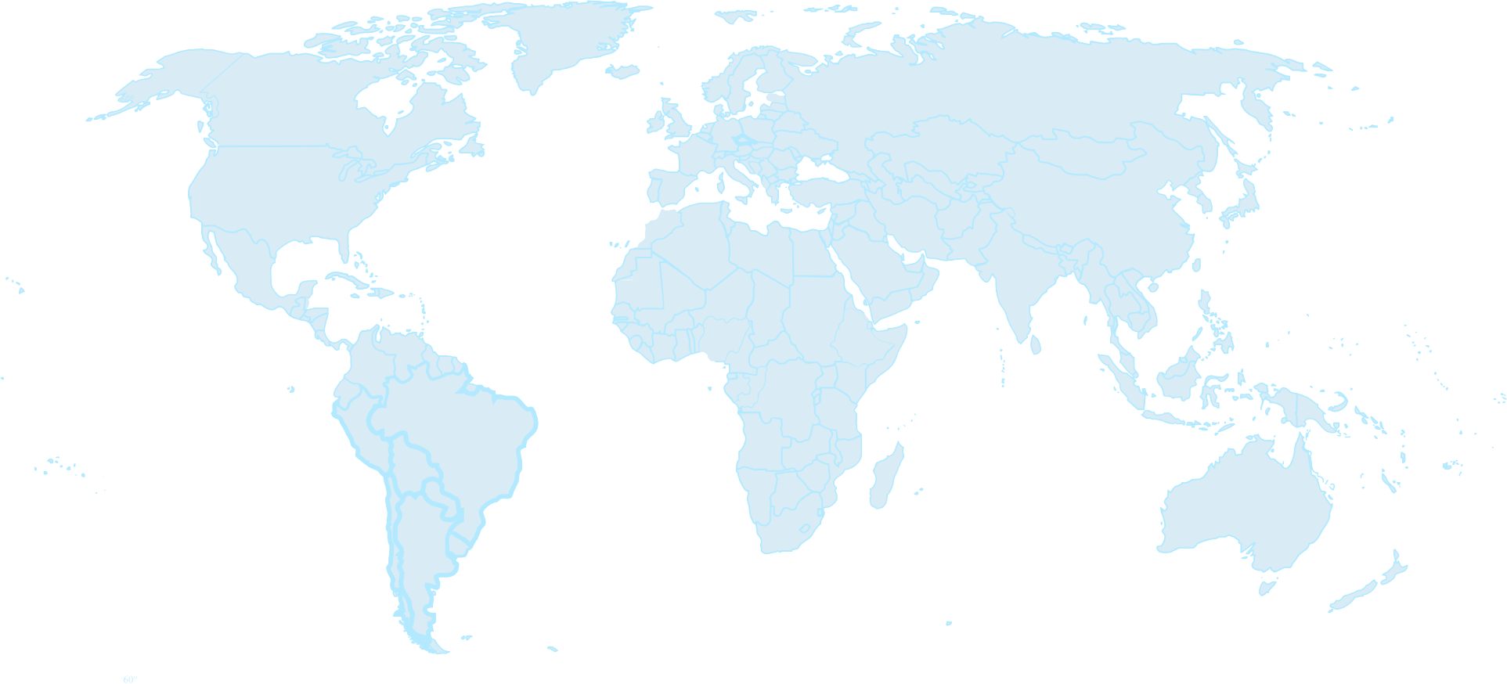
Low Cost Carriers in 2013
2013
Note: distribution in terms of number of seats intra-region
Scheduled commercial traffic
32
Source: ICAO, OAG
Total (international and domestic) services

Slide 33
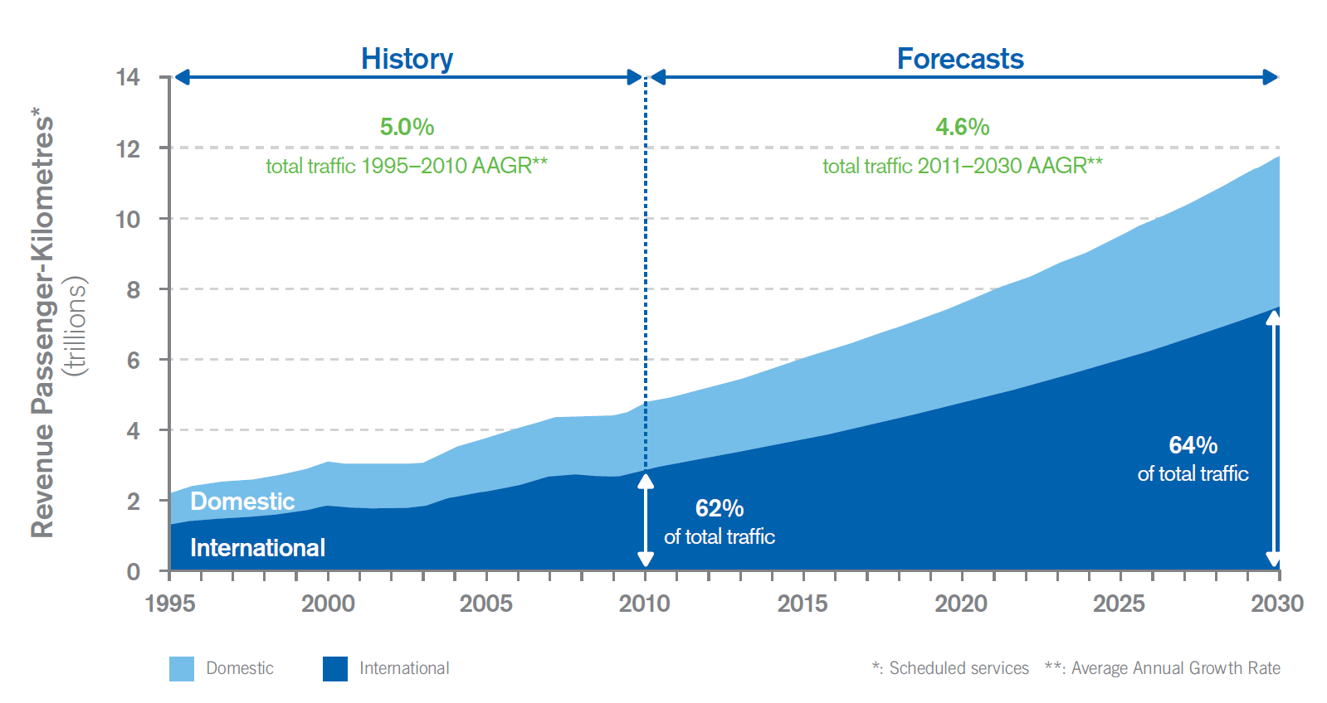
Long-term air traffic forecasts: “GATO” Scheduled passenger traffic
Source: Cir 333, Global Air Transport Outlook to 2030 - GATO

Slide 34
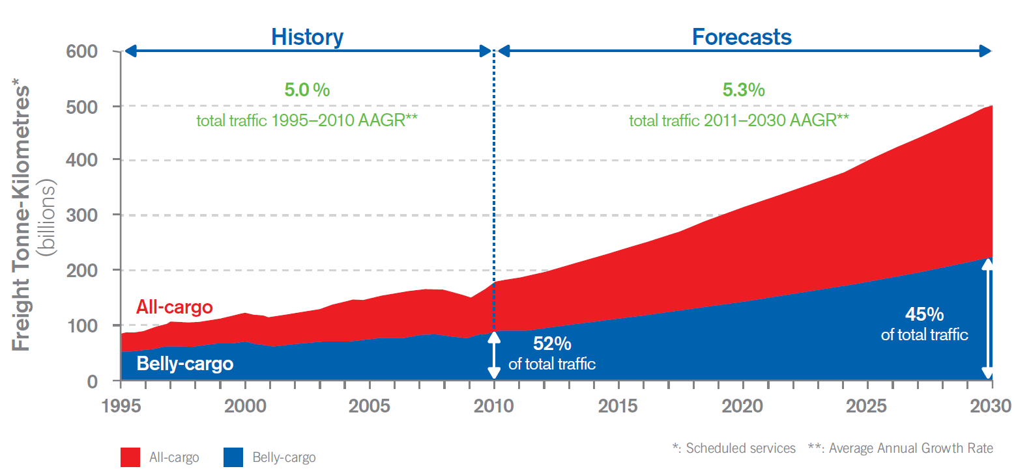
Long-term air traffic forecasts: “GATO” Scheduled freight traffic
Source: Cir 333, Global Air Transport Outlook to 2030 - GATO

Slide 35
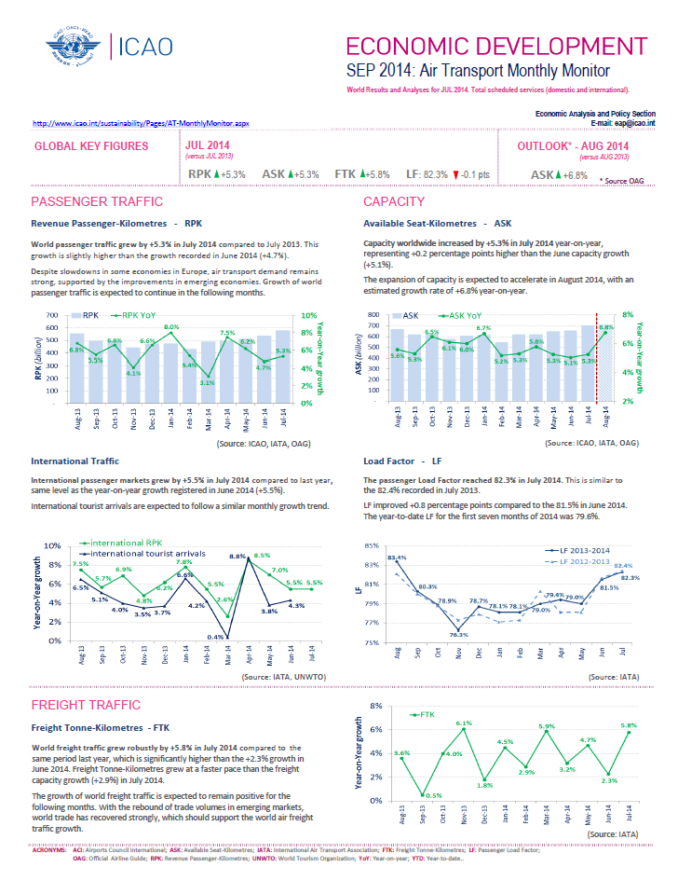
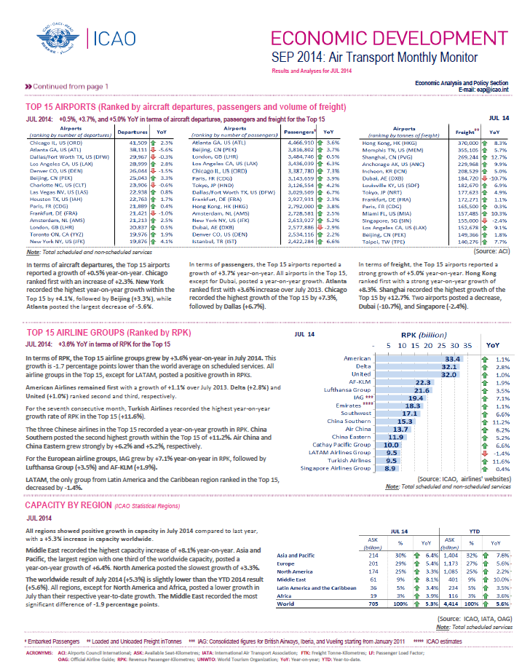
The Monthly Monitor
Published every month on ICAO website: http://www.icao.int/sustainability/Pages/AT-MonthlyMonitor.aspx
Outlook and analysis of passenger and freight traffic
Top 15 airports and airlines
Evolution of the capacity by region

Slide 36
© ICAO All rights reserved.
This document and all information contained herein is the sole property of ICAO. No intellectual property rights are granted by the delivery of this document or the disclosure of its content. This document shall not be reproduced or disclosed to a third party without prior permission of ICAO. This document and its content shall not be used for any purpose other than that for which it is supplied.
The statements made herein are based on the mentioned assumptions and are expressed in good faith. Where the supporting grounds for these statements are not shown, ICAO will be pleased to explain the basis thereof.

