Slide 1
Air Transport Reporting Forms A-S and I-S
ICAO Strategic Objective: Economic Development of Air Transport
ICAO Aviation Data Analyses Seminar Middle East (MID) Regional Office 27-29 October
Economic Analysis and Policy (EAP) Section
Air Transport Bureau (ATB)

Slide 2
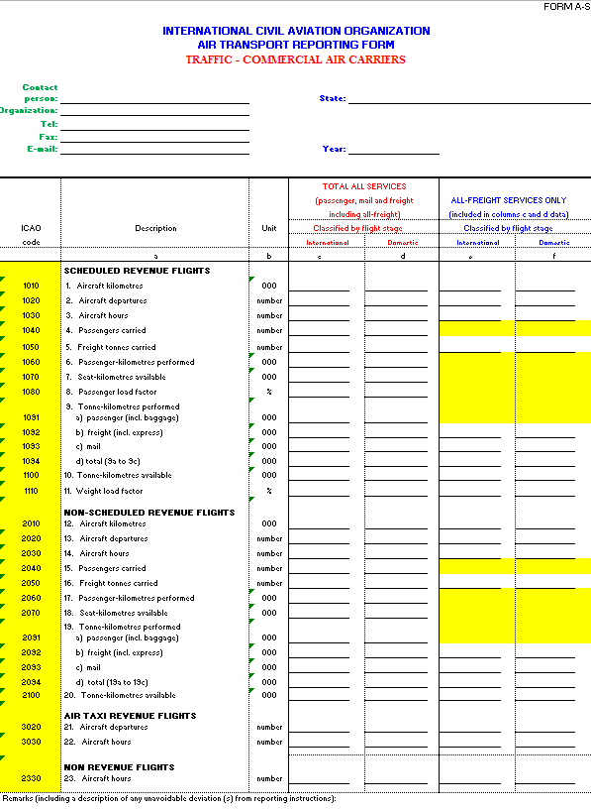
Form A-S
Traffic – Commercial Air Carriers
Annual summary of form A for all State’s carriers

Slide 3
Traffic – Commercial Air Carriers Form A-S (Annual)
Form A-S
Who Reports and When?
Who reports?
All State’s carriers
Filed within six months of the end of the reporting period
When?

Slide 4
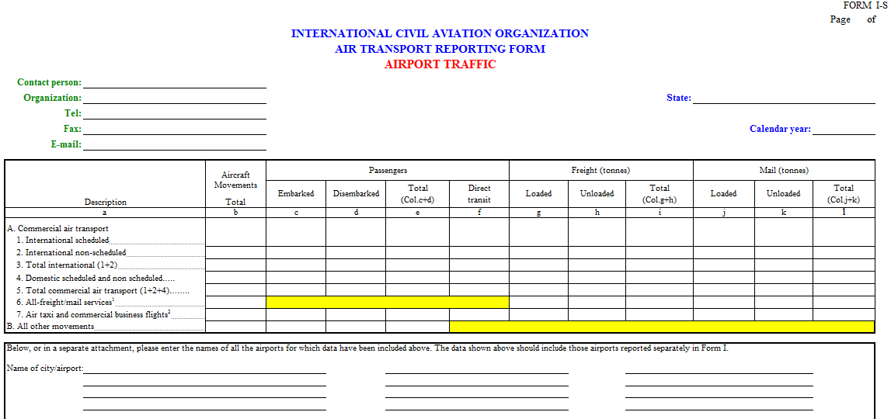
Form I-S
Airport Traffic
Annual summary of Form I for all the airports with commercial traffic in a State

Slide 5
Airport Traffic Form I-S (Annual)
Form I-S
Who Reports and When?
Who reports?
All the airports with commercial traffic in a State
Filed within six months of the end of the reporting period
When?

