Slide 1
Aeronautical Collaborative Ring (ACR)
SP/11
The
Readying Your Enterprise for SWIM
Dario Rossilli
Chief Operating Officer
Dan Wilson
Product Marketing Director

Slide 2
Presentation Overview
Corporate Introduction
About Ubitech
About IDS
Product Offering
SWIM Introduction
SWIM Explained
The Future with SWIM
Service Oriented Architecture
SWIM Benefits
Aeronautical Collaborative Ring (ACR)
ACR Core Capabilities
ACR Functional Services
ACR Adapters
The Future with ACR
Conclusion
Benefits of the ACR
Additional Information
Questions

Slide 3
Corporate Introduction
The Aeronautical Collaborative Ring (ACR)
Readying Your Enterprise for SWIM

Slide 4
About Ubitech
Canadian Corporation
located in Ottawa, Canada
Over 20% of annual turnover
is spent on research activities!
Subsidiary of Ingegneria Dei Sistemi (IDS)
located in Pisa & Rome, Italy
400+ Total Employees
Over 200 of which are dedicated to the aviation field

Slide 5
History of Ubitech
Ubitech is Established in Ottawa, Canada
Ubitech Licenses its AFTN to
Ubitech Licenses its AFTN to
Ubitech Licenses its AFTN to
1986
1987
1988
1989
1990
1991
1992
1993
1994
1995
1996
1997
1998
1999
2000
2001
Ubitech enters the telecommunications message switching market.
Ubitech modifies its telecommunications message switch to be an ICAO compliant AFTN switch
Ubitech expands its product portfolio to include automated AIS systems.
Ubitech further expands its product portfolio to include automated Billing systems for Air Navigation and Airport purposes.

Slide 6
History of Ubitech (Cont’d)
Ubitech becomes Market Leader in AIS/AIM system sales*
Ubitech earns second largest market share in AMHS sales**
Ubitech is wholly acquired by Ingegneria Dei Sistemi (IDS)
Ubitech ends licensing deals and markets direct
2002
2003
2004
2005
2006
2007
2008
2009
2010
2011
2012….
Ubitech redevelops its AFTN switch as a compliant AMHS switch
Ubitech expands its product portfolio into a full service AIS/AIM offering
Ubitech receives funding from the Canadian Government for further AIM development
Ubitech successfully completes AMHS interoperability testing between Thailand and Singapore
*The AIS/AIM Equipment and services market 2009-2018 – PMI Media Ltd.
**The AMHS Market – a PMI Media Report

Slide 7
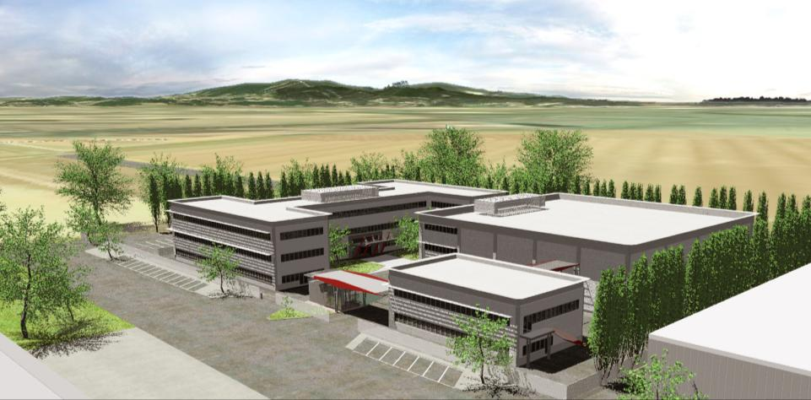
Who is IDS?
IDS Ingegneria Dei Sistemi, founded in 1980, is a world leader as a high technology solution provider in selected niche defense and civil market sectors
Private capital
Independent of other companies or agencies both at stock level and at decision level
IDS group totals 400+ persons, 75% with technical degrees
IDS’s Quality System is certified ISO 9001 Ed. 2008
IDS has the highest Military Clearance
Pisa
Rome

Slide 8
Global Corporation
Local offices across the world provide expertise, services, and 24/7 support for customers with time, quality, and cost critical requirements.
Highly trained distributors and agents extend the IDS Network to nearly every country in the world

Slide 9
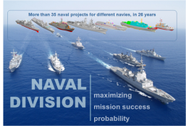
IDS Organization Structure
Ubitech is now part of the
Air Navigation Division

Slide 10
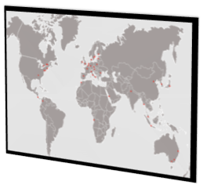
Worldwide References
Eurocontrol, Belgium
ACG, Austria
LVNL, Netherlands
SLV, Denmark
IAA, Ireland
STNA, France
Airfrance, France
CECAF, Spain
ISDEFE, Spain
AENA, Spain
DFS, Germany
Fraport, Germany
Lufthansa, Germany
ENAV, Italy
CIGA, Italy
ASSI, UK
Navtech, Sweden
LFV, Sweden
FINAVIA, Finland
Latvian CAA, Latvia
PANSA, Poland
CAA, Czech Republic
CAA, Cyprus
NavCanada, Canada
SENAM, Mexico
FAA, USA
NOAA, USA
Jeppesen, USA
UAEAC, Colombia
DECEA, Brazil
Moroccan CAA, Morocco
GACA, Saudi Arabia
CAA, Angola
AAI, India
Chinese CAA, China
DCA, Malaysia
Indonesian CAA, Indonesia
Airservices Australia, Australia
RAAF, Australia
Taiwanese CAA, Taiwan
KAC, South Korea
JCAB, Japan
ATCAJ, Japan
JCAA, Jamaica
IDAC, Dominican Republic
NAATC, Curacao
Aerocivil, Colombia
CAAB, Botswana
NACL, Zambia
DGCA, Kuwait
Oro Navigacija, Lithuania
Aerothai, Thailand
AASL, Sri Lanka
NANSC, Egypt
MoldATSA, Moldova
CAA, Uganda
ECAA, Ethiopia
CAA, DR Congo
PJIA, St. Maarten
CAF, Fujairah
ICAA, Iraq
CAA, Turkmenistan
AZANS, Azerbaijan

Slide 11
Product Offering

Slide 12
IDS Acquisition of UTI
Complete product offering for Aeronautical Information Management & Communications
Largest human resource base of aeronautical experts dedicated to this field (200+)
Global corporation with an extensive network of dedicated local resellers
Adopted a stringent development process in compliance to SWAL 3 and ESARR
Substantial increase in investment in research & development in Ubitech’s core markets

Slide 13
SWIM Introduction
The Aeronautical Collaborative Ring (ACR)
Readying Your Enterprise for SWIM

Slide 14
SWIM Explained
SWIM
Acronym: System Wide Information Management
Definition: SWIM is an open, flexible, and secure information management architecture and technology infrastructure designed to facilitate the sharing of ATM system information to all ATM stakeholders at all points along the information lifecycle.
Key Technology: SWIM employs Service Oriented Architecture (SOA) which relies on the development and international adoption of open standards for system interfaces and data exchange.
Sponsors: FAA NextGen & Eurocontrol SESAR

Slide 15
SWIM Explained (Cont’d)
Stakeholders: Pilots
Airports
Airlines
Civil Aviation Authorities
Air Navigation Service Providers (ANSPs)
Meteorological Authorities
Military
More…
Data types: Static Aeronautical Data
Dynamic Aeronautical Data
Flight trajectory
Aerodrome operations
Meteorological
Air traffic flow
Surveillance
Capacity and demand

Slide 16
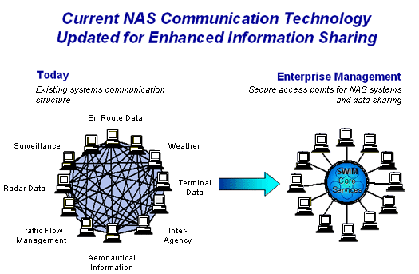
Today and Tomorrow (SWIM)
Source: www.eurocontrol.int/programmes/system-wide-information-management
Source: http://www.faa.gov/about/office_org/headquarters_offices/
ato/service_units/techops/atc_comms_services/swim/program_overview/
Removal of the traditional point-to-point communications environment
Creation of with an enterprise service bus (ESB) that provides secure interoperability between enterprise applications

Slide 17
Service Oriented Architecture (SOA)
Architectural approach for organizing and using services to support interoperability
Helps align software applications with business requirements and provide quicker, cheaper adaptation to future requirements
Leverages reusable technology and information
Decouples the development of business applications from the information technology
Description
Service
Description
Service
Service
Service Description
Service
Service Provider
Service Provider
Publish
Service Provider
Service Registry
/Broker
Data Exchange
Service Requestor
Find
Client

Slide 18
Benefits of SWIM
By assuring the provision of quality information to the right people at the right time, SWIM will:
Improve the efficiency of airspace usage
Increase aviation safety through common situational awareness
Reduce environmental impact
Shrink infrastructure costs through standardized system interfaces

Slide 19
Aeronautical Collaborative Ring
The Aeronautical Collaborative Ring (ACR)
Readying Your Enterprise for SWIM

Slide 20
ACR Project
R&D project in partnership between Ubitech, IDS, & ENAV (Italian ANSP)
Deliver an infrastructure to enable seamless information sharing across the enterprise
Build an enterprise Service Bus (ESB) to provide secure interoperability between enterprise applications
To be developed and delivered in an iterative fashion over 2 years

Slide 21
Aeronautical Collaborative Ring
ATFM
Airspace Management & Design
Electromagnetic Analysis
Airline Dispatch
Terrain & Obstacle Management
Flight Data
Service
ATM/ATC
Aeronautical
Information
Service
Surveillance
Data Service
Flight Procedure
Design
Briefing
Service
Messaging
Reporting
Flight Management
Systems (FMS)
Navigation
Database
Service
Simulation
Aeronautical
Collaborative Ring
Notifications & Alerts
Mapping
Service
Authentication
Airport CDM & AODB
Airport CDM
Service
Weather
Systems
Security
Weather
Service
ATS Messaging
Service
General
Aviation
SWIM
Service
AIM/AIS
Search &
Rescue
Global SWIM
AMHS/AFTN

Slide 22
ACR Core Capabilities
Messaging –decoupled communication and interoperability between distributed end-user applications. ACR supports Request/Reply, Publish/Subscribe, and Push/Pull communications.
Authentication –standardized, secure, and consolidated access to information, abstracting consumers from the complexity that lies behind in the backend systems. ACR infrastructure supports multiple authentication levels as well as promotion/demotion of the user authentication.
Security –protection of Confidentiality, Integrity and Availability. ACR implements security principles of access control, accountability, authenticity, non-repudiation and reliability.

Slide 23
ACR Core Capabilities (Cont’d)
Notifications & Alerts –interaction services for applications communicating through ACR. Allows connected applications to publish event notifications and alerts, enable subscribers to express their interests in receiving events, and mediate published notification and alerts to affected subscribers.
Reporting – collects, stores and retrieves all relevant information exchanged during the communication sessions via the ACR Interfaces. It provides means for recording/ logging the data exchange as well as functionality for recorded data retrieval.

Slide 24
ACR Functional Services
Aeronautical Information Service – provides exchange of aeronautical data in AIXM format using an enhanced Web Feature Service (WFS) to provide AIXM baseline data, AIXM deltas, and xNOTAMs.
Flight Data Service – enables exchange of flight object information in FIOPS and FIXM formats using WFS.
Surveillance Data Service – enables exchange of aircraft position information in ASTERIX Category 62 in XML & BXML WFS.
Weather Service – provides exchange of weather data in WXXM format using WFS.
Briefing Service – provides exchange of consolidated AIS and MET information in upcoming ePIB format using Web Service (WS).

Slide 25
ACR Functional Services (Cont’d)
Navigation Database Service – provides exchange of aeronautical data in ARINC 424A in XML/BXML using WFS which can be used to directly populate the FMC.
Mapping Service – provides the exchange of aeronautical/geographical data and satellite imagery in the form of maps using Web Mapping Service (WMS). Aeronautical chart types with predefined styles and symbology are supported.
Airport CDM Service – provides the exchange of airport operations information in AOXM format using WFS.
ATS Messaging Service – provides capability to send and receive messages over the AMHS or AFTN networks.
SWIM Service – enabling connection of end-user applications, connected to ACR, with other SWIM-compliant functional services all over the world.

Slide 26
ACR Adaptors
Most systems in operation today are not SWIM compliant and cannot be replaced quickly
Through the use of ACR Adapters these non-SWIM systems can be made active participants in the ACR
Flight Data
Service
SWIM-Compliant
Application
Aeronautical
Information
Service
Surveillance
Data Service
Briefing
Service
Messaging
Reporting
Navigation
Database
Service
Aeronautical
Collaborative Ring
Mapping
Service
Notifications & Alerts
Authentication
ACR Adapter
Non-Compliant
Application
Airport CDM
Service
Security
ACR Interface
Custom
Interface
Weather
Service
ATS Messaging
Service
SWIM
Service

Slide 27
Operational Concept
ANSPs are responsible for the data and making it available to Stakeholders
ACR can facilitate this collaborative data sharing while still keeping data ownership within the related ANSP
Access to data by Stakeholders should be regulated by the ANSP
ACR provides access-level security down to the attribute level
Example:
Coordination of GeoBorders for adjoining airspaces of different ANSPs

Slide 28
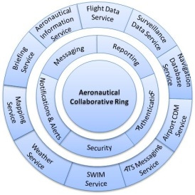
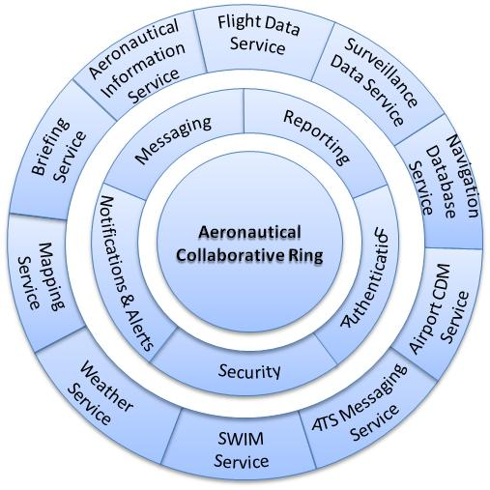
Towards Global SWIM with ACR
National ACR
Individual states implement ACR
Regional ACR
Through bi-lateral coordination, states grant access to the ACR to regional peers
Global ACR
As ACR implementation expands at the national and regional level, global coordination can occur
ACR is SWIM-compliant and therefore is compatible
with other non-ACR SWIM infrastructure

Slide 29
Conclusion
The Aeronautical Collaborative Ring (ACR)
Readying Your Enterprise for SWIM

Slide 30
Why start today?
The ACR provides these direct technical benefits immediately:
Reduce the complexity of the information system-level applications
Reduce the number of application services, which are then reused in different applications and functions
Reduce costs associated with the development and maintenance
At the business level, greater flexibility and agility

Slide 31
Additional Information
Ubitech has prepared an accompanying whitepaper further describing the Aeronautical Collaborative Ring (ACR)
For further information contact:

Slide 32
Questions?

Slide 33
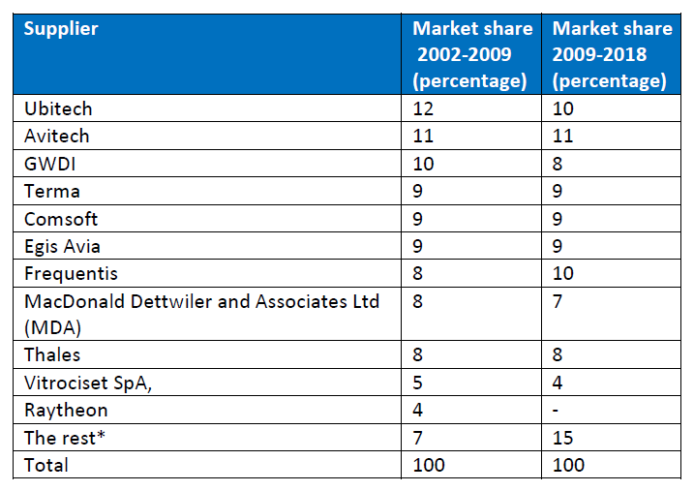
*The AIS/AIM Equipment and services market 2009-2018 – PMI Media Ltd.

Slide 34
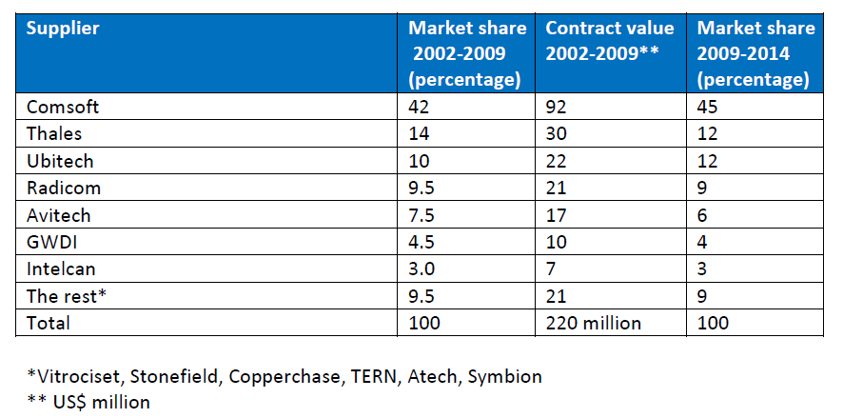
**The AMHS Market – a PMI Media Report

